Slide 1

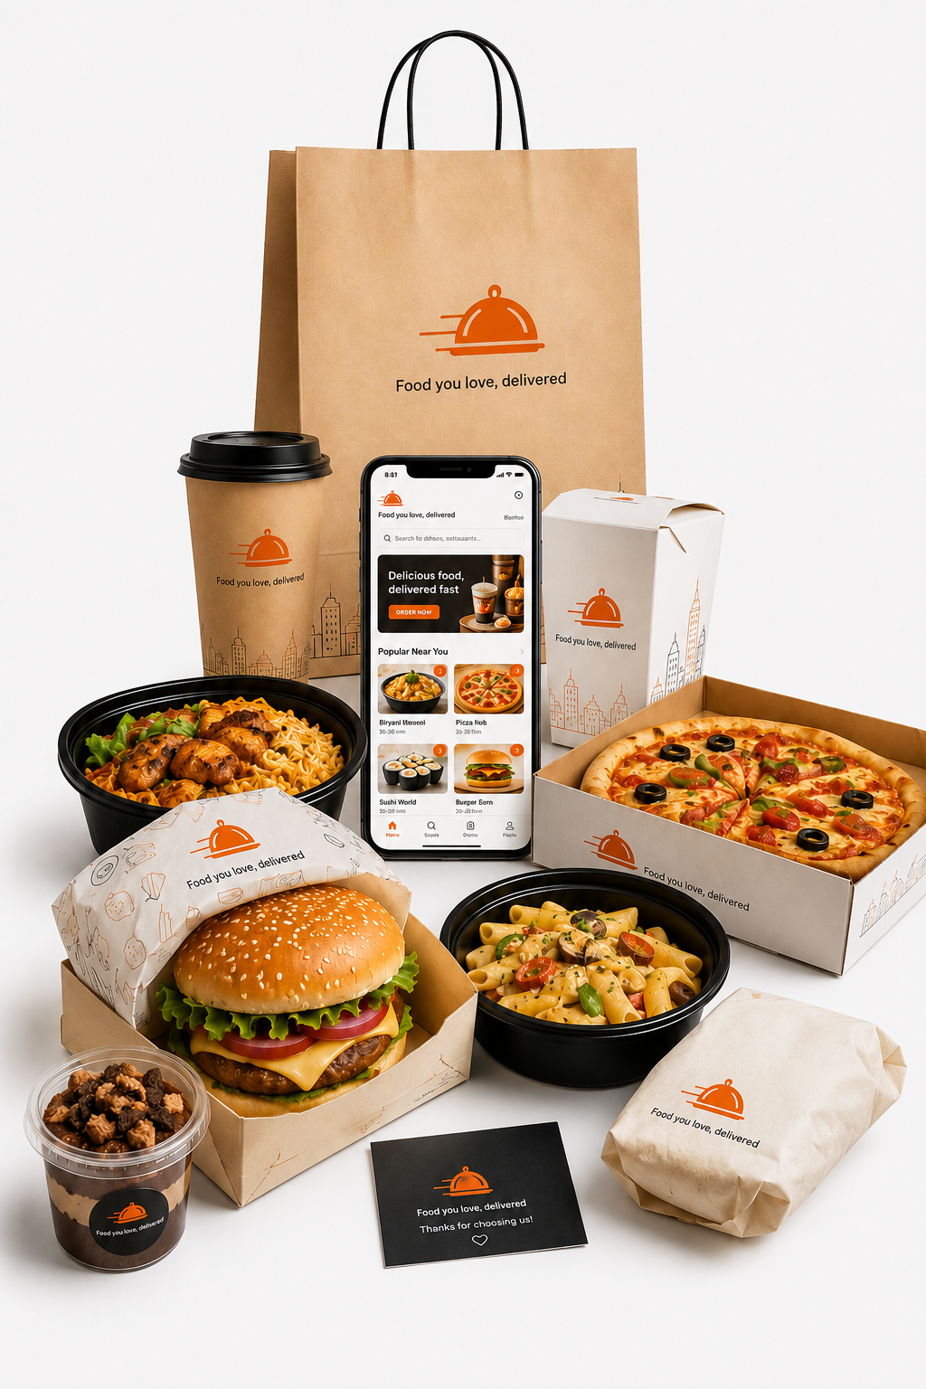
EXECUTIVE BUSINESS REPORT
TASTYBITES PRODUCT PRICING &
PROFITABILITY ANALYSIS
Comprehensive Financial Performance, Discount Optimization & Menu Strategy Analysis (March 2024 – February 2026)
PREPARED BY
DEPARTMENT
Agamya Jain | Business Analyst
Business Intelligence & Analytics
ANALYSIS PERIOD
REPORT DATE
March 2024 – February 2026 (2 Years)
July 2026 | Portfolio Edition
Slide 1 of 12

Slide 2



Project Objectives & Strategic Scope
Data-driven strategic initiatives to resolve profitability imbalances, optimize discount structures, and enhance product-level economics.
Identify High-Profit and Low-Profit Products
Understand the Impact of Discounts and Promotions on Profit Margins
Recommend Promotions and Bundling Strategies to Improve Profitability
Analyze product- and category-level revenue, profit, and margin performance to identify key profit drivers and products with weaker profitability.
Assess how discounting affects product and category profitability to identify where promotions support sales without putting unnecessary pressure on margins.
Develop targeted promotion and bundling opportunities that combine high-volume products with high-margin items to improve overall basket profitability.
Key KPIs Tracked:-​
Total Revenue | Net Profit​ | Profit Margin​ | Average Order Value (AOV)​ | Units Sold | Discount Revenue Erosion
TastyBites Product Pricing & Profitability Analysis
Slide 2 of 12

Slide 3









Executive Performance Dashboard
TOTAL REVENUE (2Y)
NET PROFIT
AVERAGE PROFIT MARGIN
₹837.3K
₹299.1K
35.7%
1,100 Transactions Analyzed
Robust Enterprise Yield
Benchmark Target: 35.0%
Product Category
Discount Impact
Volume vs Profitability
Pricing Opportunities
Seasonal
Promotion & Bundling
Recommendation
Payment Mode & Segmentation
AVERAGE ORDER VALUE (AOV)
TOTAL UNITS SOLD
DISCOUNT REVENUE EROSION
₹761.2
6,207
₹102.2K
Returning AOV: ₹763.0
Across 10 Menu Items
10.8% Avg Discount Rate
Analysis Flow:-
TastyBites Product Pricing & Profitability Analysis
Slide 3 of 12

Slide 4




Q1: Which Products And Categories Generate The Highest Revenue And Profit?
PROFIT CONCENTRATION
MARGIN OPPORTUNITY
PRODUCT MIX OPPORTUNITY
The top 3 products contribute 36.3% of total profit, making them key drivers of TastyBites' profitability.
Implication: Maintain strong pricing and availability for these core products.
Meals generate the highest revenue, but their 30.9% margin trails Beverages by over 11 percentage points.
Implication: Improving Meal margins could deliver greater profit gains than pursuing additional volume alone.
Beverages and Snacks generate 55% of total profit while contributing 48% of revenue, indicating stronger profit efficiency.
Implication: Increase their visibility through targeted upselling and bundles.
EXECUTIVE TAKEAWAY: Meals drive scale, but Beverage's drive efficiency. Meals generate 52% of revenue but only 45% of profit, while Beverages achieve the highest 42.1% margin. At product level, the top 3 items (Veg Pizza, Paneer Roll, and Chocolate Shake) drive 36.3% of total company profit (₹108.9K). However, Veg Pizza leads profit at ₹40.1K despite its low 27.7% margin, highlighting a key pricing opportunity.
TastyBites Product Pricing & Profitability Analysis
Slide 4 of 12

Slide 5

Q2. How Do Discounts Affect Profitability At The Product And Category Level?
DISCOUNT IMPACT CONCENTRATION
MARGIN PRESSURE
SELECTIVE DISCOUNTING
Meals absorb ~53% of total discount impact, driven by Paneer Wrap, Paneer Roll, Veg Pizza and Burger.
Category margin is only ~30.8%, below Beverages (~42%).
Implication: Focus discount optimization on high-impact Meal products.
Veg Pizza combines the highest discount (11.81%), lowest margin (27.73%) and highest discount impact (₹18.67K).
French Fries, by contrast, achieves a 44.35% margin at only 9.29% discount.
Implication: Reduce discount depth where margin erosion is greatest.
~11% discounts produce very different outcomes: Cold Coffee and Iced Tea retain ~43% margins, while Veg Pizza falls to 27.73%.
This shows that discount effectiveness varies by product.
Implication: Use the 10% threshold as a review trigger, not a blanket rule.
.
EXECUTIVE TAKEAWAY: Discount optimization should be product-led, not blanket-based — protect efficient promotions while tightening discounts on high-impact, low-margin products.
TastyBites Product Pricing & Profitability Analysis
Slide 5 of 12

Slide 6
Q3. Are There Products That Sell A Lot But Contribute Very Little To Profit?
Product | Profit / Unit | Contribution to Total Profit
🔴 Garlic Bread | ₹33.55 | 8.40%
🔴 Iced Tea | ₹38.79 | 8.38%
🟡 Burger | ₹43.93 | 9.08%
🟡 Nachos | ₹47.45 | 8.65%
🟡 French Fries | ₹47.83 | 9.35%
🟡 Paneer Wrap | ₹49.80 | 10.66%
🟢 Paneer Roll | ₹51.44 | 11.93%
🟢 Cold Coffee | ₹54.89 | 9.19%
🟢 Chocolate Shake | ₹56.88 | 10.95%
🟢 Veg Pizza | ₹61.41 | 13.41%
VOLUME–PROFIT GAP
PROFIT EFFICIENCY
SAME VOLUME, DIFFERENT PROFIT
Garlic Bread and Iced Tea rank among the highest in units sold but generate only ₹25.13K and ₹25.06K profit i.e., Profit of ₹33.55 per unit and ₹38.79 per unit, respectively.
Implication: Review pricing, costs and promotional intensity for high-volume, low-profit products.
Veg Pizza generates ₹61.41 profit/unit, while Chocolate Shake generates ₹56.88/unit despite lower sales volumes.
Implication: Identify opportunities to increase visibility of high-margin products.
Iced Tea sells 646 units, almost identical to Veg Pizza's 653 units, yet generates ₹15.04K less profit.
Implication: Sales volume alone should not determine product priorities.
TastyBites Product Pricing & Profitability Analysis
Slide 6 of 12

Slide 7
Q4. Which Products Can Have Price Adjustments Without Impacting Sales Volume Significantly?
Note:- Historical unit prices remained fixed by product; therefore, price elasticity cannot be directly estimated. Candidate products are identified using demand consistency, profitability and discount-response patterns and should be validated through controlled price testing.
Product | Unit Price | Units Sold | Days Sold | Selling Frequency | Profit Margin | Avg. Discount | Price-Test Potential
Garlic Bread | ₹110 | 749 | 123 | 21.6% | 34.04% | 10.48% | 🟢 Candidate
Paneer Roll | ₹170 | 694 | 111 | 19.5% | 33.96% | 11.06% | 🟢 Candidate
Veg Pizza | ₹250 | 653 | 108 | 18.9% | 27.73% | 11.81% | 🟠 Margin Review
Burger | ₹150 | 618 | 106 | 18.6% | 32.81% | 10.83% | 🟢 Candidate
Iced Tea | ₹100 | 646 | 104 | 18.2% | 43.69% | 11.22% | 🟢 Candidate
Paneer Wrap | ₹180 | 640 | 102 | 17.9% | 31.17% | 10.95% | 🟢 Candidate
French Fries | ₹120 | 585 | 99 | 17.4% | 44.35% | 9.29% | 🟡 Monitor
Nachos | ₹130 | 545 | 97 | 17.0% | 40.40% | 10.62% | 🟡 Monitor
Cold Coffee | ₹140 | 501 | 95 | 16.7% | 43.95% | 11.09% | 🟡 Monitor
Chocolate Shake | ₹160 | 576 | 92 | 16.1% | 40.09% | 11.23% | 🟡 Monitor
5 PRODUCTS EMERGE AS PRICE-TEST CANDIDATES
Garlic Bread, Paneer Roll, Burger, Iced Tea and Paneer Wrap
These products were sold on 100+ days and maintained 30%+ profit margins, indicating a good combination of recurring demand and profitability.
Action: Consider these products first for a small, controlled price test and monitor whether unit sales remain stable.
VEG PIZZA NEEDS MARGIN ATTENTION FIRST
Veg Pizza sold on 108 days with 653 units, showing strong and recurring demand.
However, its 27.73% margin is below the 30% benchmark, while its 11.81% average discount is the highest among all products.
Action: Review discounting and margin performance before considering a price increase.
SCREENING LOGIC Price-Test Candidate = ≥100 selling days + ≥30% profit margin *Selling frequency = No. of Days Product Sold ÷ 570 × 100
4 PRODUCTS NEED MORE DEMAND EVIDENCE
French Fries, Nachos, Cold Coffee and Chocolate Shake
All maintain 40%+ margins, but were sold on fewer than 100 days during the 2-year period.
Action: Focus on building more consistent demand before testing price increases.
TastyBites Product Pricing & Profitability Analysis
Slide 7 of 12

Slide 8

Q5. Recommend Promotions Or Bundling Strategies To Improve Overall Profitability.
🍞 Garlic Bread + 🥤 Iced Tea
🍔 Burger + 🍟 Fries + 🥤 Iced Tea
🌯 Paneer Roll + ☕ Cold Coffee
Garlic Bread
Iced Tea
Burger
Fries
Iced Tea
Paneer Roll
Cold Coffee
₹110
₹100
₹150
₹120
₹100
₹170
₹140
34.04%
43.69%
32.81%
44.35%
43.69%
33.96%
43.95%
↓ COMBINED BUNDLE METRICS
↓ COMBINED BUNDLE METRICS
↓ COMBINED BUNDLE METRICS
₹210 COMBINED VALUE
₹370 COMBINED VALUE
₹310 COMBINED VALUE
38.64% MARGIN
39.49% MARGIN
38.47% MARGIN
₹81.13 BUNDLE PROFIT
₹146.13 BUNDLE PROFIT
₹119.26 BUNDLE PROFIT
749 units sold + high-margin beverage
High-volume meal + high-margin add-ons
694 units sold + high-margin beverage
→ Improve profit per order
→ Promote as complete-meal combo
→ Cross-sell beverage with food
🍟 French Fries + ☕ Cold Coffee
🧀 Nachos + 🥤 Chocolate Shake
🍕 Veg Pizza + 🥤 Iced Tea
French Fries
Cold Coffee
Nachos
Chocolate Shake
Veg Pizza
Iced Tea
₹120
₹140
₹130
₹160
₹250
₹100
44.35%
43.95%
40.40%
40.09%
27.73%
43.69%
↓ COMBINED BUNDLE METRICS
↓ COMBINED BUNDLE METRICS
↓ COMBINED BUNDLE METRICS
₹260 COMBINED VALUE
₹290 COMBINED VALUE
₹350 COMBINED VALUE
44.13% MARGIN
40.23% MARGIN
32.29% MARGIN
₹114.75 BUNDLE PROFIT
₹116.66 BUNDLE PROFIT
₹113.02 BUNDLE PROFIT
Both products maintain 40%+ margins
Both products maintain 40%+ margins
653 units + 11.81% average discount
→ Build demand without deep discounts
→ Build demand without heavy discounts
→ Bundle cautiously; protect margin
TastyBites Product Pricing & Profitability Analysis
Slide 8 of 12

Slide 9


Seasonal Demand Analysis
PEAK DEMAND
STRONG PERFORMANCE
SEPTEMBER SLOWDOWN
MARGIN STABILITY
Aug-24: Highest revenue (₹41.69K) and profit (₹15.59K).
Feb-26: Revenue again reached ₹39.98K, indicating strong late-year/early-year demand.
Nov-25: Revenue ₹39.30K and profit ₹15.11K.
Action: Push high-margin products and bundles during peak/festive periods.
Sep-25: Lowest revenue (₹24.41K) and profit (₹8.62K).
Action: Use targeted promotions to stimulate demand during weaker periods.
Margins remained broadly within 34–40% despite revenue fluctuations.
Highest: 39.54% (Apr-24) | Lowest: 34.11% (Mar-24).
EXECUTIVE TAKEAWAY: Demand is uneven across the year, with stronger performance around peak and festive periods and a noticeable September slowdown. TastyBites can use this pattern to time bundles and promotions—maximizing profitable products during high-demand periods and using targeted offers to stimulate weaker months.
TastyBites Product Pricing & Profitability Analysis
Slide 9 of 12

Slide 10
Payment Mode & Customer Type Segment Analysis
Customer Type Segmentation
UPI (Highest Margin) 36.1% Margin | AOV ₹804 | Profit: ₹73.4K | Units: 1,463 | Lowest Discount (10.2%)
NEW CUSTOMERS
RETURNING CUSTOMERS
₹406.08K
Net Revenue
48.6% Revenue Share
₹431.92K
Net Revenue
51.4% Revenue Share
Wallet 36.0% Margin | AOV ₹719 | Profit: ₹74.8K | Units: 1,539 | Avg Discount (10.7%)
Cash 35.7% Margin | AOV ₹793 | Profit: ₹71.6K | Units: 1,540 | Avg Discount (11.0%)
Net Profit: | ₹145.42 K
AOV: | ₹759.03
Units Sold: | 2,994 Units
Orders: | 535
Net Profit: | ₹153.69 K
AOV: | ₹763.17
Units Sold: | 3,213 Units
Orders: | 565
Card (Highest Volume) 35.2% Margin | AOV ₹738 | Profit: ₹79.3K | Units: 1,665 | Highest Discount (11.4%)
Returning customers contribute slightly more revenue and profit, while AOV remains almost identical across both segments — suggesting limited difference in basket value.
PAYMENT–MARGIN TRADE-OFF
DISCOUNT PATTERN
CUSTOMER MIX IS BALANCED
Card: Highest volume, but lowest margin (35.2%).
UPI: Highest margin (36.1%) with lower volume.
Focus: Improve margin on high-volume Card orders.
Card: Highest discount (11.4%) and lowest margin.
UPI: Lowest discount (10.2%) and highest margin.
Focus: Review Card discounts for profitability.
Revenue split is nearly even: 48.6% New vs 51.4% Returning.
Returning customers contribute slightly more revenue and profit.
Focus: Balance acquisition with retention efforts.
EXECUTIVE TAKEAWAY: UPI combines the strongest AOV and margin profile, while Card generates the highest volume but at a lower margin. Customer mix remains balanced, with returning customers contributing slightly more revenue and profit despite virtually identical AOVs.
TastyBites Product Pricing & Profitability Analysis
Slide 10 of 12

Slide 11

Strategic Action Roadmap
QUICK WINS (0 – 3 MONTHS)
LONG-TERM INITIATIVES (3 – 12 MONTHS)
Protect Margin on High-Demand Products
Push High-Margin Products
Shift from Discounts to Bundles
Reduce discounting on products such as Veg Pizza, where strong demand is accompanied by a 27.73% margin and 11.81% average discount. Test a lower discount cap before considering price increases.
Increase visibility of French Fries, Cold Coffee and other 40%+ margin products through app placements and targeted promotions to build demand without heavy discounting.
Use Targeted Digital Offers
Use combinations such as Paneer Roll + Cold Coffee and Garlic Bread + Iced Tea to increase basket value while pairing high-volume products with higher-margin items.
Use small, targeted incentives for digital-payment users instead of broad discounts, helping encourage adoption while keeping promotional costs controlled.
Move Toward Data-Driven Pricing
Introduce demand- and margin-based pricing reviews to identify products with room for controlled price adjustments.
Establish a Menu Engineering Framework
Classify products by volume, margin and profitability and review the portfolio regularly to decide which products to promote, reprice or reposition.
Set Discount Guardrails
Create product-level discount thresholds and monitor whether promotions generate enough additional sales to justify the margin sacrificed.
Build Predictive Demand & Personalization
Use historical sales and customer behaviour to forecast demand and develop targeted bundles and offers for different customer segments.
TastyBites Product Pricing & Profitability Analysis
Slide 11 of 12

Slide 12

Thank You | Questions & Discussion
Prepared by Agamya Jain | Data Analyst | Business Intelligence & Analytics Department TastyBites
Slide 12 of 12

