Slide 1

A Smart Stick For Visually Impaired People Using Raspberry Pi
Guide-DR.S.JEEVA
Pidaparthi Agan Peter - RA1711003010930
Tanvi Jain - RA1711003010978
Batch ID - CSE09300978

Slide 2
Contents
Project Title
Abstract
Objective
Block Diagram
Algorithms and Methodologies
Modules
Appendix
Result and Discussion
References

Slide 3
Abstract
This project investigates methods and procedures to construct an efficient system to assist blinds in their everyday life. In particular, various technologies that can be utilized to build a wearable system are examined. The system imaginative and prescient and the conversation aspect of the blind navigation and steerage is designed now no longer handiest to map the environment surroundings however additionally to decide a secure direction to a favored destination. This function highlights the significance and additionally affords the commands to blinds for effective
navigation and secure Information with the aid of using incorporating object/pedestrian in real-time.

Slide 4
Objective
One of the major problems faced by Blind people is detecting and recognizing an obstacle in their path. The projects approach lies in developing a system based on Raspberry Pi 3 , which is capable of labeling objects with the help of OpenCV and TensorFlow libraries and converting the labeled text to speech and producing output in the form of audio signals to make the blind person aware of the object in front of him. The scope also includes measurement of the distance of the object from the person and reporting the same. Most of the Object Detection algorithm has been tested on GPU with high computation abilities and are less likely to achieve same speed and accuracy with less powerful devices with microprocessor only, which are in high demand in current scenario. We choose Raspberry Pi 3 as our platform because it is a standard representative of embedded device and is widely being used for devising low cost-system. We would like to have a prototype that can successfully perform real-time detection in about 5-10 fps onPi, with decent accuracy.

Slide 5
Introduction
Nowadays the demand of low cost well-trained embedded devices that can be applied in real world is
increasing.Our efforts in this project are determined to achieve a system which can render one among such
application to profit the blind people. In this project video detection and recognition is presented supported one board computer represented by Raspberry PI as an embedded solution. The aim is to form a sensible system which detects the item for the blind user, measures its distance , and report the output within the type of audio signals to alert the blind user of the obstacle ahead. This entire work is done on raspberry pi with operating system ported on it. In this project, the Pre-trained model is employed, Its accuracy is over ninetieth. It also can be custom-built to acknowledge different objects exploitation Transfer learning.

Slide 6
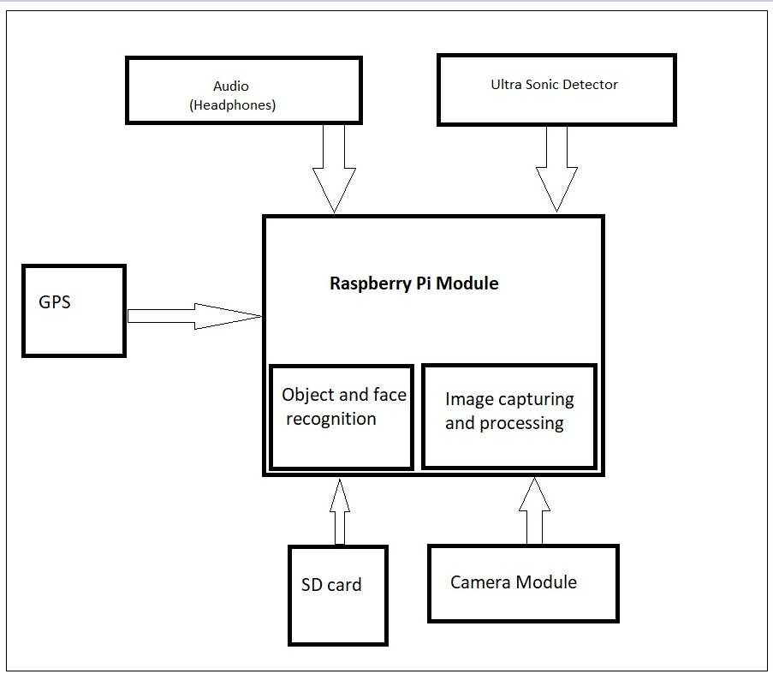
Block diagram

Slide 7
Algorithm and Methodologies
The project will identify any target present in the database by using two important algorithm in object detection and recognition, namely, MobileNet algorithm, and Single Shot MultiBox Detector(SSD) algorithm to train the machine on how to detect a object, how to recognize a object, and what output to give when the object is either recognized or not.A ultrasonic sensor is used to calculate the distance between the person and the object.
The project is further implemented on a stick that is used by the blind people so that the objects in front of them can be detected and recognized all the components are embedded into a stick and whenever it detects an object it provides the output as audio service.
The algorithms implemented in our project are as follows:
Deep Learning Algorithm: Deep learning may be a category of machine learning algorithms that uses multiple layers to increasingly extract higher-level options from the raw input. for instance, in image process, lower layers might establish edges,
whereas higher layers might establish the ideas relevant to a personality's like digits or letters or faces.

Slide 8
[CONTINUATION]
In deep learning, every level learns to remodel its input file into a additional abstract and composite illustration. In a picture recognition
application, the raw input is also a matrix of pixels.
MobileNet Algorithm:MobileNet may be a design model for Image Classification.MobileNet desires terribly less computation power to run or apply transfer learning to.This makes it an ideal suited embedded systems and computers while not GPU or low machine potency with compromising considerably with the accuracy of the results. The core layer of MobileNet is depthwise divisible filters, named as Depthwise divisible Convolution. The network structure is another issue to spice up the performance. Finally, the dimension and determination are often tuned to trade off between latency and accuracy

Slide 9
[CONTINUATION]
SSD Algorithm: SSD is intended for object detection in period. quicker R-CNN uses a district proposal network to form boundary boxes and utilizes those boxes to classify objects. whereas it's thought of the start-of-the-art in accuracy, the full method runs at seven frames per second. way below what data processing wants. SSD quickens the method by eliminating the requirement for the region proposal network. To recover the come by accuracy, SSD applies many enhancements together with multi-scale options and default boxes. These enhancements permit SSD to match the
quicker R-CNN’s accuracy mistreatment lower resolution pictures, that any pushes the speed higher.

Slide 10
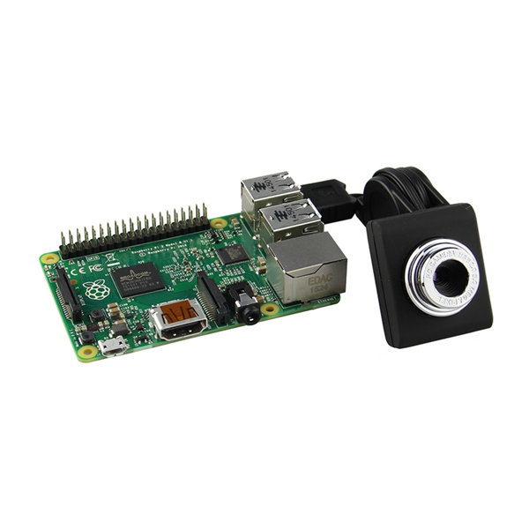
Modules Description
RASSPBERRY PI
• In this project we use Raspberry Pi is booted with the SDCard, with libraries installed like Keras, Tensorflow backend, numpy.
• Raspberry pi is connected with sensor and camera processing for visually impaired people.
CAMERA
In this project camera is used for Object recognition is done by the Pre-trained model MobileNet for recognizing the object with more than 95% accuracy. The model is trained with more than lakhs of images to recognize the object.An object such as Person, chairs, TV Monitor, Bottle etc.
Fig I - Camera Module with Raspberry Pi

Slide 11
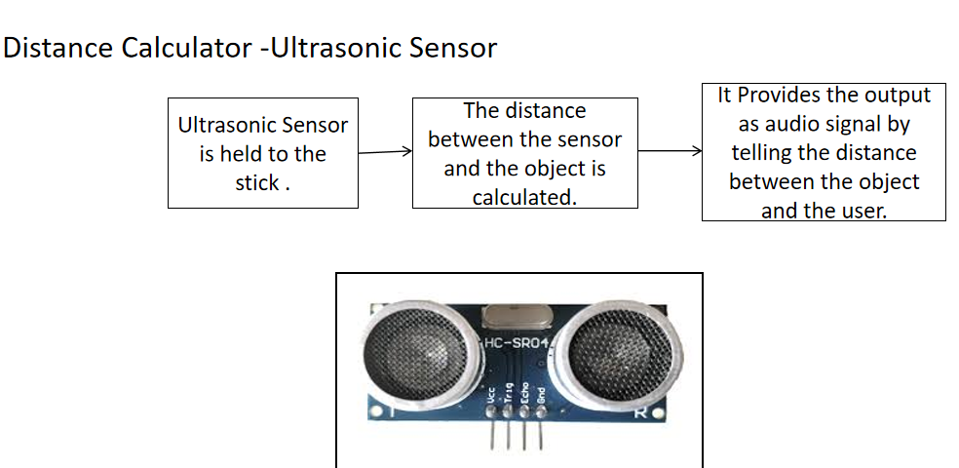
[Continuation]
Ultrasonic sensors
The sensor head emits an ultrasonic wave and receives the wave reflected back from the target. Ultrasonic Sensors measure the distance to the target by measuring the time between the emission and reception.
Fig II - UltraSonic Sensor

Slide 12
[Continuation]
The HC-SR04 distance sensor measures distance based on emitting a sound burst, and timing how long it takes to receive the echo back. Using the known constant that is the speed of sound, we can mathematically determine the distance of any object in front of this sensor by simply measuring how much time passed while the sound waves were emitted, hit the object in front of the sensor, bounced back, and came back to the sensor.

Slide 13
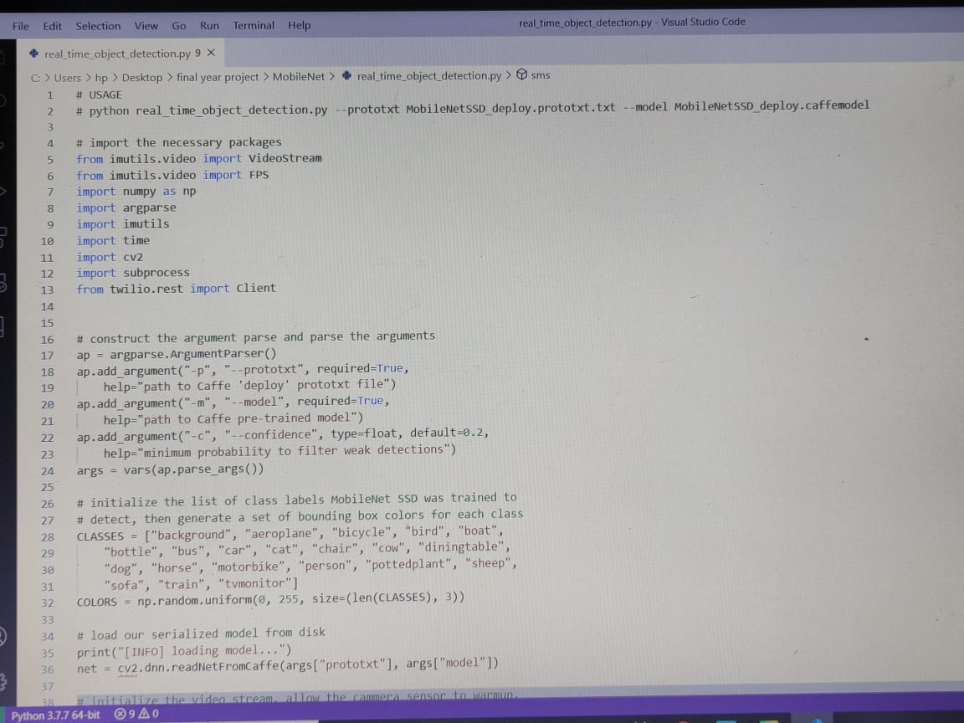
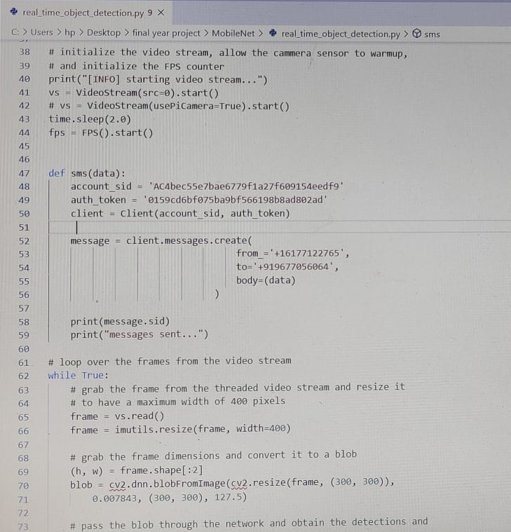
Appendix

Slide 14
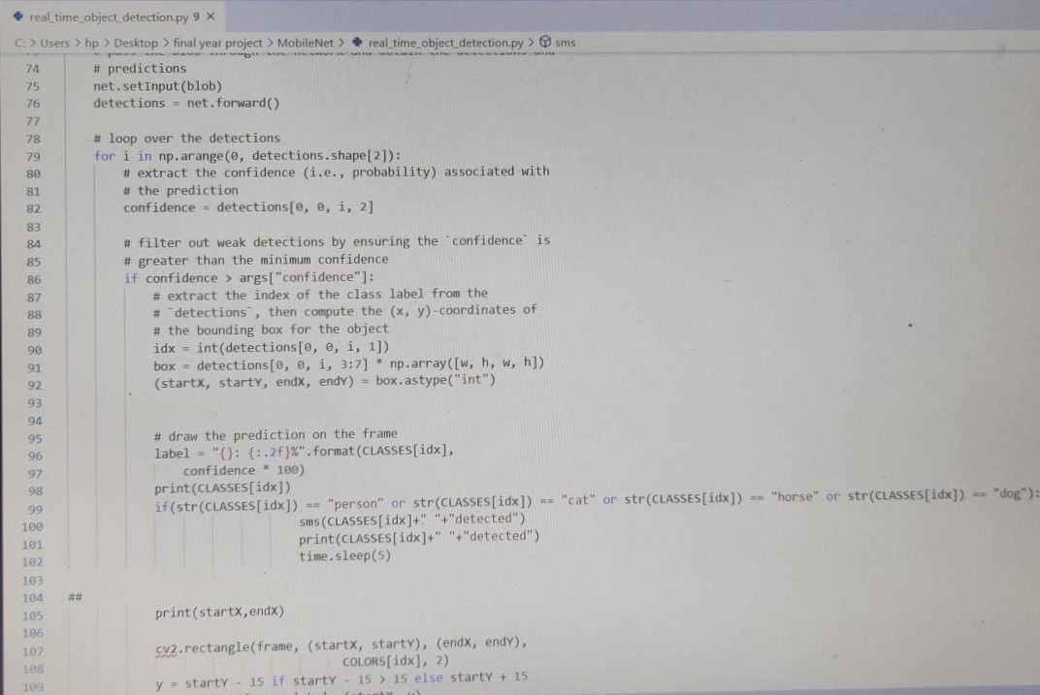
[Continuation]

Slide 15
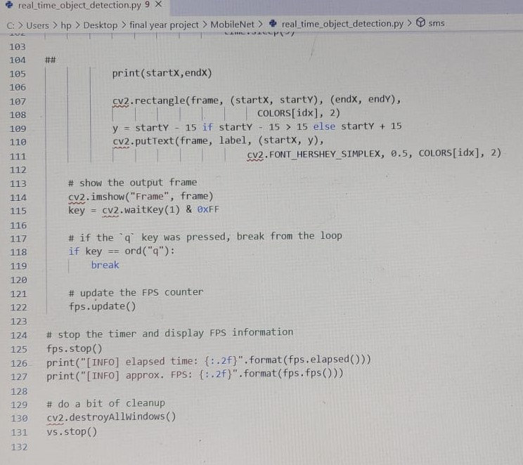
[continuation]

Slide 16
Result and Output
The project is going to contribute a foundation to work on embedded devices for object detection. It has contributed a lot to our knowledge as beginners in the fields of deep learning and embedded devices. From using the TensorFlow and OpenCV libraries , training and testing the system, embedding the code in Raspberry Pi, measuring the distance, to finally giving out the output to the blind person in the form of audio so that he can make himself aware what object is at what distance ahead, we have successfully build a real-world application from which someone can benefit.

Slide 17
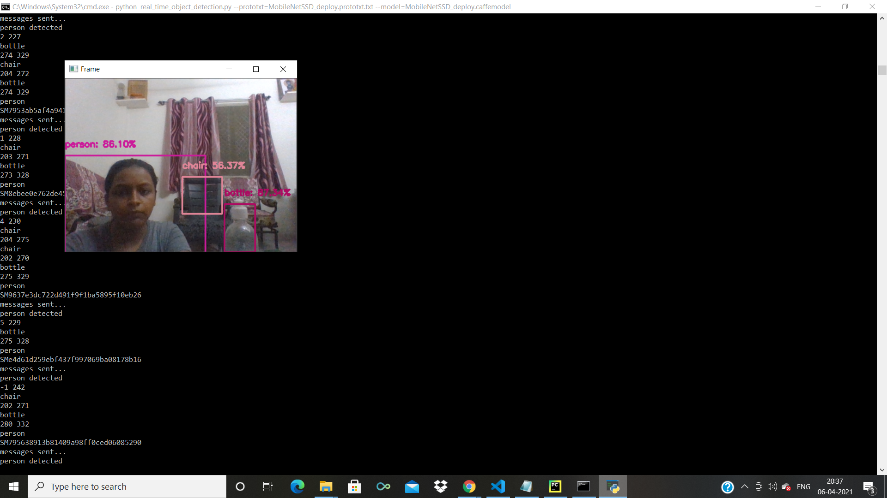
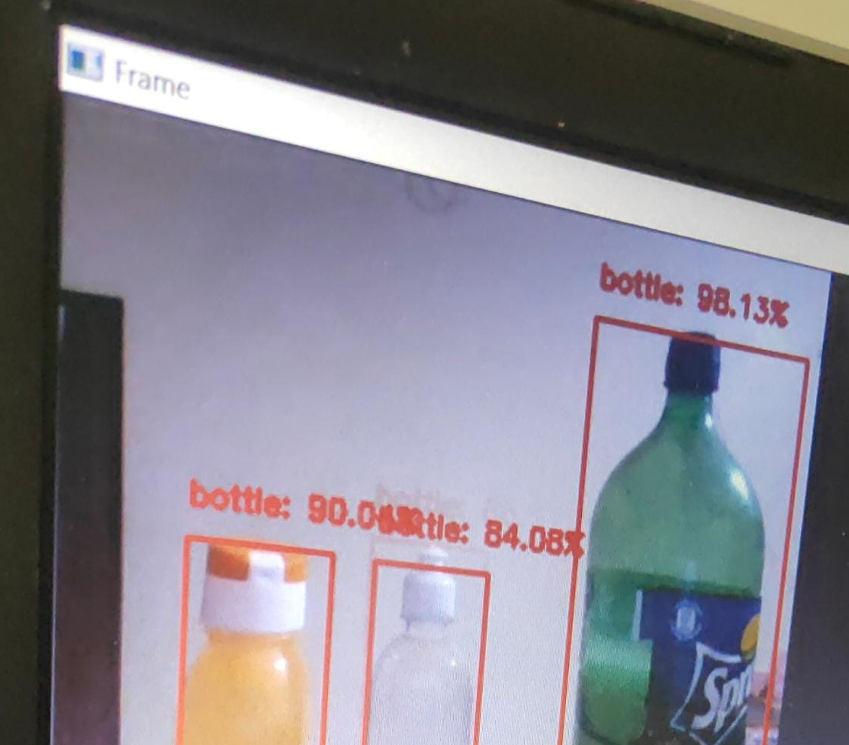
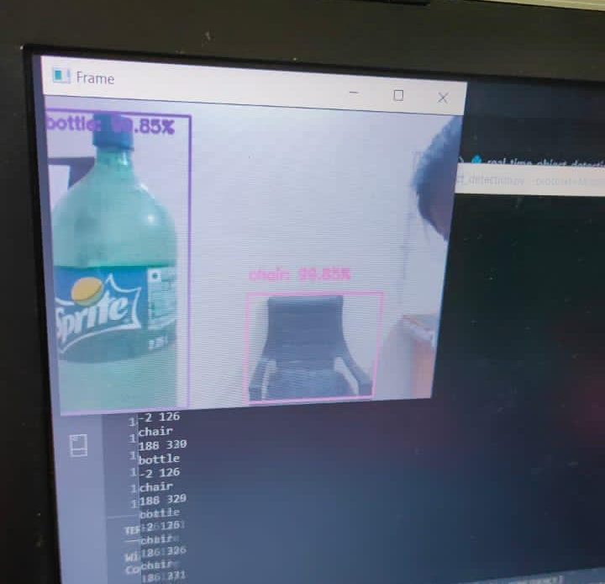

Slide 18
REFERENCE
[1]C. KAYMAK and A. UCAR, "Implementation of Object Detection and Recognition Algorithms on a Robotic Arm Platform Using Raspberry Pi," 2018 International Conference on Artificial Intelligence and Data Processing (IDAP), Malatya, Turkey, 2018, pp. 1-8, doi: 10.1109/IDAP.2018.8620916.
[2] J. Kim, S. Choi and J. Jeong, "Watch & Do: A Smart IoT Interaction System with Object Detection and Gaze Estimation," in IEEE Transactions on Consumer Electronics, vol. 65, no. 2, pp. 195-204, May 2019, doi: 10.1109/TCE.2019.2897758.
[3] S. Prasad and S. Sinha, "Real-time object detection and tracking in an unknown environment," 2011 World Congress on Information and Communication Technologies, Mumbai, India, 2011, pp. 1056-1061, doi: 10.1109/WICT.2011.6141394.
[4] K. Srinivasan and V. R. Azhaguramyaa, "Internet of Things (IoT) based Object Recognition Technologies," 2019 Third International conference on I-SMAC (IoT in Social, Mobile, Analytics and Cloud) (I-SMAC), Palladam, India, 2019, pp. 216-220, doi: 10.1109/I-SMAC47947.2019.9032689.
[5] H. Ali, M. Khursheed, S. K. Fatima, S. M. Shuja and S. Noor, "Object Recognition for Dental Instruments Using SSD-MobileNet," 2019 International Conference on Information Science and Communication Technology (ICISCT), Karachi, Pakistan, 2019, pp. 1-6, doi: 10.1109/CISCT.2019.8777441.
[6]D. N. Phuong, "A hybrid active vision system for real time application running object recognition," 2019 2nd International Symposium on Devices, Circuits and Systems (ISDCS), Higashi-Hiroshima, Japan, 2019, pp. 1-5, doi: 10.1109/ISDCS.2019.8719101.
[7]A. Mavrogiorgou, A. Kiourtis and D. Kyriazis, "IoT Devices Recognition through Object Detection and Classification Techniques," 2019 Third World Conference on Smart Trends in Systems Security and Sustainablity (WorldS4), London, United Kingdom, 2019, pp. 12-20, doi: 10.1109/WorldS4.2019.8903926.

Slide 19
THANK YOU

