Slide 1
Raspberry Pi Based System for Object Detection and Recognition for Visually Impared
Guide-DR.S.JEEVA
Pidaparthi Agan Peter - RA1711003010930
Tanvi Jain - RA1711003010978
Batch ID - CSE09300978

Slide 2
Contents
Abstract
Introduction
Innovation Idea Of the Project
Problem Statement
Scope Of the Project
Existing System
6.1 Limitations of the present system
7. Proposed System
7.1 Benefits of proposed system
8. Hardware and Software Requirements
9. References

Slide 3
Abstract
Nowadays the demand of low cost well-trained embedded devices that can be applied in real world is increasing.Our efforts in this project are determined to achieve a system which can render one of such application to benefit the blind people. In this project video detection and recognition is presented based on a single board computer represented by Raspberry PI as an embedded solution. The aim is to make a smart system which detects the object for the blind user, measures its distance , and report the output in the form of audio signals to alert the blind user of the obstacle ahead. This entire work is done on raspberry pi with operating system ported on it.

Slide 4
Introduction
People are witnessing the dawn of the new era of Deep Learning and embedded devices. Real life applications whether it be in the domain of Image recognition, Driver less cars, better preventive health care are all here today or on the horizon. The primary motivation which drives our team is how we can build a real-world application, in a cost effective manner which can benefit a section of society namely-”blinds”.

Slide 5
Innovation idea of the project
In this project, the Pre-trained model is used, Its accuracy is more than 90%. It can also be customized to recognize other objects using Transfer learning. This MobileNet is depth wise separable convolution, reduces the number of parameters. It is more suitable for vision-based applications where there is less performance power of the system.

Slide 6
Problem Statement
One of the major problems faced by Blind people is de_x0002_tecting and recognizing an obstacle in their path. The projects approach lies in developing a system based on Raspberry Pi 3 , which is capable of labeling objects with the help of OpenCV and TensorFlow libraries and converting the labeled text to speech and producing output in the form of audio signals to make the blind person aware of the object in front of him. The scope also includes measurement of the distance of the object from the person and reporting the same. Most of the Object Detection algorithm has been tested on GPU with high computation abilities and are less likely to achieve same speed and accuracy with less powerful devices with microprocessor only, which are in high demand in current scenario. We choose Raspberry Pi 3 as our platform because it is a standard representative of embedded device and is widely being used for devising low cost-system. We would like to have a prototype that can successfully perform real-time detection in about 5-10 fps onPi, with decent accuracy.

Slide 7
Eminent Professor
Cagri KAYMAK
ckaymak@firat.edu.tr
OVERSEAS LAB
Mechatronics Engineering Department
Firat University
Elazig, Turkey

Slide 8
Scope Of The Project
Reducing the bulkiness and making the system portable(eg. making a kit or through IC ,which the blind person can attach to his stick) for the application to come into picture in real life.
Modifying speed , accuracy , and reliability of the system.
Making the Raspberry Pi speak and respond to instructions given by blind person (eg. Navigation).

Slide 9
Existing system
In the existing system, object recognition can be done using any of the Image processing Algorithm like SIFT, SURF. But that kind of techniques has lots of limitations, make more difficult to recognize the object.

Slide 10
Disadvantage
Sift, surf algorithms are very low in accuracy
Can not recognize plane objects without edges
Cannot properly classify between similar objects
Uses only single image as dataset

Slide 11
Proposed System
In the proposed system, deep learning is used. Among that Convolutional Neural Network is used with pre-trained model MobileNet to recognize the object with more accuracy at real-time.

Slide 12
Advantage
Recognition is real-time
Convolutional Neural Network is very advanced deep learning algorithm
Number of data set is high hence accuracy is also high
Uses simple USB camera for video capture
No 3D camera is used
cost effective

Slide 13
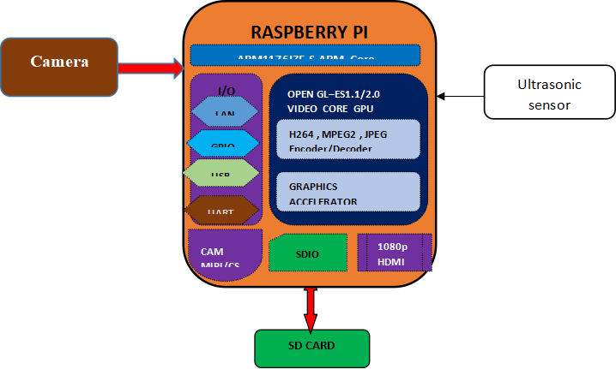
Block diagram

Slide 14
Connection Description
Raspberry Pi is booted with the SD Card, with libraries installed like Keras, Tensorflow backend, numpy, etc. USB camera is interfaced with the Raspberry pi to make it as the real-time object recognition application.

Slide 15
Hardware Required
Raspberry Pi
USB Camera
UV Sensor

Slide 16
Software Required
•Raspberry pi OS: Raspbian stretch
Programming platform: python 3 IDLE
Programing language: python 3
Library: OpenCV

Slide 17
REFERENCE
[1]C. KAYMAK and A. UCAR, "Implementation of Object Detection and Recognition Algorithms on a Robotic Arm Platform Using Raspberry Pi," 2018 International Conference on Artificial Intelligence and Data Processing (IDAP), Malatya, Turkey, 2018, pp. 1-8, doi: 10.1109/IDAP.2018.8620916.
[2] Simonyan K., Zisserman A. Very deep convolutional networks for large scale image recognition //arXiv preprint arXiv:1409.1556. – 2014.
[3] C. Szegedy et al., "Going deeper with convolutions," 2015 IEEE Conference on Computer Vision and Pattern Recognition (CVPR), Boston, MA, 2015, pp. 1-9, doi: 10.1109/CVPR.2015.7298594.
[4] He K. et al. Deep residual learning for image recognition //Proceedings of the IEEE conference on computer vision and pattern recognition. – 2016. – С. 770-778.
[5] Ren S. et al. Faster r-cnn: Towards real-time object detection with region proposal networks //Advances in neural information processing systems.– 2015. – С. 91-99.
[6]S. Prasad and S. Sinha, "Real-time object detection and tracking in an unknown environment," 2011 World Congress on Information and Communication Technologies, Mumbai, 2011, pp. 1056-1061, doi: 10.1109/WICT.2011.6141394.
[7]K. Srinivasan and V. R. Azhaguramyaa, "Internet of Things (IoT) based Object Recognition Technologies," 2019 Third International conference on I-SMAC (IoT in Social, Mobile, Analytics and Cloud) (I-SMAC), Palladam, India, 2019, pp. 216-220, doi: 10.1109/I-SMAC47947.2019.9032689.
[8]A. Mavrogiorgou, A. Kiourtis and D. Kyriazis, "IoT Devices Recognition through Object Detection and Classification Techniques," 2019 Third World Conference on Smart Trends in Systems Security and Sustainability (WorldS4), London, United Kingdom, 2019, pp. 12-20, doi: 10.1109/WorldS4.2019.8903926.

Slide 18
THANK YOU

