Slide 1
LabVIEW
Getting Start
Nitesh Pradhan
B.Tech Gold Medalist
NIT Raipur
Former Academic Partner of National Instruments

Slide 2
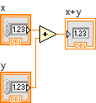
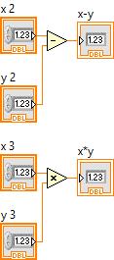

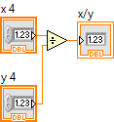
Level Zero
Solve and give the answer of all Problem
Note:-Use Numeric Function Palettes

Slide 3

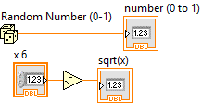

Level Zero
Solve and give the answer of all Problem
Note:-Use Numeric Function Palettes

Slide 4
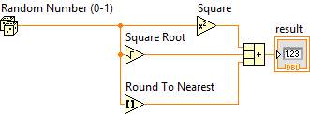
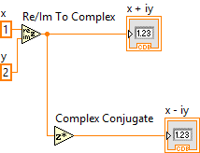

Level Zero
Solve and give the answer of all Problem
Note:-Use Numeric Function Palettes

Slide 5
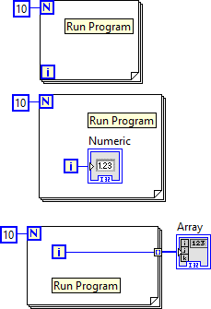
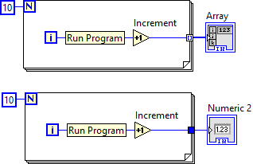
LevelZero
Solve and give the answer of all Problem
Note:-Use Numeric Function Palettes

Slide 6
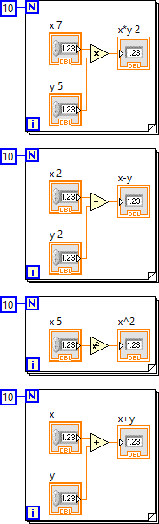
Level Zero
Solve and give the answer of all Problem
Note:-Use Numeric Function Palettes

Slide 7
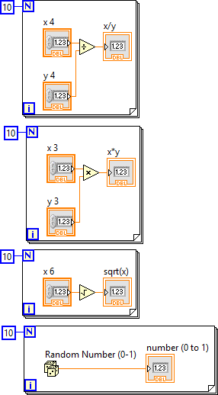
Level Zero
Solve and give the answer of all Problem
Note:-Use Numeric Function Palettes

Slide 8
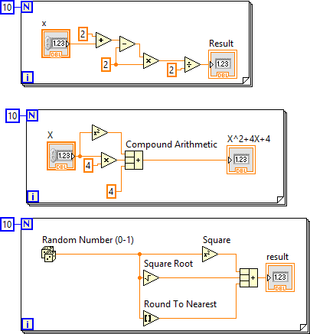
Level Zero
Solve and give the answer of all Problem
Note:-Use Numeric Function Palettes

Slide 9
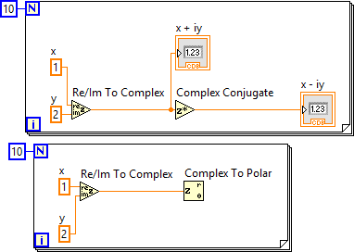
Level Zero
Solve and give the answer of all Problem
Note:-Use Numeric Function Palettes

Slide 10
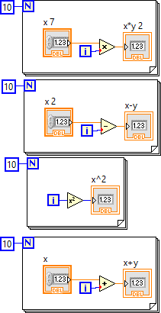
Level Zero
Solve and give the answer of all Problem
Note:-Use Numeric Function Palettes

Slide 11
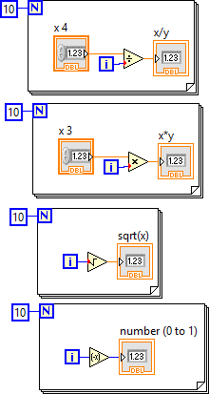
Level one
Solve and give the answer of all Problem
Note:-Use Numeric Function Palettes and For loop

Slide 12
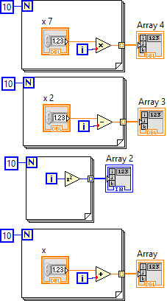
Level one
Solve and give the answer of all Problem
Note:-Use Numeric Function Palettes and For loop

Slide 13
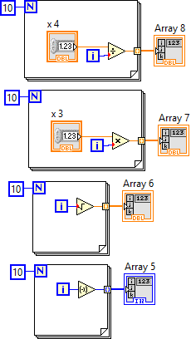
Level one
Solve and give the answer of all Problem
Note:-Use Numeric Function Palettes and For loop

Slide 14
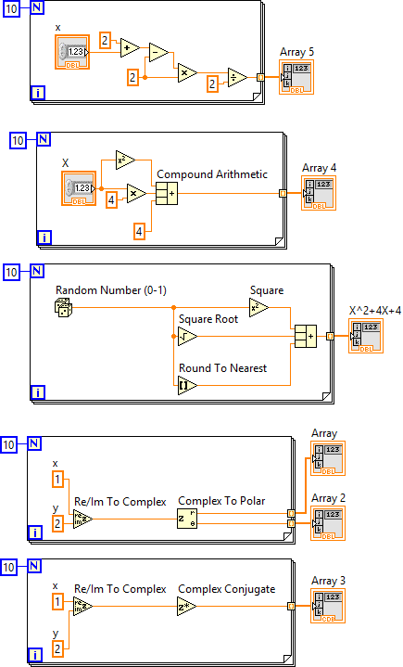
Level one
Solve and give the answer of all Problem
Note:-Use Numeric Function Palettes

Slide 15
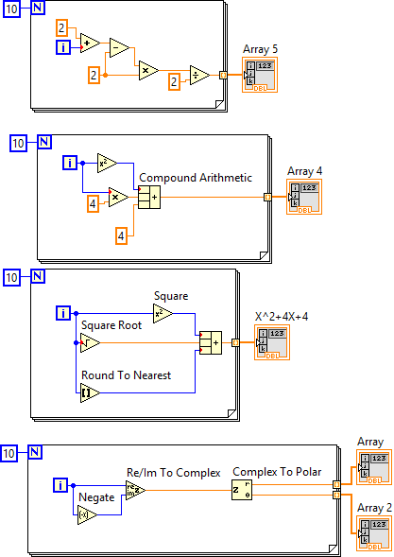
Level one
Solve and give the answer of all Problem
Note:-Use Numeric Function Palettes

Slide 16
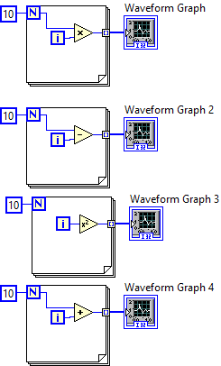
Level one
Solve and give the answer of all Problem
Note:- 1. Use Numeric Function Palettes.
2. Use Graph control palettes.

Slide 17
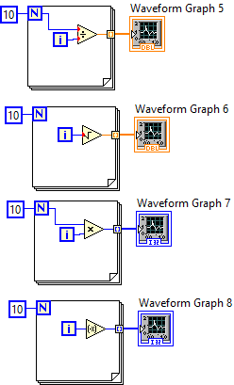
Level one
Solve and give the answer of all Problem
Note:- 1. Use Numeric Function Palettes.
2. Use Graph control palettes.

Slide 18
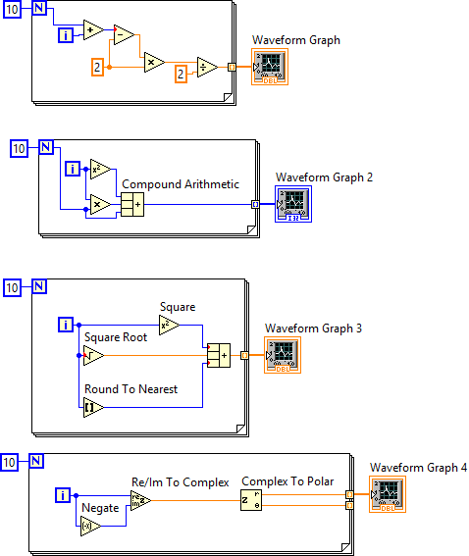
Level one
Solve and give the answer of all Problem
Note:- 1. Use Numeric Function Palettes.
2. Use Graph control palettes.

Slide 19
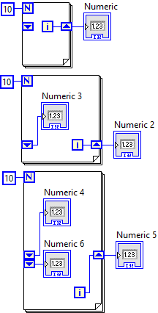
Level one
Solve and give the answer of all Problem
Note:- Right click in the border of fool loop and add shift register

Slide 20
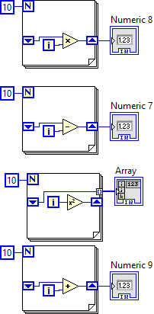
Level one
Solve and give the answer of all Problem
Note:- Right click in the border of fool loop and add shift register

Slide 21
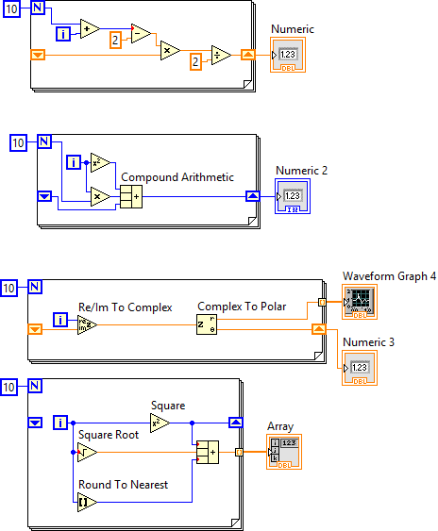
Level one
Solve and give the answer of all Problem
Note:- Right click in the border of for loop and add shift register

Slide 22
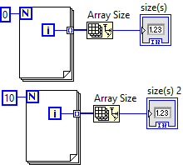
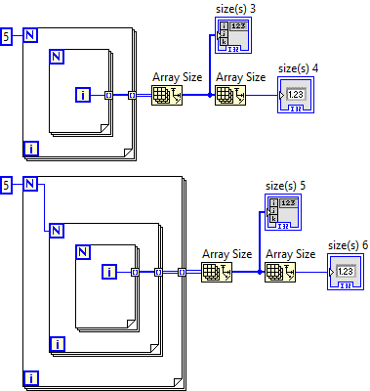
Level one
Solve and give the answer of all Problem
Note:

Slide 23
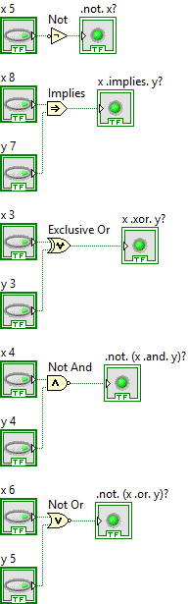
Level Two
Solve and give the answer of all Problem
Note: Use Boolean Function Palettes

Slide 24
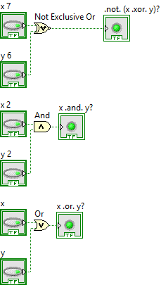
Level Two
Solve and give the answer of all Problem
Note:

Slide 25
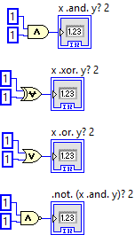
Level Two
Solve and give the answer of all Problem
Note:

Slide 26
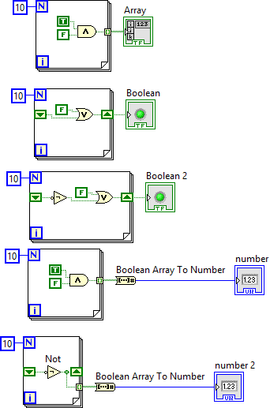
Level Two
Solve and give the answer of all Problem
Note:

Slide 27
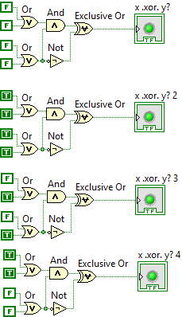
Level Two
Solve and give the answer of all Problem
Note:

Slide 28
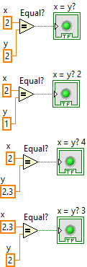
Level Two
Solve and give the answer of all Problem
Note:

Slide 29
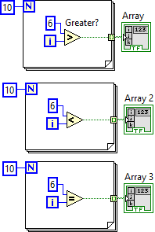
Level Two
Solve and give the answer of all Problem
Note:

Slide 30
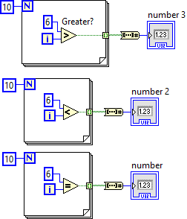
Level Two
Solve and give the answer of all Problem
Note:

Slide 31
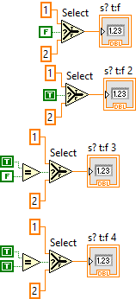
Level Two
Solve and give the answer of all Problem
Note:

Slide 32
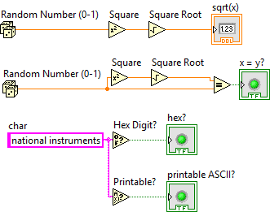
Level Two
Solve and give the answer of all Problem
Note:

Slide 33
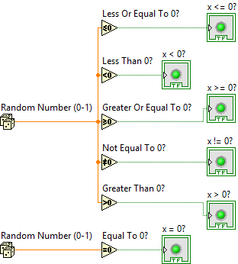
Level Two
Solve and give the answer of all Problem
Note:

Slide 34
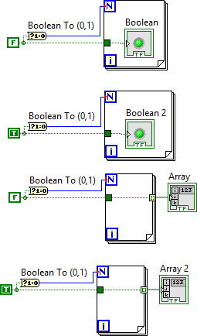
Level Two
Solve and give the answer of all Problem
Note:

Slide 35
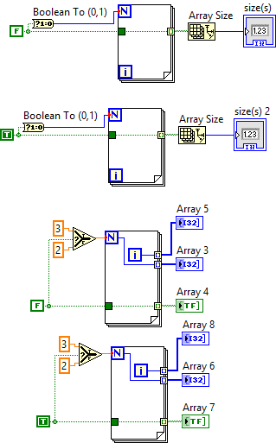
Level Two
Solve and give the answer of all Problem
Note:

Slide 36
Level Two
Solve and give the answer of all Problem
Note:

Slide 37
Level Two
Solve and give the answer of all Problem
Note:

Slide 38
Level Two
Solve and give the answer of all Problem
Note:

Slide 39
Level Two
Solve and give the answer of all Problem
Note:

Slide 40
Please Share with new LabVIEW users
Thank you

