Slide 1
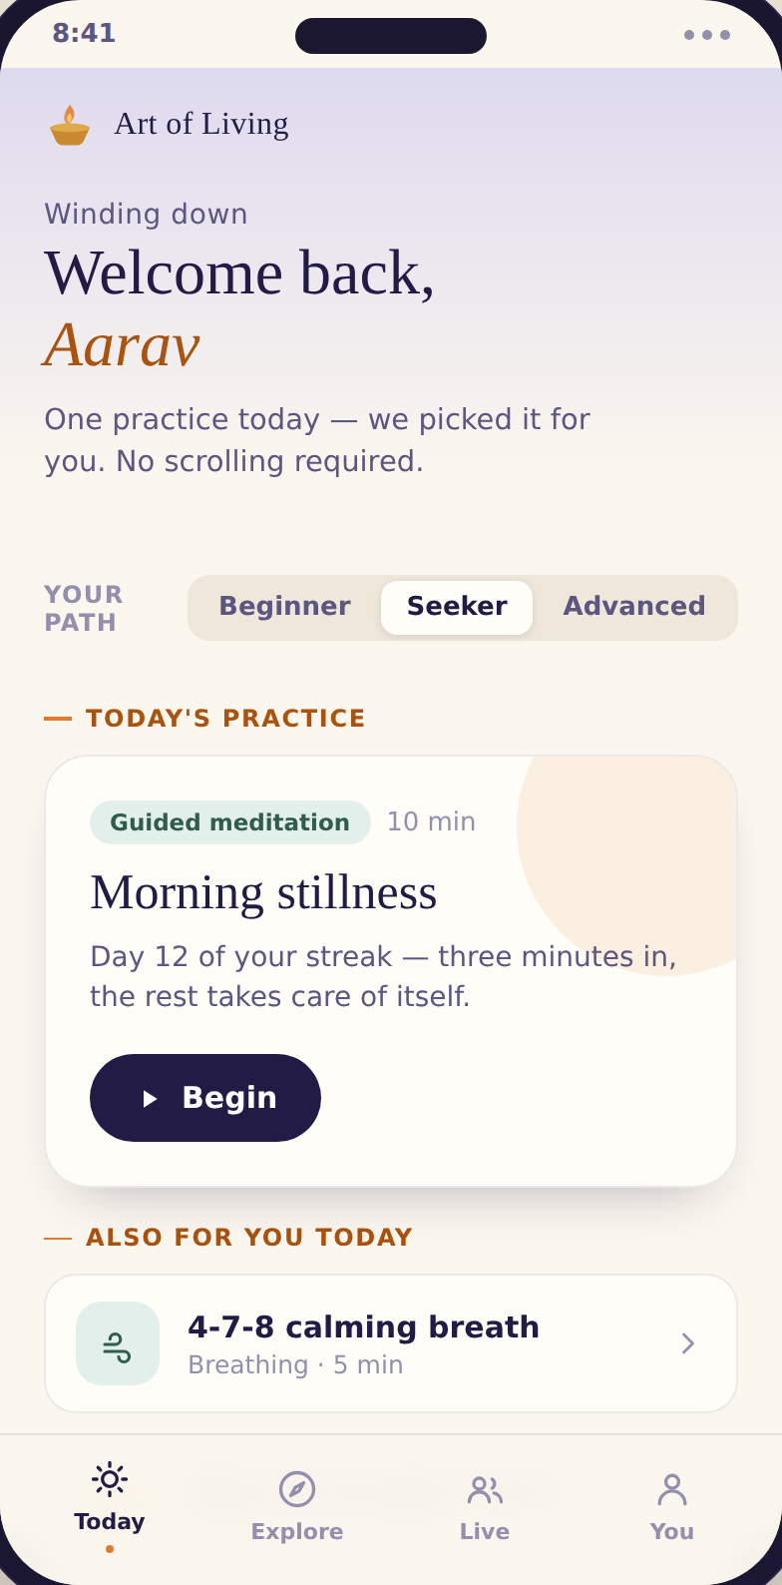
INVESTOR & LEADERSHIP SUMMARY
Art of Living
The one wellness app that guides you, answers you, and lets you practise together.
From ₹2 cr today → a ₹55 cr path
Notes:
Opening frame. The whole story: AOL has assets nobody else has; the app turns them into a compounding business. The gap from 2 to 55 crore is the spine of this deck.

Slide 2
THE OPPORTUNITY
The moment is the tailwind
1
A stress epidemic
Today
People are anxious, sleepless, and actively looking for calm — preferably a cheap habit they can keep.
110k
monthly active users
They want to be guided
~27.5k
2
“Just tell me what to do, make it easy, show me it’s working.” Personalisation and validation win retention.
paying subscribers
₹2 cr
3
AOL holds an unfair hand
revenue / year
1M+ course graduates, Gurudev’s wisdom corpus, the clinically-backed SKY breath, and a real global Sangha.
182
countries reached
Notes:
The need is real and AOL is uniquely positioned. The base is healthy but under-monetised — that's the whole opportunity.

Slide 3
THE WEDGE
Everyone owns a lane. One is open.
Calm · Headspace
Sadhguru
Level SuperMind
Quick, secular calm
One deep, singular practice
Gamified mind-performance
Art of Living
Guide me + answer me + practise together.
A secular front door for sleep, stress and focus — with spiritual depth one tap away. No competitor can copy the wisdom corpus, the live Sangha, or 1M+ course grads.
Notes:
Positioning. The bottom row is the whole thesis: a category of one, built on assets that are not copyable.

Slide 4
HOW IT COMPOUNDS
A loop that gets easier every turn
Curate
Practice
Reward
Belong
→
→
→
the day’s plan, picked for you
the session itself
see your gains, level up
practise with others
↑
Each turn feeds the next: more practice → sharper personalisation → stronger habit → deeper belonging → more practice.
And it funds itself: engaged users buy courses → revenue funds better content → a richer Curate step.
Notes:
The flywheel. Borrowed from Uber (density) and AI bots (data) — translated to a wellness app as four interlocking loops.

Slide 5
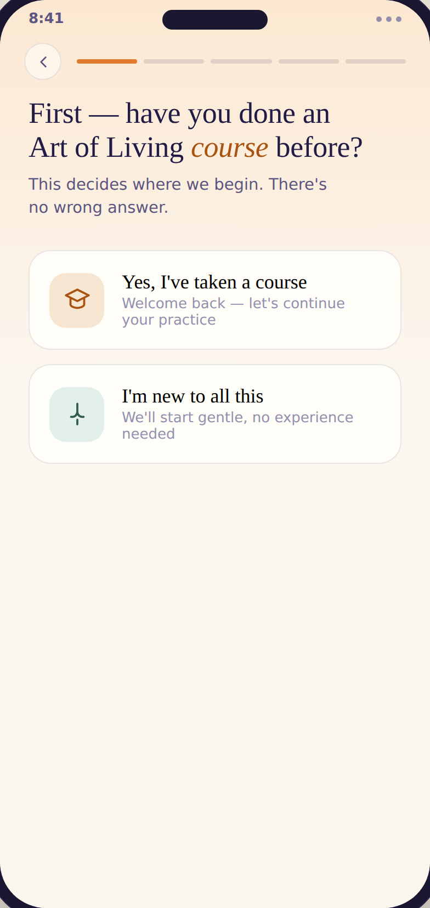
THE FUNNEL
From a free habit to a paying student
Free
Two-way
the daily habit + the funnel
Courses turn into a daily habit; the daily habit sells the next course. Sahaj moves people both ways.
Daily regulars
streaks, journeys, report cards
Prime
full library + 15% off courses
Course & retreat
the high-ticket purchase
↓
Notes:
The app's job is to walk a free user down this funnel, gently, only after trust. Prime is the warm middle rung, not the destination.

Slide 6
THE REVENUE LADDER
Subscriptions keep the lights on. Courses are the business.
≈ 55%
of revenue comes from courses
That’s the 15× jump in revenue-per-user. You cannot reach ₹55 cr on subscriptions alone — even doubled, Prime tops out near ₹10 cr.
Notes:
The single most important slide. The goal isn't a subscriptions business; it's a course business with an app as the funnel. Gifting rides across every rung.

Slide 7
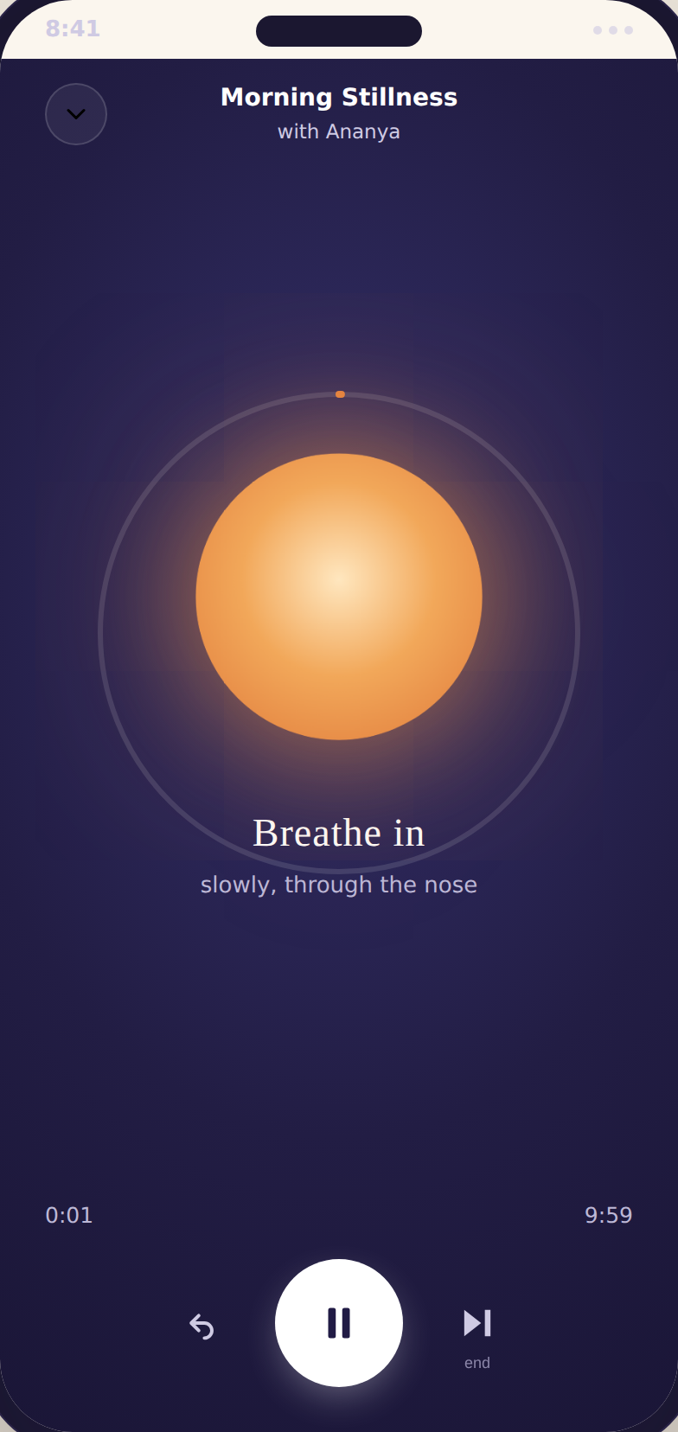
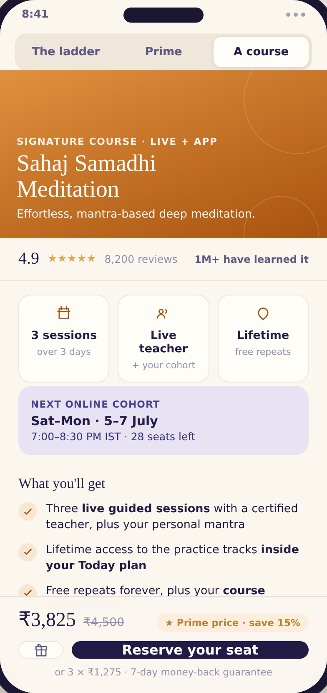
THE PROOF
Not a deck idea — a working product
Adaptive onboarding
Today: the guide
The session itself
Where revenue lands
Notes:
Every claim in this deck is a clickable prototype. Onboarding, the daily guide, the breathing player with its automatic reward moment, and the high-ticket course page all exist and connect into one flow.

Slide 8
THE BRIDGE
From ₹2 cr to ₹55 cr
Revenue / year
₹2 cr
→
₹55 cr
Monthly actives
110k
→
200k
Prime subscribers
27.5k
→
50k+
Course enrolments
—
→
tens of thousands
The leap isn’t more subscribers. At ~₹730 per paying user today, doubling the base barely moves the needle — the jump comes from moving engaged users up into courses and retreats.
Notes:
Make the ARPU math explicit. The funnel + ladder is the mechanism; this slide is the number it produces.

Slide 9
HOW WE GET THERE
Light the lamp once. Keep it lit.
Phase 1 · Earn the habit
Phase 2 · Build the ladder
Phase 3 · Scale the engine
Today, Ask (Sahaj) and Live. Wisdom + meditation, free. Win daily retention first.
Full masterclass library, course enrolment, rewards & report cards. Begin converting trust to revenue.
Retreats, festival webcasts, the store, deeper personalisation and international PPP pricing.
A stress-free, violence-free world — built one practice, and one paying student, at a time.
Notes:
Close on the phasing (the Utkarsh evolution) and tie revenue back to the mission. Phase 1 proves retention, Phase 2 proves monetisation, Phase 3 scales.

