Slide 1
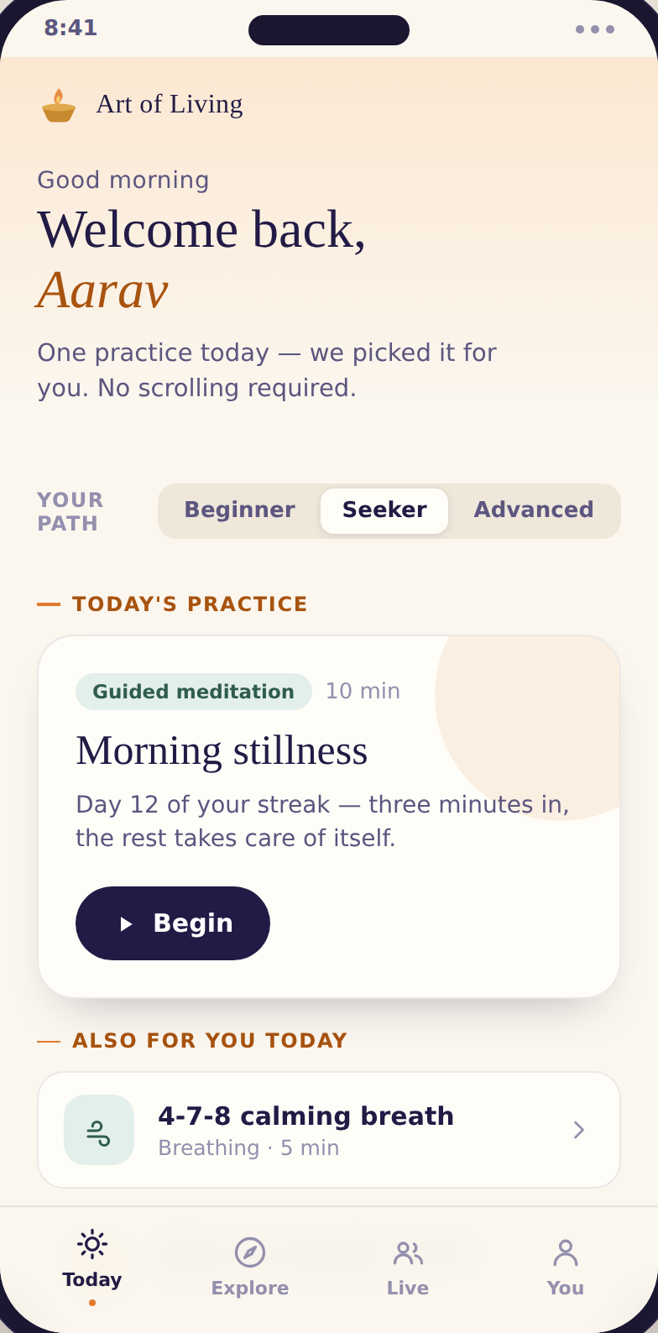
PRODUCT STRATEGY & ROADMAP
The Art of Living App
Carrying Gurudev’s wisdom and practices to more people — a daily moment of calm, for a stress-free, violence-free world.
Prepared for Gurudev & his office
Notes:
A reverent opening. This app is a vehicle for the mission: bring the practices and wisdom to more people, every day. Frame everything that follows as service first.

Slide 2
AGENDA
What we’ll walk through
Our mission — and the people we serve
GOALS
The core idea: a daily flywheel
Share the strategy & the roadmap
Invite Gurudev’s guidance, and iterate
From a free habit to a lifelong practitioner
The app, end to end — and the intelligence behind it
What we build first, and why
ASSUMPTIONS
What people told us — research
Built on today’s base: 110k monthly users, ~27.5k subscribers, present in 182 countries
A capable team is in place
Market & survey inputs are directional, not exhaustive
Priorities, roadmap & how we measure success
Sustaining the mission — and the risks we hold
Notes:
State goals and assumptions plainly, as the Uber deck does. The honest caveat about directional data builds trust with a leadership audience.

Slide 3
OUR MISSION
A daily practice in every hand,
and peace in every home.
Art of Living exists to build a stress-free, violence-free society — one breath, one practice at a time. The app is how that reaches further: it puts a guided daily practice, Gurudev’s wisdom, and a living Sangha into the pocket of anyone, anywhere — newcomer or lifelong practitioner.
Notes:
Lead with the mission, not the product. The app is the vehicle: more reach, more depth, more people holding a daily practice. Everything downstream serves this.

Slide 4
WHO WE SERVE
Three seekers, one adaptive app
The Newcomer
The Seeker
The Course Graduate
Stressed, curious, time-poor.
Practises sometimes; wants depth & meaning.
SKY / Sahaj done; wants to go deeper & belong.
“Help me feel calmer tonight — and make it easy to keep going.”
“Show me what’s next, and why it matters.”
“Keep my practice alive, and my Sangha close.”
We also serve our teachers and the Foundation — the app carries them to more students and keeps graduates engaged between courses.
Notes:
The app adapts to the person. Unlike Uber's three-sided marketplace, AOL is seeker-led; teachers and the Foundation are stakeholders the app amplifies, not a separate market.

Slide 5
REAL USERS
The people we serve — and what hurts
P
Priya, 29
A
Anjali, 42
R
Rohan, 20
Software engineer · Bengaluru
Homemaker · Pune
College student · Delhi
Wired and exhausted — scrolls till 1am, can’t switch off.
Did a course years ago; lost the routine in family life.
Exam anxiety, constant comparison, restless focus.
WANTS 10 calm minutes, tonight.
WANTS Quiet minutes that are mine — and help staying regular.
WANTS Free help to focus and sleep.
I
Mr. Iyer, 63
M
Meera, 35
D
David, 38
Retired · Chennai
NRI professional · London
Wellness-curious · New York
Did the Happiness Program a decade ago; misses the Sangha.
Rootless far from home; time-zones make live hard.
Tried Calm & Headspace; wants depth, not white noise.
WANTS My practice — and community — back.
WANTS Stay close to practice & Sangha from afar.
WANTS A calmer mind with real depth.
Representative personas — India-weighted, with two global seekers — to be validated against real user research.
Notes:
AOL's analog to Uber's named personas. Each carries a concrete pain-point and the single job they want done; the app must serve all six from one adaptive product.

Slide 6
THE CORE IDEA
A daily loop that gets easier every turn
Curate
Practice
Reward
Belong
→
→
→
the day’s practice, chosen for you
the meditation, breath or wisdom
feel the calm; see your progress
practise alongside the Sangha
↑
Every turn deepens the next: more practice → a wiser daily suggestion → a stronger habit → a closer Sangha → more practice.
This is the engine of the mission: a habit that holds, and quietly compounds.
Notes:
AOL's version of Uber's value chain. The loop is the product's heart: build a daily habit that strengthens itself, because a held habit is both a life touched and the path to everything deeper.

Slide 7

THE JOURNEY
From a free first breath to a lifelong practice
A free daily habit
It flows both ways
wisdom + a guided practice, for everyone
A course brings someone into the daily habit; the daily habit makes them ready for the next course. Sahaj guides them gently, never pushes.
Daily practitioners
streaks, journeys, a living Sangha
Prime members
the full library + member benefits
Course & retreat
SKY, Sahaj, Happiness, Silence
Notes:
The app's quiet job is to walk a curious newcomer toward a lasting practice and, when they are ready, a course. Never a hard sell; trust first, always.

Slide 8
THE APP, END TO END
Wisdom in; a personalised practice out
Wisdom & content
Curate & personalise
Five experiences
Outcomes
→
→
→
Gurudev’s talks, SKY, meditations, chants, courses
Sahaj + recommendations + journeys
Today · Explore · Ask · Live · You
a held habit · deeper practice · belonging
↑
Each practice teaches the app what serves this person better tomorrow — the same intelligence that powers Today, gently improving with every session.
Notes:
AOL's analog to Uber's ML pipeline. The intelligence (Sahaj, personalisation) is the enabler that turns a content library into a practice made for you. It is one part of the system, in service of the experience.

Slide 9
THE PRODUCT
What we are building
FIVE EXPERIENCES
THE INTELLIGENCE BEHIND IT
1
Today one practice, chosen for you
6
Curation engine picks the right daily practice
2
Explore the library: Body · Mind · Spirit
7
Journey builder sequences a path that deepens
3
Ask · Sahaj your guide to the right practice
8
Sahaj guide surfaces Gurudev’s teachings, points to teachers
4
Live group meditations & the Sangha
9
Reflection loop mood, notes & gentle nudges
5
You your journey, progress & rewards
10
Content tagging organises a vast library by need
Sahaj never replaces a teacher or Gurudev’s wisdom — it points to the authentic source, and to the right course.
Notes:
The numbered suite, like Uber's. Five human experiences, five intelligence components that quietly power them. The Sahaj caveat matters deeply for a spiritual organisation: it curates and directs, it does not invent spiritual advice.

Slide 10
SEQUENCING
Earn the daily habit first
The habit is the multiplier. Nothing deeper — trust, a course, a sustained mission — happens without it. So Phase 1 spends everything on one thing: a daily practice worth returning to.
A daily habit
Trust in the app
Readiness for a course
Course enrolment
A self-sustaining mission
→
→
→
→
Read the other way: every rupee a course earns funds more content, more reach, and more people who never pay a paisa — the free habit that starts the whole journey.
Notes:
AOL's version of Uber's impact-chain logic. The chain runs forward (habit creates everything) and backward (revenue funds the free habit and the reach). This is how money serves the mission rather than competing with it.

Slide 11
WHAT WE HEARD
The moment — and what people asked for
“Just tell me what to do.”
THE CLIMATE
People want to be guided, not handed a library to sort through.
A stress epidemic
“Make it easy to keep going.”
more people than ever are seeking calm, sleep and meaning
A gentle habit, reminders, and proof it’s working — that’s what holds people.
A guided-wellness market
“I want it to mean something.”
growing fast worldwide, and under-served in India
Calm is the door; depth and belonging are why they stay.
AOL’s unfair hand
“Don’t make it feel like a shop.”
1M+ graduates · the SKY breath · a global Sangha · Gurudev’s wisdom
Trust first. The practice must never feel sold.
Notes:
Quant + qual folded into one. The right side is the climate (the tailwind and AOL's unique assets); the left is what people actually said. Note the explicit 'don't make it feel like a shop' — that anchors the trust risk later.

Slide 12
PRIORITIES
Value vs effort
HIGH VALUE
Today + Sahaj
Live & Sangha
Daily wisdom
Full library
SKY breath
Course integration
LOW EFFORT
HIGH EFFORT
Mood & notes
Store
Report card
Deep gamification
LOWER VALUE
Notes:
Top-left ships first (high value, low effort): the habit loop. Top-right are the big bets that build the ladder (Live, library, courses). Store and heavy gamification wait. Subject to validation with engineering.

Slide 13
THE ROADMAP
Three phases. One direction.
PHASE 1
PHASE 2
PHASE 3
Earn the habit
Build the ladder
Scale the engine
India first
India + developed markets
Global · 182 countries
Today, Ask (Sahaj) and Live. Wisdom + meditation, free. Win the daily return.
Full library, course enrolment, Prime, rewards & report cards. Begin converting trust to support.
Retreats, festival webcasts, the store, deeper personalisation, fair pricing for every region.
Notes:
Phases by capability and by market, like Uber's U1->U5. Prove retention in India, build the ladder, then scale globally with region-fair pricing so cost never blocks reach.

Slide 14
HOW WE MEASURE SUCCESS
One North Star, four ways to read it
NORTH STAR Daily practitioners — people who hold a daily practice
Reach
Depth
Sustainability
Community
Monthly active users
New seekers / month
Countries touched
7- & 30-day retention
Streak length
Practice minutes
Prime conversion
Course enrolments
Revenue & per-user
Live attendance
Sangha joins
Graduates re-engaged
Notes:
North Star honours the mission: a daily practitioner is a life touched and the start of the funnel. The four KPI families let leadership read reach, depth, sustainability and community at a glance.

Slide 15
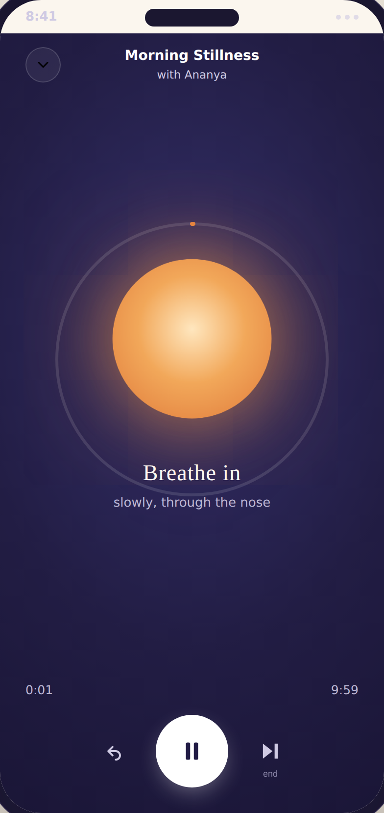
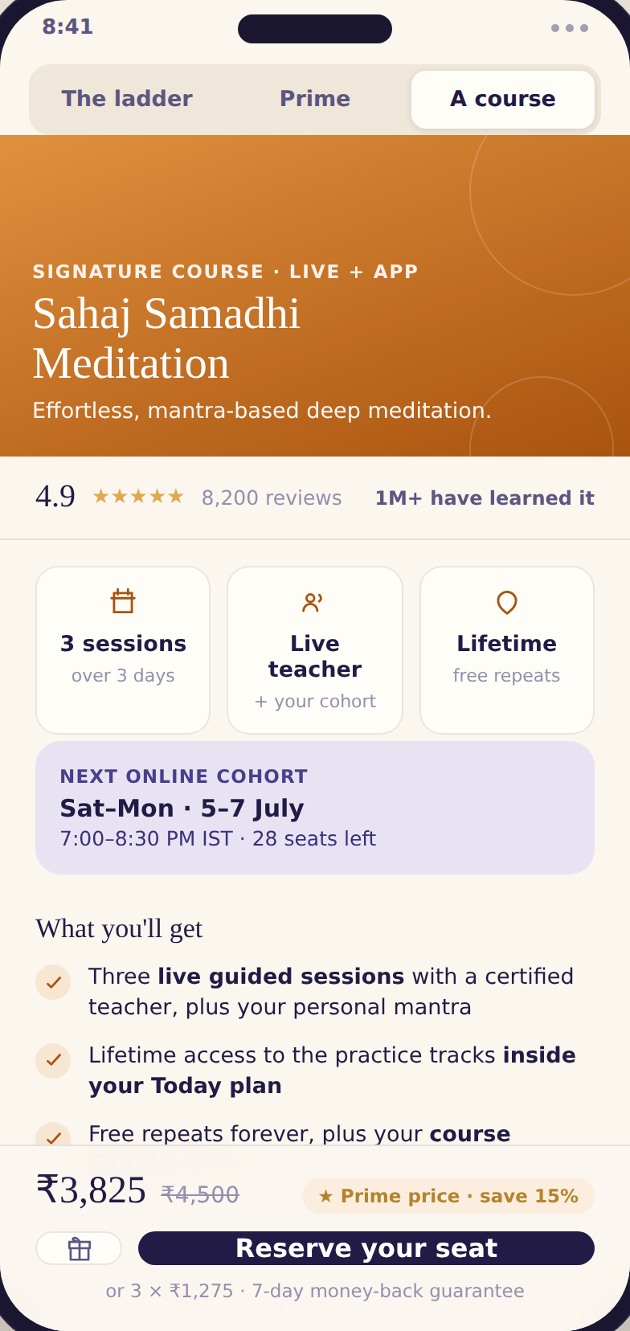
IT ALREADY EXISTS
Not a concept — a working product
Adaptive welcome
Today: the guide
The practice itself
Where support flows back
Notes:
Every claim is a clickable prototype: the adaptive welcome, the daily guide, the breathing practice with its quiet reward, and the course page. The product is real and connected end to end.

Slide 16
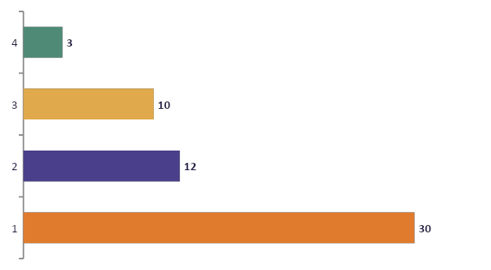
SUSTAINING THE MISSION
So the work can sustain itself — and reach further
The courses carry it
Subscriptions keep the lights on; the signature courses sustain the mission and fund the free practice that reaches everyone else.
The daily practice stays free, always.
Notes:
Money framed as service. Revenue is the means by which the mission sustains and extends itself. Gifting rides across every rung. The free core is a promise, not a teaser.

Slide 17
RISKS & HOW WE HOLD THEM
What we are watchful of
Feeling like a “sales machine”
An AI guiding the spirit
Trust before any ask. The daily practice is free forever; courses are offered, never pushed.
Sahaj surfaces Gurudev’s authentic teachings and points to real teachers — it never invents spiritual advice.
Over-reliance & wellbeing
Holding the habit
The app encourages real practice and community, not endless screen time.
Retention is the hardest problem; Phase 1 is dedicated to it before anything else.
Secular door, spiritual depth
Privacy & competition
Welcoming to newcomers without diluting the tradition — a balance we design for, carefully.
Practice data is treated as sacred; our assets (Sangha, wisdom, SKY) cannot be copied.
Notes:
Named honestly, with the mitigation beside each. The first two matter most to a spiritual organisation: the app must never feel commercial, and the AI must never presume to be the teacher.

Slide 18
WITH YOUR GUIDANCE
Light the lamp once.
Keep it lit, everywhere.
A guided practice in every pocket. A calmer mind each morning. A Sangha that travels with you. The same wisdom, carried further than ever — and a product that sustains the work so it can keep reaching.
We seek your blessings to begin.
Notes:
Close with reverence, not a pitch. Restate the mission, show the product as its vehicle, and ask for guidance and blessings to proceed.

Slide 19
Appendix
Architecture · detailed roadmap & value–effort · market · the numbers

Slide 20
APPENDIX · MARKET
A growing need, a global footprint
A rising tide
Guided-wellness and meditation apps are among the fastest-growing consumer categories worldwide — and India is still early.
Already global
Art of Living already reaches people in 182 countries; the app meets a demand that exists today, it does not create it.
Under-served depth
Most apps offer secular calm. Few offer a living tradition, real teachers and a community — the space AOL can own.
Figures are directional and to be confirmed with current market data before any external use.
Notes:
Honest, source-light framing for an internal audience. The key point: AOL serves existing demand and is differentiated by tradition, teachers and Sangha.

Slide 21
APPENDIX · COMPETITION
Everyone owns a lane. One is open.
Calm · Headspace
Sadhguru
Level SuperMind
Quick, secular calm
One deep, singular voice
Gamified performance
Art of Living
Guide me + answer me + practise together — on a living tradition.
A secular door for sleep, stress and focus, with real spiritual depth beneath. No one can copy the wisdom, the SKY breath, the teachers or the Sangha.
Notes:
The wedge: a category of one, built on assets competitors structurally cannot replicate.

Slide 22
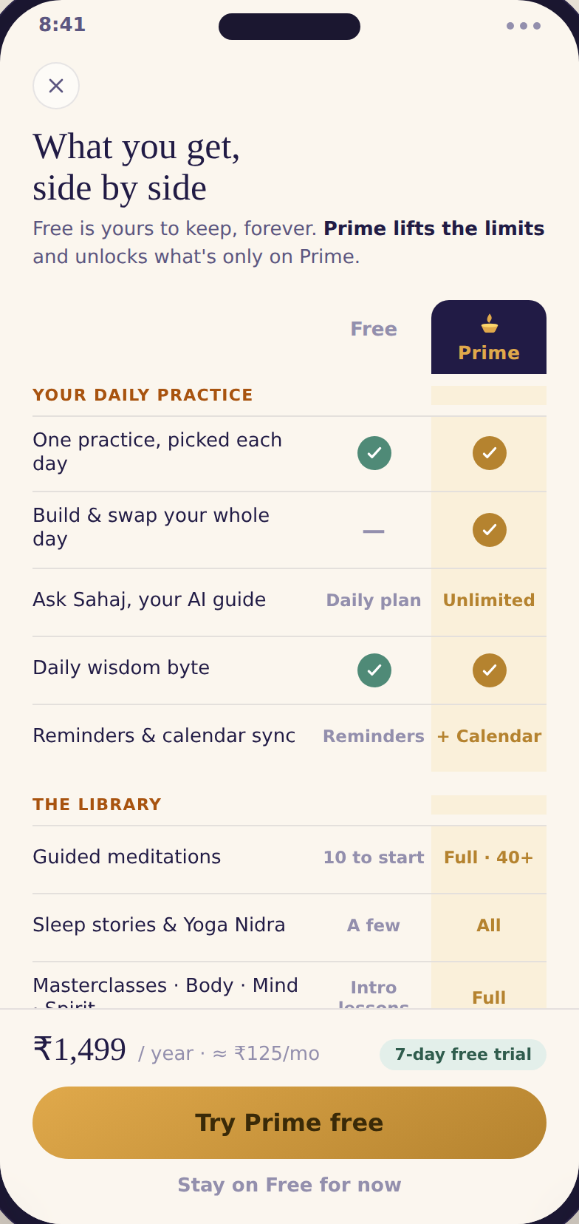
APPENDIX · FREE VS PRIME
What stays free, what Prime adds
The principle
Free is genuinely useful
The daily practice, streaks, journey, live meditations and the Sangha stay free — forever. That builds trust and holds the habit.
Prime lifts the limits
The full library, unlimited Sahaj, deeper history and offline access reward those who go further.
Courses are the heart
Prime members save on every course — the gentle bridge from a free habit to the practices that sustain the mission.
Notes:
The Amazon-Prime-style comparison. Free stays meaningful so the app never feels mercenary; Prime and the course discount carry the sustainability.

Slide 23
APPENDIX · THE BRIDGE
From where we are, to where we can serve
Daily practitioners
growing every month
→
the North Star
Monthly active users
110k
→
200k
Subscribers
~27.5k
→
50k+
Annual revenue (to sustain & extend)
₹2 cr
→
₹50–60 cr
The leap is not more subscribers alone — it is gently guiding engaged practitioners toward the courses, so the mission can reach far more people than it does today.
Notes:
The growth math, mission-framed: revenue rises by deepening practice into courses, and that revenue is what lets the free practice reach the next 100,000.

Slide 24
APPENDIX · ARCHITECTURE
End to end: wisdom in, a personalised practice out
Sources
Ingest & store
Enrich · NLP/CV
Intelligence
Experiences
Measure & learn
Gurudev’s talks
Content lake
Auto-tagging (theme, level, B·M·S)
Sahaj retrieval (RAG)
Today
North Star + KPIs
SKY & breath
Explore
Meditations
Transcription (ASR)
Translation & localisation
Recommender (next practice)
Content-gap analysis
Chants & bhajans
→
→
→
→
Ask · Sahaj
→
Metadata store
Embeddings / vector index
Journey builder
Course catalog
Live
Continuous feedback
Live sessions
Profile & events
Authenticity & quality check
Personalisation (time, persona, progress)
You
User signals
↑
Outcomes & content-gaps feed back continuously — refining personalisation and revealing what to create next.
Notes:
Technical analog to Uber's catalog pipeline: content + signals flow through ingestion, ML enrichment and an intelligence layer into the five experiences, with a measurement-and-feedback loop. Sahaj retrieval is grounded in the authentic corpus by design.

Slide 25
APPENDIX · VALUE VS EFFORT
Every feature, placed
LOW EFFORT
HIGH VALUE
HIGH EFFORT
1 Today — daily pick
8 Course integration
1
3
5
8
2 Ask · Sahaj
9 Prime & benefits
2
6
3 Daily wisdom
10 Report card
4
7
9
14
4 SKY breath basics
11 Mood & notes
5 Full library
12 Store
10
12
6 Live & Sangha
13 Deep gamification
11
13
7 Journey & milestones
14 Full personalisation
LOWER VALUE
Saffron = do first · sage = invest · violet = easy extras · grey = later. Subject to engineering validation.
Notes:
The numbered version mapped to the product suite — Uber's value-effort treatment. Numbers match the legend; quadrant colour shows the call.

Slide 26
APPENDIX · DETAILED ROADMAP
Workstreams × phases
 | Phase 1 · Earn the habit | Phase 2 · Build the ladder | Phase 3 · Scale the engine
Experiences | Today, Ask, Live (MVP) | Explore library, You / journey, report card | Offline, deeper personalisation, widgets
Content & wisdom | Core meditations, daily wisdom, SKY basics | Full library, masterclasses, chants | Retreats, festival webcasts, regional languages
Sahaj · intelligence | Daily plan, basic recommendations | Journey builder, richer retrieval | Advanced, multilingual personalisation
Sangha · community | Live group meditations | Groups, graduate re-engagement | Global Sangha, events
Sustainability | Free — earn trust first | Prime, course enrolment, 15% off | Retreats, store, gifting, regional pricing
Markets | India | India + developed markets | Global · 182 countries
Notes:
Uber's U1->U5 roadmap recast as AOL workstreams across the three phases. Phase 1 proves the habit in India; Phase 2 builds the ladder; Phase 3 scales globally with region-fair pricing.

