Slide 1
Indian Institute of Information Technology Una
PRACTICUM-IV
“HeartGuard”
Predictive Modelling for Cardiovascular Wellness
By :- Keshav Agarwal (22136)

Slide 2
Outline
01
Introduction
02
Motivation
03
Project Objectives
04
Innovation in the Project
05
Literature Review/
Currently available
solutions
05
Work Progress and Demonstration

Slide 3
01
Introduction

Slide 4
1. INTRODUCTION
Machine learning models have shown promise in predicting heart disease, offering a proactive approach to healthcare.
A heart disease prediction model is a sophisticated application of machine learning algorithms and data analytics designed to assess and predict the likelihood of an individual developing cardiovascular issues.
Machine learning:- It teaches computers to make decisions from data by learning patterns, without explicit programming.

Slide 5
02
MOTIVATION

Slide 6
2. MOTIVATION
Heart disease is a prevalent and life-threatening health condition that requires early detection for effective treatment.
Cardiovascular diseases (CVDs) are the leading cause of death globally, taking an estimated 17.9 million lives each year.
More than 4 out of 5 CVD deaths are due to heart attacks & strokes, & 1/3rd of these deaths occur prematurely in people under 70 years of age.

Slide 7
03
Project Objectives

Slide 8
3. Project Objectives
To collect a comprehensive dataset containing relevant health features.
To collect information regarding various features related to heart.
To explore and analyse the dataset to understand the relationships between features and the target variable (heart disease).
To design and implement a machine learning model for heart disease prediction.
To evaluate the model's performance using appropriate metrics.

Slide 9
04
Innovation in the Project

Slide 10
4. Innovation in the Project
Real-time health monitoring integration.
Personalized risk factor analysis.
Continuous learning for adaptive model updates.

Slide 11
05
Currently available solutions

Slide 12
5. Currently available solutions
Heart disease prediction models are used in emergency department of the hospitals.
Heart disease prediction models are used in early diagnosis and screening.
Heart disease prediction models are used in research purposes.

Slide 13
06
Work Progress and Demonstration

Slide 14
6. Work Progress & Demonstration
Dataset Exploration.
Source of the Dataset :-
https://www.kaggle.com/datasets/rashikrahmanpritom/heart-attack-analysis-prediction-dataset
Explored & learned python, libraries - NumPy, Matplotlib, Pandas, sci-kit.
Confusion matrix.
Precision, Recall, F-1 score.
Learning the Basics of ML.

Slide 15
6. Work Progress & Demonstration
Training and Testing of the Model.
Selection of Model for Project.
Currently Exploring Neural Networks for better accuracy and implementation.

Slide 16
6. Work Progress & Demonstration
Features used to determine the Heart disease :-
Age - age in years
origin
gender (1=Male/ 0=Female)
cp chest pain (1 = typical angina; 2 = atypical angina; 3 = non-anginal pain)
trestbps (resting blood pressure)
chol (serum cholesterol in mg/dl) (1 = true; 0 = false)
fbs (if fasting blood sugar > 120 mg/dl)
restecg (resting electrocardiographic results)
thalach: maximum heart rate achieved
exang: exercise-induced angina (True/ False)
oldpeak: ST depression induced by exercise relative to rest
slope: the slope of the peak exercise ST segment
ca: number of major vessels (0-3) colored by fluoroscopy
thal – 1 = normal; 2 = fixed defect; 3 = reversable defect

Slide 17
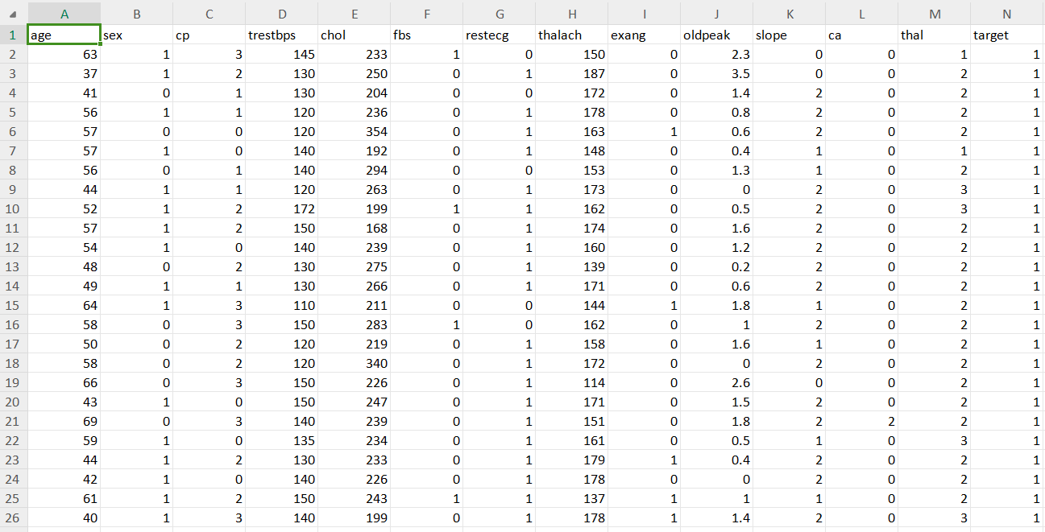
6. Work Progress & Demonstration

Slide 18
Thanks! Questions and Answers
Contact Details :-
Keshav Agarwal (22136) ,7017540010

