Slide 1


CMR TECHNICAL CAMPUS
UGC AUTONOMOUS ACCREDITED BY NBA & NAAC WITH A GRADE APPROVED BY AICTE, NEW DELHI AND AFFILIATED TO JNTU, HYDERABAD
DEPARTMENT OF COMPUTER SCIENCE AND ENGINEERING
MAJOR PROJECT REVIEW
Automated reconnaissance tool for pentesting engagements
PRESENTED BY : Sundeep Varma
BATCH NO : 24
CSE IV A

Slide 2
Abstract
Reconnaissance denotes the work of information gathering before any real attacks are planned. The idea is to collect as much interesting information as possible about the target. To achieve this, many different publicly available sources of information are used. The extracted information will often already allow a detailed insight into the affected systems.This encompasses technical as well as nontechnical information. Technical information may be IP-ranges, insight into the (internal) network infrastructure, used hardware and even passwords. There are various tools available in the community do the reconnaissance.The tool I propose chains all the tools commonly used during the reconnaissance process like sublister,nmap,search sploit, aquatone,eyewitness, HTTPX, dirbuster, gobuster etc. Chaining all these tools system offers reconnaissance for both bug bounty and CTF styled processes. In the end this project provides a clean report all the findings.

Slide 3
Existing System
Advantages of Existing System
There are not many tools online which could automate the reconnaissance, Even if there are any tools they just automated only one segment ie either directory brute forcing, or searching the exploit for services.There are no tools which would integrate the recon of bug bounty or of CTFs.
Not many tools for Entire recon automation.
Few are Paid.
They have complex syntax.
NO proper report generator.
No Tool integrating bug bounty and CTF recon.

Slide 4
Proposed System
Advantages of Proposed System
The system/Program I propose does the entire recon automated and is heavily customizable, Not only it offers the automation in recon for CTFs but also for bug bounty programs. It generates a proper report of the entire findings. It uses the best of common tools to rely on results.
Proper report.
Heavily customizable.
Offers recon on Bug Bounty and CTFs
Pre installs all the libraries and tools required.

Slide 5
Hardware Requirements
Software Requirements
Processor : AMD A4 or higher
RAM : 4GB or Higher
Storage : 1GB or Higher
OS : Kali /Parrot
Programming Languages : GO, BASH, RUST, DOCKER, Python
Text Editor : VIM,VS CODE

Slide 6
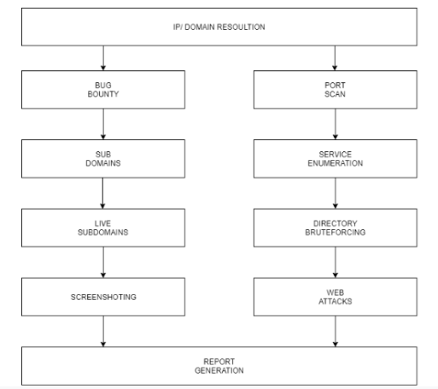
Architecture

Slide 7
Modules
IP Module :ip modules the ip is taken and analyzed for missing octals or domain lookup is done.
Port Scan : Nmap is made Scan on the target for checking the open ports.
Common exploits are made search on the obtained running services
Subdomains : Subdomains are analyzed and obtained with various tools
Live Subdomains Active and live subdomains are filtered by HTTPX
Screenshotting : Screenshotting is done using eyewitness or aquatone
Directory brute forcing : Directory brute forcing is done using gibuster or dirbuster with common seclist wordlist
Web Attacks :Web Attacks like sql injection ,xss , rce, injection attacks are performed using various tools

Slide 8
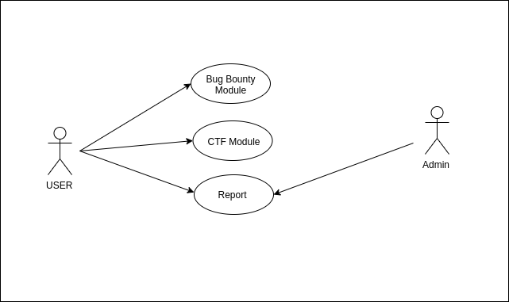
Use case diagram

Slide 9
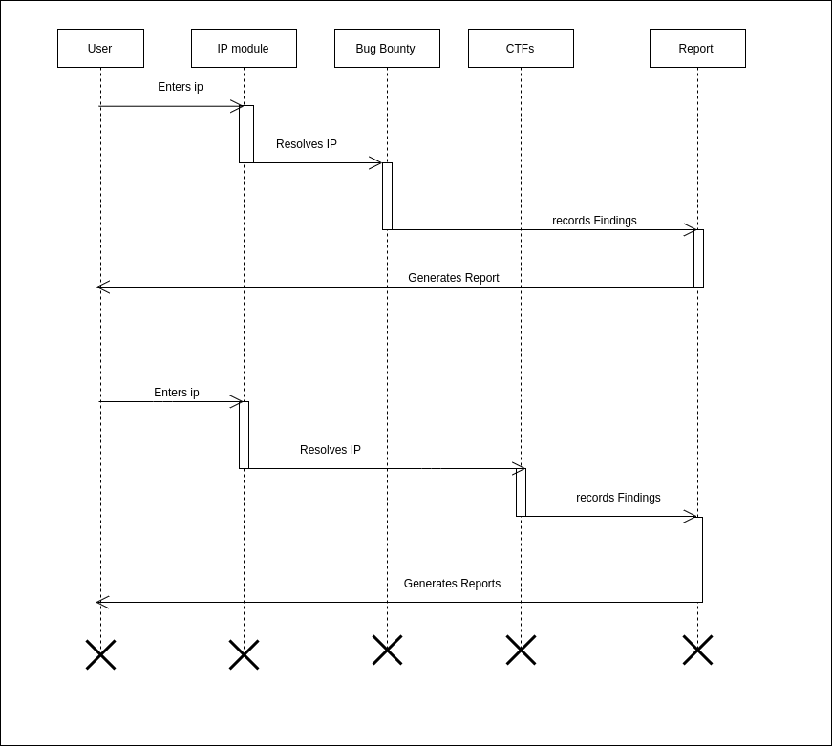
Sequence diagram

Slide 10
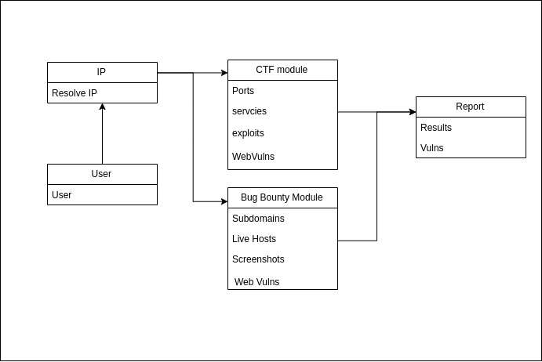
Class Diagram

Slide 11
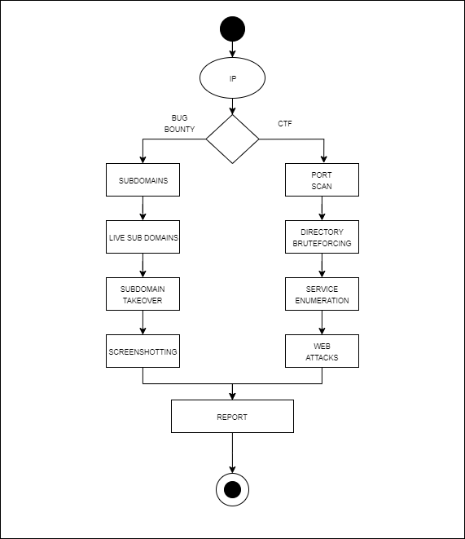
Activity Diagram

Slide 12
Sample Code
def rem_noise():
global aldmn1
global unqdmn1
print('\n***************Removing noise*************')
os.system('cat assetfinder.txt sublister.txt subfinder.txt >> all_domains.txt')
aldmn = sp.getoutput("wc -l all_domains.txt | grep -o '[0-9]\+'")
aldmn1=aldmn
print('subdomains aquired : '+aldmn)
print('\n***************Removing duplicate subdomains*************')
os.system('cat all_domains.txt| sort | uniq >> uniq_domains.txt')
print('unique domains')
unqdmn = sp.getoutput("wc -l uniq_domains.txt | grep -o '[0-9]\+'")
unqdmn1=unqdmn
print('subdomains aquired : '+unqdmn)

Slide 13
Sample Code
def portscan(ip):
print("*************** Nmap Scan Started*************")
os.system('nmap -sC -sV -A '+ip +' -Pn- -oG nmapo3.txt > /dev/null 2>&1')
print('\n***************Nmap Scan Completed*************')
filename='nmapo3.txt'
f = open(filename)
lines=f.readlines()
portlist=lines[2]
val=portlist.split("\t")
nl=val[1:-1]
listtostr=''.join([str(elem) for elem in nl])
ns=listtostr[6:].split(",")
filenm=ip+'.txt'
file1 = open( filenm, 'w')
for k in ns:
file1.write(k)
file1.write("\n")
file1.close()

Slide 14
Sample Code
global ports
oports =sp.check_output('awk -F "/" \'{print $1}\' '+filenm , shell=True)
rversions=sp.check_output('awk -F "/" \'{print $7}\' '+filenm , shell=True)
rservices= sp.check_output('awk -F "/" \'{print $5}\' '+filenm , shell=True)
prt=oports.decode("utf-8")
prt=list(prt.split("\n"))
ports=prt
filename=ip+'_ports.txt'
os.system('touch '+filename)
file1 = open(filename, 'w')
file1.write("ports")
for k in prt:
file1.write(k)
file1.write("\n")
file1.close()
global versions
global services

Slide 15
Sample Code
ver=rversions.decode("utf-8")
ver=list(ver.split("\n"))
versions=ver
ser=rservices.decode("utf-8")
ser=list(ser.split("\n"))
filenm=ip+'_services.txt'
file1 = open( filenm, 'w')
for k in ver:
v=k.replace('(','').replace(')','')
file1.write(v)
file1.write("\n")
file1.close()
rservices= sp.check_output('awk -F " " \'{print $1" " $2}\' '+filenm , shell=True)
ser=rservices.decode("utf-8")
ser=list(ser.split("\n"))

Slide 16
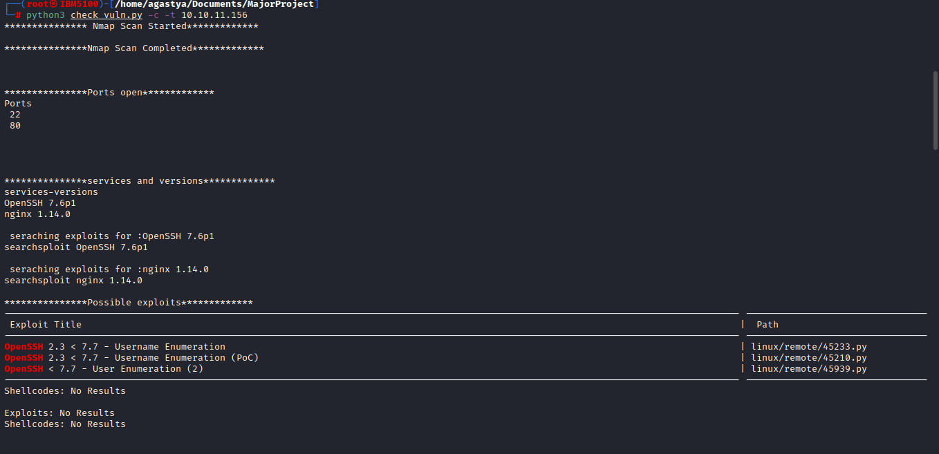
Result

Slide 17
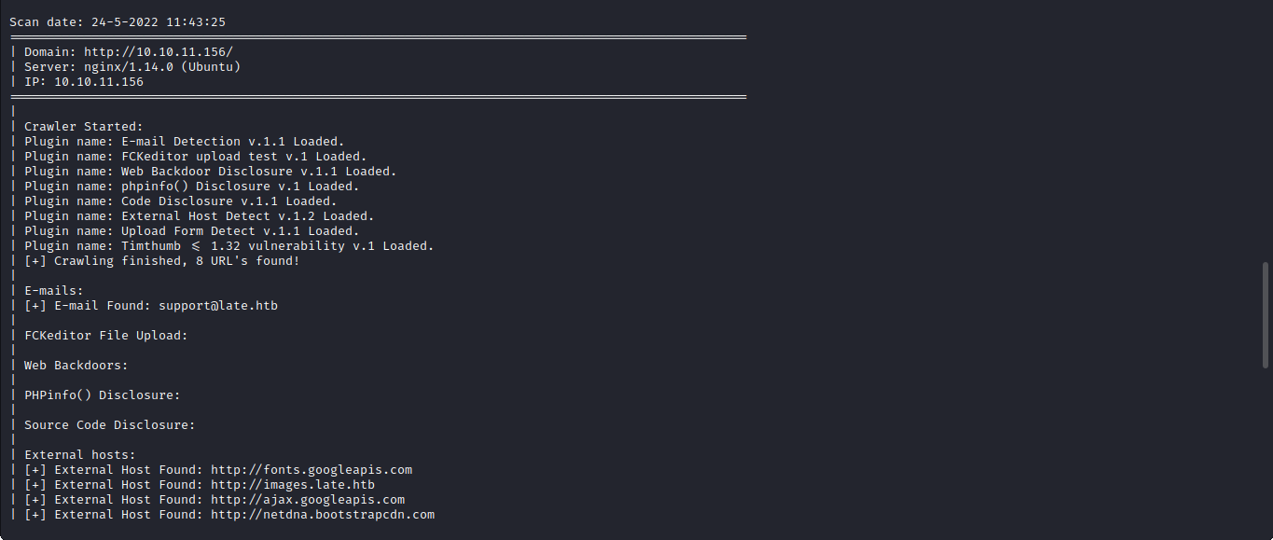
Result

