Slide 1
PRODUCT ANALYSIS · PM FOLLOW-UP
Time to First Purchase
Same-day buyers · 1 Nov 2020 – 31 Jan 2021 · 4,794 buyer-days
19.1
median minutes to first purchase
Notes:
[~30s] You asked how long it takes someone to buy, from arriving to their first purchase that same day, and how it moves daily. Short answer: 19 minutes. Longer and more useful answer: it has not moved in three months, and that turns out to be the interesting part. Do not explain methodology yet.

Slide 2
WHAT WAS MEASURED
First event of the day, to first purchase that same day
Unit of analysis is the user-day: one user on one calendar day, not the user, session, or order. 4,794 is 4,794 user-days, not 4,794 people.
Same-day only, by construction: someone who browses Monday and buys Thursday is excluded entirely, not recorded as a long duration.
Median, not mean: the distribution is severely right-skewed. The slowest 5% of buyers hold 49% of all elapsed time.
Page 1 scorecards, Time to first purchase dashboard
Notes:
[~60s] Three definitions that shape everything after. (1) Unit is the user-day, not the person: 4,794 user-days, not 4,794 customers. (2) Same-day only, by construction, because that is what was asked; someone who researches Monday and buys Thursday is absent entirely, not counted as a long duration. (3) Median not mean, and the gap is large: 19 against 75. If pressed: 5% of buyers hold half the elapsed time, chart comes later.

Slide 3
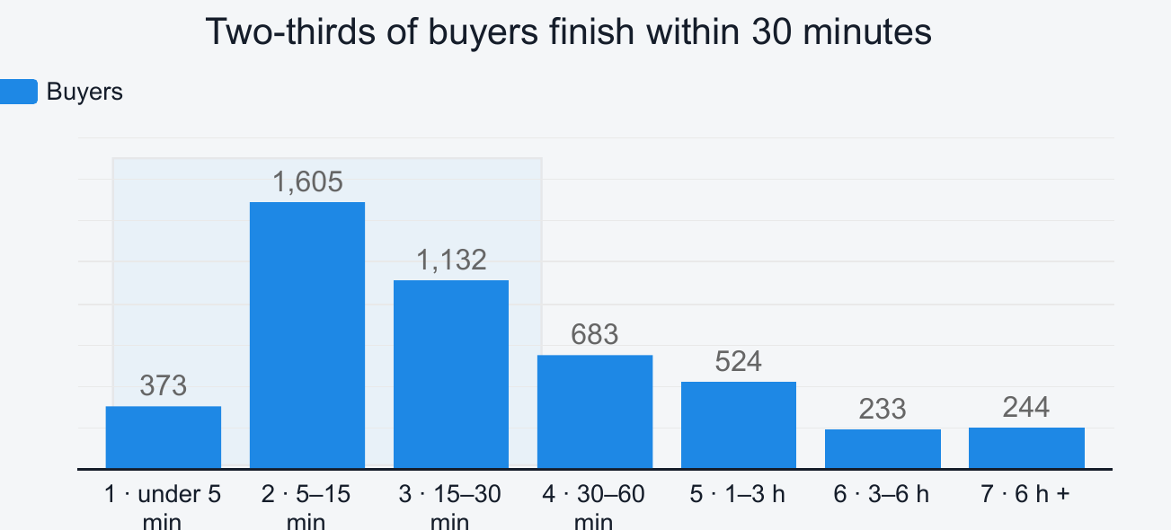
THE ANSWER
Two-thirds of buyers finish inside 30 minutes
3,110
of 4,794 buyers purchase within half an hour of arriving. 41% do it inside fifteen minutes.
The modal band is 5 to 15 minutes, not the fastest one. Only 7.8% buy in under five minutes, so the common pattern is a short but non-trivial browse rather than arriving with a product already decided.
Notes:
[~60s] Two-thirds finish inside half an hour, 3,110 of 4,794. 41% inside fifteen minutes. The interesting bit: the biggest band is 5 to 15 minutes, not the fastest. Only 7.8% buy in under five. So the typical pattern is a short but real browse, not someone arriving already decided. TRANSITION: that is the level, now the daily progression you asked for.

Slide 4
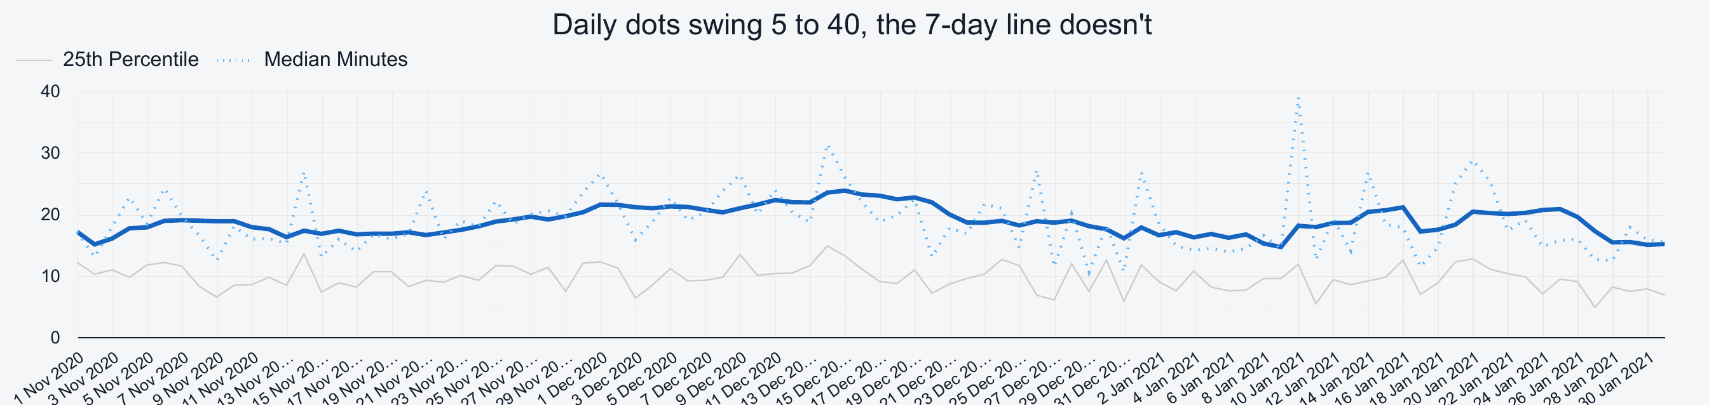
DAILY PROGRESSION
And it has not moved all quarter
The smoothed line stays in a narrow band across all 92 days. The daily dots swing widely, but those swings are sample size: some January days rest on fewer than two dozen buyers, so single-day movement carries no information.
Daily median with 7-day trailing average, and the 25th percentile
Notes:
[~60s] This is the answer to the actual question and it is a negative one. 92 days, smoothed line in a narrow band, no trend, no break. Warn them off the dotted line: some January days rest on fewer than two dozen buyers, so a couple of people move the median several minutes. Only the smooth line carries information. TRANSITION: a flat line alone is not interesting; what makes it interesting is what was happening around it.

Slide 5
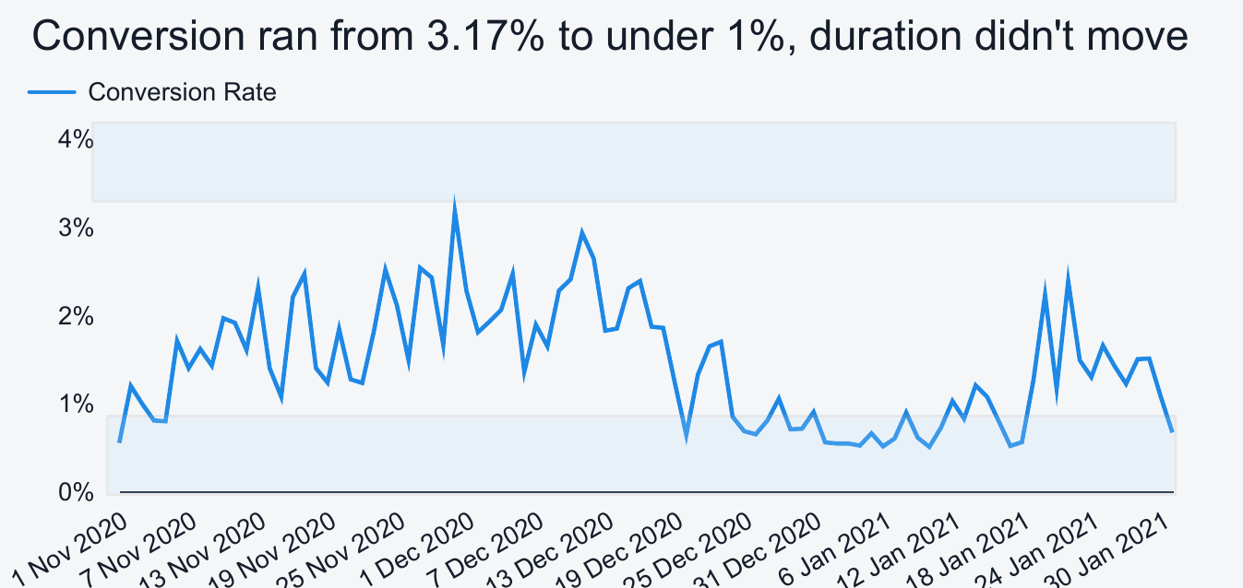
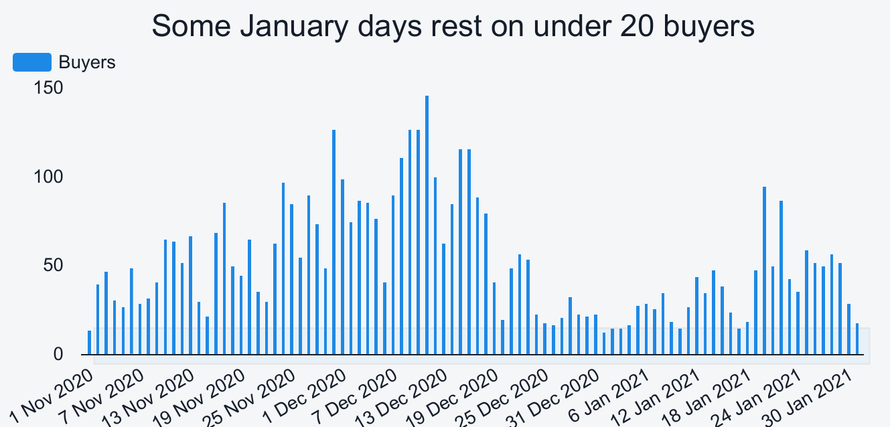
THE CONTRAST
Everything else moved. This did not.
Conversion peaked at 3.17% on 30 November, Black Friday week, then fell to a small fraction by mid-January. Daily buyer volume peaked near 150 in December and fell below 20 in January. Demand, traffic quality and conversion all moved substantially. The median time to purchase did not move with them.
So it is not an early-warning indicator. It did not respond to the largest demand swing in the data, and it will not signal a change in conversion before conversion does.
Notes:
[~75s, SLOW DOWN] Left: conversion peaked 3.17% on 30 Nov, Black Friday week, down to a fraction by mid-January. Right: daily volume peaked near 150, fell below 20. Demand, traffic quality and conversion all moved a great deal. The median did not move with any of them. Practical conclusion: this is not an early-warning metric, it will not tell you conversion is falling before conversion does. PAUSE here.

Slide 6
SO WHAT IS IT MEASURING?
Slow orders are bigger orders,
not pricier ones
Segmenting order value by speed band answers it.
Notes:
[~15s] If the number does not move and does not track anything, what is it measuring? Order value by speed band answers that. Move straight through.

Slide 7
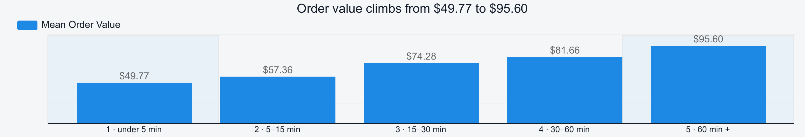
ORDER VALUE BY SPEED BAND
Order value climbs from $49.77 to $95.60
A 1.9x spread, or $45.83 more per order, between the fastest band and the slowest.
Notes:
[~45s] Split orders by how long the purchase took and average order value climbs the whole way: just under $50 fastest, $95.60 slowest. 1.9x, about $46 a head. Slower buyers are worth more. The question is why, and the two possible reasons point in opposite directions. TRANSITION: an order's value is how many things times how much each costs, so split it.

Slide 8
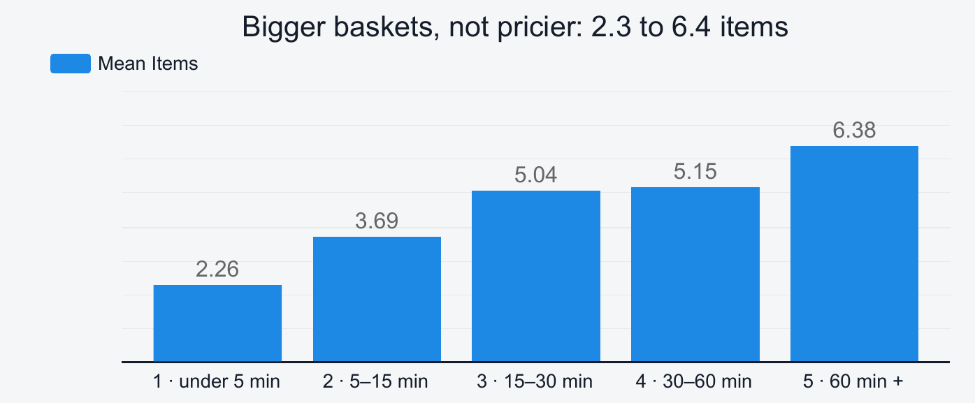
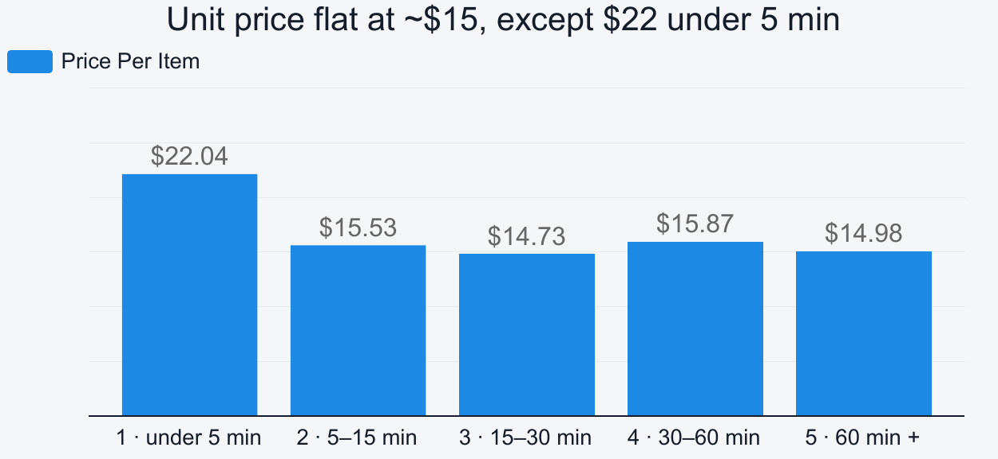
WHY
The entire gap is basket size
Items per order nearly triples, from 2.26 to 6.38. Price per item stays flat at roughly $15 across four of the five bands. The two multiply back to the order values within a few cents, so slower buyers are not trading up to more expensive products. They are putting more of the same products in the basket.
The fastest band is a different behaviour, not a faster version of the same one: smallest basket, highest unit price at $22.04.
Notes:
[~75s, SLOW DOWN] Items per order nearly triples, 2.3 to 6.4. Price per item flat at about $15 across four of five bands. Multiply the columns and you get the previous slide's order values within a few cents, so the entire $46 gap is basket size. Nobody trades up; they put more of the same $15 products in the basket. Flag the oddity: fastest band has the smallest basket but the highest unit price at $22.04. Not a rushed version of everyone else, a different behaviour. ~8% of buyers.

Slide 9
INTERPRETATION
Two readings, and this data cannot separate them
A
Duration signals intent
B
Duration is a by-product of basket size
Long sessions are people browsing a category and assembling a basket. The minutes are engagement, and compressing them would remove the browsing that fills the cart.
Six items mechanically take longer to add than two, at about $15 an item either way. Duration then carries nothing that basket size does not carry more directly.
The test that would separate them: hold items-per-order constant and re-examine. If a four-item order is still worth more at 60 minutes than at 5, something beyond mechanics is operating. If the relationship disappears, duration is a proxy and basket size is the real variable.
Both readings agree on one thing: this is not a number to drive down. Cutting time-to-purchase means shrinking baskets.
Notes:
[~90s] Be careful here, two readings and the data cannot separate them. A: duration signals intent, the minutes are engagement, compressing them removes the browsing that fills the cart. B: duration is a by-product of basket size, six items take longer to add than two. Both predict exactly this chart. What settles it: hold basket size constant, take only four-item orders, and see if value still rises with time. THE USEFUL PART: both readings agree this is not a number to drive down. If asked which I think: instinct says B, but I would rather run the test than give you my instinct.

Slide 10
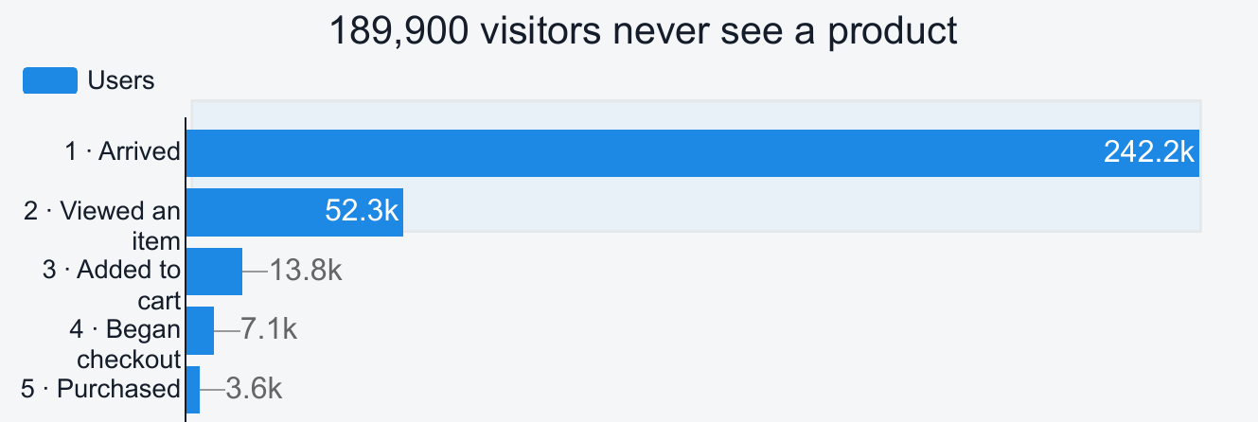
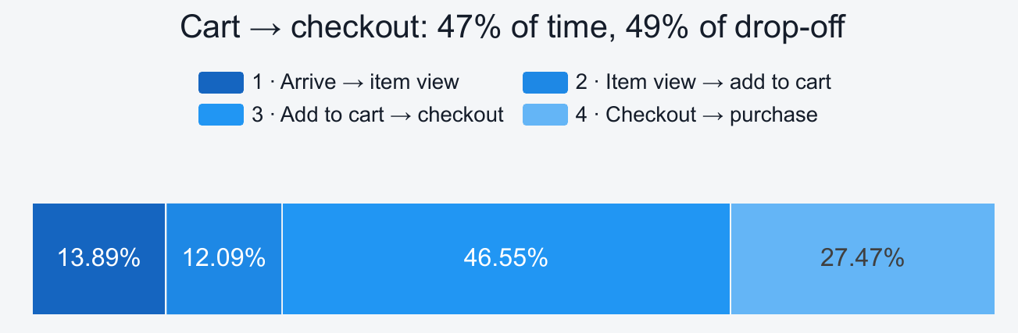
WHERE TO LOOK INSTEAD
The losses are before the product page, and at checkout
189,900 of 242,200 visitors leave without viewing a single product. In absolute terms that dwarfs every other step combined, and no checkout work touches it.
Add-to-cart to checkout is the one stage worth instrumenting. It consumes 46.6% of journey time and loses 48.6% of the users who reach it, the only stage where both are true. Everywhere else, reducing time risks removing the browsing that fills baskets. Here the basket is already assembled, so the time is far likelier to be hesitation or friction.
Notes:
[~90s, SLOW DOWN] Left: 189,900 of 242,200 leave without viewing a single product, 78%. Bigger than every other funnel step combined and no checkout work touches it. Right: add-to-cart to checkout takes 47% of journey time and loses 49% of the people who reach it, the only stage where both are true. Why that matters: everywhere else cutting time risks cutting basket size, but here the basket is already assembled, so the time is hesitation or friction, not adding items. The one place where faster plausibly gains conversions instead of costing revenue. Cannot say what the obstacle is; those events are not tracked.

Slide 11
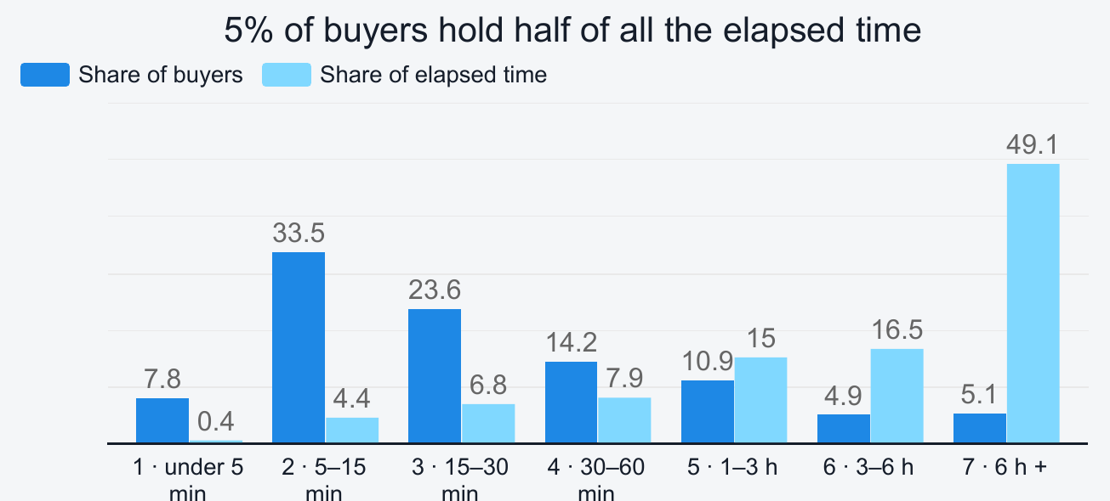
WHAT THIS CANNOT SEE
A day is not a session
5.1% of buyers hold 49.1% of all elapsed time.
Measurement runs from the first event of the calendar day, so a user who visits at 09:00 and returns to buy at 17:00 records an eight-hour purchase. Those durations are largely gaps between visits, not shopping time, which is why the mean reads 74.7 against a median of 19.1.
The slow bands should not be read as high-consideration buyers.
Also noted: same-day only by construction · 883 purchase events carry no transaction id, tested and unbiased across speed bands · a holiday quarter · no device or channel split · add-to-cart untracked for 18 days in November
Notes:
[~60s] One limitation that constrains the headline, then the rest for completeness. Measurement starts from the first event of the calendar DAY, not the visit. Someone browsing at 9am and buying at 5pm records an eight-hour purchase. That is the tall bar: 5% of buyers holding 49% of elapsed time, and the whole reason the mean is 75 against a median of 19. Practical: do not read the slow bands as patient high-consideration shoppers. Highlight from the rest: 883 purchase events carry no transaction id; tested and unbiased across bands, but revenue totals are floors not totals.

Slide 12
RECOMMENDATIONS
What to do with this
1
Do not set a target on time to first purchase.
Under either reading, driving it down means shrinking baskets. It belongs in segmentation, not on a KPI dashboard.
2
Do not treat slow buyers as a problem to fix.
They carry the largest baskets and the highest order values, $95.60 against $49.77.
3
Prioritise the cart to checkout stage.
46.6% of journey time and 48.6% of the users who reach it. Instrument it before specifying a fix.
4
Treat the pre-product-page loss as a separate, larger workstream.
189,900 visitors, and no checkout work touches it.
5
Use time to first add-to-cart if a friction metric is wanted.
It ends before basket assembly begins, so it can legitimately be optimised downward.
Notes:
[~60s] Five things. (1) No target on time to first purchase, driving it down means shrinking baskets. (2) Slow buyers are not a problem, they are the valuable ones, $95.60 against $49.77. (3) Prioritise cart to checkout, 47% of time and 49% of drop-off; instrument first, then fix. (4) Pre-product-page loss is a separate and bigger piece of work, 189,900 people. (5) If you want a duration metric you can actually optimise, use time to first add-to-cart. Then: happy to take questions.

