Slide 1
Movie Genre Analysis for Microsoft Movie Studio.
By
Agatha Nyambati
2nd June 2024

Slide 2
Business understanding
Microsoft is venturing into movie production with a new studio.
Lacking movie-making expertise, they need data-driven insights.
Our goal: Analyze box office data to identify commercially successful film genres.

Slide 3
Data Exploration
We'll analyze the bom.movie_gross.csv.gz, tn.movie_budgets.csv and tmdb.movies.csv dataset.
This dataset contains information on movie genres and their box office gross
We'll use Python library, pandas to explore the data.

Slide 4
Key metrics
Analyze domestic gross for top five movie.
Compare movie popularity and gross
Analyze release date trends
Analyze budget and gross correlation

Slide 5
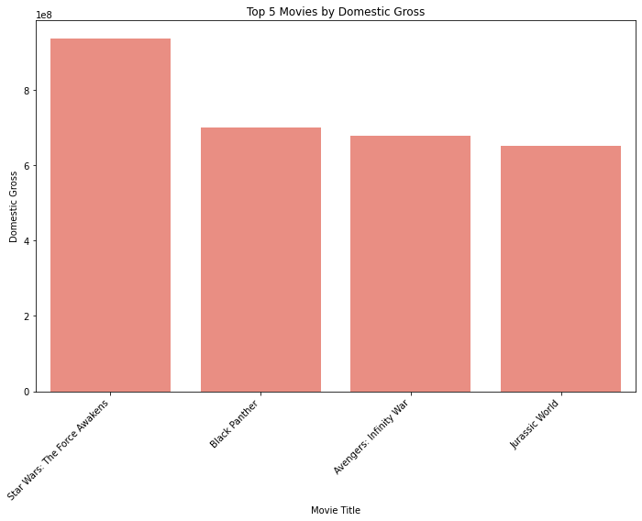
Domestic Revenue Trends

Slide 6
Domestic Revenue Trends
From the graph;
1.Star wars: The Force Awakens performed well with the highest return domestically.
Black Panther,Avengers:Infinity War and Jurassic world have a competitive reception in the market because their gross has a small difference.
Black Panther is the second in gross performance

Slide 7
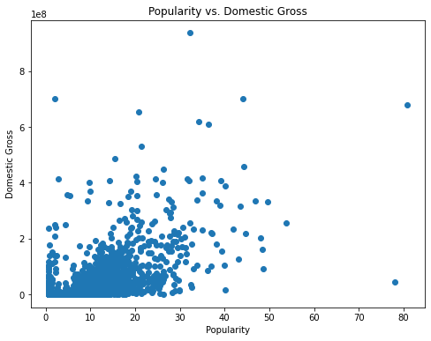
Popularity and domestic gross

Slide 8
Popularity and domestic gross
From the graph;
A correlation coefficient of 0.588 suggests that there's a positive trend. As a movie's popularity increases its domestic gross also tends to increase. However, the strength of this positive relationship is moderate, not extremely strong. Popularity attracts audiences, Movies with higher popularity scores might be more widely known leading to larger audiences and potentially higher domestic gross.

Slide 9
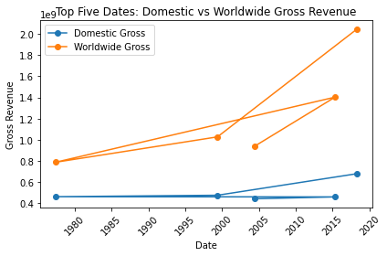
Release date trends

Slide 10
Release date trends
From the graph;
both domestic and worldwide experienced high average revenue the year 2018 on the month of April. .April seems to be the best month to release a new movie because the gross return is high.

Slide 11
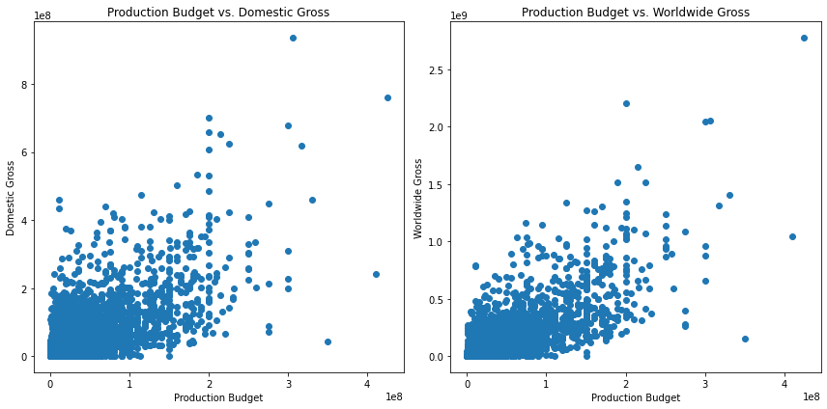
Budget and gross correlation

Slide 12
Budget and gross correlation
0.6857, and 0.7483 indicates a moderately strong positive correlation between production budget and worldwide/domestic gross respectively.
Movies with higher budgets tend to have higher worldwide/domestic gross, on average. 3.The correlation doesn't necessarily mean a high budget guarantees high gross. Other factors like script quality, directorial vision, and critical reception can also play a significant role.

Slide 13
Recommendations
Diversity in Successful leading movie genre: Star war, Black Panther , Avengers and Jurassic World
Focus on Increasing Movie Popularity
Invest in high-Quality movies to create a visually stunning experience that can attract audiences

Slide 14
Actionable Insights for Microsoft Studios
Focus on creating films in the top-performing movie titles identified.
Consider movie variations within the top categories for a broader market.
Analyze target audience demographics for each movie to tailor marketing strategies.
Focus on movies with proven success
Collaborate with experienced filmmakers in identified genres

Slide 15
Conclusion
Data analysis provides valuable insights for movie production decisions.
Focusing on top-performing genres increases the chances of box office success.
Successful entry into the movie industry requires understanding audience preferences, budget and market dynamics

Slide 16
Next Steps:
Implement recommendations for genre selection and movie production
Monitor performance metrics and revise strategies accordingly

Slide 17
Thank you.
Email : agathanyambati14@gmail.com

