Slide 1
Project Review AI POWERED CODE GENERATER
Team Members:
Agatheeswaran A (8208E22ASR008),
Haseeb Mohammed H (8208E22ASR022),
Praveenkumar S (8208E22ASR040).
Project coordinater:
Mr.R.Gobinath(ME,Phd),
Assistan Professer.
1904AS651 - Mini project

Slide 2
Motivation/Introduction
In today’s fast-paced development world, writing code from scratch for common tasks can be time-consuming and repetitive. We saw a strong opportunity to build an intelligent system that can understand natural language and generate working code
Many students and developers spend a lot of time looking for code snippets online.
Beginners often struggle to convert their logic into proper syntax.
Developers waste time writing boilerplate code repeatedly.

Slide 3
Problem Identified
Time-Consuming Code Writing:
Writing code from scratch can take a lot of time, especially for beginners or in large projects.
Lack of Expertise:
Non-technical users or those new to programming may struggle to write or debug code.
Syntax and Logical Errors:
Developers often face syntax errors or logical mistakes that can be time-consuming to identify and fix.
Inefficient Coding Practices:
Manual coding sometimes leads to redundant or inefficient code due to human error.
Limited Productivity:
Developers may spend excessive time on repetitive tasks, reducing innovation and productivity.
1904AS651 - Mini project

Slide 4
Key Business Objectives
Simplify Code Generation Enable users to generate accurate and efficient code using simple natura language input.
Increase Developer Productivity Reduce the time spent on writing repetitive or boilerplate code, allowing developers to focus on logic and design.
Support Multiple Programming Languages Provide cross-language support (e.g., Python, Java, C++, JavaScript, etc.) for broader usability.
Improve Accessibility to Coding Help non-programmers and beginners write code with ease by eliminating the barrier of syntax knowledge.
Build a Scalable & Trainable AI Model Design the system to continuously learn and improve from user queries and feedback.

Slide 5
Base Paper Details
TITLE:AI-Assisted Code Generation
PUBLISHER:IEEE
AUTHORS:1. Simon Torkaa,
2. Sahin Albayrak.
PUBLISHED:14 DEC 2024

Slide 6
LITRATURE REVIEW
TiTlE | AUTHORS | OVERVIEW | PUBLISHED YEAR | DOMAIN
AI-ASSISTED CODE GENERATION AND OPTIMIZATIN | Sr.Swamy Prasadarao Velaga,Program Automation Architect, (IT DEP). | Collaborations between human experts and AI models are crucial and can ultimately reduce the user and expert effort, combine the strength of both sides, ensure the expert control. | 9, Sep. -2023 | MACHINE LEARNING (DETECTION AND CORRECTION ERRORS)
OPTIMIZING AI-ASSISTED CODE GENERATION | Simon Torkaa, SahinAlbayraka, Technische Universität Berlin | With the ongoing development of AI code generators to create both traditional code and AI code, there are significant opportunities and risks for software and AI development. | 14 Dec 2024 | MACHINE LEARNING, NATURAL LANGUAGE PROCESSIN, LARGE LANGUAGE MODEL

Slide 7
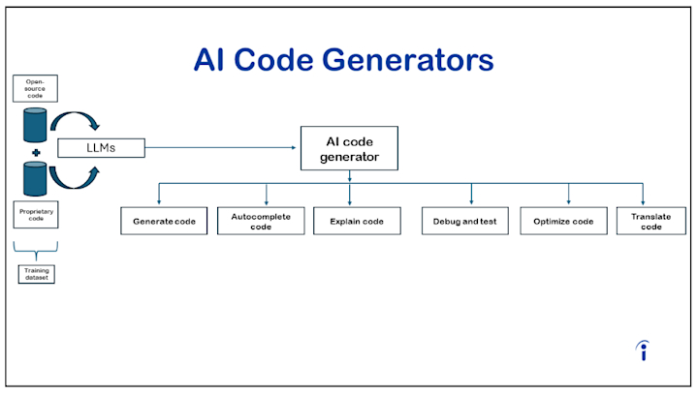

Slide 8
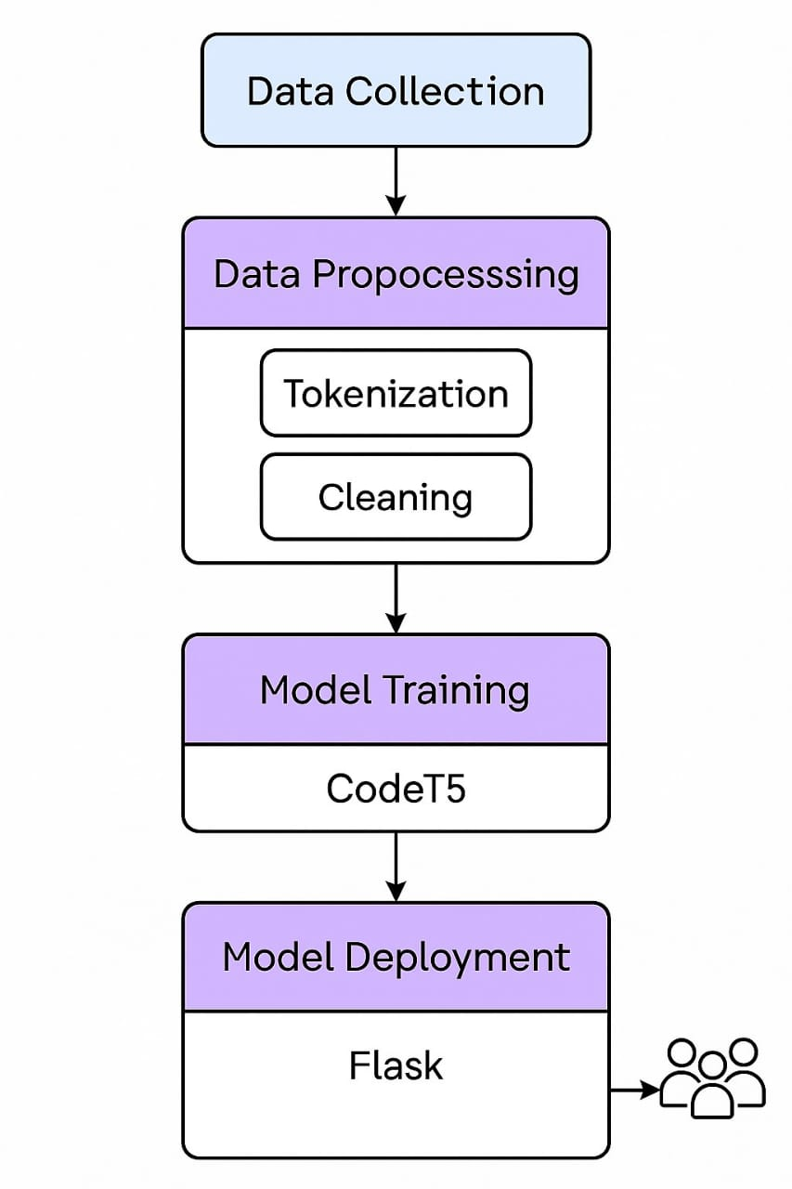
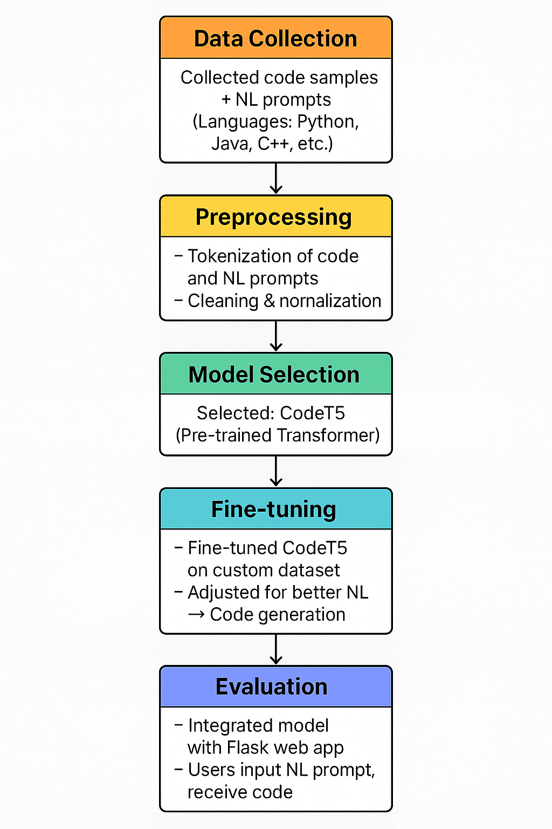
MODEL ARCHITECTURE

Slide 9
Methodology
Data Collection: We created a dataset of code samples and paired them with corresponding natural language prompts across multiple languages (Python, Java, C++, etc.).
Model Choice: After researching multiple models, we selected CodeT5 for its pre-trained capabilities on code understanding and generation.
Preprocessing: Tokenization and cleaning of both natural language and code snippets.
Training & Fine-tuning: Fine-tuned the CodeT5 model using our dataset to improve accuracy on custom prompts.
Evaluation: Used BLEU scores and manual validation to assess code quality.
Deployment: Integrated the trained model with a Flask-based web interface for user interaction.

Slide 10
Hardware &Software Requirements
1. Operating System
Windows 10/11 (for local development)
Linux (Ubuntu 20.04/22.04, CentOS, Debian) (for server deployment)
macOS (M1/M2) (optional)
2. Programming Languages
Python 3.8+ (for AI model, backend development)
JavaScript (ES6+) (for frontend development)
3. AI/ML Frameworks
PyTorch or TensorFlow/Keras (for training the Transformer model)
Hugging Face Transformers (for fine-tuning pre-trained models like CodeT5, GPT)
Scikit-learn (for evaluation metrics like BLEU, ROUGE)

Slide 11
https://www.researchgate.net/publication/377706469_AI-Powered_Programming_Using_ChatGPT_for_Code_Generation_Support https://repo.ijiert.org/index.php/ijiert/article/download/1334/3299/6918 HTTPS://Downloads/base%20paper-AI%20powered%20code%20generater.pdf
Reference
Details of base paper and literature survey paper link
1904AS651 - Mini project

