Slide 1

~ Student Performance Analysis ~
Dataset: Student Performance in Exams
Tools: Excel, Power BI
Focus: Performance trends and influencing factors

Slide 2
Project Objective
Analyze Performance
Identify Factors
Examine student scores in mathematics, reading, and writing subjects
Determine key variables influencing academic outcomes
Compare Groups
Recommend Actions
Compare results across gender, lunch type, and test preparation status
Provide data-driven recommendations for improvement

Slide 3

Dataset Overview
Dataset Characteristics
500 student records
Clean dataset with no missing values or duplicates
Key Variables
Gender
Lunch type
Test preparation completion
Mathematics scores
Reading scores
Writing scores

Slide 4
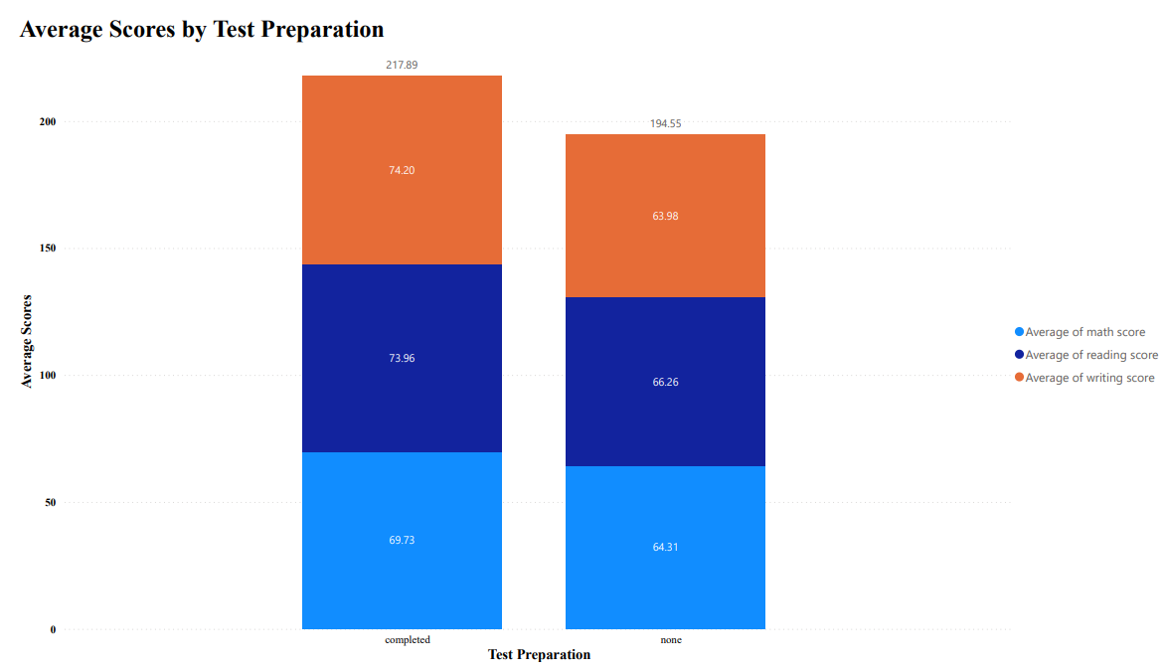
Test Preparation

Slide 5
Test Preparation
Key Findings
Students who completed test preparation programs scored 10–15 marks higher than those who did not prepare.
This improvement was consistent across all three subjects demonstrating the value of structured academic preparation.
Academic preparation strongly improves performance across all subject areas

Slide 6
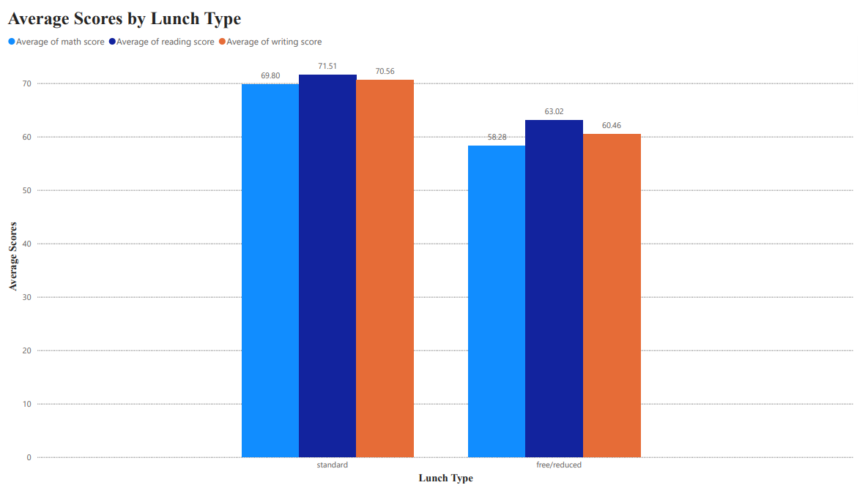
Lunch Factor

Slide 7
Lunch Factor
Standard Lunch Group
Students with standard lunch scored 8–12 marks higher across all subjects
Free/Reduced Lunch Group
Lower scores observed, highlighting the impact of resource access on academic performance
Access to adequate resources and nutrition significantly affects academic performance and student outcomes

Slide 8
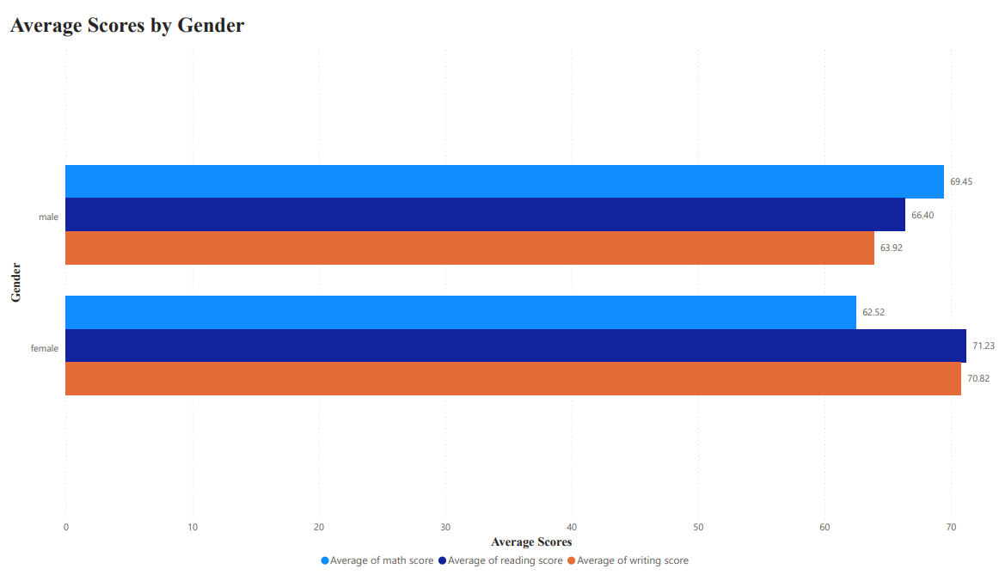
Gender-Based Performance Patterns

Slide 9

Gender-Based Performance Patterns
Male Students
Stronger performance in mathematics
Higher average scores in quantitative reasoning and problem-solving
Female Students
Stronger performance in reading and writing
Key Insight: Students demonstrate subject-specific strengths that vary by gender, suggesting different learning preferences and cognitive approaches across disciplines.
Higher average scores in verbal and composition tasks

Slide 10

Overall Performance Comparison
1
Reading
Highest average scores
2
Writing
Second highest performance
3
Mathematics
Lowest average scores
Mathematics shows the greatest performance gap compared to reading and writing, indicating a need for targeted intervention and additional support in this subject area.

Slide 11
Key Insights Summary
1
Test Preparation Impact
2
Socioeconomic Influence
Students who completed test preparation programs showed significant score improvements of 10–15 marks across all subjects
Lunch type and resource access significantly affect performance, with standard lunch students scoring 8–12 marks higher
3
Subject-Specific Strengths
4
Mathematics Gap
Male students excel in mathematics while female students perform better in reading and writing
Mathematics shows the largest performance gap, requiring focused intervention and additional learning support

Slide 12

Actionable Strategies
Test Preparation Programs
Implement structured test preparation programs to help students achieve 10–15 marks higher across all subjects
Support Low-Income Students
Provide targeted support for students with free/reduced lunch to address
resource gaps
Mathematics Learning Support
Strengthen mathematics learning support through tutoring and additional
resources
Monitor Performance
Use data analytics to track student progress and identify at-risk students early

Slide 13

Conclusion
Key Takeaways
Student performance is influenced by multiple interconnected factors including test preparation, socioeconomic status, and subject-specific learning patterns.
Academic support programs and resource access play a crucial role in determining student outcomes. Data-driven strategies can significantly improve educational results.
The data reveals clear opportunities for intervention
and improvement.

