Slide 1
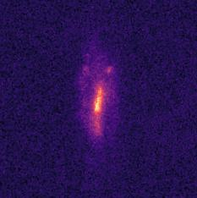















Multi-scale Loss
Image Simulations
Unrolled ADMM Network (N layers)
Raw Data
Ground Truth
Layer 1
Layer 2
Layer N
Rotate, shear
resample
$v$ update
$v$ update
$v$ update
…
$z$ update
$z$ update
$z$ update
COSMOS
Dataset
Convolution
Add noise
$x$ update
$x$ update
$x$ update
$u$ update
$u$ update
$u$ update
Observation
Reconstruction
Random Parameters
CNN
Hyperparameters $ρ1$, $ρ2$
PSF

