Slide 1
Employee Attrition Analysis
By Alberto Gell

Slide 2
Introduction to Employee Attrition Analysis
Human Resources seeks to identify the key factors contributing to employee turnover in an organization undergoing rapid growth. By visualizing patterns in employee engagement, job satisfaction, and other related metrics, this analysis aims to highlight the conditions that worsen attrition.

Slide 3
Agenda
Objective:
What is a logistic Regression Model ?
What is a Random Forest Model ?
Attrition By Job role
Impact of Training on Job Satisfaction and Performance
Predictive Models Used For Analyzing Attrition
Recommendations

Slide 4
Logistic Regression
Objective:
Logistic Regression is a predictive modeling technique used to estimate the probability of an event occurring, such as whether an employee will leave or stay (attrition)
It works by analyzing the relationship between the target (attrition) and various factors (job satisfaction, overtime).
The model outputs a probability score between 0 and 1, and we use this score to classify whether an employee is likely to stay or leave (if the probability is greater than 0.5, the model predicts they will leave).

Slide 5
Random Forest
Objective:
Random Forest is an advanced machine learning technique that uses multiple decision trees to make predictions. Each decision tree looks at different combinations of factors, and the final prediction is made based on the majority vote of all the trees.
It’s more flexible and powerful than Logistic Regression because it can capture complex, non-linear relationships between factors like Job Satisfaction, OverTime, and MonthlyIncome.

Slide 6
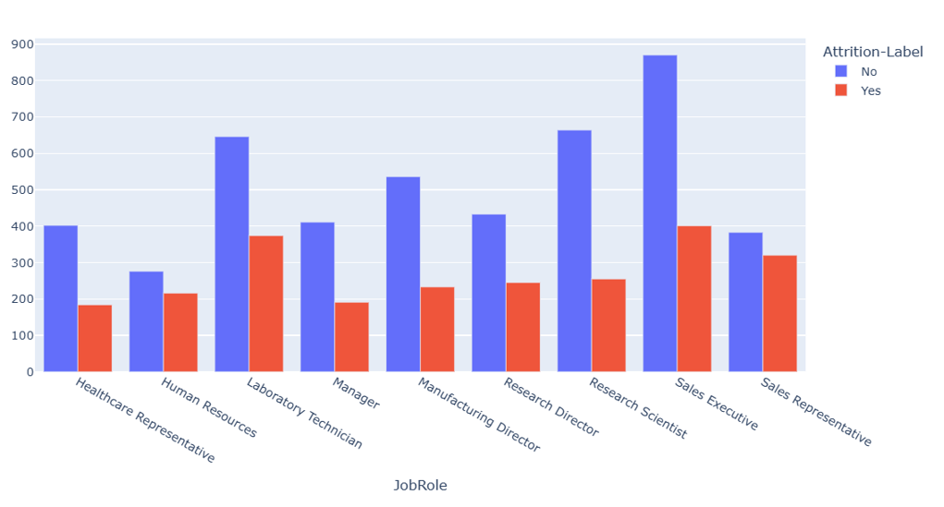
Attrition by Job Role
Analysis:
Sales Representatives have the highest attrition rate of (45.5%)
Research Scientists have the Lowest attrition rate of (27.7%)
Key Insights:
While Sales Representatives earned higher monthly incomes on average, this did not correlate with lower attrition, indicating that factors beyond compensation—such as job satisfaction and workload—play a critical role in employee retention
Notes:
Sales Representatives earn a higher monthly income ($7,986) compared to Research Scientists ($6,858), yet they still exhibit a higher attrition rate
Sales Representatives tend to stay with the company longer (16.57 years) than Research Scientists (10.76 years). Despite their longer tenure, the high attrition rate for Sales Representatives could indicate burnout or dissatisfaction with job growth opportunities.

Slide 7
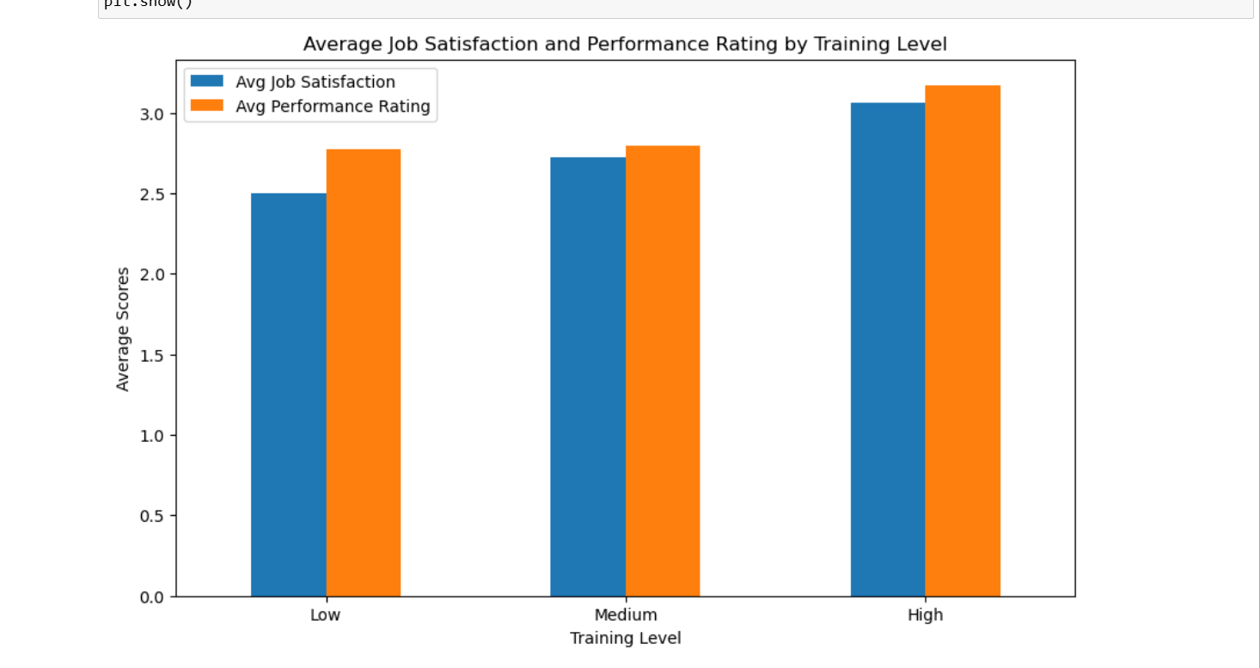
Impact of Training on Job Satisfaction and Performance
Key Insights:
For each additional unit of training, job satisfaction increases by 0.162 units, highlighting the critical role of employee development in boosting satisfaction.
Performance rating improves by 0.114 units with each additional unit of training, showing that more training leads to better employee performance

Slide 8
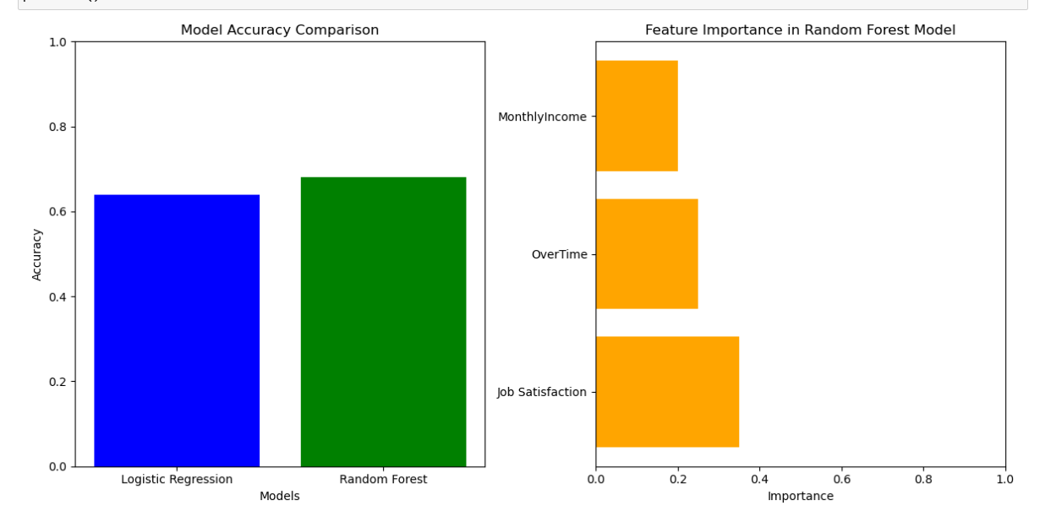
Predictive Models for Attrition
Key Insights:
The bar chart compares the accuracy of the Logistic Regression and Random Forest models. The horizontal bar chart highlights the importance of features such as Job Satisfaction, OverTime, and MonthlyIncome in predicting employee attrition using the Random Forest model.
The analysis shows that JobSatisfaction, Training, OverTime, and Workload are key drivers of attrition. While income is important, it does not prevent turnover in the same way that job satisfaction and training do. Offering professional development and managing workload can improve retention and performance.
Analysis:
Random Forest Accuracy: 68%
Logistic Regression Accuracy: 64%
Notes:
I compared the Sales Representative role (highest attrition) and the Research Scientist role (lowest attrition) across key features such as MonthlyIncome, YearsAtCompany, JobSatisfaction, and PerformanceRating.

Slide 9
Recommendations
  Enhance Job Satisfaction with targeted training for high-attrition roles.
  Implement work-life balance initiatives to manage workload and reduce overtime.
  Establish performance-based recognition programs to reward improvements in Job Satisfaction and Performance Ratings.

