Slide 1
INTERLIS in Canton Solothurn
A success story since 1999

Slide 2


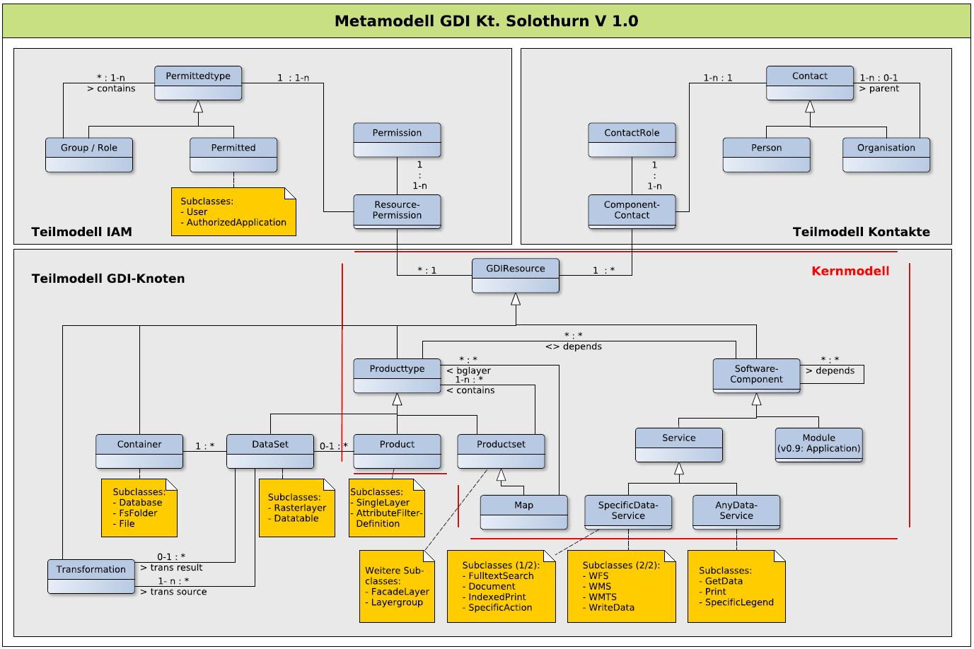

Topics
Use Case 1: INTERLIS for exchanging and aggregating (geo-)data
Use Case 2: INTERLIS in the context of the model-driven approach
Open Source GIS versus proprietary GIS software
Notes:
I prepared 2 use cases which shows the use and the success of INTERLIS in our canton. And I really think it is a success story since at the end of the day we really are more efficient and the quality of the geodata is higher than ever before. I try not to focus on technical details but still I have to mention some technical stuff. For the technical stuff: I’m here the full week, so we have plenty of time.
1) Use case 1 shows actually the original use of INTERLIS in the context of cadastral surveying. We – the department of geoinformation – are collection all the cadastral surveying data from the private offices and are aggregating them (after a quality control) in our database and are providing these data to our internal and external users and customers. We do this since circa 1999.
2) The second use case is not that old: The focus here is not aggregating data from different offices but data acquisition in our very own cantonal departments like the department of enviromnemt or department for land use planning. We decided to use the model-driven approach for this. This means it all starts with the conceptual modelling and let the INTERLIS tools steer the machines, e.g. like create table in the database.
3) Lorenz asked me also to tell you something how we decided to take the open source road instead of using the common proprietary GIS systems. So I’m gonna tell you something about the long and sometimes also hard road we took. But I can promise: It’s worth the effort.

Slide 3


SELECT * FROM me;
Stefan Ziegler
Head of Department of Geoinformation (Canton Solothurn)
Supervisor of licensed surveyors
INTERLIS addict
@edigonzales
git.sogeo.services/stefan
Notes:
First: please allow me to introduce myself. You need and want to know who is standing in front of you.
My name ist Stefan Ziegler. I’m the head of the department of geoinformation and the supervisor of the 5 licensed surveyors in our canton which are working in a private company and: I guess I'm a bit an INTERLIS adddict which is also the reason I’m here.

Slide 4
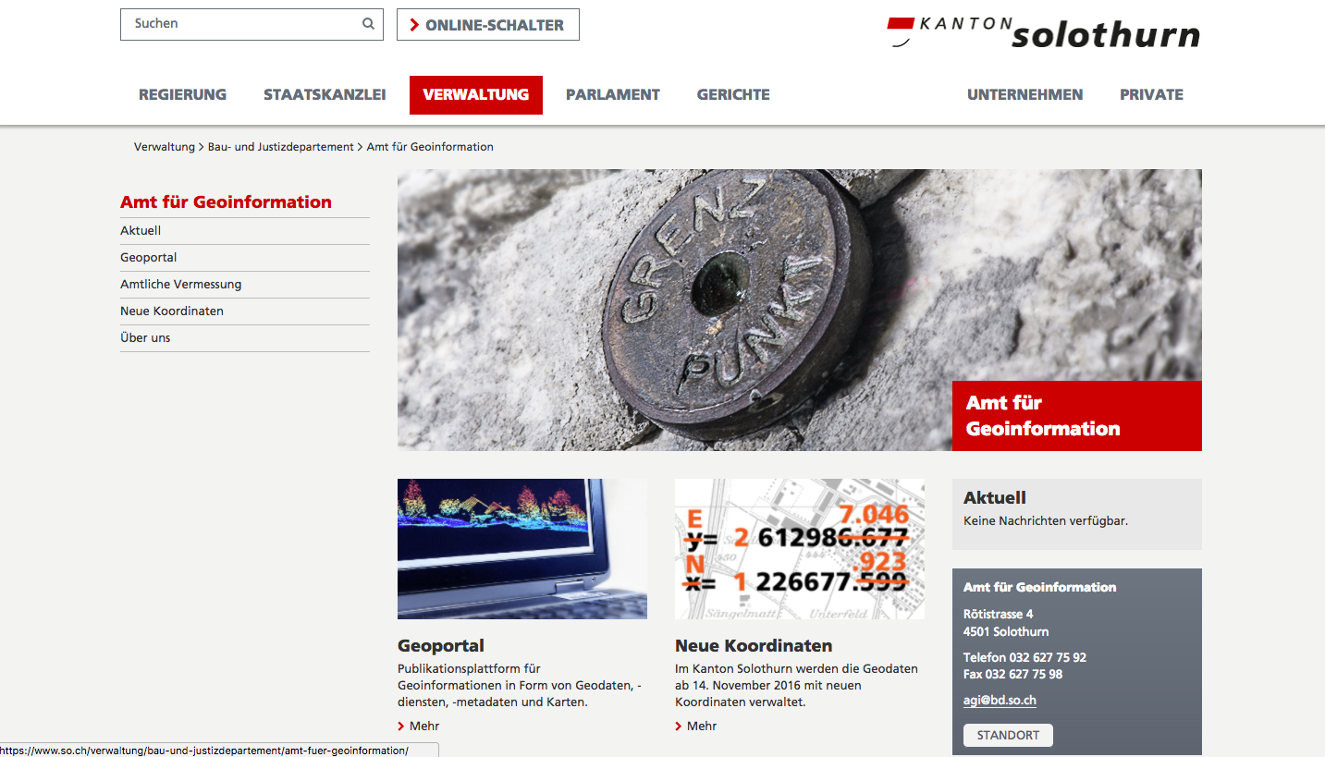
Department of Geoinformation
11 employees
Supervision of the (private) licensed surveyors
Responsible for high level reference points (count approx. 550)
Operator of the cantonal geodata infrastructure (WebGIS, QGIS, PostGIS)
GIS analysis
Consulting
Development of specific application (e.g. QGIS plugin)
Training
Notes:
Let me tell also something about the department I'm working for.
We are 11 employees. We are responsible for the supervision of the private licensed surveyors. We do not a lot of surveying by ourselves. The only thing we do: we are responsible for the high level reference points in the canton (approx. 550 points).
We are the operator of the cantonal geodata infrastructure, mainly a webgis, QGIS and postgis.
We do some GIS analysis for other departments if they don’t have time or the know how.
We do some GIS consulting.
Then for years we did a lot of developing of specific application like QGIS plugins. We noticed now that we have to invest in our know how since we lost the track here a bit.
And last but not least: we do train our internal users.

Slide 5
Caso de Uso 1

Slide 6
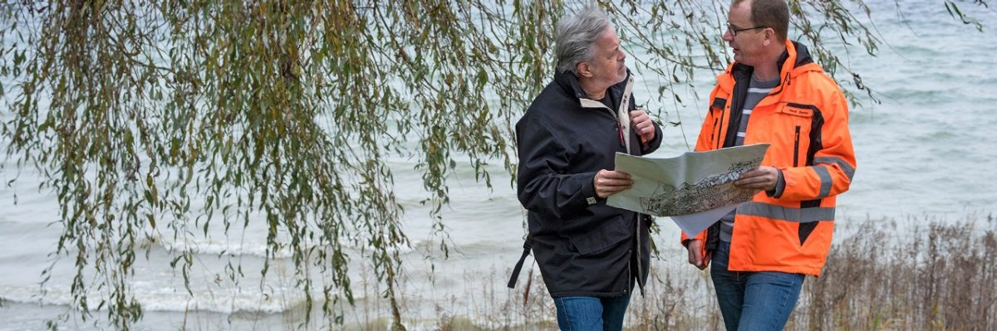
Organization of Cadastral Surveying
Notes:
Cadastral Surveying is not a task that is done by one authority. But different authorities on different levels are involved:
The Federation
The Cantons
And the municipalities and/or private licensed surveyors.

Slide 7
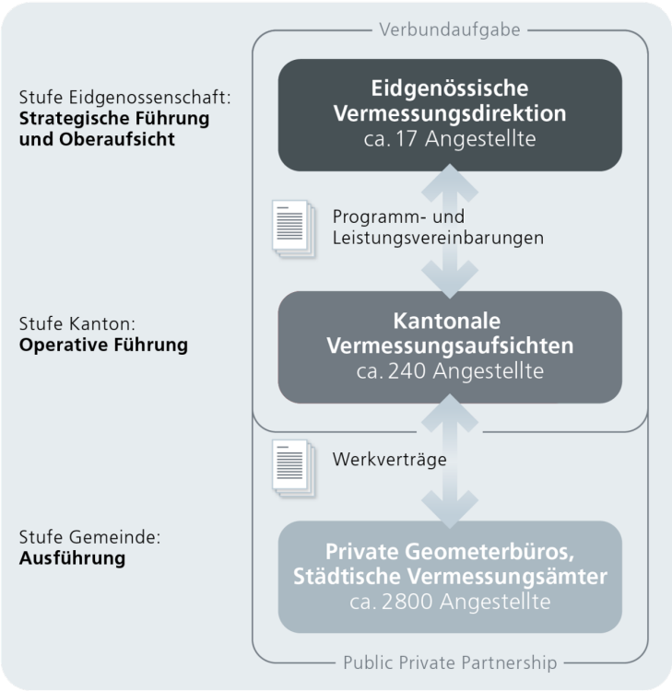
Organization of Cadastral Surveying
Federation
Canton
Municipality / Private companies
Notes:
First, let me tell you something about the organization of the cadastral surveying. Since it is written in a federal act there is federal department (approx 17 employees) with a task called “Oberaufsicht”. Means something like Super-supervisioning. The execution of the cadastral surveying is delegated to the cantons. The cantons again can do it on their own or delegate it further. Most of the cantons delegate it to private companies. So do we. We have 109 municipalities and 5 private companies with a licensed surveyor in each company.

Slide 8
Content of Cadastral Surveying
Control Points
Land Coverage
Single Objects
Heights
Local Names
Parties?
Parcels and Rights
Pipelines
Territorial Boundaries
Soil Movements
Building Addresses
Administrative Classification
Notes:
The data model of the cadastral surveying covers not only parcels and rights (that have a geometry) but also 10 other topics, like:
Control reference points
Land coverage
Heights
Local Names
Territorial boundaries
Addresses
But NO owners or parties are stored in this data set. The names of the owners are only in the land registry data set.

Slide 9
Land Registry
Cadastral Surveying
Federation
Federation
INTERLIS
Land Registry
Canton
INTERLIS
Advocate
Private Company
Notes:
Let’s go on the use case 1:
To show you where INTERLIS is used and the real benefits of it, I have to show and explain you the data flow in the cadastral surveying and land registry. These two parties – in switzerland – are quite seperated. Especially it is not ONE data set with both information. You have one data set whith the geometry of the parcels. And one data set with all the rights and owners.
Kinda special in canton Solothurn: the advocate who writes the contract is not a private advocate but an employee of the canton. So the land registry and the advocate are quite close.
There are two interesting data flows:
1) The licensed surveyor sends every week or after some changes in the municipality the whole data set to the canton. We also send these data sets to the federation.

Slide 10
Canton
FTP
valid
Validate dataset
not valid
FTP
Email
Private Company
Notes:
Let’s take a close look:
The licensed surveyor uploads by FTP the INTERLIS file on an INTERLIS check service (which is run by a private company). If the file is valid, it is stored in a directory on the server. If it is not valid the surveyor receives an email with the error messages which shows him what is wrong so he can fix it.
Once a day we – the canton – are downloading all files stored on the check service server and are importing them in our database. With the process we have really recent data for all our users.

Slide 11

INTERLIS benefits #1
Validation of data is effortlessly possible. Effortless = by a machine.
Aggregation of 100+ single data sets in one single database is effortlessly possible.
Data quality and the awareness of quality raised dramatically in the last 18 years.
Specific process runs 24/7 since 2006. Maintenance is minimal. Human resources can be used for other projects!
Notes:
Let’s sum up some of the INTERLIS benefits here:
It is effortlessly possible to validate the data which is acquired by private companies. And effortless means that the validation can be done by a machine.
The aggregation of the 100 and more single data sets in one single data base is also effortlessly possible.
The data quality and even the awareness of the data quality raised dramatically in the last 18 years.
This specific process runs 24/7 since 2006 and the maintenance is minimal.
All this would not be possible if we don’t use INTERLIS. We would not be able to check the data against a common data model neither to aggregate the data so easy. And I’m also sure that the data quality would be worse.
But let me be clear and honest: for collecting the data, it is not sufficient to have an INTERLIS data model but you really need manuals and guidelines that regulate a lot of stuff like when is a building a building etc.

Slide 12
Land Registry
Cadastral Surveying
Federation
Federation
INTERLIS
Land Registry
Canton
1. INTERLIS
109 * INTERLIS
Advocate
Private Company
2. Email
Notes:
I told you about two interesting data flows before. Let‘s look at the second one. This one is kinda new for us and has a funny name in german „Kleine Schnittstelle“ which means „small interface“.
The first one was about the whole data set. The second one is focused on a single deal / transaction.
When it comes to a business where a licensed surveyor is needed, like dividing a parcel. The surveyor does his job and he sends the needed documents on paper to the land registry and advocate.
This document is called „Mutationsplan und –tabelle“.

Slide 13
Notes:
In this example the parcel 1948 is divided and a new one is created (no 2711). The red line indicates the new border and red means that that deal / transaction is not yet signed by all the parties and is not yet in the land register.
The fun part is the table or matrix. It tells us the calculations between the old and new parcels. How man square meters from the old parcel is now in the new one. This example is really simple since only one old parcel is involved. But it can get easily very difficult if a long street is involved.
Until now the employee in the land register was typewriting these numbers from the analog document into the land register database. But from now on the licensed surveyor is sending also an INTERLIS file which can be easily imported. The plan is sent as PDF. At the moment it is still required to send also the analog document because there is no digital signature yet.
The process itself is similar to the one before. The land surveyor sends the INTERLIS file to the check service and the land register software downloads valid data every 5 minutes the files and imports them into the land register database. If the deal / transaction is done (all parties have signed contracts etc.) the licensed surveyor receives an email that he can commit that transaction also in his data. And the red line will get black.

Slide 14
INTERLIS benefits #2
No more discrepancies between cadastral surveying and the land register.
Legal certainty!!!
Notes:
Again what are the benefits of INTERLIS here?
I almost do not dare to say but we had a lot of discrepancies between the cadastral surveying and the land register. This means we had parcels which existed in the data of the cadastral surveying and vice versa. And this is soooo uncool! And you cannot start this process if the two data sets matches each other.
And therefore just two words: Legal certainty.

Slide 15
Caso de Uso 2
Notes:
Let’s move on the second use case. This use case does not focus on the aggregation single datasets into one database but focuses more on the so called model-driven approach. That means especially formalizing processes (that a machine can do most of the tasks, that can be delegated to a machine) and debating / arguing about the employees / customer needs.

Slide 16
SDI Canton Solothurn
Notes:
As a introduction, I have to show how just a very very simplified sketch of how the architecture of our spatial data infrastructure of the canton looks like. We have a centralized postgresql/postgis database and several different clients that read and write data from and to the database. Every employee can have data in our database and he can read the data and write new data / records to it.

Slide 17
Data acquisition before MDA
Employee XY: “Hi Department of Geoinformation, I need some new tables in the database. Can you create these tables for me in the database?”
Dep. of Geoinformation: “Sure. We do this for you.”
After hanging up the phone:
CREATE TABLE arp_nutzungsvereinbarung.projekt AS …
Notes:
Until now when some employee of department has a project and in this project he needs to capture some data for e.g. publishing on a map, he calls us and asks for some new tables in the database.
After hanging up the phone, we just create these tables.

Slide 18
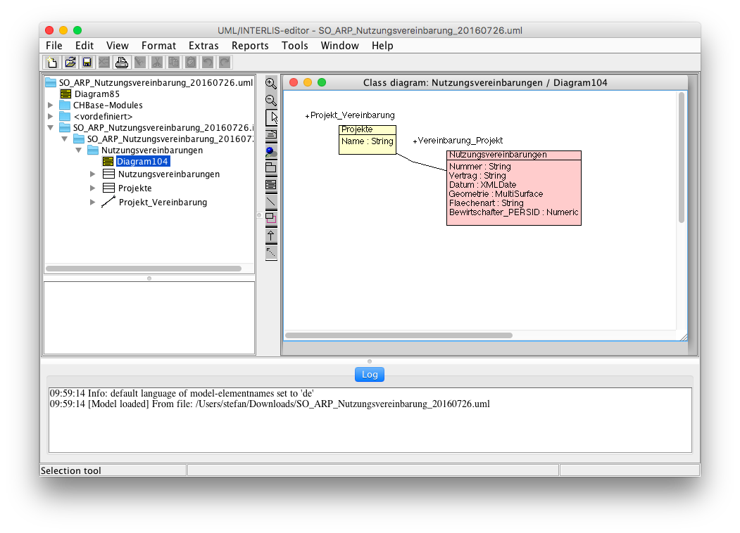
Data acquisition after MDA
Notes:
Since almost a year we changed this process. Before creating the tables in the database, we create an INTERLIS data model together with the employee of the department. This has some advantages over the old process:
Since it’s a corporate process and a formalized process the employee has the think about of what he really wants and needs.

Slide 19
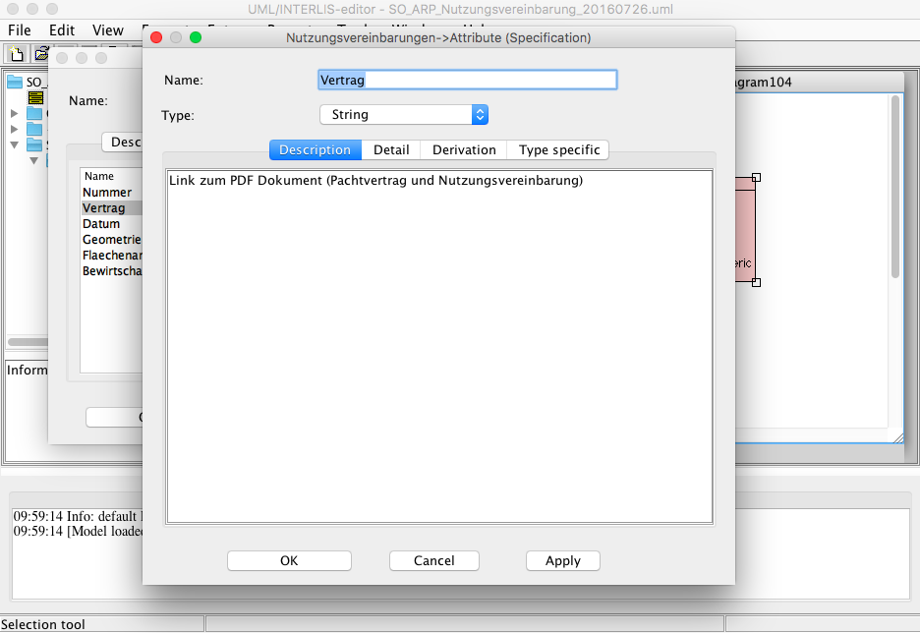
Notes:
The data model has to be and can be easily documented in itself by adding comments.

Slide 20
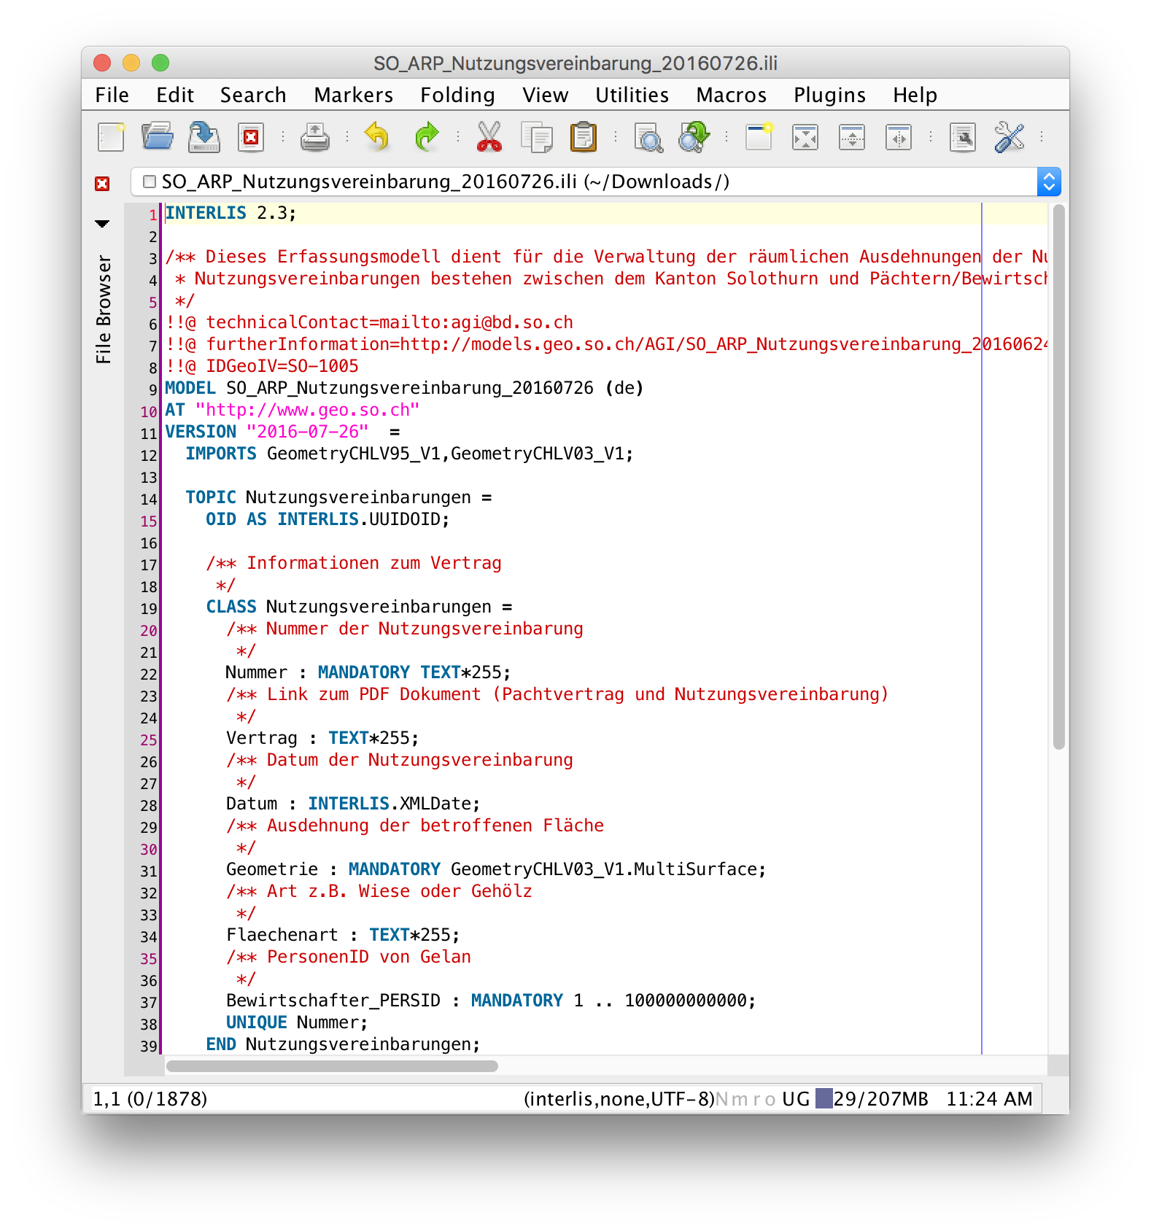
Notes:
These comments are available throughout the whole process. In the INTERLIS data model file of course.

Slide 21
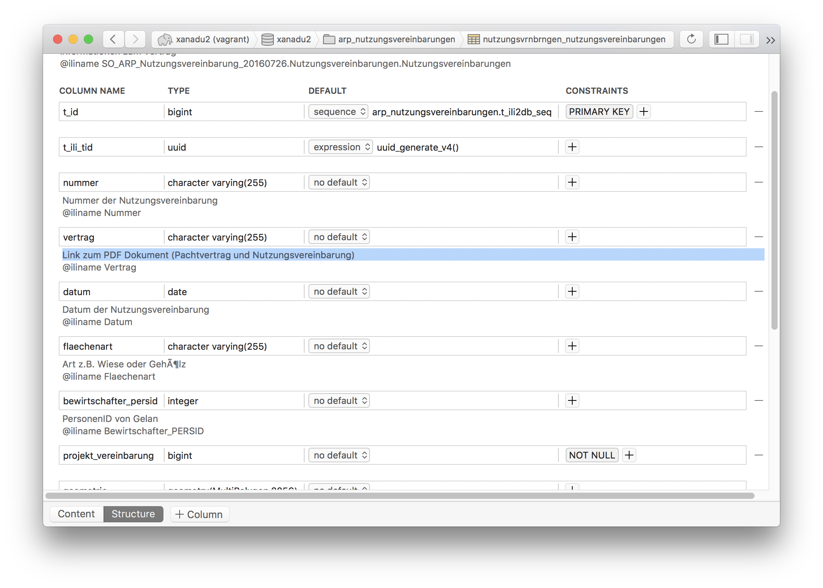
Notes:
In the database after importing the model.
And since there is a whole ecosystem of tools for the process chain, these tasks can be easily adopted and can and will be done always the same way.

Slide 22
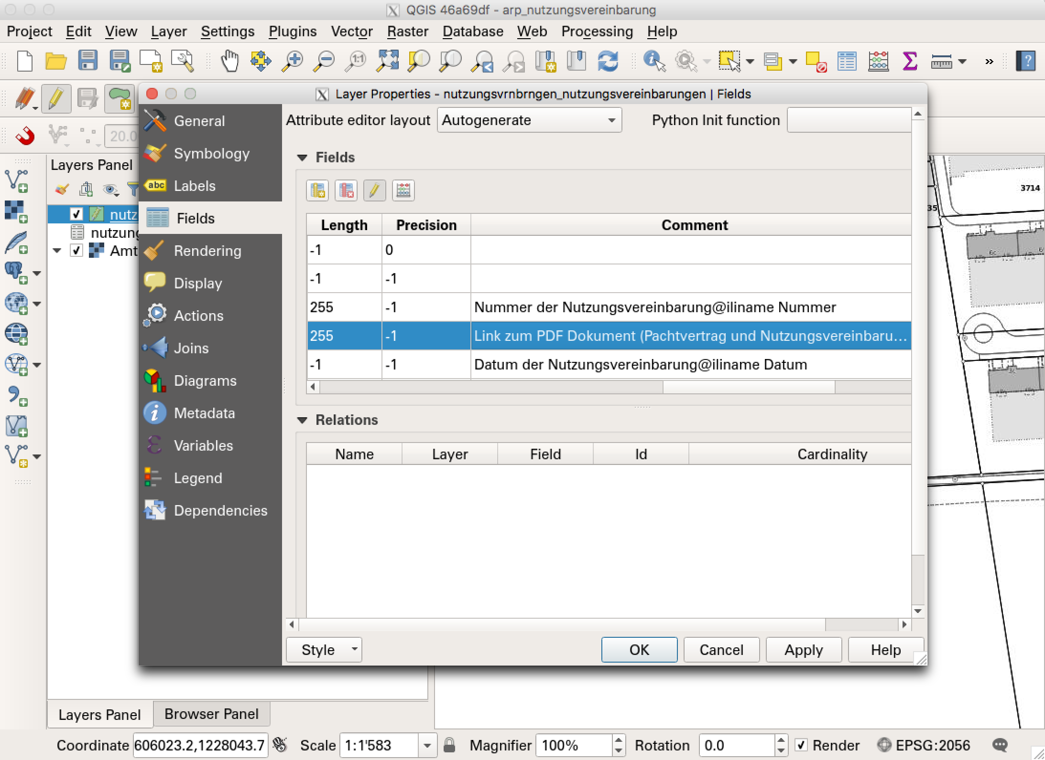
Notes:
The comments can also be found in the layer properties in QGIS.

Slide 23
INTERLIS benefits #3
Better data models / structured data.
Better and faster documented data schemas / models in the database.
Formalized and machine-to-machine processes.
Easy data validation
Notes:
What are the benefits:
First of all. Better data models. Since the customer had to think about what he really wants.
The documentation is really better and has to be done only once and therefore faster.
The processes are formalized and thanks to e whole ecosystem of INTERLIS tools the these processes can be done by a machine. This helps to understand all the corresponding tasks better, e.g. when you have to instruct new employees.
You also get the possibility to validate the data against the data model. Which is also a plus

Slide 25

Notes:
In the last topic, let me tell you something about why we use heavily open source software.

Slide 26
Open Source in Canton Solothurn
Parliament decided to change from Windows to Linux (2001)
Main reason: save money
GIS: ArcGIS was not available for Linux. Look out for (open source) alternatives which run on Linux.
Few years later:
Mission aborted
Notes:
The parliament decided to change from Windows to Linux in the year of 2001. The main reason was to save money.
At this time we used ArcGIS. Which was not available for Linux. So we had to look out for alternatives.
Few years later, the canton decided to abort this mission and move back to Windows. Why: It was just not sufficient enough for daily business. Everything was worse than before (email client, open office, pdf reader etc.).
At this time we had already invested in open source gis software and it was running quite good. So we decided not to go back to Windows and ArcGIS.

Slide 27
FOSSGIS benefits
It’s all about freedom.
Transparency.
No troubles with licensing.
Save money. But don’t think it comes at no charge (free != gratis).
Notes:
What are the benefits from my personal point of view:
It’s all about freedom. I can do whatever I want with the software. If I have a missing feature I can let it develop or develop it myself. I can choose the developer. I can choose the time when it should be develop etc.
And it is also transparent b/c you can watch the code. No more excuses from the developer which you don’t believe.
What is really cool: you don’t have no troubles with all this licensing stuff. Either you paying to much or you have to less licenses or you have troubles with a licensing server.
And last but no least: I still think you can save money. But please do not think comes at no charge. There is a famous saying: Free as in free speech. Not as in free beer.

