Slide 1


Biological Databases Bibliographic Databases Day 1 - MEDLINE
Reagon Karki

Slide 2
Outline
Introduction
MEDLINE
Concepts
Search Engines over MEDLINE
PubMed
Europe PMC
SCAIView
Demos
Notes:
22718609

Slide 3
Introduction
Bibliographic database is an organized digital collection of references and citations of published literature
Sources: Journal articles, scientific reports, books, patents, etc.
Contents are indexed with controlled vocabulary for speeding up search results and retrieving relevant citations
Notes:
22718609

Slide 4
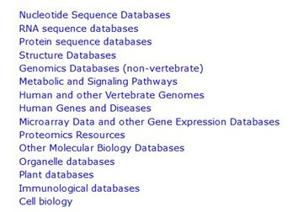
MEDLINE
Scientific reports
Journals
Books
Patents
MEDLINE

Slide 5
MEDLINE
Bibliographic database of U.S. National Library of Medicine (NLM).
Is a database of life-sciences and biomedical information.
Includes several fields such as medicine, nursing, biochemistry, pharmacy, dentistry, health care, marine biology, plant and animal science.
It contains 25 million references/citations from about 5200 journals worldwide.
Selection criteria is based on the recommendation by the Literature Selection Technical Review Committee (LSTRC).
Since 2010, about 93% of citations are in English and 85% have English abstracts.

Slide 6
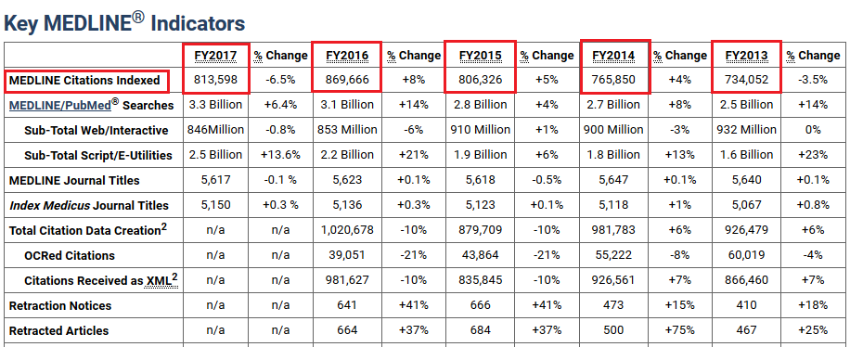
MEDLINE
Distinctive feature: The records are indexed with NLM’s Medical Subject Headings (MeSH) to assist users for information retrieval.

Slide 7
Concepts
Controlled Vocabulary: It is an organized list of words/phrases used to index content and to retrieve content through browsing or searching.
This list is controlled and made available by a controlled vocabulary registration authority.
All terms in a controlled vocabulary should have an unambiguous, non-redundant definition.
If multiple terms are used to mean the same thing, one of the terms is identified as the preferred term in the controlled vocabulary and the other terms are listed as synonyms or aliases. For example: Alzheimer, Alzheimer’s Disease, Alzheimer disease and AD
If the same term is used to mean different concepts, then its name is explicitly qualified to resolve this ambiguity.
Notes:
https://www.nlm.nih.gov/bsd/disted/video/

Slide 8
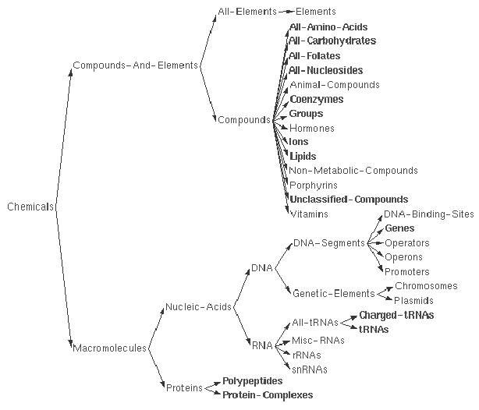
Concepts
Taxonomy: It is a collection of controlled vocabulary terms organized into a hierarchical structure. i.e. classification of entities or concepts.
Notes:
https://www.nlm.nih.gov/bsd/disted/video/

Slide 9
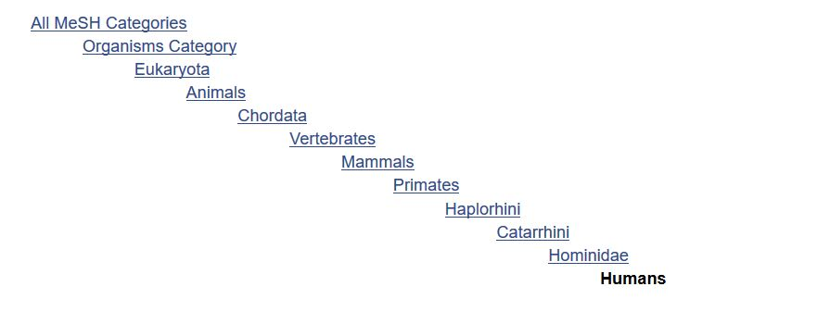
Concepts
Thesaurus: It is a networked collection of controlled vocabulary terms grouped together according to their similarity of meaning.
MeSH: It is NLM’s hierarchically structured controlled vocabulary used to index MEDLINE articles. https://www.nlm.nih.gov/bsd/disted/video
Notes:
https://www.nlm.nih.gov/bsd/disted/video/

Slide 10
Concepts
Ontology: It is a controlled vocabulary used to describe concepts, properties and attributes of concepts of a certain domain of interest.
How is it different from MeSH?
MeSH is an outcome of controlled vocabulary and taxonomy
MeSH represents general biology
Ontologies are domain specific
Gene Ontology
Disease Ontology (Demo)

Slide 11
NCBI’s PubMed
Is a search engine based on MEDLINE.
MEDLINE is a primary component of PubMed.
PubMed can be searched using MeSH terms, author names, title words, text words or phrases, journal names, or any combination of these.
Retrieves you abstract.
Each citation in MEDLINE has an unique PubMeD identification number.
Provides links to full-text articles found in PubMed Central (PMC) or at publisher web sites, and other related resources.
PMC is a free full-text archive of biomedical and life sciences journal literature.
Notes:
26921134
15647377

Slide 12
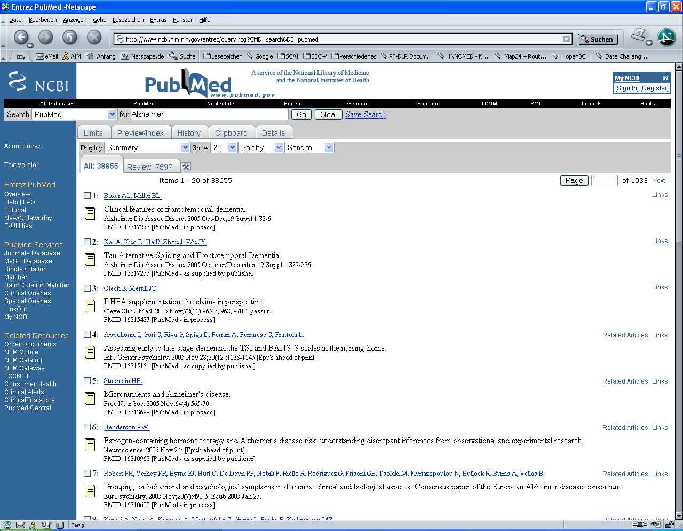
DEMO
2006
Notes:
https://www.nlm.nih.gov/bsd/disted/video/

Slide 13
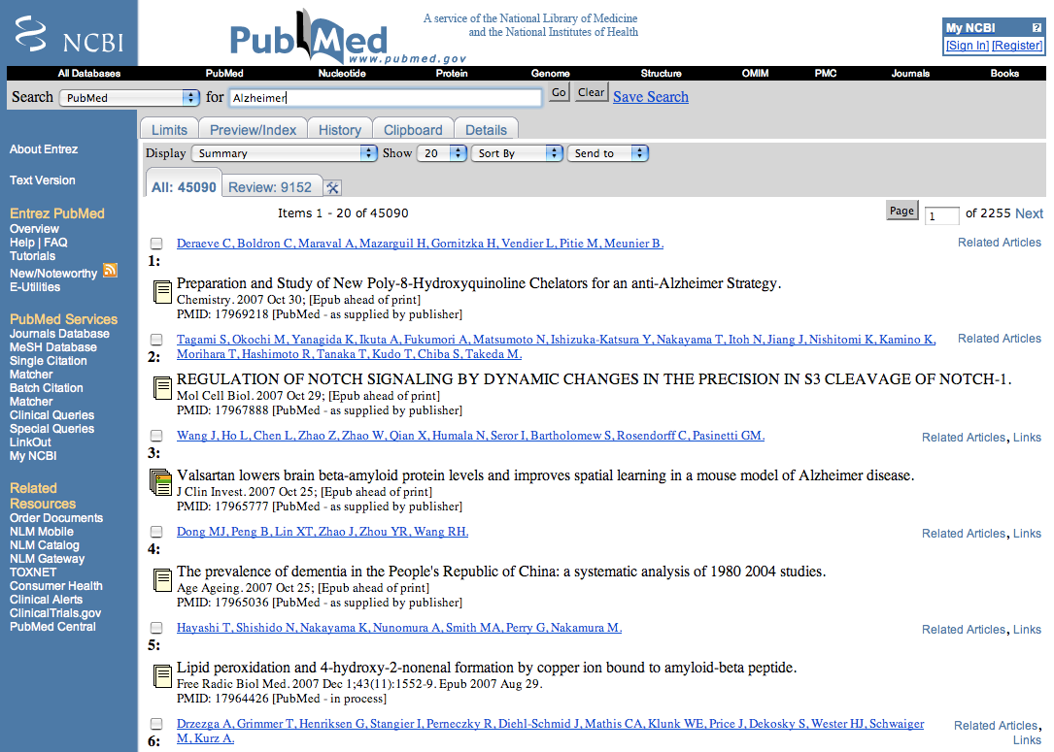
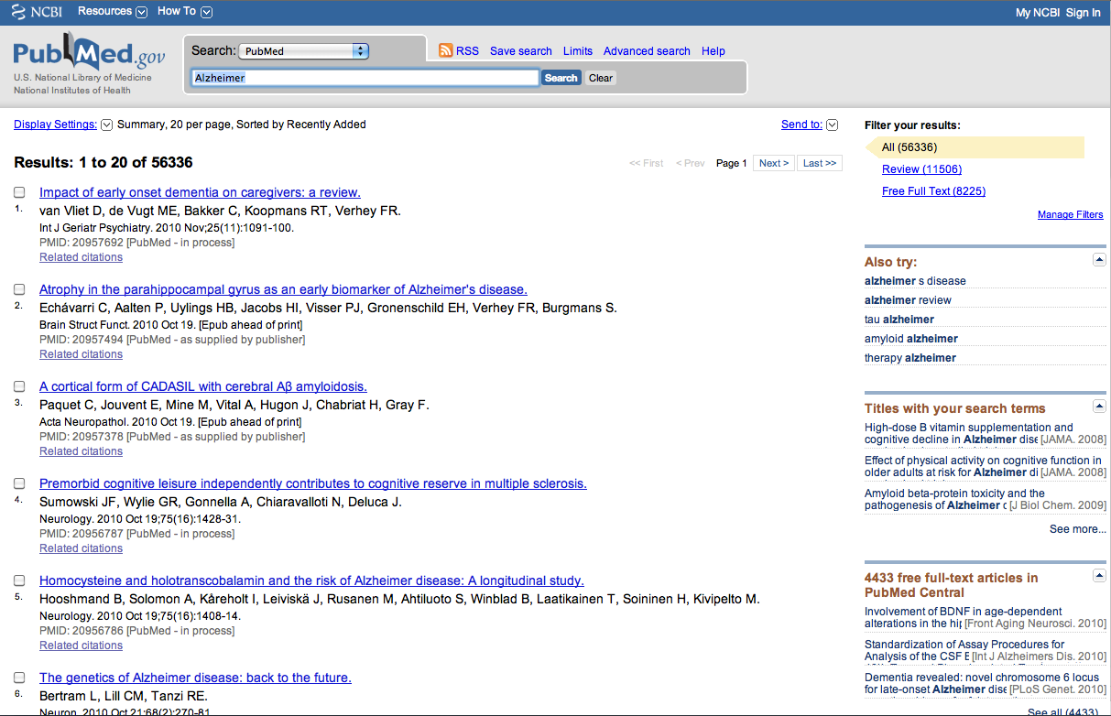
DEMO
2010
Notes:
https://www.nlm.nih.gov/bsd/disted/video/

Slide 14
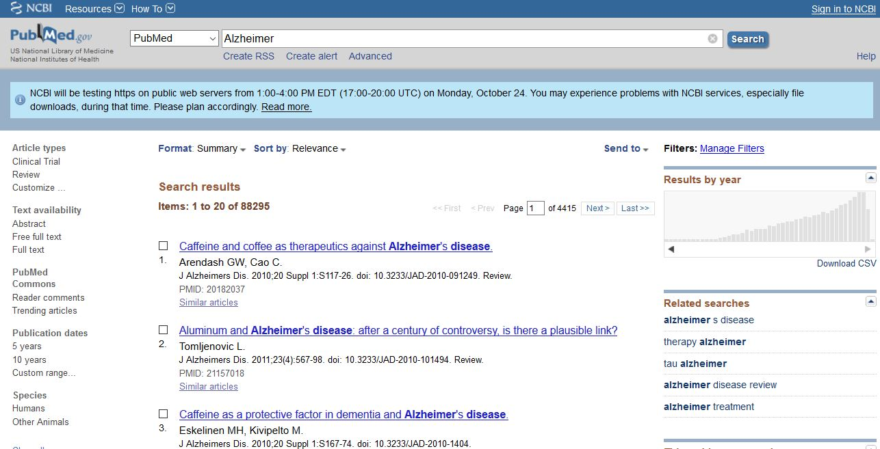
2016
Last accessed: 24.10.2016
Notes:
https://www.nlm.nih.gov/bsd/disted/video/

Slide 15
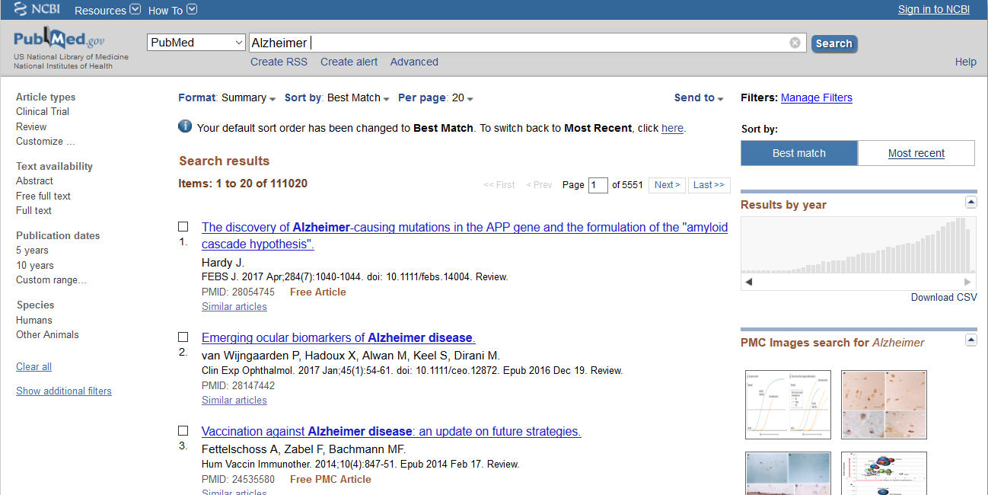
Last accessed: 17.12.2018
2018
Notes:
https://www.nlm.nih.gov/bsd/disted/video/

Slide 16
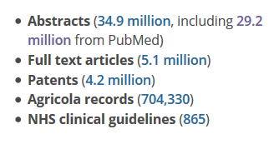
EMBL/EBI’s Europe PMC
A database to search the worldwide life sciences literature
Similar to PubMed
5 million more abstracts
Additionally contains Patents, NHS (National Health Service) guidelines, Agricola records, PhD theses….
http://europepmc.org/

Slide 17
Europe PMC
Difference between Europe PMC and PubMed?
Number of citations
Citations are not indexed using MeSH but use their own controlled vocabulary
How does the searching work?
A score is assigned to a document based on the frequency of the search term.
A weighting is also applied based on publication date, therefore newer documents are more likely to appear first in the Europe PMC (default relevance sort).

Slide 18

Notes:
DNA repair
Mitosis

