Slide 1
AI developer bootcamp: Speech
James Carpinter
CTO, Zarmada | Microsoft Regional Director
james@zarmada.com | @jamescarpinter

Slide 2
How do I interact with my users using speech instead of text?
How do I recognize my users’ voices?
Language
Dynamics 365
Skype
Knowledge
Speech
Browser
Azure Bot Service
Cognitive Services
Vision
Cortana
Web
Azure ML
Cognitive Toolkit

Slide 3




Bing Speech
Speaker Recognition
Translator (Speech)
Custom Speech

Slide 4
Bing Speech
Speaker Recognition
Translator (Speech)
Custom Speech

Slide 5
Bing Speech
Transcribe speech-to-text (STT) or generate speech from text (TTS, or text-to-speech)
STT supports 29 languages, TTS supports 42 languages
Either: PCM single channel at 16kHz with 16 bits per sample or OPUS
Provides partial translations and confidence levels
Cross-platform
REST, WS, C# client, C# server, JS, iOS, Java
Low latency
Sub-second after last byte received
Detailed responses
Lexical, ITN, Masked ITN, Display form
Multiple TTS voices
Including different genders (for some locales)

Slide 6
Bing Speech: Modes
Interactive
Command and control style for user apps; expects short phrases
Dictation
Continuous recognition; longer sentences with a more formal style
Conversation*
Transcribe interactions between humans; less formal and mixture of short & long sentences

Slide 7
Bing Speech: Endpoints
 | REST API | Websocket API
Speech hypotheses
Continuous recognition
Maximum audio input | 15 seconds | 10 minutes
Speech end detection

Slide 8
Bing Speech: Endpoints
var r = new HttpRequestMessage(HttpMethod.Post, "https://speech.platform.bing.com/...");
r.Headers.Authorization = new AuthenticationHeaderValue("Bearer", token);
r.Headers.TransferEncodingChunked = true;
r.Content = new ByteArrayContent(stream.ToArray());
r.Content.Headers.ContentType = MediaTypeHeaderValue.Parse("audio/wav; codec=\"audio/...
var response = await Client.SendAsync(request);
REST (or WS)
var client = SpeechRecognitionServiceFactory.CreateDataClient(..., uri);
client.OnResponseReceived += (s, e) => ...
client.OnPartialResponseReceived += (s, e) => ...
client.SendAudio(buffer, buffer.Length);
Client
var client = new SpeechClient(new Preferences(..., uri, ...));
client.SubscribeToRecognitionResult += (args) => ...
await client.RecognizeAsync(new SpeechInput(stream, requestMetadata), ...);
Server

Slide 9
Bing Speech
Speaker Recognition
Translator (Speech)
Custom Speech

Slide 10
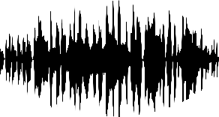

Translator (Speech)
Cloud-based open API service: send voice, receive text (and, optionally, translated TTS)
Optimized for conversations
Only supports WebSockets
Enables real-time scenarios like Skype Translator
Supports 11 languages
Also supports partial results
Pay per hour (tiered model)
Client app
Cet outil de traduction est un moyen facile d'étendre la portée de vos contenus internes et externes.
WEB API

Slide 11

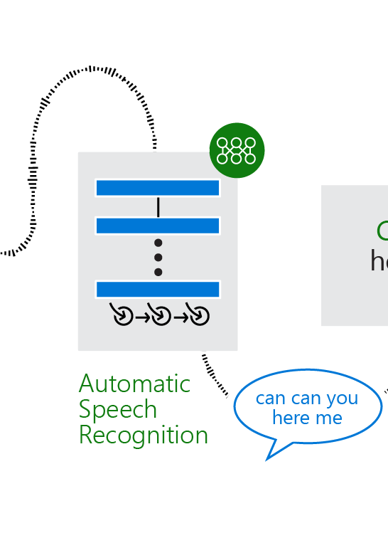
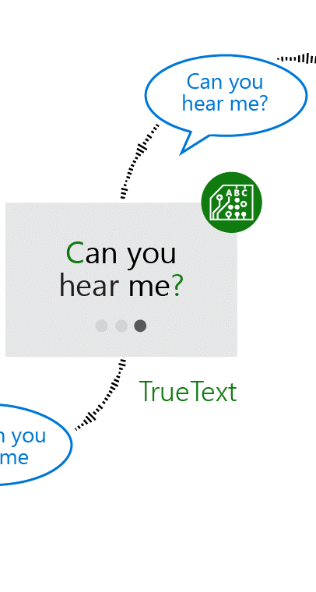




Translator (Speech)

Slide 12
Translator (Speech): Speech Correction
`
um non je veux dire oui, mais je suis je n'ai jamais fait moi-même les utilisateurs avant e UH .je vais demander aller profondément pour m'aider
um no i mean yes but i am i've never done it myself did users before uh I will ask go deep to help me
Raw ASR Output
Speech Recognition
um no i mean yes but i am i've never done it myself did you use yours before uh I will ask gurdeep to help me
Lattice Rescoring
Same translation system, major output difference
TrueText
Speech Correction
Translation
no i mean yes but I am i've never done it myself did you use yours before uh I will ask gurdeep to help me
Text to Speech
Disfluency Removal
Yes.
But I’ve never done it myself.
Did you use yours before?
I will ask Gurdeep to help me.
Oui.
Mais je ne l'ai jamais fait moi-même.
Avez-vous utilisé le vôtre avant?
Je vais demander à Gurdeep de m'aider
Segmentation Punctuation and True Casing

Slide 13
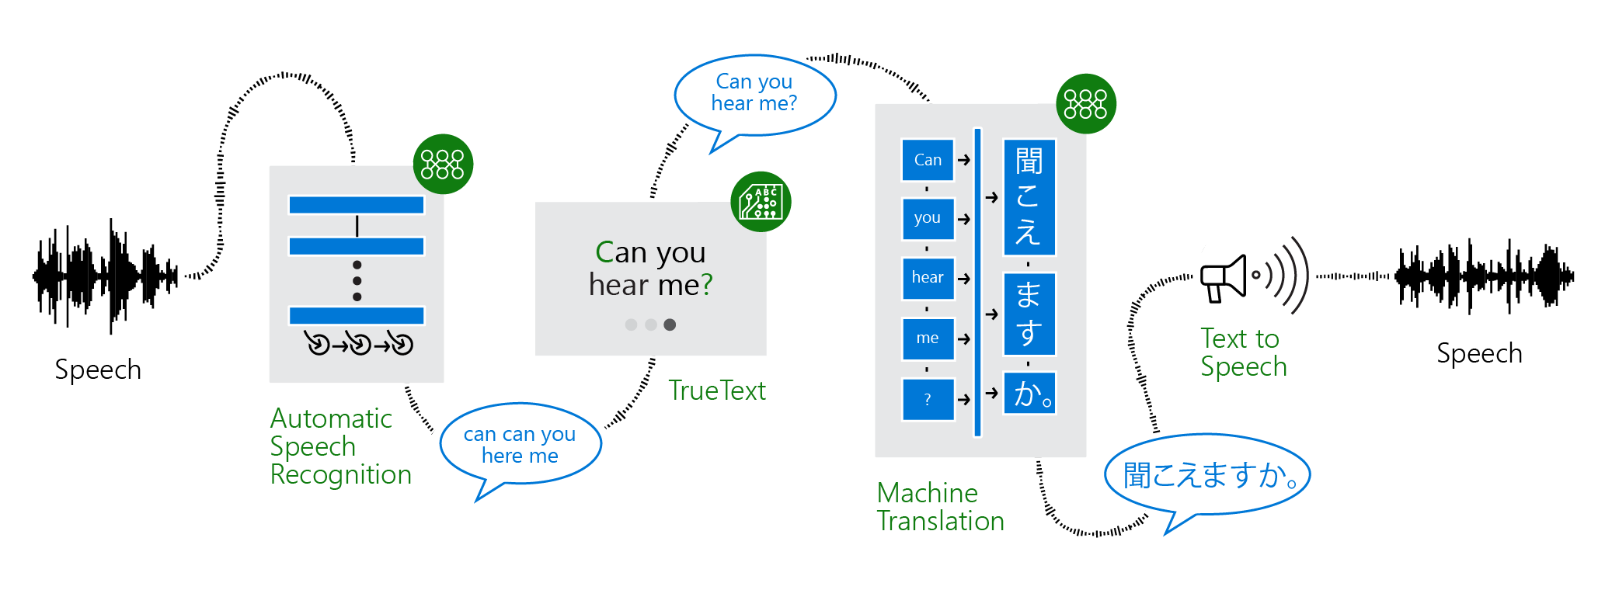
Translator (Speech)

Slide 14
Translator (Speech)
All 60+ supported language for text translation (output)
10 supported languages for speech recognition (input)
All 18 supported language for text translation (output)
Final Transcripts
Partial Translations
Final Translations
Partial Transcripts

Slide 15
Demo
STT & TTS

Slide 16
Bing Speech
Speaker Recognition
Translator (Speech)
Custom Speech

Slide 17
Custom Speech
Tune speech recognition to your speakers & vocabulary
API/SDK compatible with Bing Speech service (i.e. REST, WS, and SDKs)
Scale out to support required levels of concurrent requests
No logging? More $$
Supports English, Chinese, German (Spanish coming)
Language
Domain-specific vocabulary, terminology
Acoustics
Noise conditions, accents, age
Acronyms
Map spoken (b. b. eight) to display (BB8)
Base models
Build on conversation or dictation

Slide 18
Custom Speech
1. Prepare
Language models require training phrases
Acoustic models require transcribed audio recordings
Acronyms trained with spoken & display forms
2. Upload
Submit files to the CRIS portal for processing (audio can be zipped)
3. Train
Select base acoustic + language models and the uploaded data sets (language and/or acoustic)
4. Evaluate
Run acoustic data sets against the new model to determine word error rate
5. Deploy
Create endpoints based on selected acoustic and language models
Update app code to use new endpoints
Scale as required

Slide 19
Custom Speech: Endpoints
var r = new HttpRequestMessage(HttpMethod.Post, "https://79e069e2b9654768a9aa...");
r.Headers.Authorization = new AuthenticationHeaderValue("Bearer", token);
r.Headers.TransferEncodingChunked = true;
r.Content = new ByteArrayContent(stream.ToArray());
r.Content.Headers.ContentType = MediaTypeHeaderValue.Parse("audio/wav; codec=\"audio/...
var response = await Client.SendAsync(request);
REST
var client = SpeechRecognitionServiceFactory.CreateDataClient(..., uri);
client.AuthenticationUri = tokenUri;
client.OnResponseReceived += (s, e) => ...
client.OnPartialResponseReceived += (s, e) => ...
client.SendAudio(buffer, buffer.Length);
Client
var client = new SpeechClient(new Preferences(..., uri, ... tokenUri ...));
client.SubscribeToRecognitionResult += (args) => ...
await client.RecognizeAsync(new SpeechInput(stream, requestMetadata), ...);
Server

Slide 20
Demo
Custom Speech

Slide 21
Bing Speech
Speaker Recognition
Translator (Speech)
Custom Speech

Slide 22
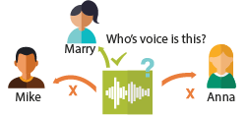
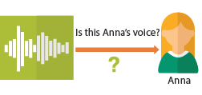
Speaker Recognition
Use unique voice characteristics to recognize a user
Supports English & Chinese
RESTful API or SDK for Windows and Android
Same audio format as STT: PCM single channel 16kHz
Limited to 1000 profiles
For authentication: keep in mind, recordings will work…
Identification
Who is speaking?
Who’s voice is this?
Mary
Mike
Anna
Verification
Check if two voices are the same
Is this Anna’s voice?
Anna

Slide 23
Speaker Recognition
1. Create Profile
Provides unique identifier for use with a specific operation
2. Create Enrollment
Train the profile for use with a specific operation
Identify: 30s – 5 min
Verify: 3x of the same verification phrase
3. Recognize
Identify: submit audio sample and a list of possible profiles (max 10)
Verify: submit audio sample of phrase and the profile

Slide 24
Demo
Speaker Verification

Slide 25
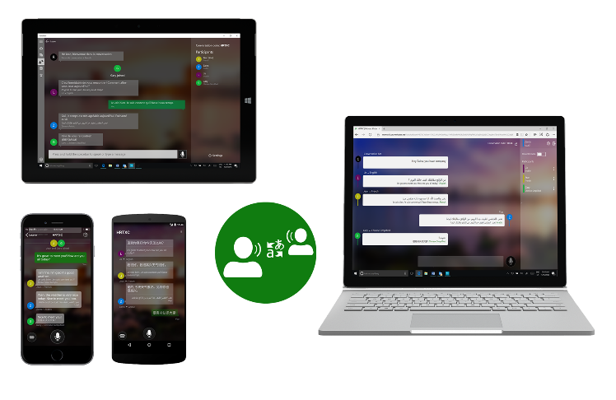
Translator: Futures
Microsoft Translator Live
“Universal translator”: multi-language interactions through personal devices
Customized speech recognition
http://translate.it
Developer access pending
Presentation Translator
Live translation and subtitling
A Microsoft Garage project built on the Microsoft Translator Live feature
Slide contents used to customize the recognition models
Regular speakers can personalize their acoustic models

Slide 26

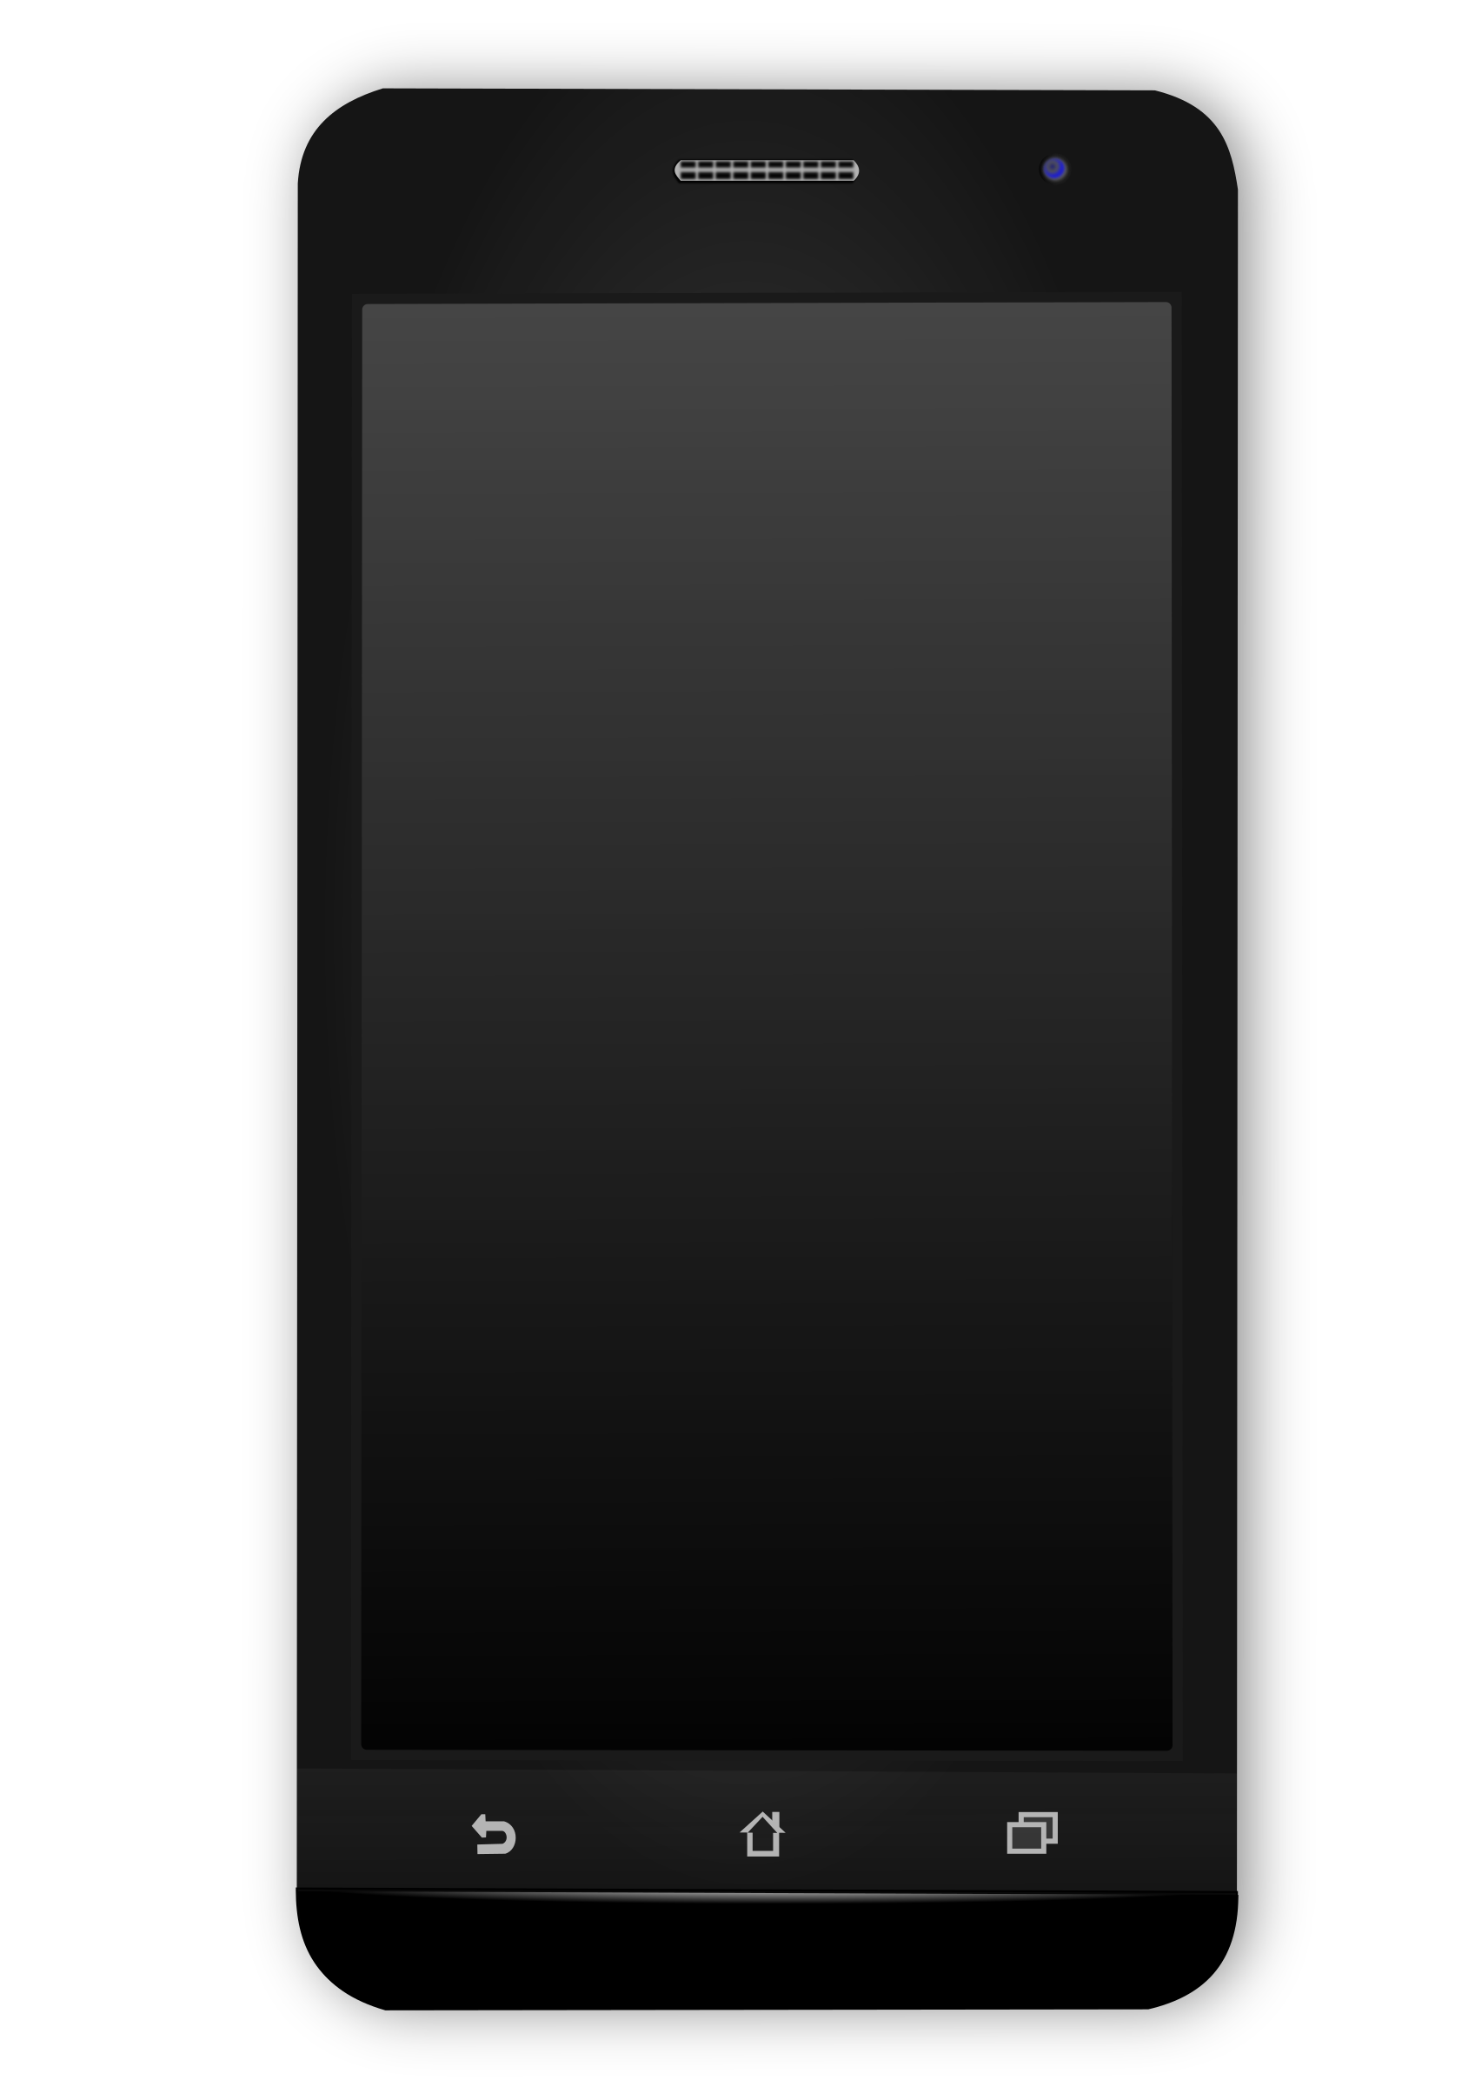
Translator: Futures
Built using technology available today in Cognitive Services:
Custom Speech
Translator
Speaker Identification
Slides
Custom Speech Service
Language Model
Custom SR Endpoint
Translator

Slide 27
What do I use then?
EASY
MODERATE
ADVANCED
Bing Speech
General purpose TTS and STT engine; broad language support
Speaker Recognition
Some training required before users can be identified/verified
Translator (Speech)
Fewer languages supported than standard Translator
Custom Speech
Requires language (easy) and/or acoustic data
(harder); not that advanced ☺

Slide 28
How do I interact with my users using speech instead of text? Bing Speech, Custom Speech
How do I recognize my users’ voices? Speaker Recognition
Language
Dynamics 365
Skype
Knowledge
Speech
Browser
Azure Bot Service
Cognitive Services
Vision
Cortana
Web
Azure ML
Cognitive Toolkit

