Slide 1
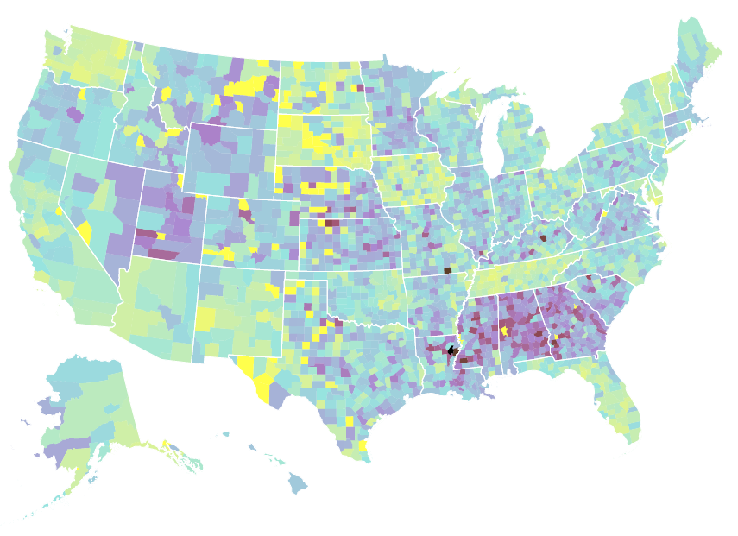

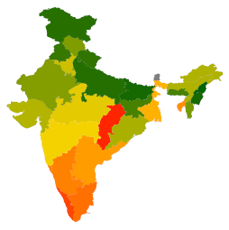
Hello.
Notes:
Hello: who I am, my interests, background, current role
--nyu, bio/math, MATLAB, public health, data viz
--mortality: how to address it
Projects:
What is the research question?
Why is the research important?
Who is asking the research question?
Where did the data come from?
How was the data collected?
What did you have to do with the data?
Visualization: here to talk about utilization of tools, not theory of visualization (Mike’s already done that)
Workflow: overview of how *data science* works irl
[questions welcome any time, also leave time for questions at the end]

Slide 2
Visualization
Theory: tool selection and tradeoffs
ggplot2: an introduction
Exercise

Slide 3
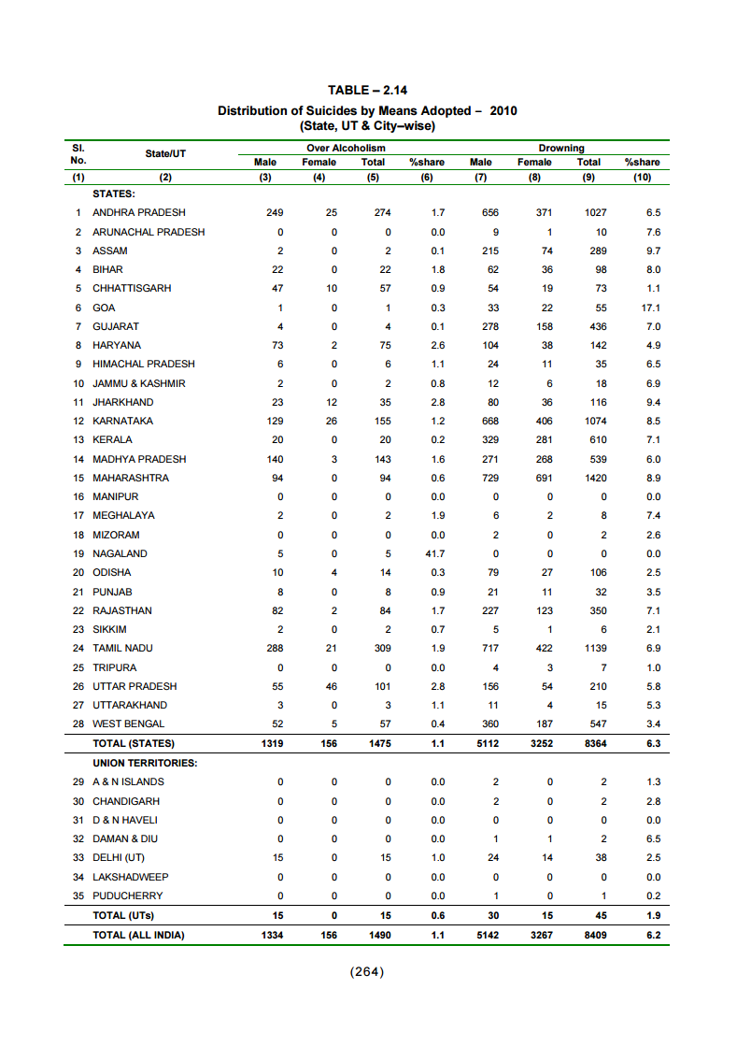
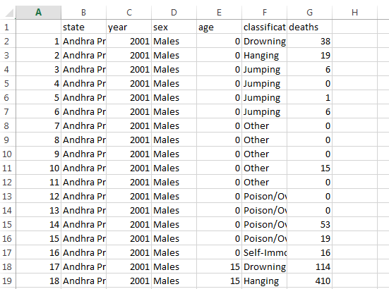
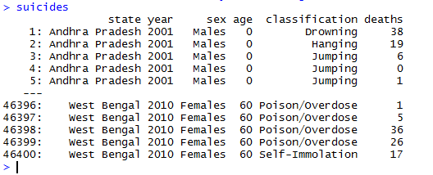
“HOW DO I VISUALIZE
THIS DATA?”
Notes:
Data can come in a wide range of formats: .rdata, .csv, .xls, hd5, .fwf, .txt, .pdf….
The question: how do I visualize this data?

Slide 4
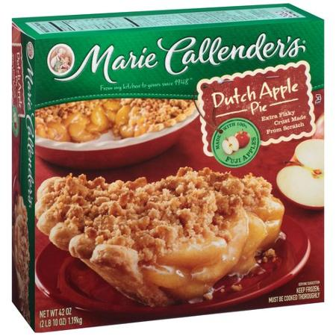
The apple pie spectrum of data visualization
Notes:
Analogous question: how do I make an apple pie?
One end of the spectrum: You go to the store and buy a frozen pie: fast, easy, low-effort
Correlate: Microsoft excel

Slide 5
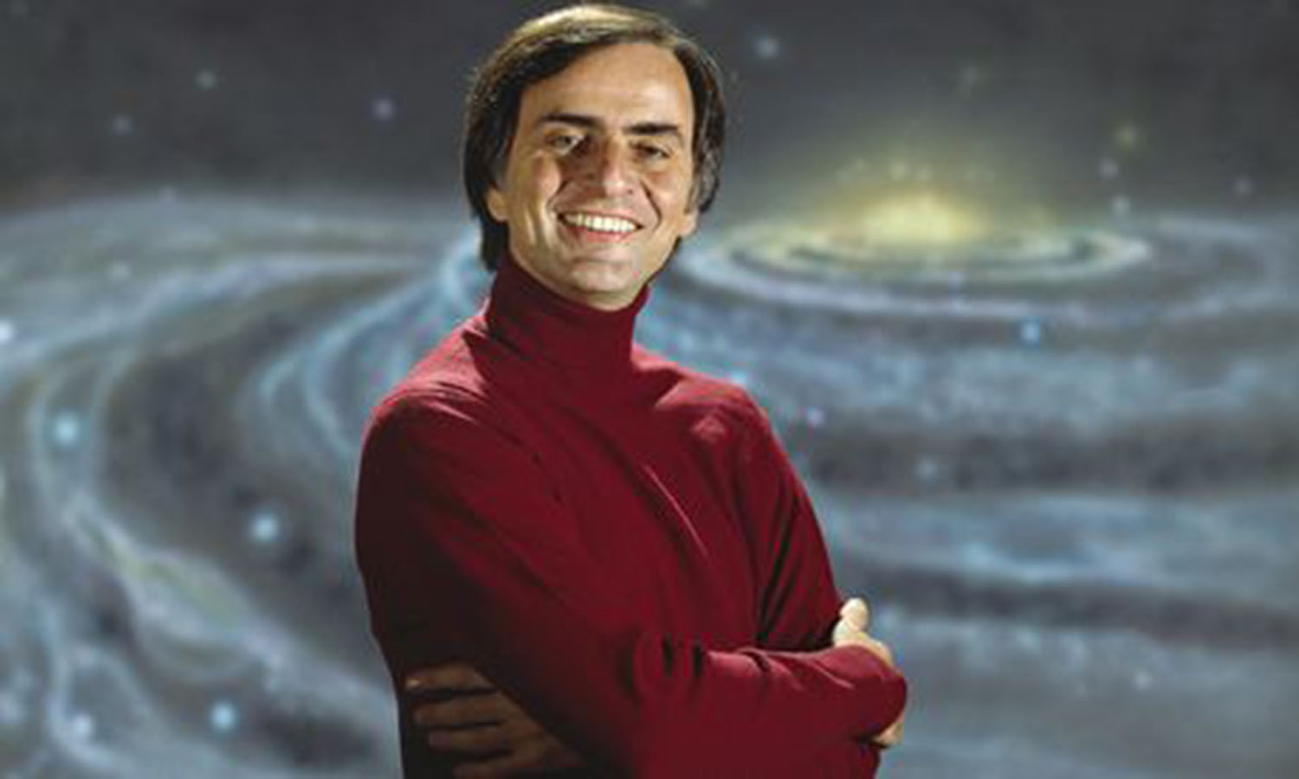
The apple pie spectrum of data visualization
Notes:
Other end of the spectrum: Carl Sagan
“If you want to bake an apple pie from scratch, you must first invent the universe”
Correlate: d3
D3 example: http://vizhub.healthdata.org/us-health-map/

Slide 6
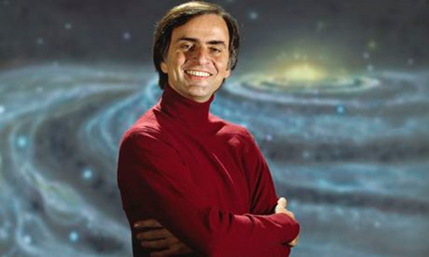
Fast
Easy
Standardized
Inflexible
Hard to automate
You can do anything
You have to do everything
Notes:
overview

Slide 7
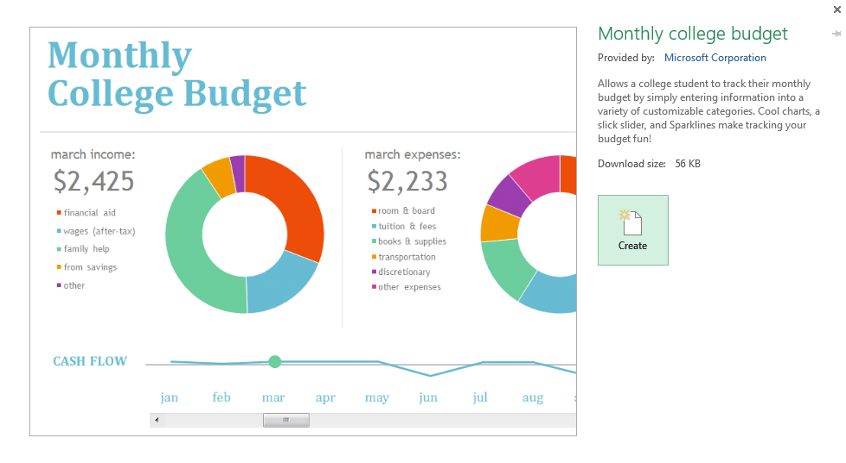
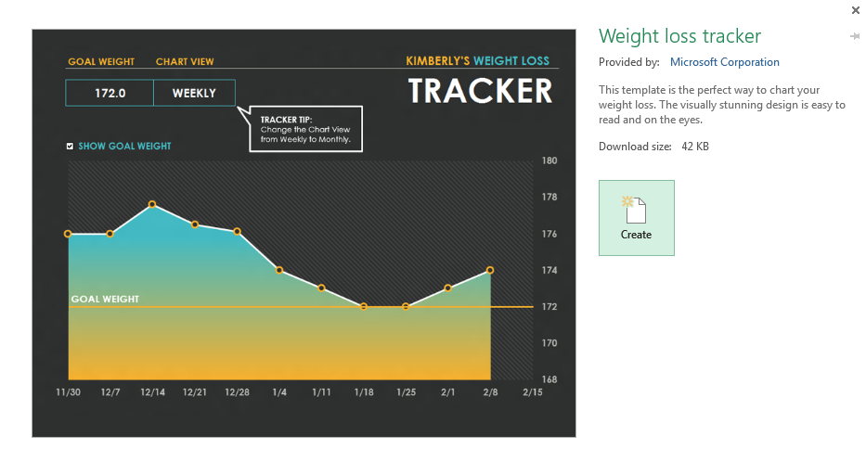
The spectrum is about involvement, not beauty.
Notes:
Stress: this spectrum is about involvement, not beauty
i.e. “how much work do I have to do?”
Viz’s on any part of the spectrum can be beautiful or ugly
Show excel templates vs http://bertozzivill.github.io/disaster_taxonomy/ (templates are pretty, data viz not so much)

Slide 8
Notes:
(switch this immediately to next slide, replace apple pie analogy with real tools)

Slide 9


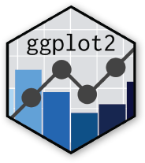


Notes:
Plotly: you specify a lot of the plotting features, but interactivity is built in
Shiny: entire web application easily build-able
Ggplot: no capacity for interactivity/web-ness, but you can specify almost all of what you see
Note: ggplot can nest in plotly can nest in R

Slide 10
ggplot2 is a static plotting library for R.
Why static?
Standard for publications & communications
Foundation for interactive visualization
You can’t make a good interactive plot if you can’t make a good static plot.
ggplot helps you make good static plots:
Standard aesthetic properties (aka: pretty)
Highly customizable
Great documentation/online community
Notes:
Segue into email exchange with Rakhi and Anil

Slide 11
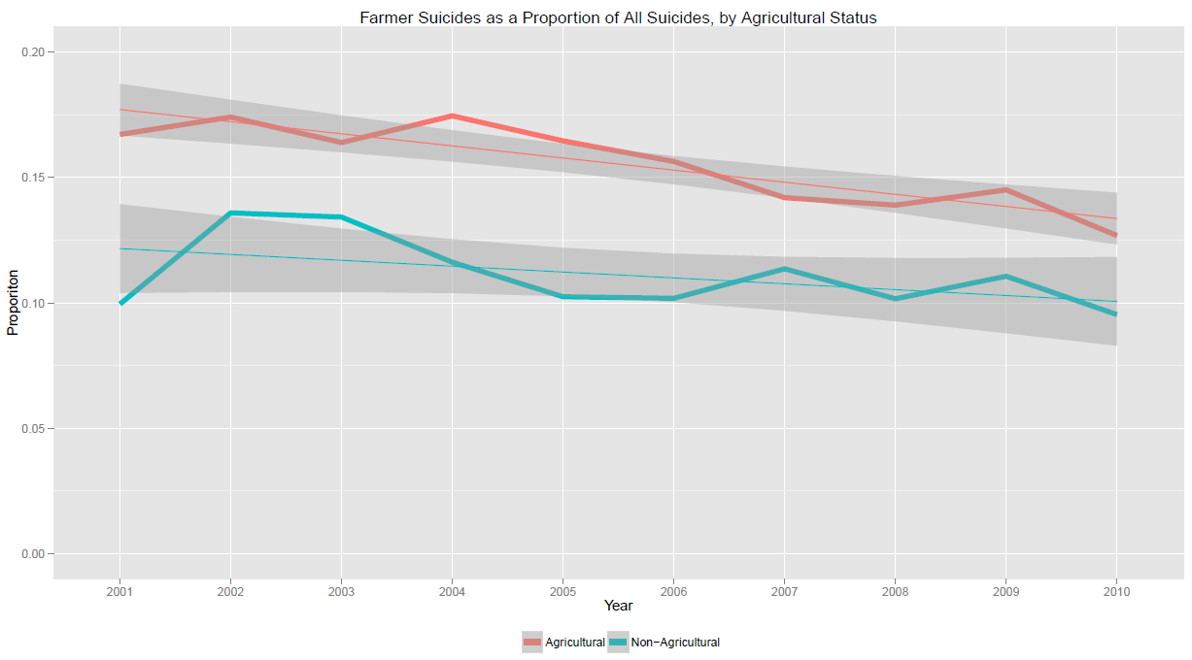
Notes:
Interested in % of suicides committed by farmers: made this plot

Slide 12

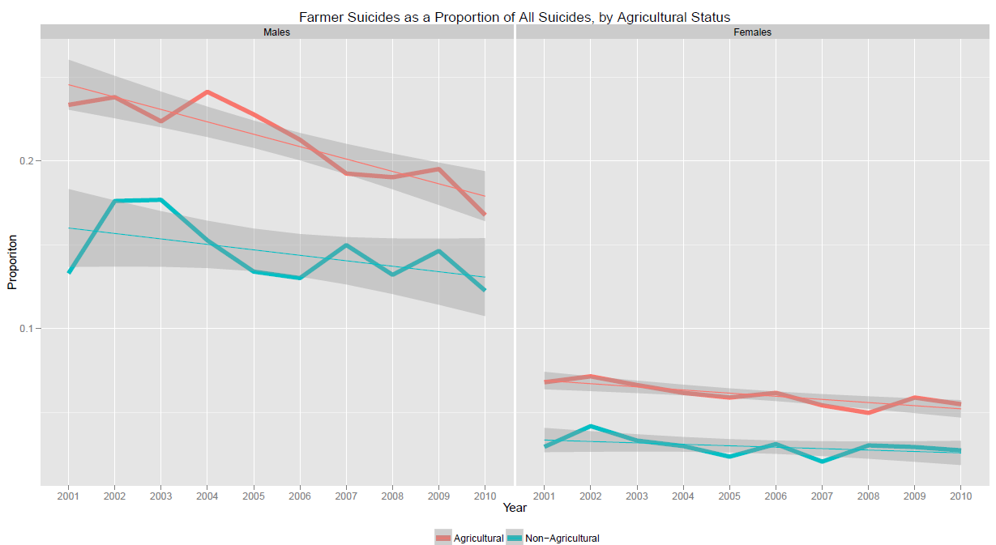


Slide 13

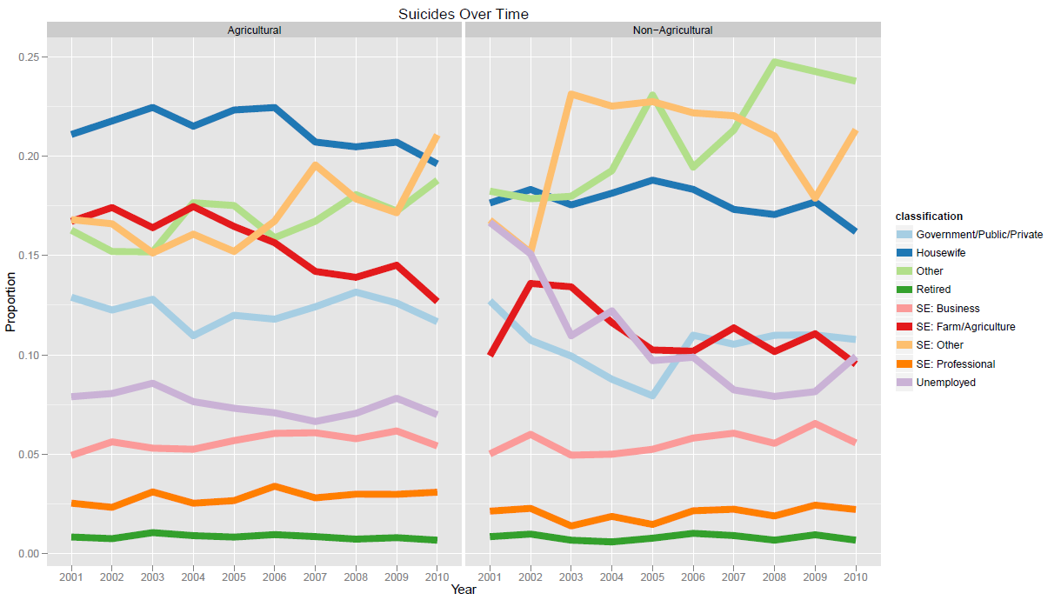
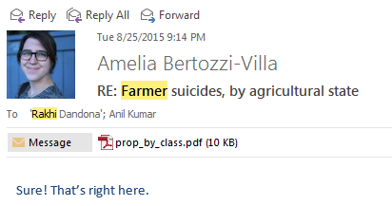
Notes:
Takeaways: If I had done each of these as one-off charts in Excel, it would have been awful. Using plotting software, it was trivial.
(also show trello convo from Wednesday?)
Easiest way to learn ggplot: use it!
Segue into example code.

Slide 14
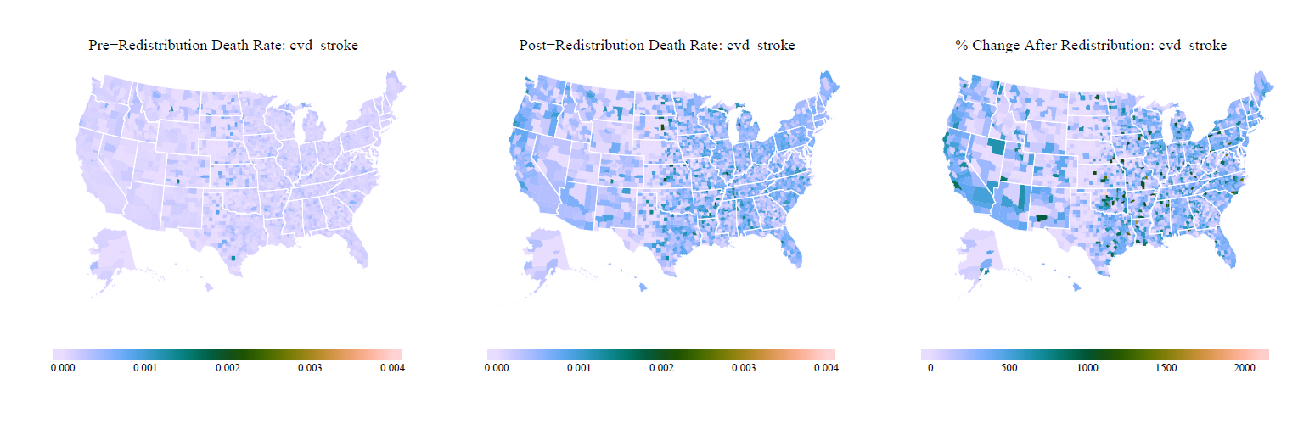
Notes:
Another example: last Wednesday
See: https://trello.com/c/GnNou0pw/333-garbage-redistribution-figures-for-howard-bauchner-presentation

Slide 15
The easiest way to learn ggplot is to use it.
Notes:
Aaand exercise, then break.

Slide 16
Workflow
Coding scenarios
Linear
Functional
Parallelized
Real-life examples along the way

Slide 17
f(
) =
Linear

Slide 18
Linear
Small datasets
Short, straightforward scripts
No/few iterations
Example: collapse_allcause_ages.r

Slide 19
g(
) =
g(
) =
Functional

Slide 20
Functional
Medium-sized or multiple datasets
More involved scripts, esp. with repetition
Split the often-repeated parts out into a function; call that function repeatedly
Example: rake.r and associates

Slide 24
h(
) =
h(
) =
h(
) =
h(
) =
Parallelized

Slide 25
Parallelized
Big datasets (too big to run on one computer)
Long, complex operations: split into several independent scripts
Simultaneously perform operations on multiple machines
Master script controls workflow
Example: _run_all_raking.r

Slide 26

Parallel Computing 101
Your laptop is small; supercomputers are big
Your laptop can (mostly) only do one thing at once; supercomputers can spread work out over many smaller machines
Notes:
Conceptually, can imagine that you’re giving directions to each computer individually.
Actually even better than that: you just tell the group of computers what you want done, and they arrange themselves
### coding example
Afterwards: stress that when you’re building a system like this, you always start from linear and move outward, but it helps to have the big picture in mind.
Show a counterexample: really long and heinous code (e.g. python extraction)

Slide 27
What have we learned?
Data Visualization
Picking the proper tool requires understanding the issues at hand
ggplot2 is an excellent package for static mapping & foundational understanding of visualization
Workflow
Picking the proper code structure requires understanding the issues at hand
The more comfortable you get with different, code architectures, the cleaner, faster, and more interpretable your code will be
Thank you! Questions?

