Slide 1


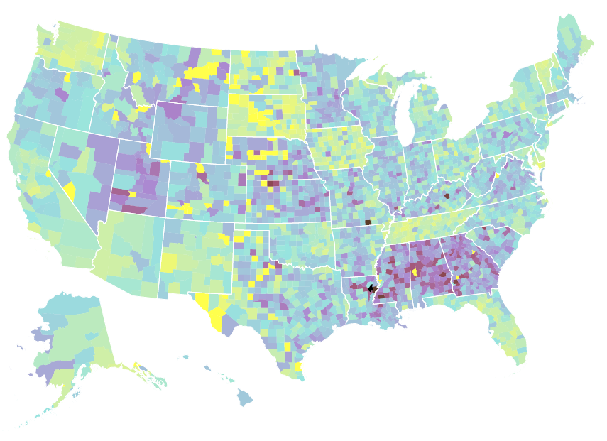
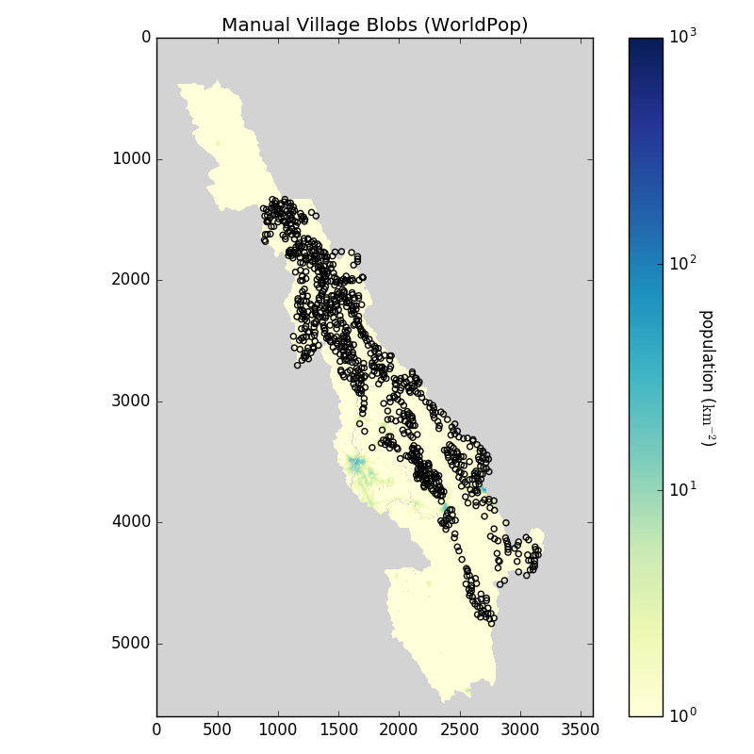
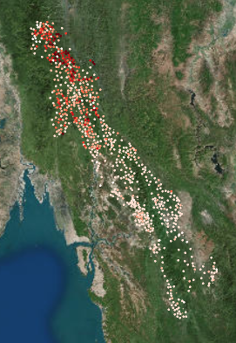
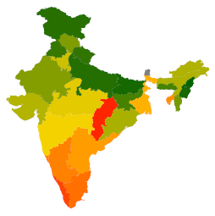
Hello.
Notes:
Hello: who I am, my interests, background, current role
--nyu, bio/math, MATLAB, public health, data viz
--mortality: how to address it
Visualization: here to talk about utilization of tools, not theory of visualization (Mike’s already done that)
Workflow: overview of how *data science* works irl
[questions welcome any time, also leave time for questions at the end]

Slide 2
Visualization
Theory: tool selection and tradeoffs
ggplot2: an introduction
Example & exercise

Slide 3
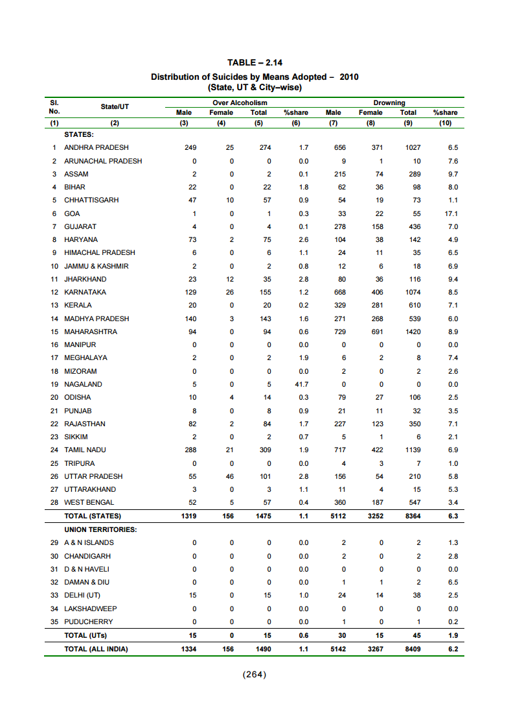
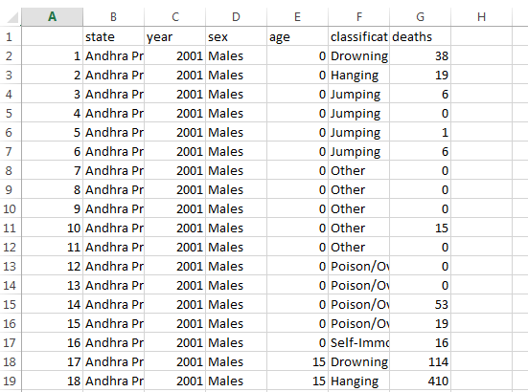
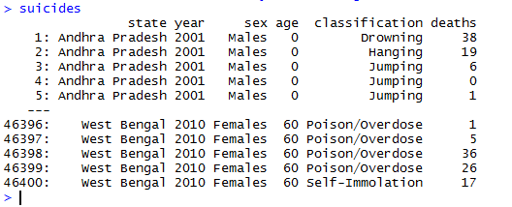
“HOW DO I VISUALIZE
THIS DATA?”
Notes:
Data can come in a wide range of formats: .rdata, .csv, .xls, hd5, .fwf, .txt, .pdf….
The question: how do I visualize this data?

Slide 4

The apple pie spectrum of data visualization
Notes:
Analogous question: how do I make an apple pie?
One end of the spectrum: You go to the store and buy a frozen pie: fast, easy, low-effort
Correlate: Microsoft excel

Slide 5
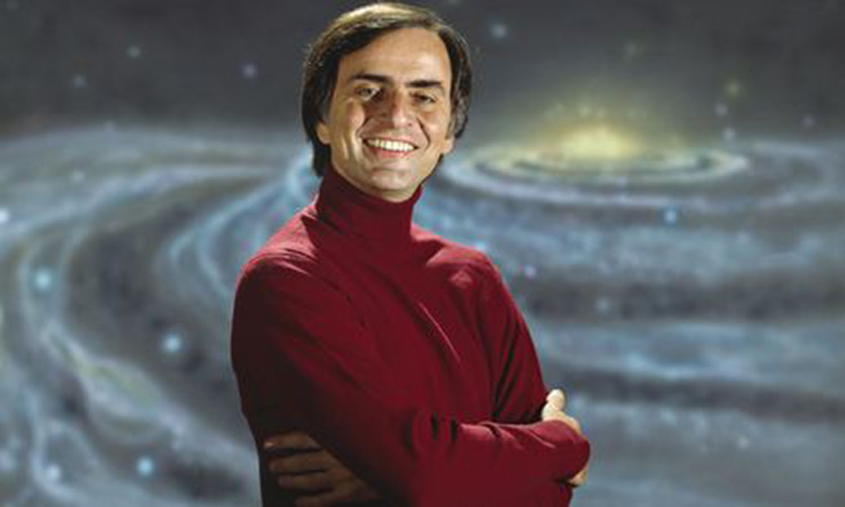
The apple pie spectrum of data visualization
Notes:
Other end of the spectrum: Carl Sagan
“If you want to bake an apple pie from scratch, you must first invent the universe”
Correlate: d3
D3 example: http://vizhub.healthdata.org/us-health-map/

Slide 6
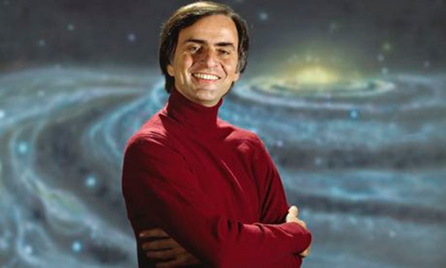
Fast
Easy
Standardized
Inflexible
Hard to automate
You can do anything
You have to do everything
Notes:
overview

Slide 7
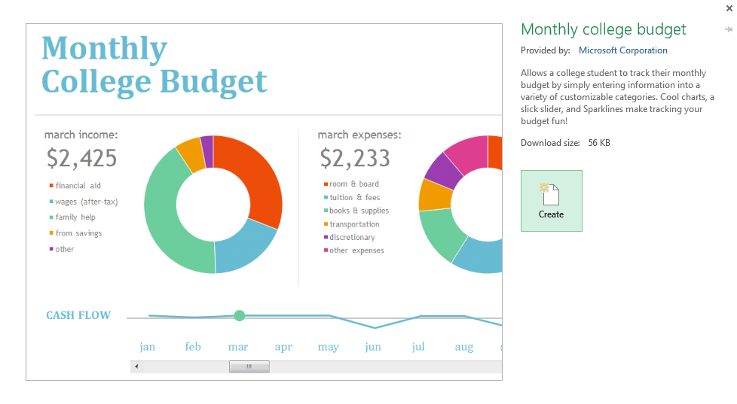
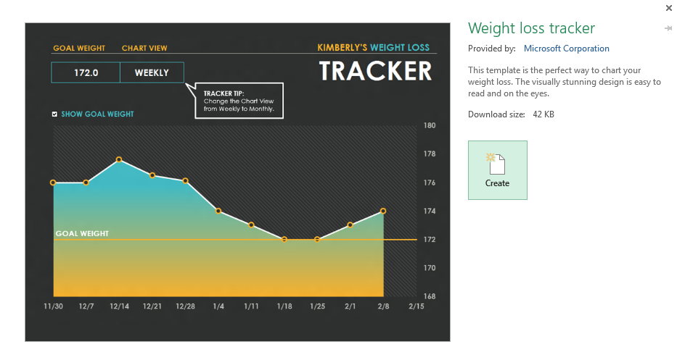
The spectrum is about involvement, not beauty.
Notes:
Stress: this spectrum is about involvement, not beauty
i.e. “how much work do I have to do?”
Viz’s on any part of the spectrum can be beautiful or ugly
Show excel templates vs http://bertozzivill.github.io/disaster_taxonomy/ (templates are pretty, data viz not so much)

Slide 8
Notes:
(switch this immediately to next slide, replace apple pie analogy with real tools)

Slide 9


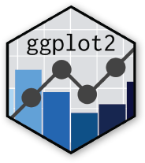
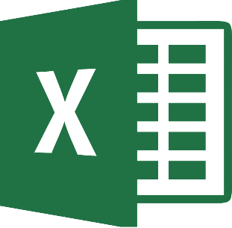

Notes:
Plotly: you specify a lot of the plotting features, but interactivity is built in
Shiny: entire web application easily build-able
Ggplot: no capacity for interactivity/web-ness, but you can specify almost all of what you see
Note: ggplot can nest in plotly can nest in R

Slide 10
ggplot2 is a static plotting library for R.
Why static?
Printed documents
Foundation for interactive visualization
You can’t make a good interactive plot if you can’t make a good static plot.
Notes:
Segue into email exchange with Rakhi and Anil

Slide 11
ggplot helps you make good static plots
Standard aesthetic properties (aka: pretty)
Highly customizable
Easy to solve problems (with the internet!)
Notes:
Segue into email exchange with Rakhi and Anil

Slide 12
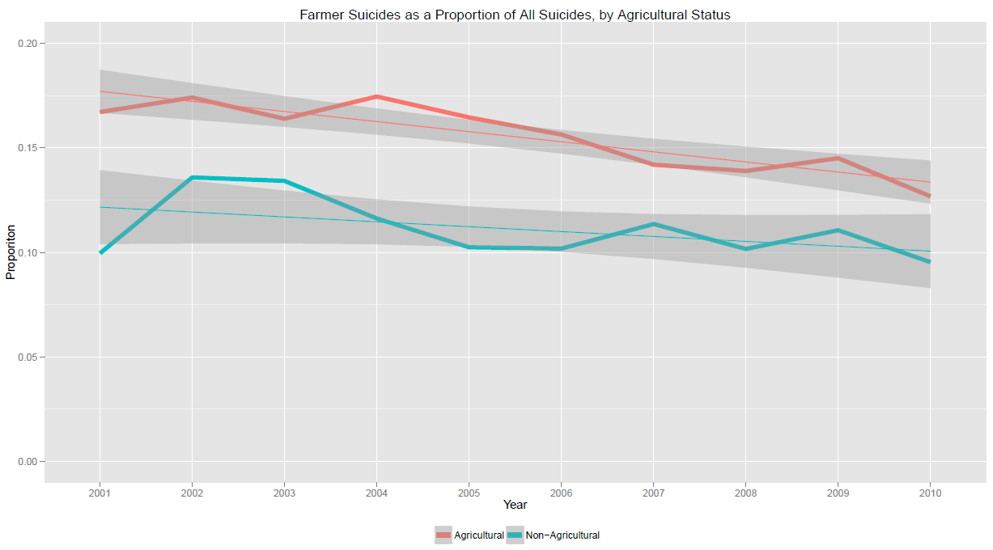
Notes:
Interested in % of suicides committed by farmers: made this plot

Slide 13

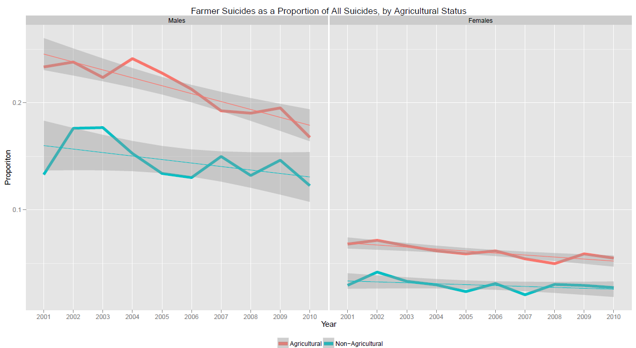


Slide 14

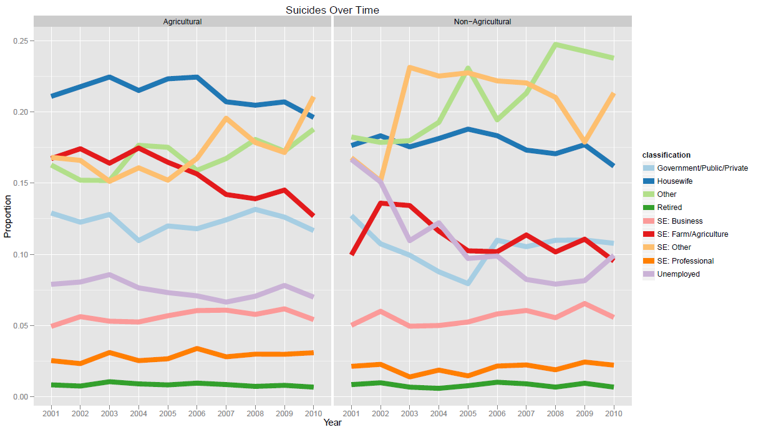

Notes:
Takeaways: If I had done each of these as one-off charts in Excel, it would have been awful. Using plotting software, it was trivial.
(also show trello convo from Wednesday?)
Easiest way to learn ggplot: use it!
Segue into example code.

Slide 15
The easiest way to learn ggplot is to use it.
www.github.com/bertozzivill/intro_to_r
Notes:
Aaand exercise, then break.

Slide 16
How do you write your code to…
Coding scenarios
Linear
Functional
Parallelized
Real-life examples along the way

Slide 17
f(
) =
Linear

Slide 18
Linear
Small datasets
Short, straightforward scripts
No/few iterations
Example: collapse_allcause_ages.r

Slide 19
g(
) =
g(
) =
Functional

Slide 20
Functional
Medium-sized or multiple datasets
More involved scripts, esp. with repetition
Split the often-repeated parts out into a function; call that function repeatedly
Example: rake.r and associates

Slide 24
h(
) =
h(
) =
h(
) =
h(
) =
Parallelized

Slide 25
Parallelized
Big datasets (too big to run on one computer)
Much faster than linear computing
Simplify scripts
Master script controls workflow
Example: _run_all_raking.r

Slide 26

Parallel Computing 101
Your laptop is small; supercomputers are big
Your laptop can (mostly) only do one thing at once; supercomputers can spread work out over many smaller machines
Notes:
Conceptually, can imagine that you’re giving directions to each computer individually.
Actually even better than that: you just tell the group of computers what you want done, and they arrange themselves
### coding example
Afterwards: stress that when you’re building a system like this, you always start from linear and move outward, but it helps to have the big picture in mind.
Show a counterexample: really long and heinous code (e.g. python extraction)

Slide 27
What have we learned?
Data Visualization
Picking the proper tool
ggplot2 is a great starting point
Code Architecture
Picking the proper code structure
Fundamentals of parallelization

Slide 28
Amelia Bertozzi-Villa : abertozz@uw.edu ameliabv.com
Thank you! Questions?

