Slide 1
SENTINEL RAG
A self-correcting RAG laboratory
“Most RAG systems fail silently. Mine knows when it’s failing, fixes itself, and shows you the receipts.”
3 chunking strategies · hybrid BM25 + FAISS · Grader + HyDE · RAGAS evaluation · live four-screen UI
Notes:
Locally hosted, end to end: ingestion, three chunking strategies, hybrid retrieval, an agentic self-correction loop, a RAGAS evaluation harness and a four-screen web UI. ~50 synthetic AI/ML docs. Embeddings run locally (bge-small-en-v1.5); the LLM roles run on Groq. Everything is observable: every pipeline step streams to the UI and every run is persisted.

Slide 2
THE PROBLEM
RAG pipelines fail silently
Wrong retrieval
The generator never saw the passage that contains the answer.
Confident hallucination
It answers anyway — fluently, and with made-up citations.
No attribution
A wrong answer could be a retrieval miss or bad generation; nothing tells you which.
Two-stage pipelines fail in two places. If you can’t see the stages, you can’t fix the pipeline — you find out when a user does.
Notes:
This is the core motivation. A RAG system is a two-stage pipeline: retrieve, then generate. Each stage fails differently. Sentinel RAG makes both stages visible, graded and self-correcting — and stores the receipts for every run.

Slide 3
WHAT IT IS
Four pillars, one observable pipeline
01 Chunk three ways fixed 512/50 · hierarchical 256/1024 · semantic percentile splits — compared, not assumed
02 Retrieve hybrid BM25 top-20 + FAISS top-20, fused with Reciprocal Rank Fusion
03 Correct itself a grader scores every retrieval; a low score triggers a HyDE rewrite and re-retrieval
04 Prove it RAGAS metrics across a 6-combo matrix, rendered in a live scoreboard
Notes:
The point of the lab is comparison: the same query through three chunking strategies, with self-correction on and off, measured. Nothing is hand-waved — the architecture diagram, the grader threshold, the eval numbers are all in the repo.

Slide 4
ARCHITECTURE
Ingestion → indexes → the correcting loop
Corpus
50 AI/ML docs
3 chunkers
fixed / hier / semantic
bge-small
384-d, L2-norm
Indexes
FAISS IP + BM25
score < 0.6 → HyDE rewrite → re-retrieve → re-grade (max 2)
Query
≤ 2000 chars
Router
simple / complex
Hybrid + RRF
top-5
Grader
score 0–1
Generate
cited answer
Trace + UI
SQLite / SSE
Documents are embedded raw; queries carry the BGE instruction prefix. Reindex builds into a staging dir, then swaps the live index files.
Notes:
Top row is ingestion: 50 markdown docs are chunked three ways, embedded with bge-small-en-v1.5 (384-dim, L2-normalized so inner product equals cosine), and stored as nine files — a FAISS IndexFlatIP and a BM25 index plus chunk metadata per strategy. Bottom row is the query path. The router decides simple vs complex (top-3 vs top-5 and whether HyDE is allowed). The grader gates generation. The whole loop streams over SSE and lands in SQLite.

Slide 5
INGESTION
50 docs in, nine index files out
▪ python -m app.ingest — chunks every doc three ways, embeds, builds 3 × (FAISS + BM25 + chunks.json)
▪ bge-small-en-v1.5 — 384-dim, L2-normalized — so IndexFlatIP is exact cosine search
▪ Query prefix — queries carry the BGE instruction prefix; documents are embedded raw
▪ Semantic chunker — the only chunker that runs the model at ingest: embeds sentences to find breakpoints
▪ Live reindex — builds into .staging, then os.replace onto the live index; retriever cache resets
▪ Provenance — corpus_version = SHA-256 of the corpus — the eval test set is stamped with it
Notes:
Ingestion is a single CLI command and is also invoked by the Documents page. Reindexing is single-flight (a lock), so an upload during a rebuild queues rather than corrupts. The staging swap means a reader never sees a half-built index; the known limit is that the swap is per-file, not atomic across all three strategies.

Slide 6
CHUNKING
Three strategies, three trade-offs
Strategy | Parameters | Trade-off
Fixed | 512-token windows, 50-token overlap | Predictable and cheap; blind to content, can cut a definition in half
Hierarchical | child 256 / parent 1024, children carry parent_id | Match on small, generate on big; parent text duplicated per child
Semantic | cosine breakpoints at the 25th percentile, 512-token cap | Respects meaning; costs an extra embedding pass over every sentence
No strategy dominates — short factual queries favour small chunks, explanatory questions favour larger context. That is exactly why the lab compares them.
Notes:
Every chunk is a dataclass with chunk_id, doc_title, text, strategy and optional parent_id/parent_text. Hierarchical retrieval matches at the child level and expands to the parent before generation, which is what the eval calls the 'context'. The semantic chunker hard-caps any over-long sentence at 512 tokens.

Slide 7
RETRIEVAL
Hybrid search, fused by rank
▪ BM25 top-20 + FAISS top-20 — lexical catches exact terms, dense catches paraphrase
▪ Reciprocal Rank Fusion, k = 60 — score = Σ 1/(60 + rank) — fuses ranks, no score calibration needed
▪ Top-5 into the grader — top-3 when the router classifies the query as simple
▪ Simple path skips HyDE — retrieve → grade once → answer or not_found
Every chunk keeps its bm25_rank, vector_rank and rrf_score — the UI shows you which retriever found it and how it was ranked.
Notes:
RRF is deliberately boring: it needs no tuned weights between a sparse score and a cosine score. The per-chunk ranks are persisted in the trace, so the UI can show exactly why a chunk surfaced.

Slide 8
SELF-CORRECTION
The loop that refuses to guess
Router
simple / complex
Retrieve
top-3 or top-5
Grade
0–1 relevance
Generate
only if ≥ 0.6
The rules
▪ score < 0.6 on a complex query → HyDE rewrite → re-retrieve → re-grade, max 2 retries
▪ grader error → fail closed immediately — a broken grader never burns the retry budget
▪ an answer with zero valid citations is thrown away as not_found, never shown
▪ final statuses: success | not_found | error — and the trace records why (fallback_reason)
Notes:
Router and grader run at temperature 0; generation 0.3; HyDE 0.7. Token budgets are sized for a reasoning model, which spends hidden tokens before answering. Fail-closed is a deliberate choice: an infrastructure error must not look like a confident answer, and it must be distinguishable from a retrieval miss — which is what fallback_reason gives us.

Slide 9
GROUNDING
Citations are checked, not trusted
▪ The generator must cite [n] — inline markers placed right after the claim they support
▪ The backend validates — out-of-range markers dropped, duplicates removed, renumbered in order of appearance
▪ The answer is rewritten — so the visible markers always match the citation list exactly
▪ Zero valid citations — the whole answer is discarded as not_found — never shown ungrounded
▪ Per-run diagnostics — fallback_reason, grader_error, source_doc_hit, retries — stored with every trace
Notes:
The citation validator is also why the UI can make citations interactive: click a [n] and the UI scrolls to and highlights the exact chunk that backs the claim. The chunk_id in each citation is the ground truth link.

Slide 10
WAR STORY
The bug that ate 118 of 120 answers
▪ The eval looked terrible — 118/120 answers were “I couldn’t find a confident answer”
▪ But retrieval was perfect — context precision ≈ 0.97, source_doc_hit = 1.0 — the right chunks were found every time
▪ The model wrote 【1】, the validator knew only [1] — CJK bracket variants meant zero valid citations → every grounded answer discarded
▪ Fix + receipts — normalize the bracket variants; add final_status / fallback_reason / grader_error / doc_hit to every record
Lesson: diagnose before tuning — the grader threshold was never the problem.
Notes:
This is the most honest slide in the deck. The first eval run was invalid because of a citation-parser bug, not a bad pipeline. The fix was two lines; the valuable part was the instrumentation that made the bug obvious instead of invisible. The harness now refuses to persist a run whose failure rate says 'outage', and can resume across quota resets.

Slide 11
EVALUATION
Measured with RAGAS
▪ Test set — 50 question/answer rows — one per corpus doc — each with a reference answer and reference contexts
▪ Matrix — 3 strategies × correction on/off = 6 combos
▪ Metrics — faithfulness + answer relevancy (LLM judge) and non-LLM context precision / recall
▪ Judging scales — one judge per Groq account; the pipeline pools and rotates all keys
▪ Guard rails — pre-flight probe before anything is cleared, abort-on-error-rate, --resume across quota resets
Notes:
The harness maps a pipeline trace to a RAGAS sample: on success the response is the generated answer and the contexts are the last retrieval; on fallback it uses the fallback message and the closest chunks. Reference contexts are the full source doc, which is what makes context precision/recall computable.

Slide 12
RESULTS
What the numbers say so far
Strategy | Correction | Faithful. | Relevancy | Ctx prec. | Ctx recall | Answered
fixed | on | 1.000 | 0.868 | 0.950 | 1.000 | 10/10
fixed | off | 0.967 | 0.837 | 0.950 | 1.000 | 10/10
hierarchical | on | — | — | 0.850 | 0.900 | 6/10
hierarchical | off | pending
semantic | on / off | pending
n = 10 per combo on gpt-oss-20b (the 120b free-tier quota was exhausted). “—” means the judge was throttled, not zero. source_doc_hit = 1.0 and grader_error = 0 on the completed combos: retrieval and grading are healthy.
Remaining combos finish with: python -m eval.run_ragas --limit 10 --resume
Notes:
Be straight about coverage: three of six combos, ten rows each. Fixed is the headline: 10/10 answered, faithfulness 1.0 with correction on. The known limitations are the free tier (account-wide limits, which is why the keys pool across accounts) and a non-LLM context-metric artifact on the semantic strategy where doc_hit is 1.0 but the string-overlap metric scores low.

Slide 13
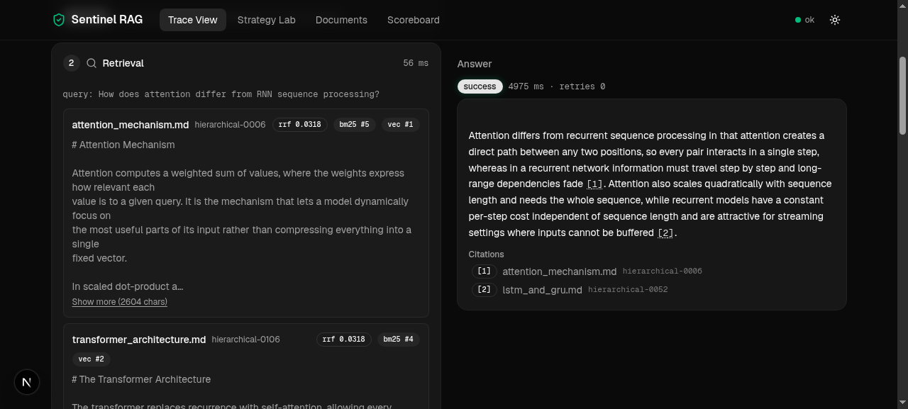
THE UI
Trace View — the pipeline, live
What you are looking at
▪ steps stream in over SSE with per-step timings
▪ grading shows the score and the pass threshold
▪ chunks expand to full text
▪ citations are clickable — they jump to and highlight the exact chunk
▪ Recent traces replays any stored run
▪ fallbacks say why they fell back
Notes:
This is the demo screen. The trace shown was loaded from history, not re-run — which is the resilience feature: if the quota dies during the demo, every previous run is still replayable. The idle state teaches the five stages before the first query is typed.

Slide 14
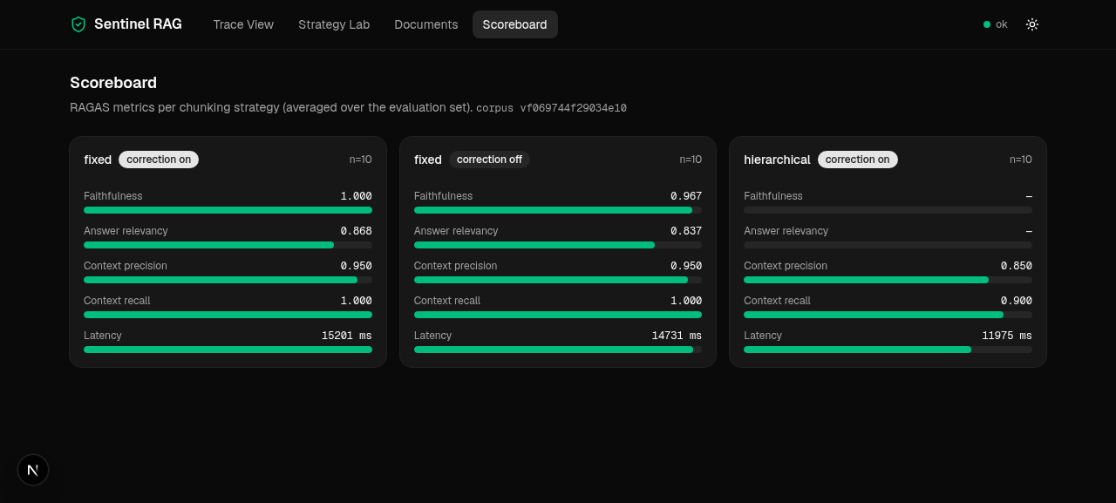
THE UI
Scoreboard — the receipts
Per-combo cards
▪ RAGAS means per strategy × correction
▪ latency bars, n and corpus version shown
▪ reads GET /api/eval — same numbers as the README
Notes:
The scoreboard is populated by the eval harness writing to the eval_results table. The corpus version is stamped so numbers are always attributable to a corpus state.

Slide 15
ENGINEERING
Built to survive a demo
▪ SSE streaming — first event carries trace_id; client disconnect stops the pipeline between steps
▪ SQLite, WAL mode — traces and eval results coexist with live traffic; one connection per call
▪ Live reindex — staging dir → atomic file swap per strategy; retriever cache reset; single-flight lock
▪ Groq key pool — round-robin across separate accounts, a 401 evicts a dead key, one judge per account
▪ Eval harness guards — probe → abort-on-error-rate → resume; a bad run can never overwrite a good one
▪ Bounded concurrency — asyncio.Semaphore(2) around pipelines; blocking calls pushed to threads
Notes:
Everything here was added because it failed once: the revoked key, the exhausted quota, the mid-matrix rate limit. The system's failure modes are handled in code, not in hope.

Slide 16
RUN IT
Three commands, three screens
BACKEND
uv venv .venv && uv pip install -r requirements.txt
python -m app.ingest # build the indexes
uvicorn app.main:app --port 8000
FRONTEND
pnpm install
pnpm dev # http://localhost:3000
EVALUATE
.venv-eval/bin/python -m eval.run_ragas --limit 10 --resume
python scripts/check_api.py # deterministic self-checks
Notes:
Ports: backend 8000, frontend 3000. The frontend talks to the backend directly (CORS), no Next.js proxy — that is what makes SSE work. The eval runs in a separate venv because RAGAS pins an older openai SDK than the app.

Slide 17
HONEST LIMITS
What I’d fix next
▪ Coverage — 3 of 6 eval combos done, n = 10 — the rest are a quota question, not a code question
▪ Metric artifact — semantic scores low on non-LLM context metrics despite perfect doc hits
▪ Chunker cost — semantic chunking embeds every sentence at ingest
▪ Next — finish the full gpt-oss-120b matrix on the pooled accounts
▪ Next — a cross-encoder reranker between retrieval and grading
▪ Next — per-question drill-down on the scoreboard; token streaming in the answer
“It knows when it’s failing, fixes itself, and shows you the receipts.”
Notes:
Close on the receipts line. Everything claimed in this deck is in the repo: the architecture matches the implementation plan, the numbers come from results.json, and the failure story (the citation bug, the quota outage) is documented in the README rather than hidden.

