Slide 1
Agentic RAG
Agent Framework Dev Project
April 2026 – New Hampshire edition
Jason Haley Microsoft AI MVP jason@jasonhaley.com

Slide 2
Today’s Overview
Quick recap of traditional RAG
Why basic RAG breaks down
What makes agentic RAG “agentic”
Core concepts and architecture
When to use agentic RAG
Key takeaways

Slide 3
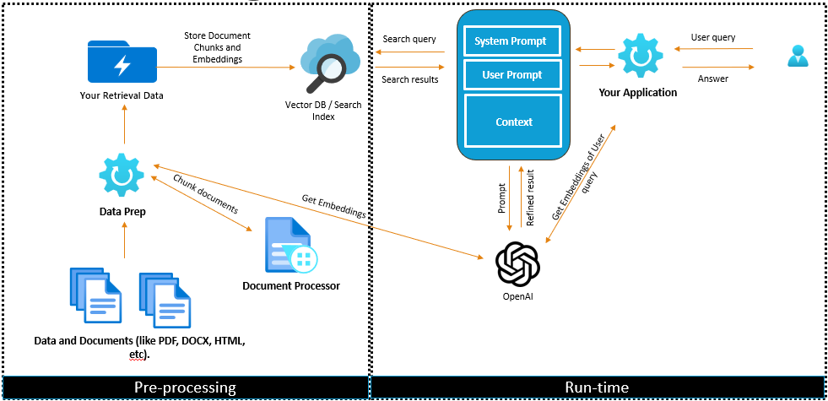
Traditional RAG in 60 Seconds
Notes:
Speaker notes
Problem: LLMs don’t know your private data
Classic flow:
User query → retrieve top-k chunks → generate answer
Works great for:
Fact lookup
Single-document questions
Important framing:
RAG = retrieve once, answer once

Slide 4
Traditional RAG: Quick Recap
The Basic Flow
User query → Embed → Similarity search → Retrieve context → Generate answer
The Problem It Solves
Grounds LLM responses in your data, reducing hallucinations and providing source attribution
Simple & Effective
Works great for straightforward queries with clear intent
Notes:
Speaker notes
Problem: LLMs don’t know your private data
Classic flow:
User query → retrieve top-k chunks → generate answer
Works great for:
Fact lookup
Single-document questions
Important framing:
RAG = retrieve once, answer once

Slide 5
Why Traditional RAG Breaks Down
Example Query
"What were the key findings from our Q3 reports and how do they compare to industry trends?"
Fixed Retrieval
Single similarity search can't break down complex queries
Single Source
Can't search internal docs and external data
No Iteration
One shot only, can't refine or follow up
The Core Problem
Traditional RAG treats all queries the same way.
Notes:
Speaker notes
Three common failure modes:
Fixed retrieval strategy
Single-shot reasoning
No ability to recover when retrieval is bad
The system assumes:
The user asked the perfect question
The first retrieval is sufficient
Reality: neither is usually true

Slide 6

What Makes Agentic RAG “Agentic”?
The LLM becomes a reasoning engine
It decides what to do, which tools to use, and when to stop
🧠
🔧
🔄
Planning
Tool Selection
Iteration
Break complex queries
into steps
Choose the right data
source
Refine until satisfied
Notes:
Speaker notes
Agentic RAG adds:
Decision-making
Iteration
Tool use
State
Simple definition:
Agentic RAG = RAG with a control loop
The system can now ask:
“Do I need more info?”
“Should I search again?”
“Should I use a different tool?”

Slide 7
The Agents’ Jobs
1. THOUGHT
→
2. ACTION
→
3. OBSERVATION
What do I need to find?
Execute tool/search
Review results
4. REPEAT IF NEEDED
Example: "What's our pricing vs competitors?"
Thought: Need internal pricing first
Action: search_internal_docs("pricing")
Observation: Found our pricing → $49/month
Thought: Now need competitor data
Action: web_search("competitor pricing")
Observation: Found competitors → Average $55/month
Notes:
Speaker notes
The agent is not “smarter”
It’s responsible for:
Planning steps
Choosing tools
Observing outcomes
Adjusting approach
Think of it as:
An orchestrator, not a chatbot
This is what enables multi-step reasoning

Slide 8
Query Augmentation & Multi-Step Retrieval
Example Query
"What were the key findings from our Q3 reports and how do they compare to industry trends?“
Query Rewriting
Transform original user query to be effective for your retrieval system
Query Expansion
Enhance results by generating multiple queries from the original query
Query Decomposition
Breakdown complex user queries into focused sub-queries
Notes:
Show Weavieate’s -> Context Engineering eBook
Speaker notes
Instead of one query, the agent can:
Break a question into sub-questions
Run multiple targeted searches
Example:
“Compare fixes for slow network vs intermittent drops”
Each sub-question may hit:
Different documents
Different indexes
Different tools

Slide 9
Retrieval Is Just One Tool
Vector Store
Web Search
SQL/APIs
Semantic Searches
Realtime External Data
Structured Data Searches
Code Interpreter
Document Diffing
Calculators
Tools Using Code to Analyze Data
Tools for Advanced Document Comparison
Tools to Aggregate or Perform Complex Math
Notes:
Speaker notes
In Agentic RAG, vector search is just a tool
Other tools might include:
APIs
Databases
Calculations
Document diffing
Key mindset shift:
Retrieval is a decision, not a default

Slide 10

When to Use Agentic RAG
Traditional RAG
Agentic RAG
✅ When to use:
✅ When to use:
Simple, direct queries
Single data source
Speed is critical
Low cost requirement
Predictable behavior needed
Complex, multi-part queries
Multiple data sources
Query decomposition needed
Iterative refinement valuable
Flexibility over speed
📝 Example:
📝 Example:
"What is our return policy?"
"Compare our Q3 performance to industry trends and suggest areas for improvement"
Notes:
Speaker notes
Examples:
Comparing multiple documents or versions
Enterprise questions spanning multiple domains
Conversational troubleshooting flows
Pattern:
Anything that requires reasoning about retrieval

Slide 11

Key Takeaways
Agentic RAG = RAG + Reasoning
The LLM plans, selects tools, and iterates until it has enough information
🎯 Best for complex, multi-source queries
Use when query complexity justifies the additional cost and latency
⚖️ Trade flexibility for predictability
More intelligent but less deterministic than traditional RAG
🔧 Start small and iterate
2-3 tools, clear descriptions, comprehensive logging
Notes:
Speaker notes
Traditional RAG is a great baseline
Agentic RAG adds:
Control
Recovery
Reasoning
Think of agents as:
A power tool, not a default
Final thought:
“If your system never needs to think twice, you don’t need an agent.”

Slide 12
Resources
Python + Agents: Building AI agents and workflows with Agent Framework
Docs Getting Started: Microsoft Agent Framework
Github: Agent-Framework
Agentic retrieval in Azure AI Search
Azure-Search-Python-Samples – agentic-retrieval-pipeline-example and Quickstart-Agentic-Retrieval
Udai’s Github: aisearch – related YouTube video: Building Enterprise AI Agents using Azure AI Search
My Github: agent-framework-agentic-rag-python
AgentFramework.dev
Understanding Microsoft Agent Framework – YouTube playlist

