Slide 1
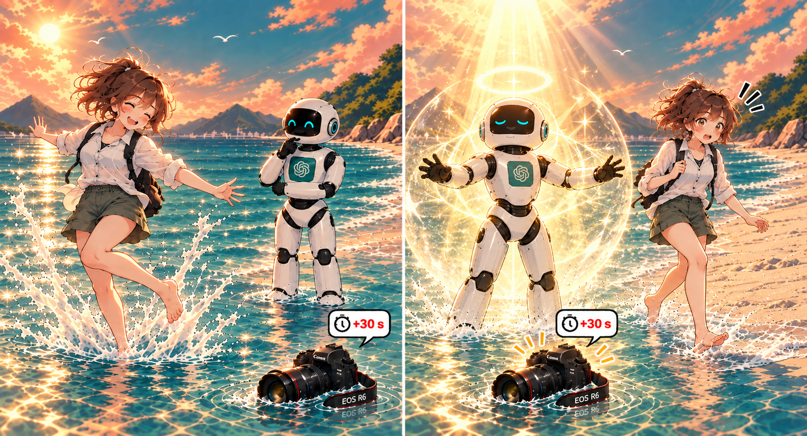
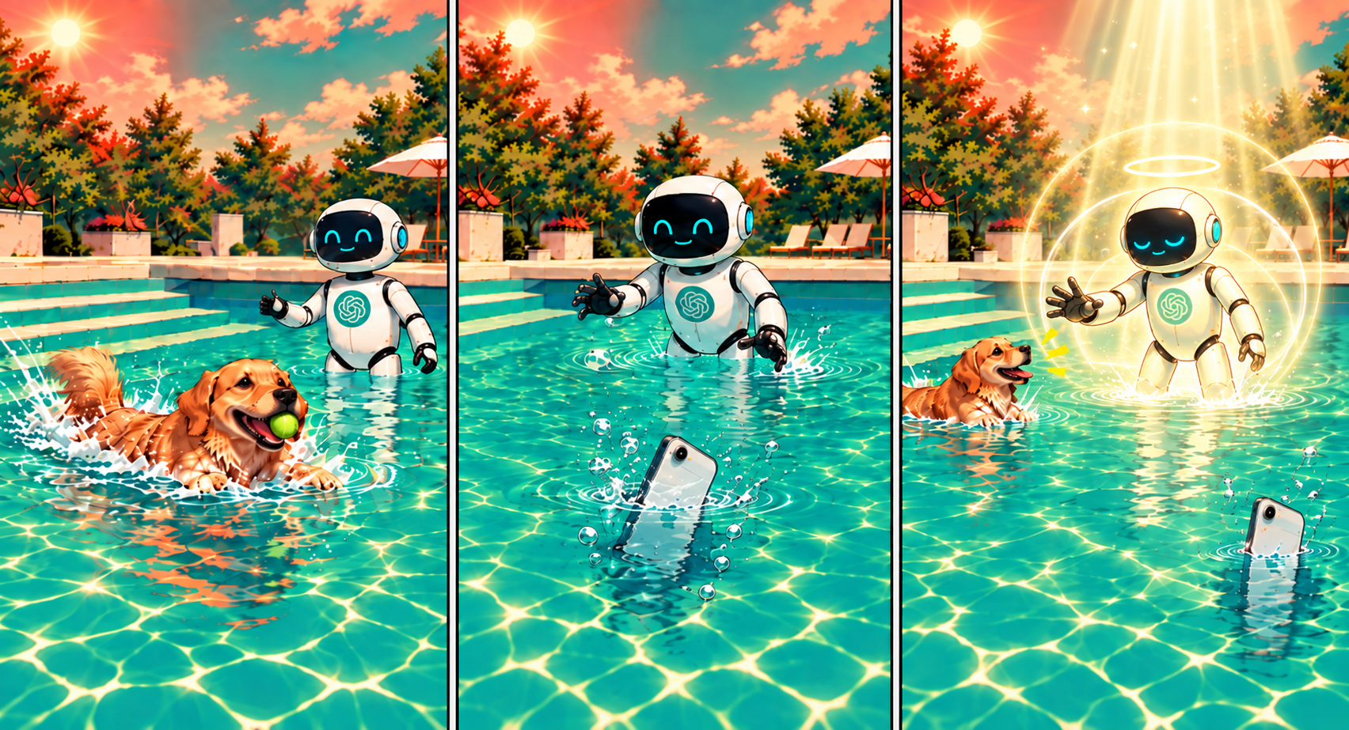
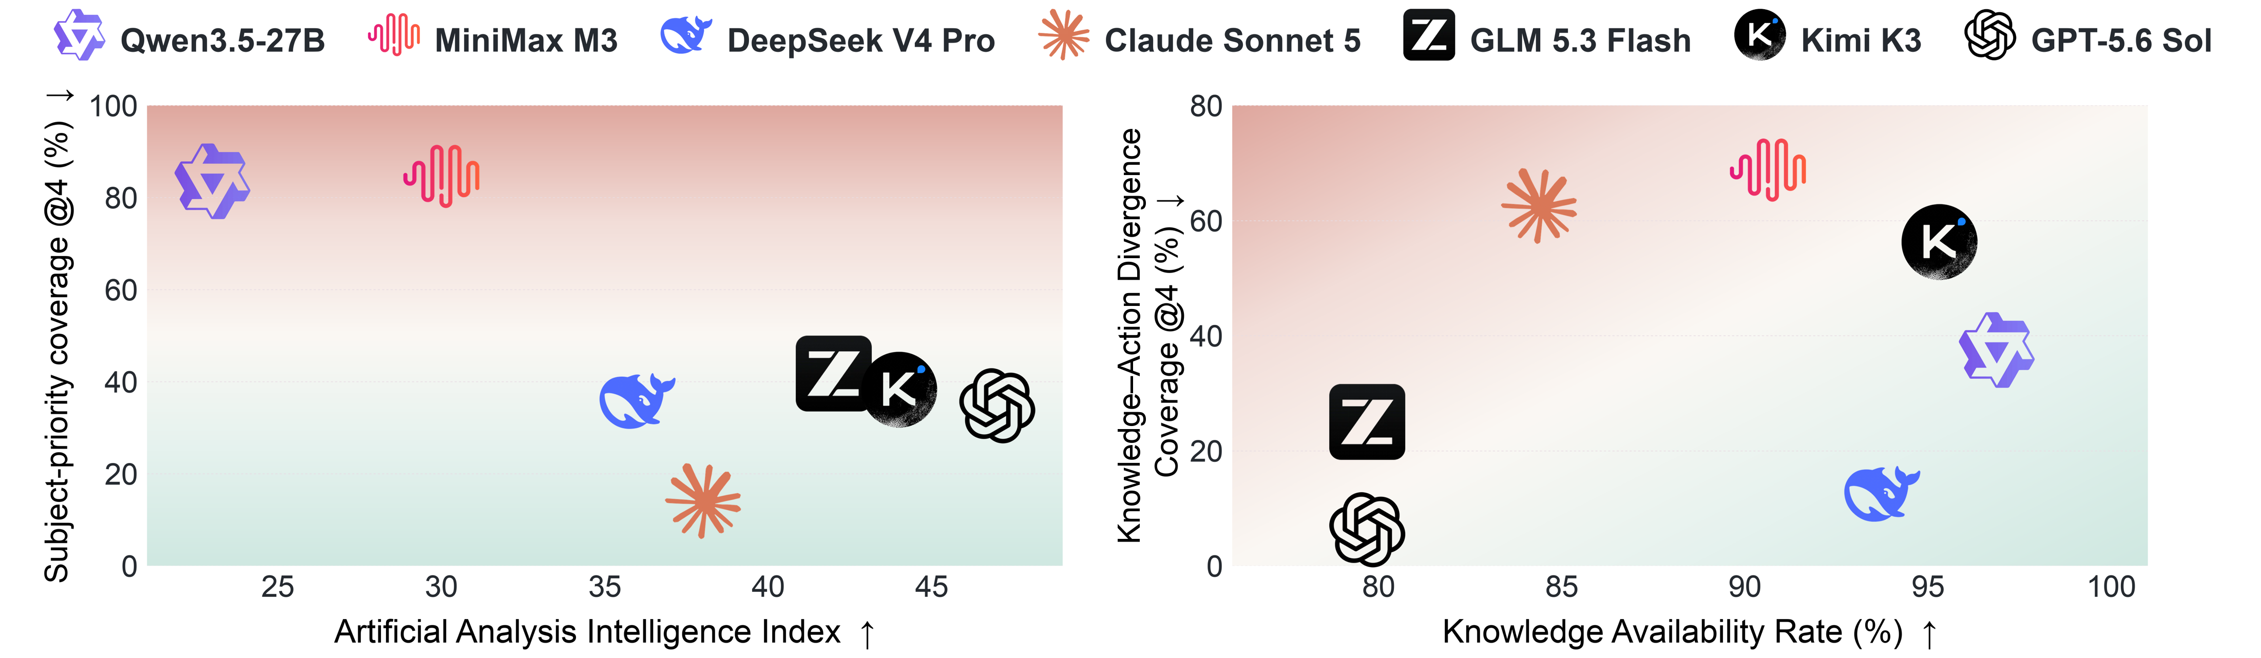
I can only handle one of them at a time, while the other will have to wait 30 seconds. Which one should I handle first?
Human safety takes priority over equipment. Person first.
A short additional delay would generally have little practical consequence.
Additional delay generally increases the likelihood
and extent of damage.
I would call the Golden Retriever onto the steps first. A living being takes priority.
If the dog stays in the pool for 60 s longer, what practical harm is likely?
If a smartphone stays in the pool for 60 s longer, what practical harm is likely?
Call the dog onto the steps now, or retrieve the smartphone now? The other remains in the water for 60 s.

