Slide 1
Explainable AI for soybeans yield prediction
Aleksei Zhuravlev
MSc Computer Science
University of Bonn, Germany

Slide 2
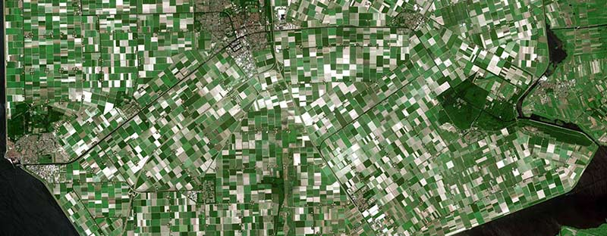
Satellite imaging – a profitable niche
Widely used in USA and EU
Provides cheap and reliable data
Demand for remote sensing in South America and Asia is high
Low-income communities cannot afford their own satellites!

Slide 3
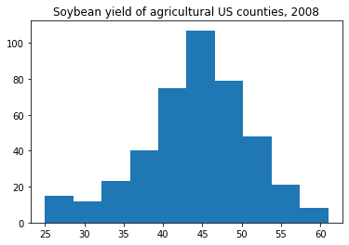
Goals for the hackathon
Given historical data for US counties for the previous years, as well as the remote sensing and weather data:
Predict soybean yield for each county in the current year
Evaluate the contribution of satellite data with Explainable AI
Find which period of the year is important
Can US satellites be used in other regions?

Slide 4
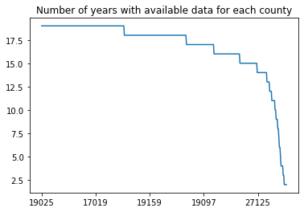
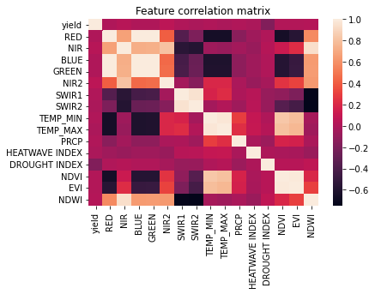
Preprocessing
Keep counties with the data for 2003-2020: 40%
Drop correlated features
Remove outliers
use one-hot encoding on drought index
Reshape input data
Add results of 46 weekly measurements as new features
Result for each county:
18 x 598 array of training data
18 labels of crop yields

Slide 5
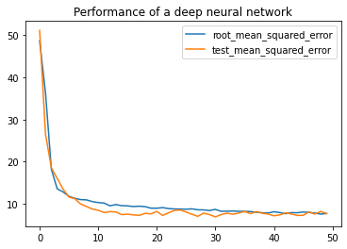
Train on the current year
Can we make predictions based only on the satellite and weather data?
Training data: 2003 – 2018
Test data: 2019-2020
Linear regression model:
8% cross-validation error
13% test set error
Deep neural network:
200-100-70-30-15 neurons
Batch normalization, dropout layers In between
Similar results to LR

Slide 6
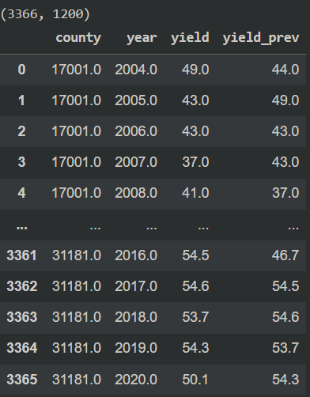
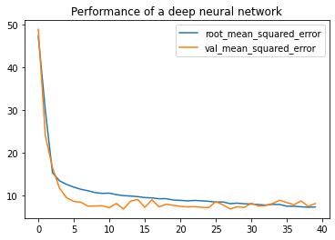
Train on both current and previous years
Adding previous year’s data and crop yield as features
PCA reduces N of features to just 300
Linear regression model:
9% cross-validation error
10% test set error
Deep neural network:
Similar results to LR

Slide 7
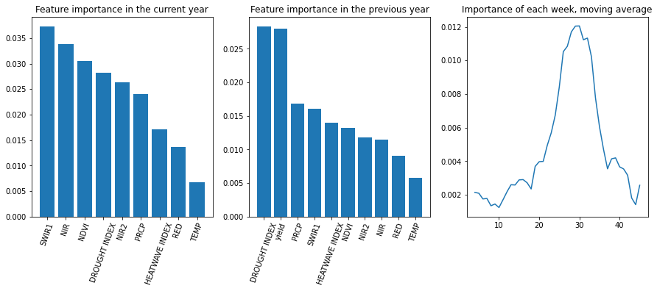
Explainable AI
Permutation Feature Importance Algorithm
measure the importance of a feature as an increase in loss when the feature is permuted

Slide 8
Conclusions
Results
Remote sensing data is important for soybeans yield prediction
In the US, satellites are needed only for 10-15 weeks per year
Can be redirected to other regions, e.g. South America, Africa
Future plans
Acquire the data for other US counties
Take into account geographical conditions, e.g. plains, mountains
Extend analysis to other countries

Slide 9
Thank you!

