Slide 1
Allisto Right where you need us.
Environment for both doctors and patients, promoting early detection of autism and further diagnosing
Notes:
1

Slide 2
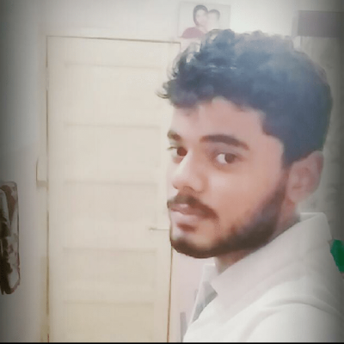
Team Name
Theme
Stack Trace
Machine Learning
Aashish Kumar
Aditya Thakur
Nedheesh Hasija
Rishi Banerjee
GitHub: @aesher9o1
GitHub: @AgentTango
GitHub: @NedStark
GitHub: @rshrc
2
Notes:
2

Slide 3
The Problem
Complete absence of any kind of help for detection and/or diagnosing autism in babies.
3
Notes:
3

Slide 4
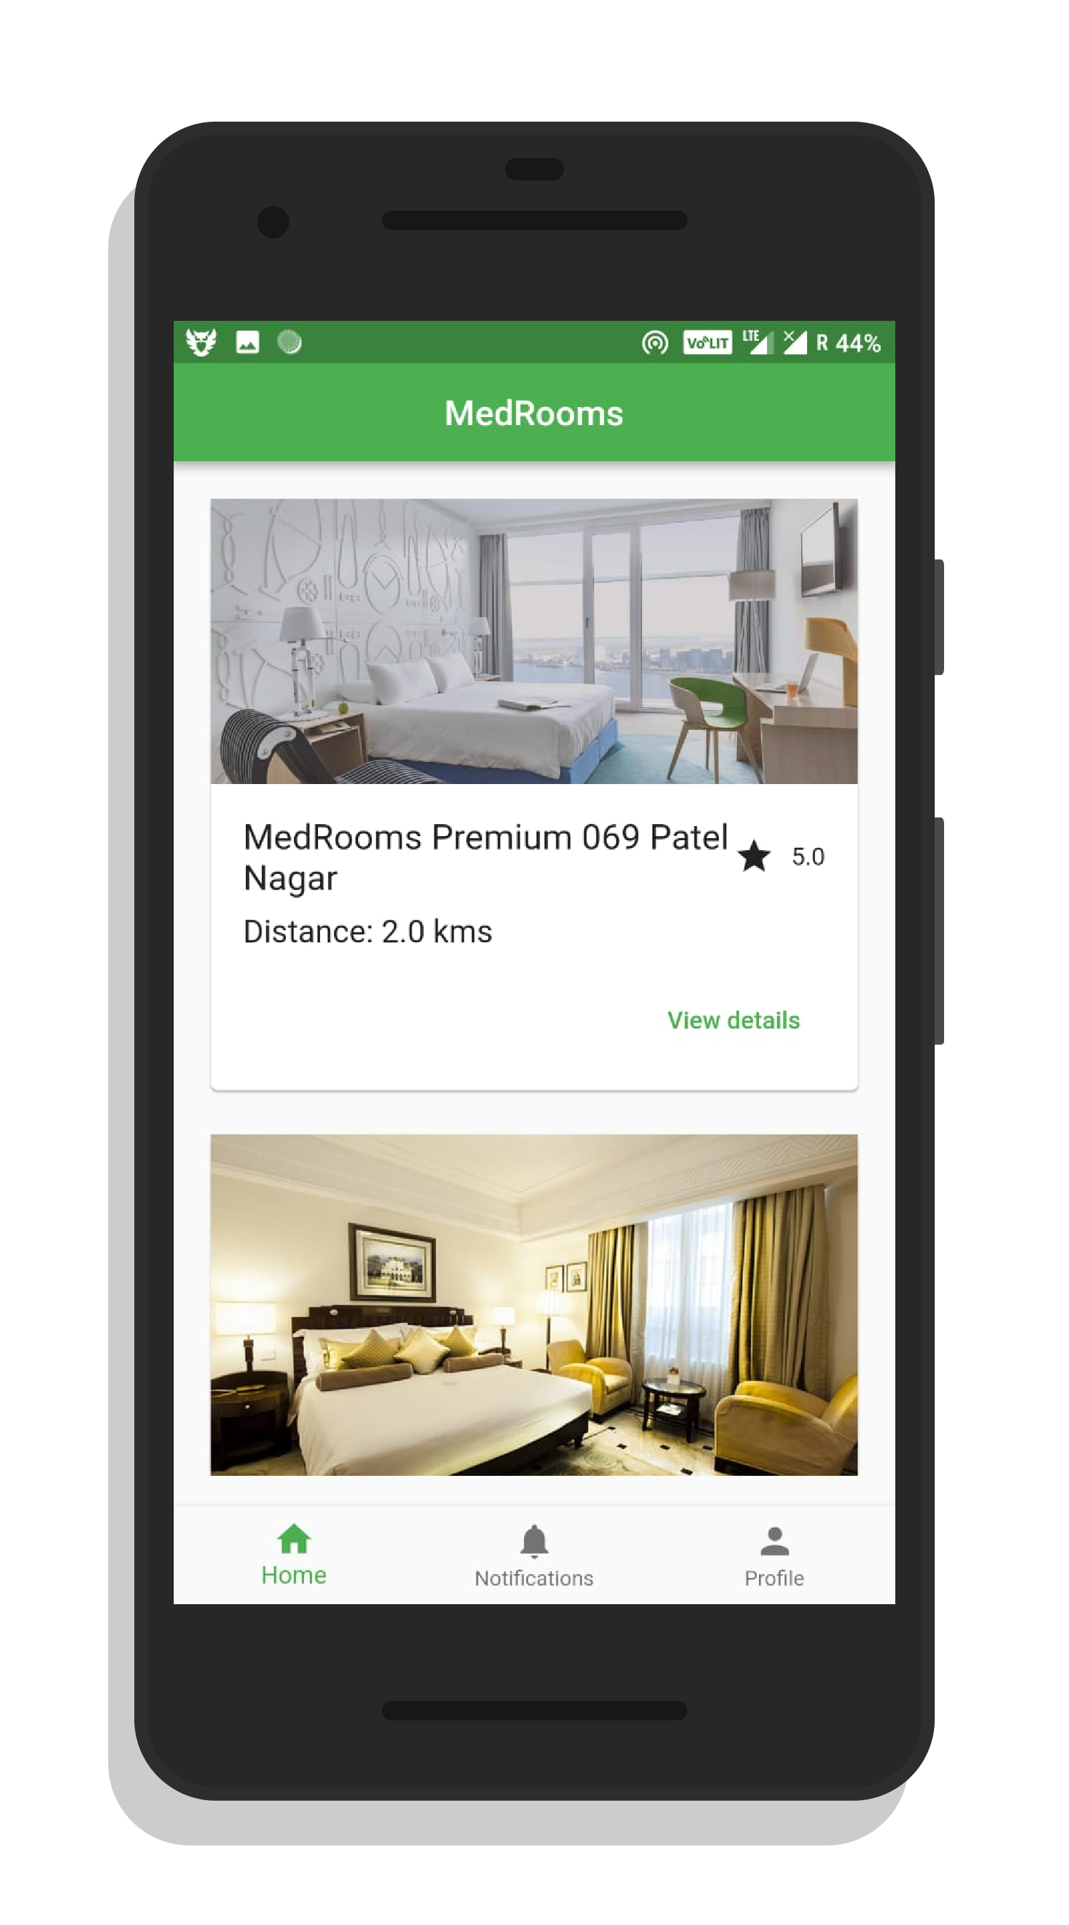
IDEA
Allisto
A complete environment which can take care of everything from detection to diagnosing.
Provide patients affordable detection of autism.
Provide a portal for the doctors to interact with the patients.
Affiliating with doctors to provide the best possible medical services.
Using Machine Learning to predict child’s probability of having autism.
4
Notes:
In future, it can help local medical stores benefit from the rented rooms by providing medicines and equipment.
It will further help increase employment opportunities for people willing to work as nurses and medicine delivery men for the rented rooms.
4

Slide 5
IDEA
Allisto
Why is this a good idea?
It increases awareness about autism.
Helps in early detection of autism in children.
Helps doctor get the proper information fast, so that they have time to act accordingly.
It increases accessibility of public healthcare for everyone
Increases employment opportunities
Utilizes healthcare infra and staff
Reduces need of newer infrastructure; we will need lesser hospital rooms.
Transparency of patient data to concerned personnel.
5
Notes:
5

Slide 6
IDEA
Allisto
How does the android app work?
The app is divided into three parts, which will be available to the user after sign in.
The 1st part : The News Column
Displays all the latest news regarding the domain, using web-scraping.
On click opens up a detailed explanation in the browser.
The 2nd part : User Profile
Has a complete form for the user to fill.
It also has a vaccine and medication portal which will be editable to the doctor.
The user also gets to upload relevant audio and video of the child.
The 3rd part : Pocket Doctor
A pre trained multi-purpose chat bot which is made in Dialogue Flow.
6
Notes:
6

Slide 7
IDEA
Allisto
How does the web app work?
The web app is an integral part of the environment
It calls the REST API, and displays the prediction based on the audio.
It provides the doctor with all the valuable information beforehand.
It is a cross platform, portable web application made on Angular and Electron.
It updates with the android app in real-time, using Firebase for database.
7
Notes:
7

Slide 8
IDEA
Allisto
How does the API work?
8
Notes:
8

Slide 9
IDEA
Allisto
Transparency
A blurry line?
Often, customers are forced to pay extra hidden costs. In our sight, this is a crime and intolerable. We will provide each party with every detail they require.
The parties involved need to specify pricing, and any relevant details/terms they wish for others to comply with.
None shall be permitted to modify these.
Information submitted prior is considered final for all.
9
Notes:
9

Slide 10
IDEA
Allisto
Roadblocks
Environment
The major problem we faced was the lack of a useful environment, that integrates both the doctor and the patient side.
Dataset
The lack of a proper dataset in the field created problems when the model was trained.
Resources
The lack of monetary resources limited us to the model used in training.
10
Notes:
10

Slide 11
IDEA
Allisto
Additional Support Information
Android | Deep Learning | Electron
Android : Android is a mobile operating system developed by Google, based on a modified version of the Linux kernel and other open source software and designed primarily for touchscreen mobile devices such as smartphones and tablets.
Deep Learning : We made a simple Artificial Neural Network to classify the recorded audio as autistic or non-autistic.
Electron : Electron is an open-source framework developed and maintained by GitHub. Electron allows for the development of desktop GUI applications using front and back end components originally developed for web applications: Node.js runtime for the backend and Chromium for the frontend.
11
Notes:
11

Slide 12
IDEA
Allisto
How much will it cost?
Almost Nothing.
The application itself won’t need much.
Currently, our environment runs on pyhtonanywhere.com which is free to use. This can later be expanded based on traffic and needs of our service.
The cost being negligible, we can also earn funds through sponsorships/ads and a miniscule fees that is charged from hospitals affiliated with us and using the service.
12
Notes:
12

Slide 13
IDEA
Allisto
Future of the service
Yes, it can scale further.
In future
13
Notes:
13

