Slide 1
ePIC craterlake: tracking performance & ML particle ID
Clean vs beam-background comparison · DIS NC 10x100 · 20 Sep 2026
Baseline tracking-performance agent: geometric acceptance, momentum resolution, track-finding efficiency, fake rate — plus reconstruction PID confusion and a new ML PID pipeline
Every metric on BOTH dataset types (clean Type 1, +background Type 2) + per-bin ratio/difference comparison
Truth: MCParticles (GEANT) · Reco: CentralCKFTracks, matched at weight >= 0.5
Status: tracking complete (150 clean + 200 bkg files, all 5 comparisons) · ML PID trained at grid scale, working points preliminary
Part 2 of this deck: how a newcomer continues this work with the AI agent

Slide 2
Datasets
Sample | Campaign | Files | Events/file | Used here
Type 1 clean | 26.02.0, minQ2=1 | 4,609 | 1,083 (~5.0M) | 150 files (~162k ev)
Type 2 +bkg | 26.07.1, minQ2=1 | 1,463 | ~99 (~145k) | 200 files (~20k ev)
Type 2 spare tiers | 26.07.1, minQ2=10/100/1000 | 902/547/551 | ~99 | staged, not yet run
Type 2 is the statistics bottleneck: ~11x fewer events/file than Type 1
Endpoints: JLab dtn-eic (clean) · hpceph-xrootd.twgrid.org (bkg, flaky: Operation expired -> per-file read cache + failure budget)
Different campaigns (26.02.0 vs 26.07.1): differences isolate background only insofar as geometry/reco match — acceptance is the cross-check

Slide 3
How each number is built
Matched pairs: CentralCKFTrackAssociations, valid at weight >= 0.5 (trkperf/matching.py single choke point)
Binned in truth pT (log) x truth eta (0.5 bins) x species (e, pi, K, p); >= 50 entries/bin or flagged insufficient
Acceptance: >= 4 of 7 central truth-hit collections fire (collection-level layer proxy)
Resolution: sigma of ROOT Gaussian core fit to (pT_reco - pT_truth)/pT_truth, bounded to physical [0,1]
Efficiency: absolute (matched/generated) + within-acceptance, Wilson intervals
Fake rate: unmatched reco tracks / all reco tracks, binned in the track's own (pT, eta)
Reco momentum comes from CentralCKFTrackParameters (qOverP, theta, phi) — CentralCKFTracks.momentum is all zeros in these files

Slide 4
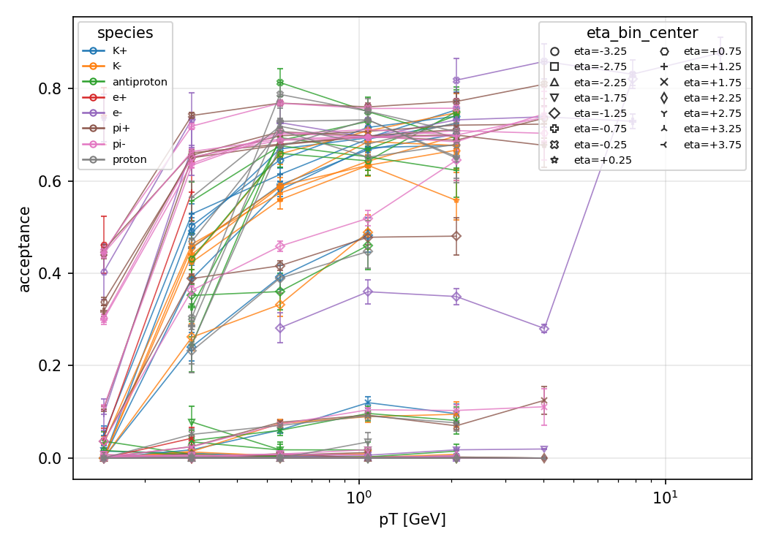
Acceptance: central tracking covers hadrons, not backward electrons
pi+ central (pT ~1.1 GeV, eta 0.25): 0.697 clean vs 0.740 bkg — agree within statistics
Backward e- (eta -2.75): ~0.00 in BOTH tags — outside the central tracker by geometry, not a background effect
706 bins compared clean-vs-bkg; bkg side 606 bins, 390 flagged (< 50 entries)
Acceptance is background-independent by construction -> agreement validates the cross-campaign comparison

Slide 5
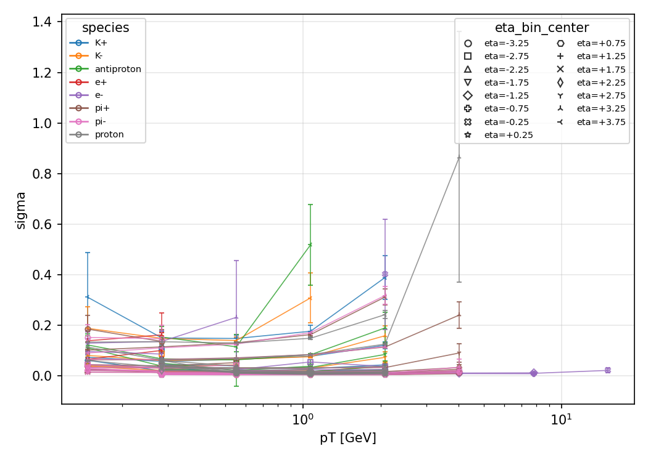
Resolution ~2% core; efficiency ~0.97 within acceptance
Gaussian core sigma (converged fits): median 0.019 (e-) / 0.016 (pi+) — chi2/ndf of order 1
pi+ central: absolute eff 0.96 clean vs 0.95 bkg; within-acceptance 0.97 vs 0.97 — no visible degradation
666 resolution + 706 efficiency bins compared; under-fed bkg bins flagged, never silently filled

Slide 6
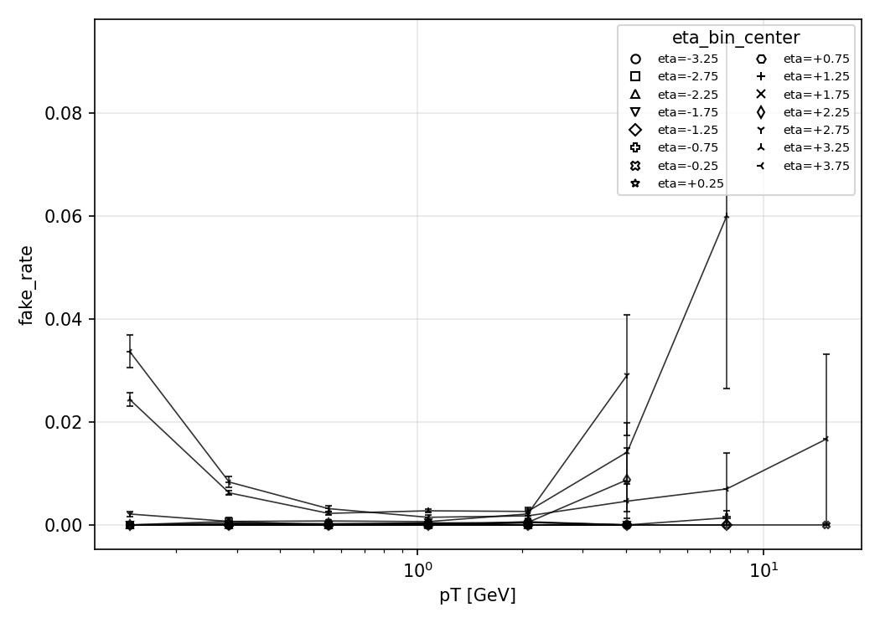
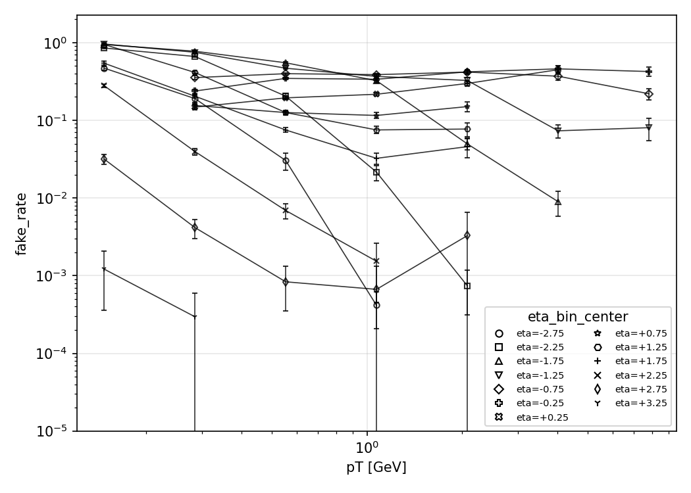
Fake rate: the one tracking metric background explodes
Low pT (~0.15 GeV): clean 0.000 vs +background 0.47-0.96 across eta
Combinatorial fakes from the background overlay dominate soft tracks; 118 bins compared
Never measured on single-particle gun (zero fakes by construction)

Slide 7
Reconstruction PID confusion: the baseline ML must beat
Mass-hypothesis PID from the reconstructor: for each truth species, fraction assigned each reco species, per (pT, eta)
4,138 bins compared clean-vs-bkg — the reference point for the ML confusion matrices
Pre-computed ParticleID likelihoods are unusable (null track relations in both campaigns) -> ML uses detector response directly

Slide 8
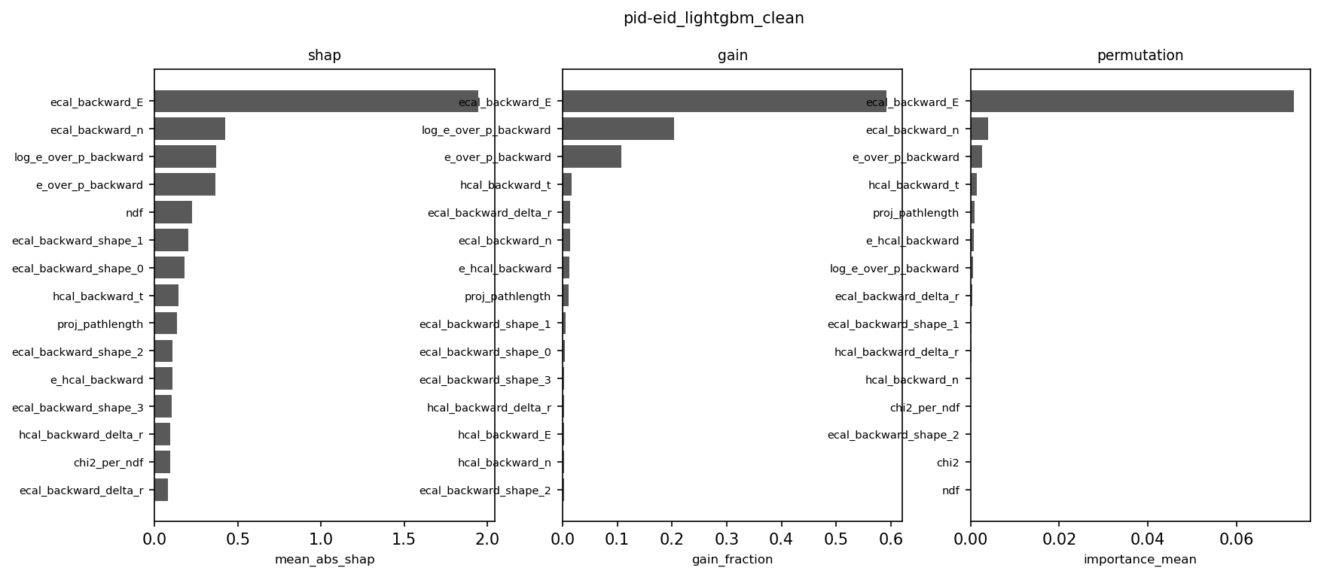
ML PID pipeline: leg-scoped tasks, 3 learners, hard gates
Tasks: eid + ehad (headline, backward leg) · Kpi/pK (exploratory) · pooled 4-class (cross-check)
Inputs: E/p, cluster E/shapes from hits, dRICH path lengths, chi2/ndf, DeltaR-matched projections — never kinematics, charge, truth, or producer PID
LightGBM / XGBoost / sklearn-HGB, grouped-by-file CV, seeded; 258 unit tests green
Gates (non-zero exit): train-test gap, label-shuffle control, E/p-attribution, leakage tripwire (> 0.95 halts)

Slide 9
PRELIMINARY: electron ID at grid scale
Test AUC per learner; held-out, file-grouped splits
Task | Clean LGBM/XGB/HGB | Bkg LGBM/XGB/HGB
eid (e/pi) | 0.9978 / 0.9978 / 0.9979 | 0.9943 / 0.9947 / 0.9937
ehad (e/had) | 0.9978 / 0.9978 / 0.9979 | 0.9950 / 0.9950 / 0.9951
hadpid (expl.) | 0.690 / 0.696 / 0.690 | —
pooled (x-check) | 0.866 / 0.869 / 0.867 | —
eid clean: n-sigma 4.03; eff 96.9% @ 1% fake, 94.7% @ 0.1% fake (38k e / 2k pi held out)
eid +bkg: n-sigma 3.58; eff 89.4% @ ~1% fake — modest degradation, wider stats
Cross-learner agreement PASS everywhere (spreads <= 0.006)
PRELIMINARY: physics attribution gate FAILs at scale (raw ECAL energy outranks E/p) — under adjudication, do not quote as final

Slide 10
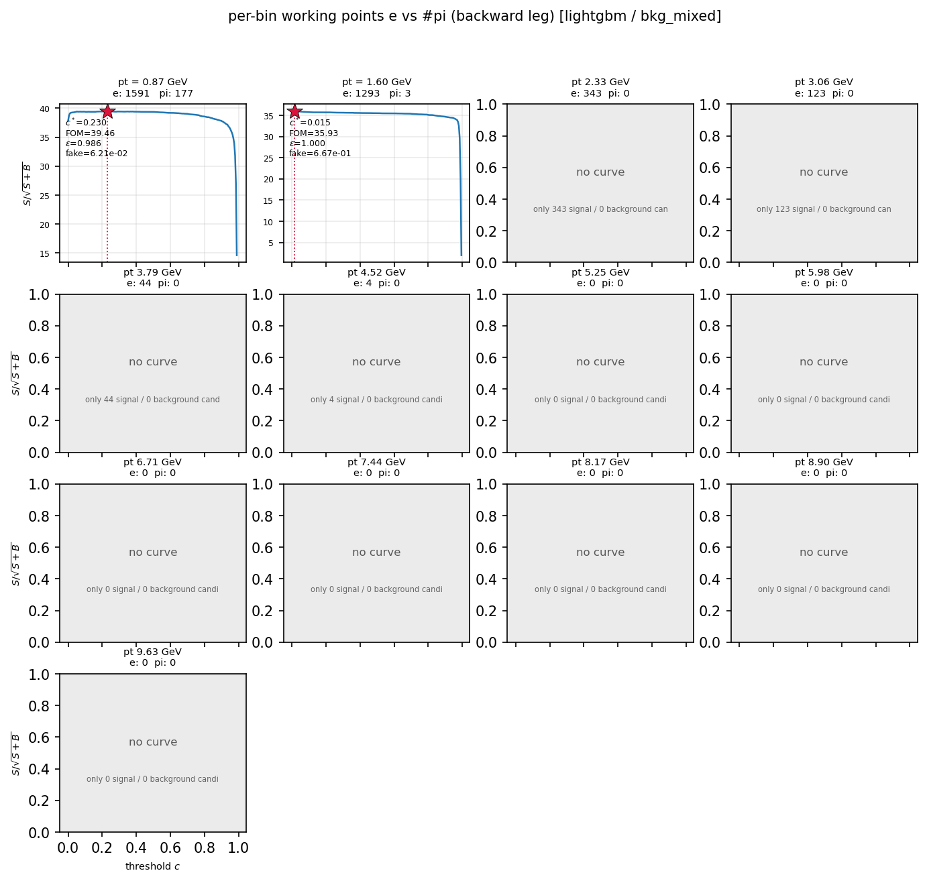
Working points: max-significance cuts, fully manifested
Cut c* maximises FOM = S/sqrt(S+B) globally + per pT bin; degenerate optima labelled, never presented as working points
Zero-background tails quote Clopper-Pearson lower limits, never 1/0 rejection
13 figures per channel: FOM curves, c*(pT), eff/fake/purity maps, rejection vs p, n-sigma vs p, overtraining check
Manifests complete: 104/104 clean + 26/26 bkg; eid/ehad clean-vs-bkg comparisons written

Slide 11
Caveats you should hear
ML PID working points are preliminary until the E/p-attribution FAIL is adjudicated (shortcut learning vs over-strict gate)
Hadron channels are exploratory baselines (K/pi AUC ~0.57-0.70, calorimeter-only) — full pi/K/p needs Cherenkov/timing links
Type 1 vs Type 2 are different campaigns: acceptance agreement supports, but cannot prove, a pure-background interpretation
Bkg statistics ceiling ~1e-3 fake rate without minQ2 10/100/1000 escalation; 545/606 efficiency bins flagged on the bkg side

Slide 12
Conclusions & next steps
Tracking is robust to background except soft-track fakes: acceptance/efficiency/resolution agree; low-pT fake rate 0 -> ~0.5-0.95
Electron ID looks excellent (AUC ~0.998 clean / ~0.995 bkg) but stays preliminary pending the attribution decision
Next: (1) adjudicate E/p vs raw-energy ranking; (2) decide Type-2 statistics escalation (1,263 files + higher minQ2 staged); (3) hadron-ID Cherenkov/timing routes
Everything reproducible: trkperf + pid packages, 258 + 41 tests, JSON/MD/ROOT outputs with full provenance in output/

Slide 13
Part 2 — continuing the work with the AI agent
Onboarding: environment, skills, commands, and rules of the road

Slide 14
Agent setup: open the project, read the contracts
Work inside eic-shell; start data services with eic-mcp up (uproot/xrootd/rucio on 127.0.0.1:9101-9103)
Launch the agent with baseline_tracking_performance_agent/ itself as the working root
Read first: AGENTS.md (rules), PLAN.md (tracking as-built), PLAN_pid.md (PID as-built + open items in section 12)
  Skills load automatically per task — 8 total:
  tracking: acceptance, momentum-resolution, track-efficiency, fake-rate, pid-confusion
  grid procedure: trkperf-grid-workflow · ML PID: pid-ml, pid-performance
Reference pair for fast iteration (no network): data/dataset_small/ (clean signal + signal_BKG_mix)

Slide 15
Tracking workflow through the agent
Ask for a metric skill-first (e.g. 'run acceptance'): it discovers files via rucio/xrootd, never from a hardcoded list
Clean: python -m trkperf <metric> --file-list filelists/clean_150.txt --dataset-tag clean --min-q2-tier 1
Background: add --max-file-failures 5-20 --cache-dir cache/bkg_files (flaky endpoint: retries once, skips, records)
Compare: python -m trkperf compare --metric <m> --clean ... --bkg ... (or scripts/run_comparisons.sh)
Long bkg runs: scripts/launch_bkg.sh (detached setsid+nohup) — sessions die with the container, the cache makes relaunches cheap
Escalation order for thin bins: more files in tier, then minQ2 10 -> 100 -> 1000 (Type 2 only)
Outputs land in output/<metric>_<tag>.{json,md,root} + plots, with full provenance meta

Slide 16
ML PID workflow through the agent
Smoke first (seconds, local pair): python -m pid all --relax-gates; full suite: python -m unittest discover -s pid/tests
Steps: python -m pid {schema-check|features|train|evaluate|importance|performance|compare} --dataset-tag <tag> ...
Grid: pid/scripts/run_pid.sh <clean|bkg_mixed> <filelist> <max-failures> (trains all 3 learners, ends with check_learners.py agreement gate)
Working points: pid performance (13-figure manifest + figure_notes); comparison: pid compare (e.g. compare all for eid+ehad)
Monitor: scripts/job_report.sh (read-only status of both grid jobs); process, stage, gates, tracebacks, manifests
Status legend: headline (eid/ehad) vs exploratory (Kpi/pK) vs cross-check (pooled) — exploratory plots carry .note sidecars

Slide 17
Rules of the road (what the agent enforces)
Extend trkperf/ / pid/ — never bespoke one-off I/O; pid/ imports trkperf for all ROOT access
Never install software; classifiers come from ~/.eic_python_pkgs via PYTHONPATH
Gates are hard exits: fix the cause, or record an explicit adjudication — never sail past, never silently swallow exceptions
Flaky endpoint != broken: timed-out MCP call -> wait, retry once, then report tool + arguments
Never quote thin bins: >= 50 entries or flagged insufficient_stats; never reuse a stale cached result as fresh
Commit all except *.pyc and giant pickles (the 460 MB feature tables stay out of git); verify with tests + ruff before pushing
First tasks for a newcomer:
  run both test suites -> rerun the smoke (pid all) -> read a manifest + one comparison JSON -> pick an item from PLAN_pid.md section 12

