Slide 1
ePIC tracking & ML PID — results by plot
Each slide: one result figure, the exact merit equation, and the data source behind it
Tracking: 150 clean files (26.02.0, minQ2=1) vs 200 +background files (26.07.1, minQ2=1); truth bins in pT (log) × η (0.5) × species; match weight ≥ 0.5; ≥ 50 entries/bin or flagged
ML PID: eid/ehad (backward leg, headline), Kpi/pK (exploratory), pooled (cross-check); LightGBM/XGBoost/sklearn-HGB, file-grouped splits, held-out evaluation
Figures from three folders: output/plots/ (evaluate+importance, tagged names), output/plots_clean/ + output/plots_bkg_mixed/ (working-point figures per tag)
Outputs: output/*.json/.md/.root + output/plots/*.png; manifests 104/104 clean, 26/26 bkg
ML working points are PRELIMINARY — physics attribution gate under adjudication

Slide 2
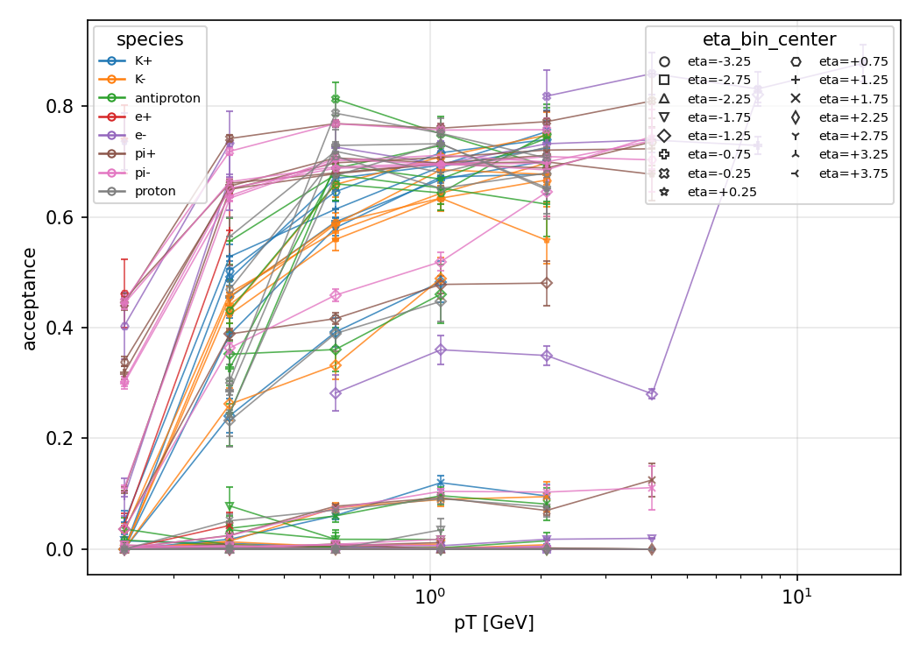
Geometric acceptance: hadrons covered, backward electrons not
output/acceptance_clean_vs_pt.png — acceptance vs pT, curves per species/η
A = N_in_acc / N_gen, N_in_acc = particles with ≥ 4 of 7 hit collections firing
Error: Wilson 95% score interval (never zero-width at A = 1, NaN at n = 0)
π⁺ central (pT ~1.1 GeV, η 0.25): 0.697 clean vs 0.740 bkg — agree; acceptance is background-independent by construction, so this validates the cross-campaign comparison
Backward e⁻ (η −2.75): ≈ 0 in both tags — outside the central tracker by geometry
Colors = species, marker shapes = η bins; read one curve per (species, η)
706 bins compared; bkg side 606 bins, 390 flagged (< 50 entries)
Source: output/acceptance_clean.json (150 files) vs acceptance_bkg_mixed.json (200 files) → acceptance_comparison.json

Slide 3
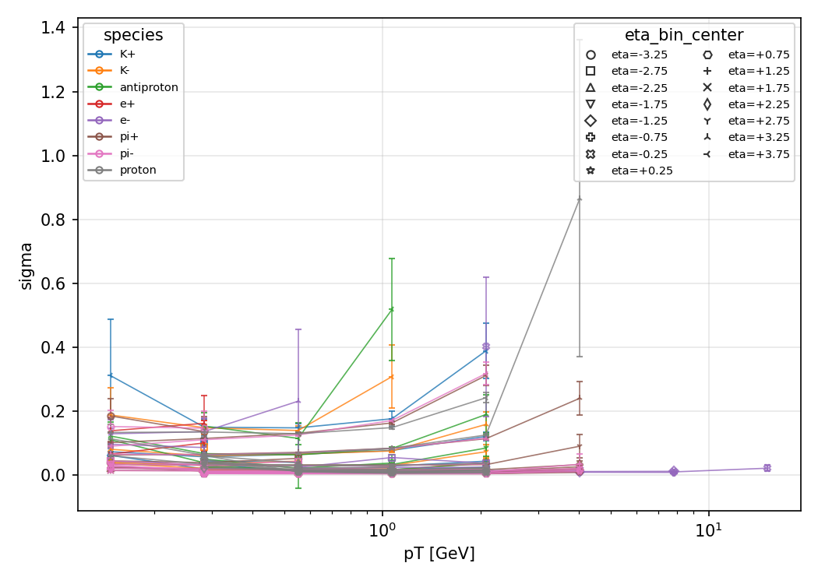
Momentum resolution ≈ 2% core, Gaussian
output/resolution_clean_sigma_vs_pt.png — fitted core σ vs pT
δ = (pT_reco − pT_truth) / pT_truth, fit TH1F.Fit(TF1 gaus), two-pass core refit ±3σ
σ bounded to the physical [0, 1] (100% resolution ceiling); bound-pinned fits reported converged=False, never as huge numbers
Converged medians: σ = 0.019 (e⁻) / 0.016 (π⁺); χ²/ndf of order 1
Reco momentum from CentralCKFTrackParameters (qOverP, θ, φ) — CentralCKFTracks.momentum is all zeros in these files
Source: output/resolution_clean.json (150 files, ROOT fits) vs resolution_bkg_mixed.json (200 files) → resolution_comparison.json (666 bins)

Slide 4
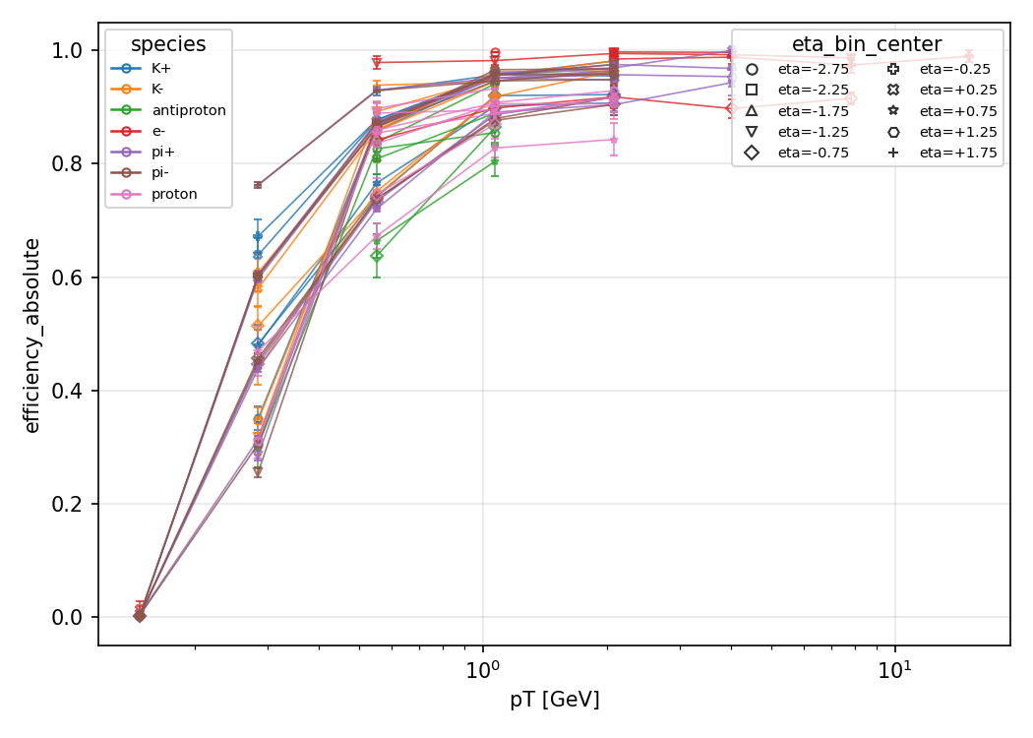
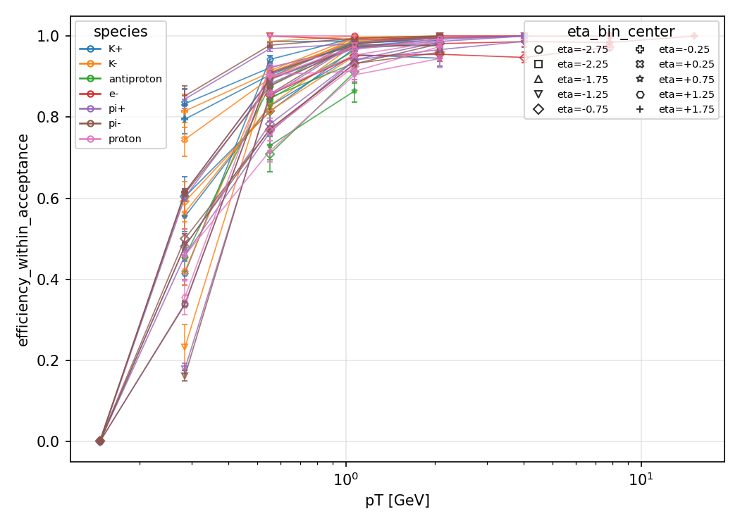
Track-finding efficiency ≈ 0.97, no background loss
absolute (top) and within-acceptance (bottom) vs pT
ε_abs = N_matched / N_truth and ε_in = N_matched_in_acc / N_in_acc, Wilson 95% errors
π⁺ central: ε_abs 0.960 clean vs 0.954 bkg; ε_in 0.971 vs 0.969 — no visible degradation
Both efficiencies measured directly (not acceptance × conditional); floor on the smaller denominator
706 bins compared; under-fed bkg bins flagged, never silently filled
Source: output/efficiency_clean.json vs efficiency_bkg_mixed.json → efficiency_comparison.json

Slide 5
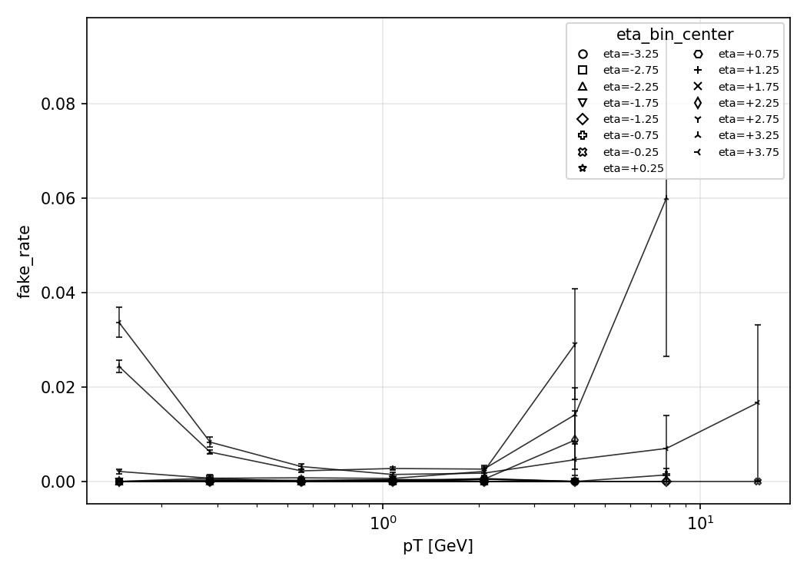
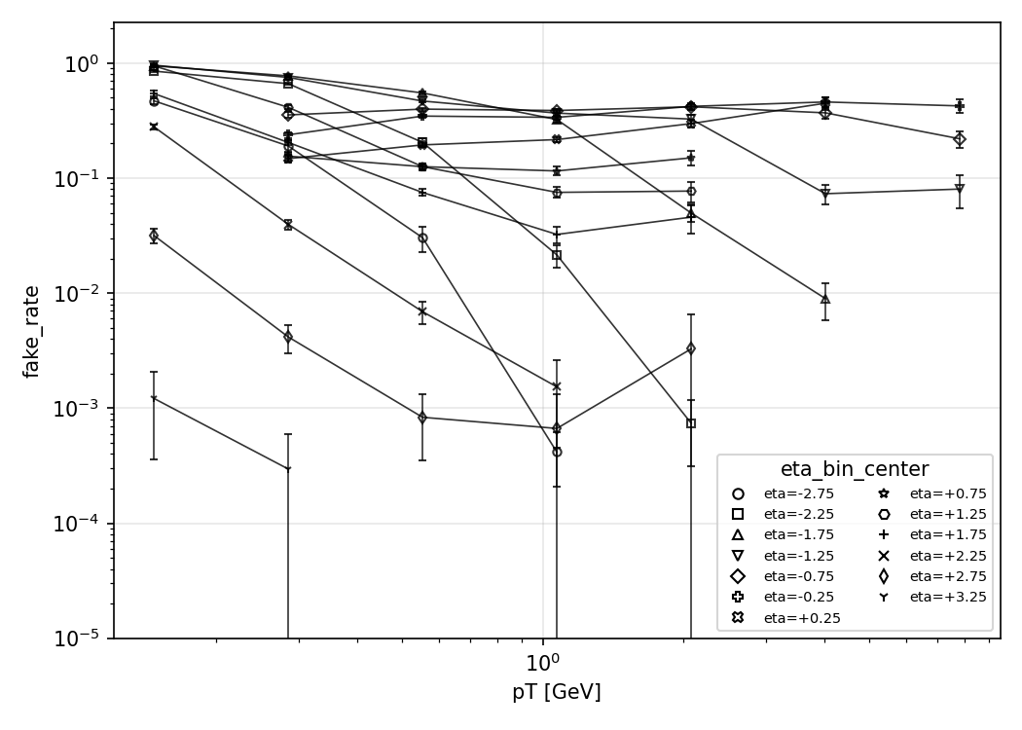
Fake rate: background explodes soft-track combinatorics
clean linear (top) vs +background log-y (bottom)
f = N_fake / N_tracks, fake = reco track with no weight-≥0.5 truth match; Wilson 95% errors
Binned in the track's OWN (pT, η) — a fake has no true species; never measured on single-particle gun
Low pT (~0.15 GeV): 0.000 clean vs 0.47–0.96 +background across η — the one tracking metric background breaks
118 bins compared clean-vs-bkg
Source: output/fake-rate_clean.json vs fake-rate_bkg_mixed.json → fake-rate_comparison.json

Slide 6
ML inputs: detector response only — 52 features
52-column allowlist (leg-scoped tasks use their leg's half)
Family | Variables (×2 legs where shown) | n
ECAL E/p | e_over_p, log_e_over_p (backward + forward) | 4
ECAL cluster | E, n, t, ΔR, has_shape, shape_0..6, rms_x/y/r, core_frac | 24
HCAL + leakage | E, n, t, ΔR, e_hcal, leakage | 12
Cherenkov | has_drich_gas/aerogel, gas/aerogel pathlength | 4
Tracker | chi2, ndf, chi2/ndf, proj_pathlength | 4
Flags | has_ecal, has_hcal (×2 legs) | 4
NEVER inputs | p/pT/η (binning vars), charge, truth, producer PID | —
Missing stays NaN + has_* flag — never zero-filled; all-NaN columns dropped loudly (eid matrix: 52 → 30 real inputs)
Fail-closed allowlist + NEVER-model patterns (mc_/true_/gen_, weights, ids); leakage tripwire halts at |corr| > 0.95
Source: pid/config.ALLOWED_BASELINE_COLUMNS; feature tables output/pid-features_{clean,bkg_mixed}.pkl (627k / 93k rows)

Slide 7
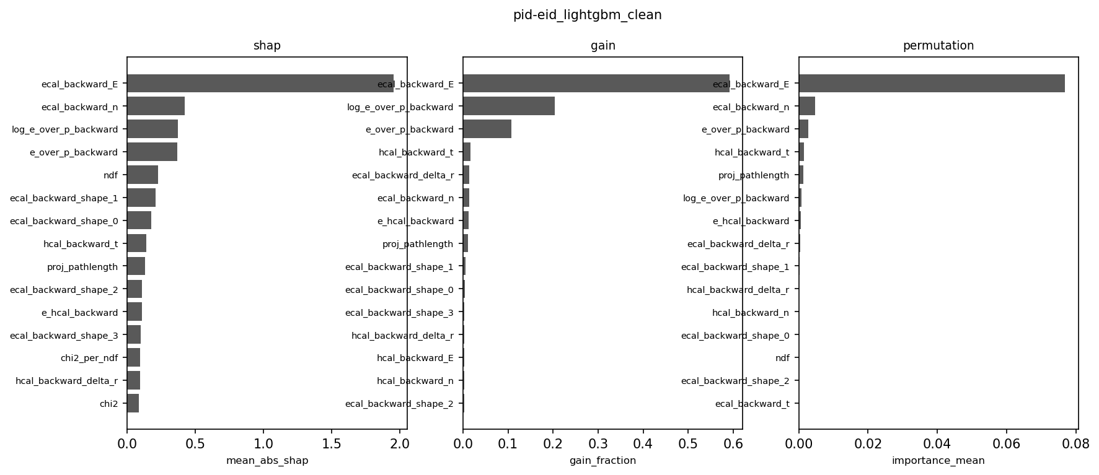
Feature importance: calorimeter energy leads, E/p decides
pid-eid_lightgbm_clean-importance.png — SHAP / gain / permutation
SHAP top (eid, LightGBM, clean): ecal_backward_E 1.96, ecal_backward_n 0.42, log_e_over_p 0.37, e_over_p 0.36, ndf 0.22
Gain top: ecal_backward_E 0.59, log_e_over_p 0.20, e_over_p 0.11 — gain counts usage, SHAP measures decision
Gate: E/p must lead SHAP for eid/ehad — here raw ECAL energy outranks it → physics FAIL under adjudication (shortcut vs over-strict gate)
+Background agrees on the ranking (SHAP: E 1.76, n 0.50, E/p 0.30; gain: E 0.80) — the attribution pattern is stable across tags
Exact TreeSHAP from the booster (no shap package); multiclass XGB averages over classes; HGB uses gain + permutation
Source: output/pid-eid_lightgbm_clean-importance-{gain,shap,permutation}.json; 52 rows each

Slide 8
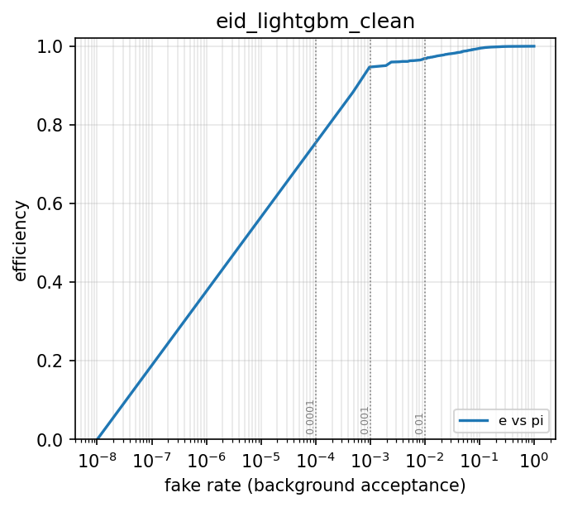
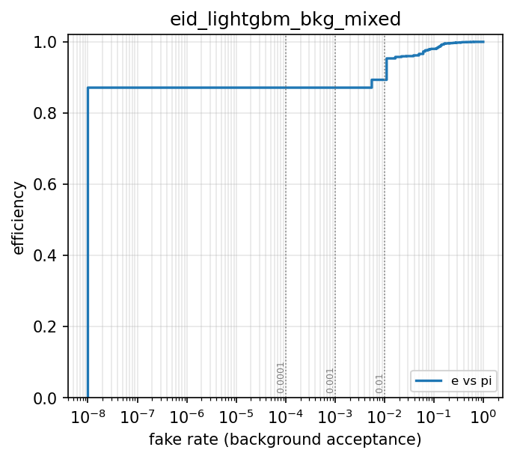
ROC: electron ID holds up on +background
ROC, clean (top) vs +background (bottom)
eff(c) = S(c)/Stot, fake(c) = B(c)/Btot; AUC = P(s_sig > s_bkg)
Clean (top): AUC 0.9978, 38k e / 2k π held out; +background (bottom): AUC 0.9947, 3.4k e / 180 π
Same classifier family, same cuts vocabulary — the bkg curve sits marginally below, not collapsed
Dotted verticals mark the 10⁻²/10⁻³/10⁻⁴ working-point targets on both
Source: output/plots/pid-eid_lightgbm_{clean,bkg_mixed}-roc.png (evaluate, tagged names)

Slide 9
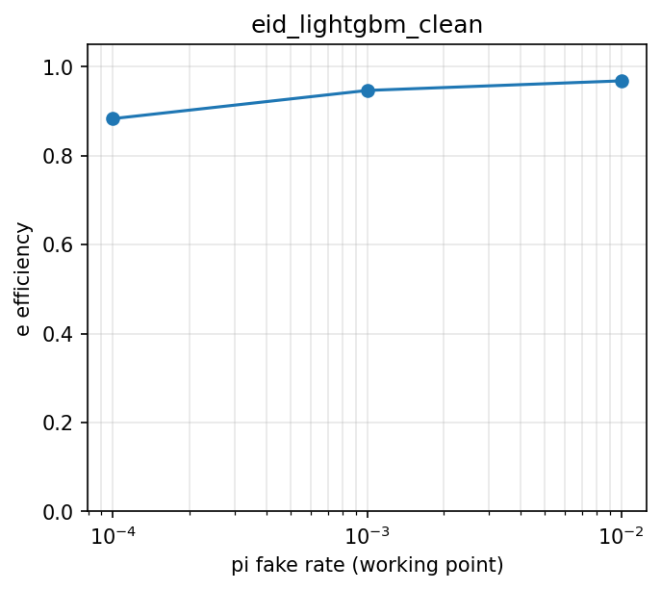
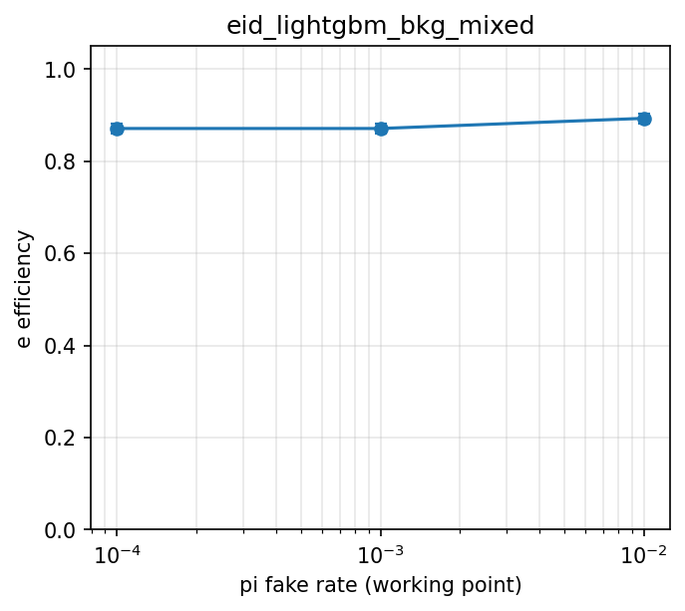
Efficiency at fixed fake rate, both tags
efficiency vs fake-rate target, clean (top) vs +background (bottom)
Clean: eff 96.9% @ 1% fake (achieved 0.97%), 94.7% @ 0.1% — Garwood intervals on counts
Bkg: eff 89.4% @ ~1% (achieved 0.56%), 87.1% @ 0.1% (0 background passing — limit regime)
Working points read off each tag's own ROC, so the comparison is apples-to-apples
Source: output/plots/pid-eid_lightgbm_{clean,bkg_mixed}-eff_vs_fake.png

Slide 10
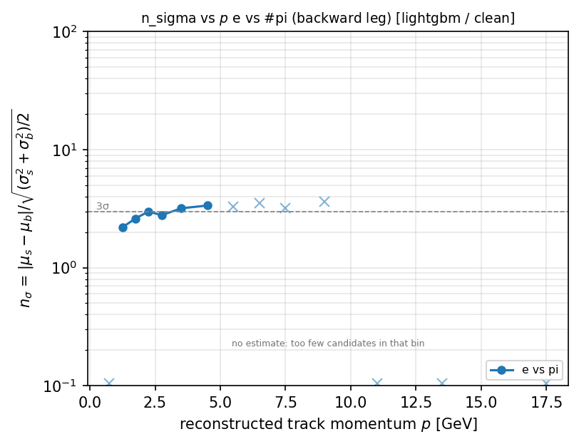
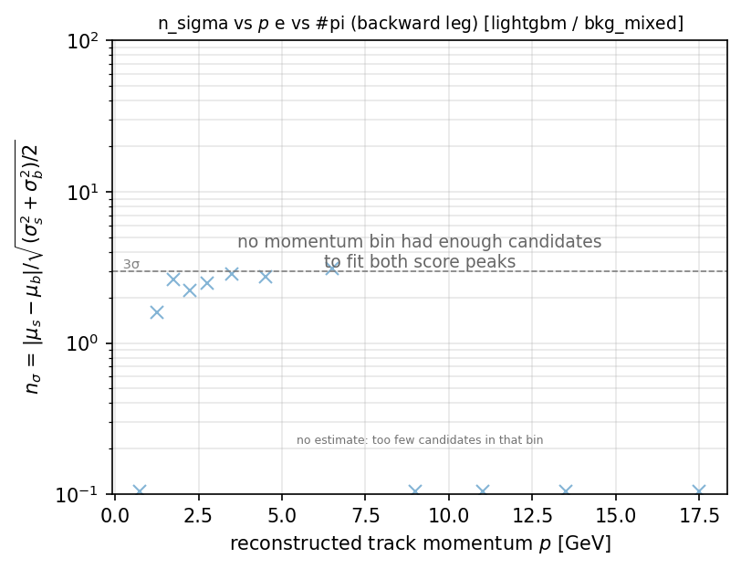
Separation power: nσ = 4.0 clean, 3.6 +background
pid-eid_nsigma_vs_p.png, clean (top) vs +background (bottom)
nσ = 2·erfinv(2·AUC − 1) [exact for equal-width Gaussians, fit-free]; fallback: logit-space Gaussian fits
eid: nσ 4.03 clean (top) → 3.58 bkg (bottom); ehad: 4.02 → 3.65 (LightGBM, held-out)
AUC = 1 saturates the estimator → 95% CL lower limit d_L from the no-overlap integral, never ∞
Circles = point estimates, triangles = limits, crosses = thin bins; 3σ line drawn
Source: output/plots_{clean,bkg_mixed}/pid-eid_nsigma_vs_p.png (per-bin AUC tables)

Slide 11
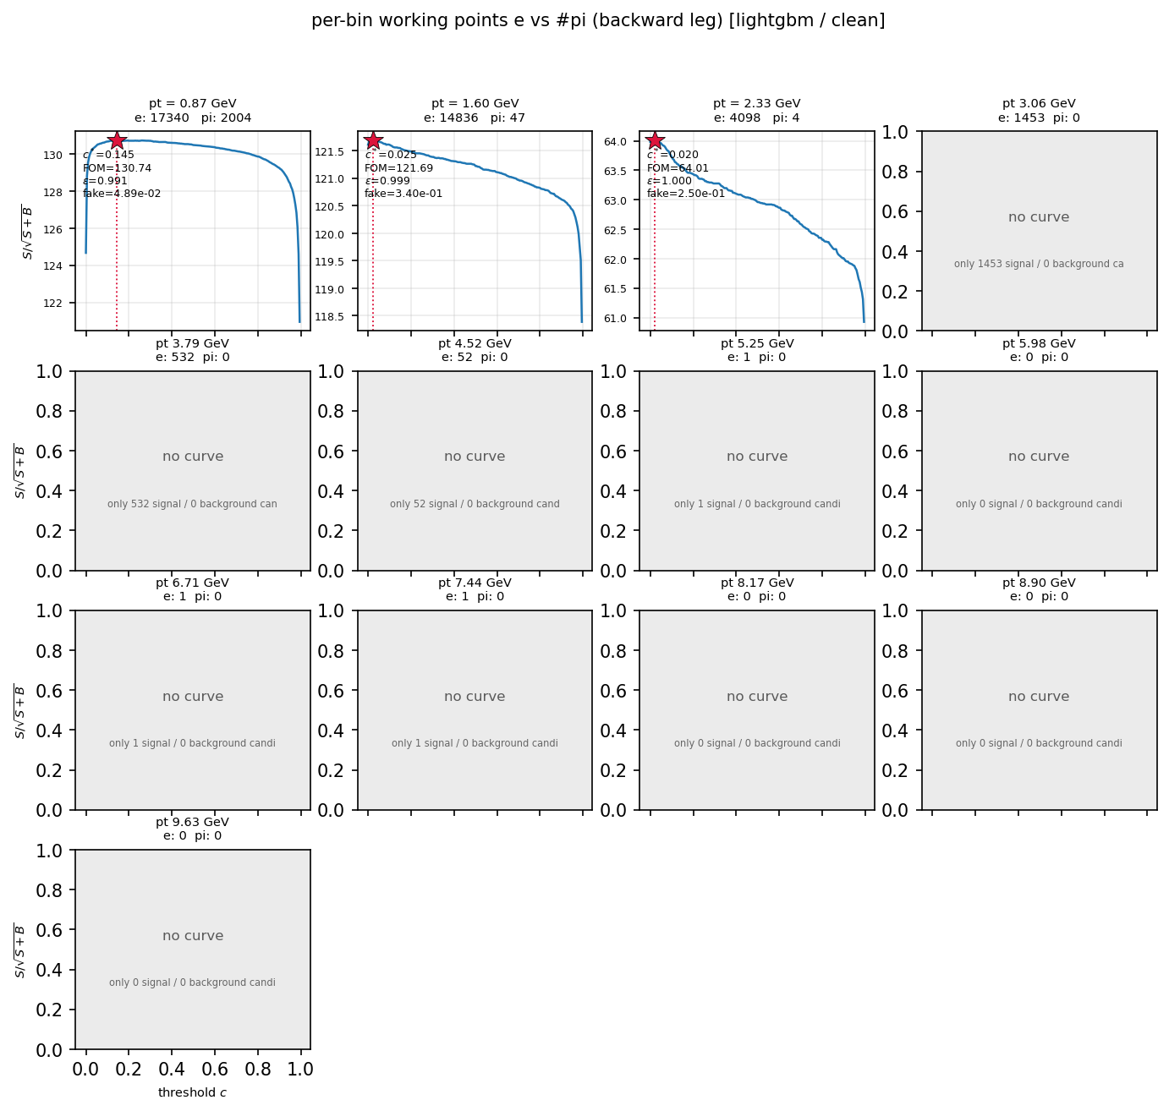
Working points: max-significance cuts per channel and pT bin
pid-eid_significance_vs_cut_panels.png — FOM(c) per pT bin with c*
FOM(c) = S(c)/√(S(c)+B(c)); c* = argmax; ties → most rejective; Σw² variances when weighted
Per-bin c*(pT): bins lacking a species get no curve and a grey panel with the reason — never interpolated
Degenerate optima labelled (accept-everything, permissive, pinned, <5 bkg) rather than presented as selections
Grey panels name their reason (e.g. only N signal / 0 background) — the bkg tag has more of them
13 figures/channel; manifests 104/104 clean + 26/26 bkg; eid/ehad clean-vs-bkg comparisons written
Source: pid performance on all_scores.pkl (test rows); output/pid-{eid,ehad,Kpi,pK}_lightgbm_{clean,bkg_mixed}-*.json

Slide 12
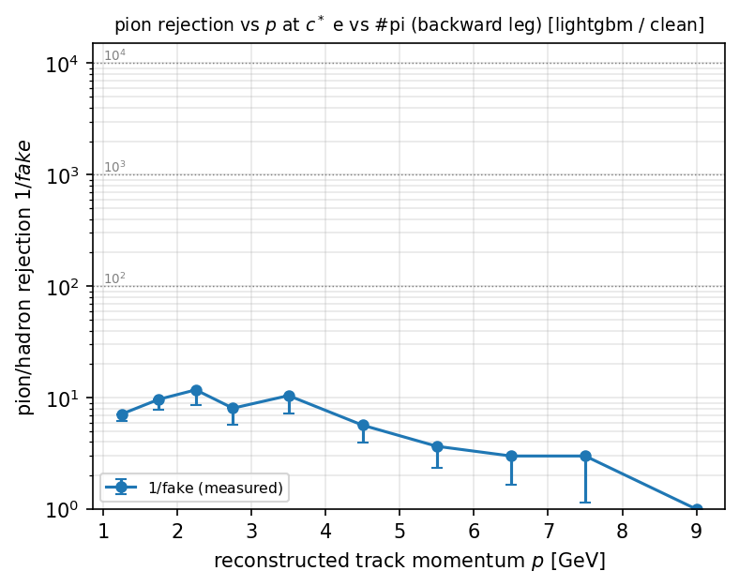
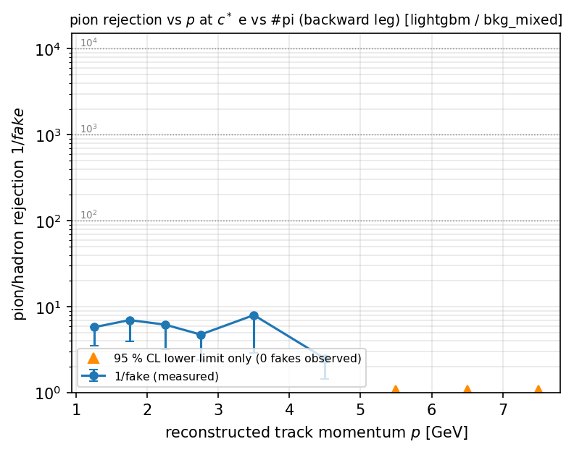
Pion rejection vs momentum, with honest limits
pion rejection vs p, clean (top) vs +background (bottom)
R = 1/f(c*); zero passing background → R undefined → 95% Clopper-Pearson LOWER limit R > 1/f_upper
Clean (top): measured points where statistics allow; orange triangles = limit-only bins
Bkg (bottom): thinner — more limit arrows, the price of 180 held-out pions
Error bars reach down to the limit; electron channel ships this as pion_rejection_vs_p
Source: output/plots_{clean,bkg_mixed}/pid-eid_pion_rejection_vs_p.png (count-based limits)

Slide 13
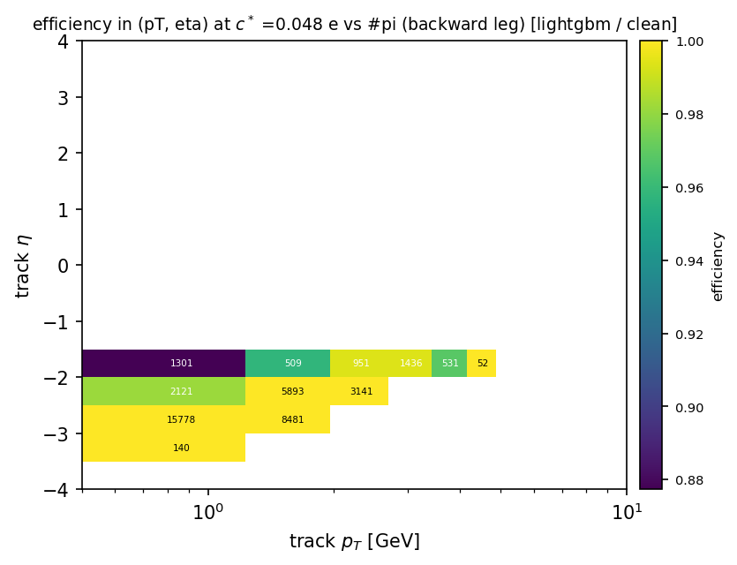
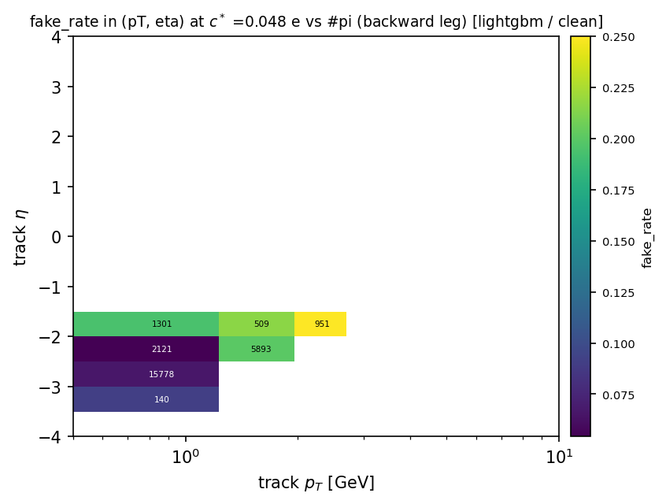
Where the selection works: 2D efficiency and fake maps
efficiency (top) and fake-rate (bottom) in (pT, η) at c*
cell: eff = S/Stot, fake = B/Btot at c*; cells with < 20 candidates masked NaN (white), never zero
Counts annotated per cell — a dip with high counts is a detector crack; a white cell is unmeasured
Uniform pT bins 0.5–10 GeV × η bins 0.5; reco-binned (what a cut is applied to) with truth-binned *_truthpt twins
Source: output/pid-eid_lightgbm_clean-{eff,fake}_map_pt_vs_eta{,_truthpt}.json

Slide 14
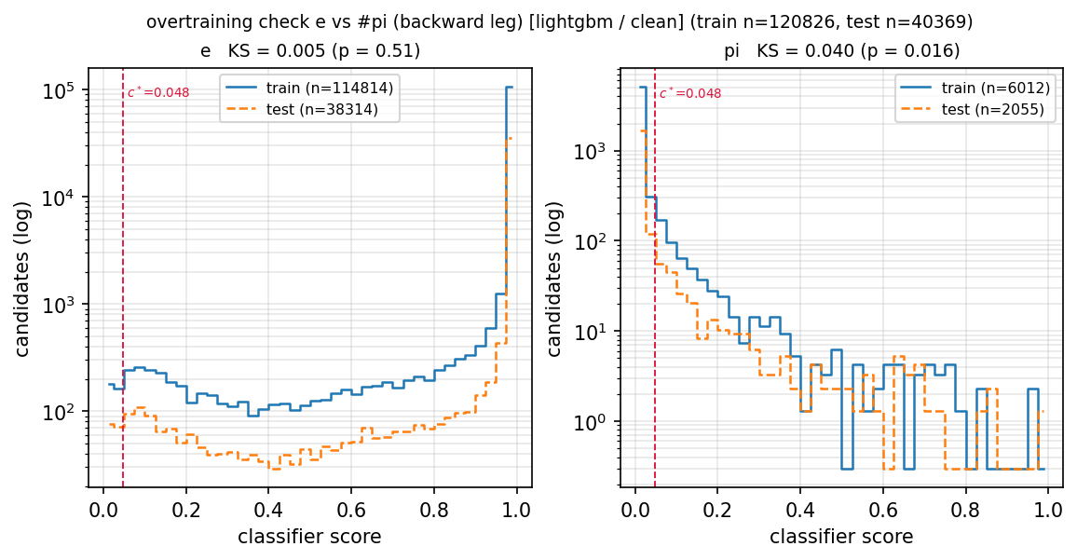
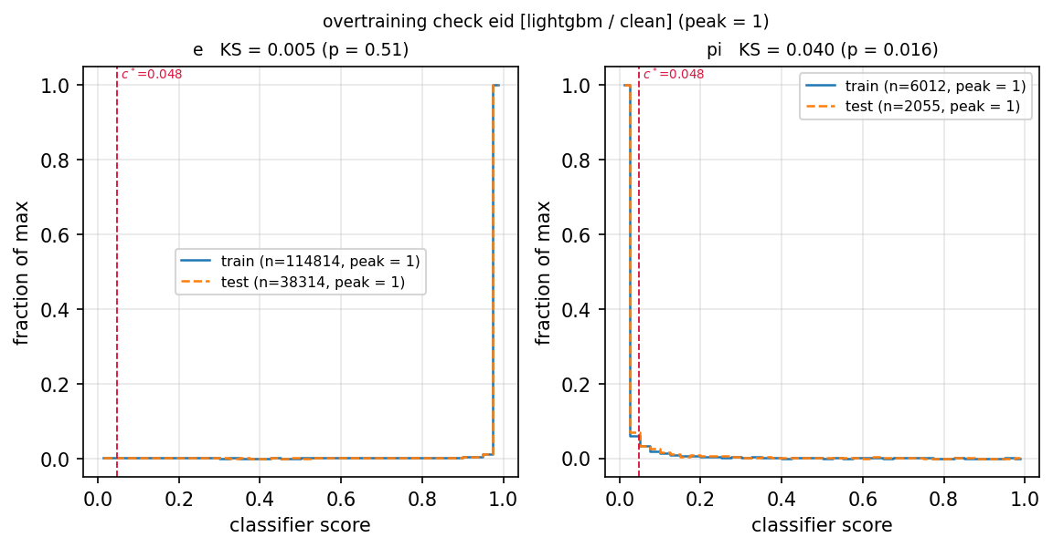
Overtraining check: shapes coincide at peak = 1
counts (top) vs peak-normalised (bottom) — no memorisation gap
Counts (top): train floats above test by the 3× row ratio — expected; peak-normalised (bottom): shapes coincide at 1.0
Per-class train/test score histograms + two-sample KS: e KS = 0.005 (p = 0.51), π KS = 0.040 — no memorisation
Train rows used ONLY here; every merit is computed on held-out files (file-grouped splits); gap gate ≤ 0.02 (measured 0.0008)
Source: output/plots_clean/pid-eid_score_dist_train_vs_test{,_density}.png from all_scores.pkl

Slide 15
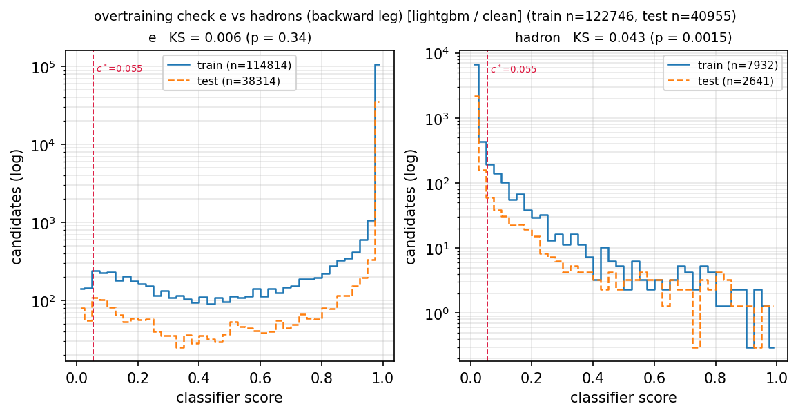
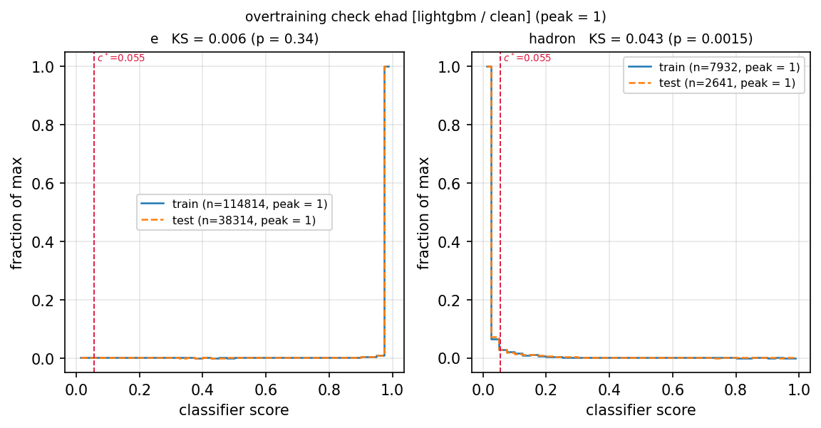
Overtraining check: ehad agrees too (peak = 1)
counts (top) vs peak-normalised (bottom) — ehad, clean
Counts (top) vs peak-normalised (bottom): e KS = 0.006, hadron KS = 0.043 — same story as eid
Train−test AUC gap 0.0009 (lightgbm clean); label-shuffle control passed
Kpi/pK peak twins also written (plots_clean); their KS ~0.10–0.14 reflects weak models on small samples, consistent with the failed train−test gap gate there
Source: output/plots_clean/pid-ehad_score_dist_train_vs_test{,_peak}.png from all_scores.pkl

Slide 16
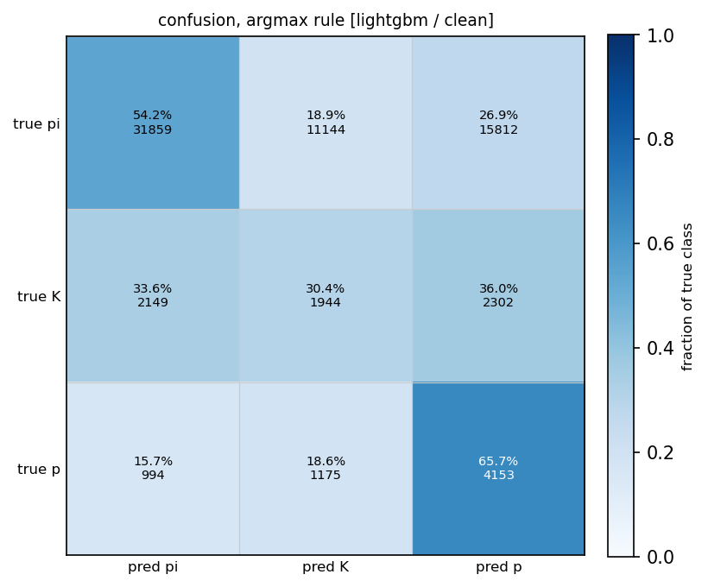
ML confusion: who gets mistaken for whom
pid-hadpid_confusion_matrix.png — row-normalised, counts annotated
row fraction = N_ij/N_i [efficiency view]; col fraction = N_ij/M_j [purity view]; Wilson intervals
Built from HELD-OUT rows only (in-sample recall flatters: K 72% in-sample vs 27% held out on smoke)
At-cut version uses per-class c* with an explicit UNASSIGNED column — the PID may decline to identify a track
Cells annotated with % + counts; blue intensity = row fraction
Task-level figure (hadpid task, written once); complements the reconstructor's own confusion (4,138 bins compared)
Source: output/pid-hadpid_lightgbm_clean-confusion.json + confusion_matrix_atcut

Slide 17
Clean vs +background: ratios, differences, and caveats
ratio R = b/c, (δR/R)² = (δb/b)² + (δc/c)² (R=0 carries db/|c|); diff D = b−c, δD = √(δb²+δc²)
Tracking: acceptance/efficiency/resolution agree; fake rate explodes at low pT. PID: eid nσ 4.03→3.58, eff@1% 96.9%→89.4%
Bkg statistics ceiling ≈ 10⁻³ fake rate without minQ2 escalation (545/606 efficiency bins flagged on bkg side)
Caveats: different campaigns (acceptance agreement is the cross-check); ML points preliminary (E/p gate); hadron channels exploratory
Source: output/*_comparison.json + pid compare (eid/ehad overall, vs_pt, vs_eta + summaries)

