Slide 1
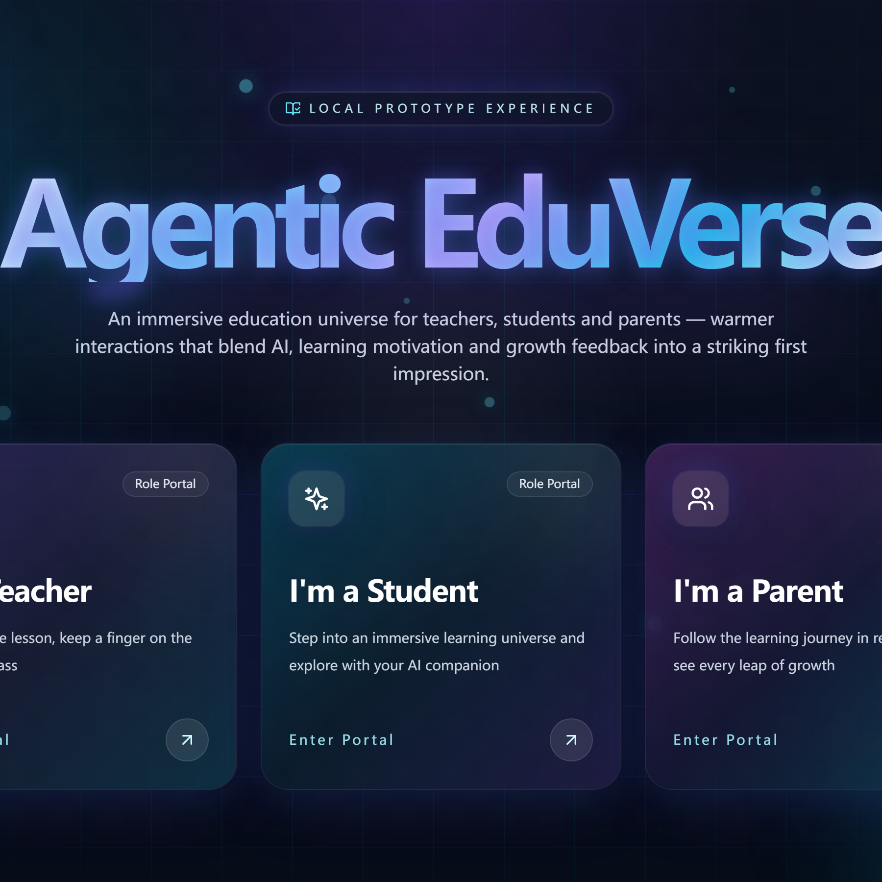
HACKMIT ROADSHOW · 2026
Agentic
EduVerse
One universe. Three portals.
An AI classroom that already runs.
Team Binary — Jenny & Elara Malvern College Chengdu

Slide 2
The world has a teaching gap
44M
7/10
more teachers are needed by 2030 to give every child a classroom.
ten-year-olds in low- and middle-income countries cannot read a short story.
Source: UNESCO, Global Report on Teachers
Source: World Bank, Learning Poverty
One teacher cannot be everywhere. We built software that helps the whole room learn together.
Agentic EduVerse · Roadshow 2026
02 / 14

Slide 3
Our solution: one platform, three doors
Most tools serve one person. Agentic EduVerse connects the teacher, the student and the parent — in one live classroom.
Teacher
Student
Parent
Runs the live lesson, uploads materials, records the class.
Joins with a room code, learns with five AI companions, earns coins.
Links through a verified invite and follows progress every week.
One shared platform
Live video classroom
AI companions & translator
Learning record & reports
8 interface languages
Agentic EduVerse · Roadshow 2026
03 / 14

Slide 4
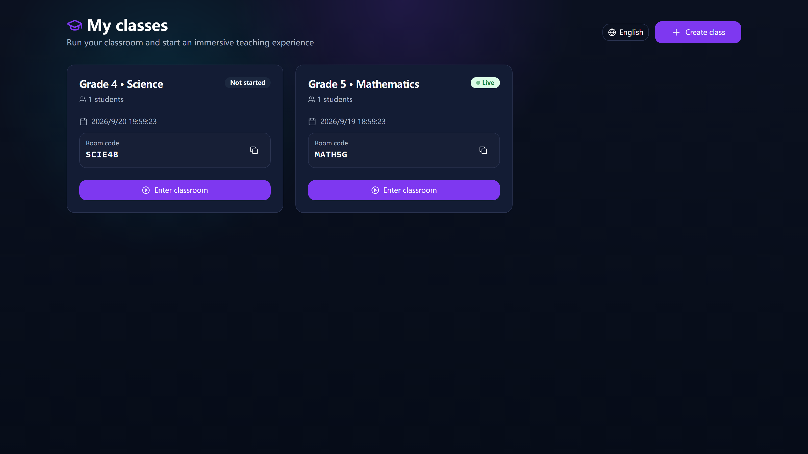
Teacher portal: run the whole lesson
Create a class in one minute
Every class gets a 6-character room code and an optional password.
One click goes live
HD camera, microphone and screen share inside the browser.
Share materials instantly
Students see new files the moment they are uploaded — no refresh.
Invite parents safely
A signed link valid for 24 hours, tied to one verified email.
Real product — class cards with room codes and a live status badge
Agentic EduVerse · Roadshow 2026
04 / 14

Slide 5
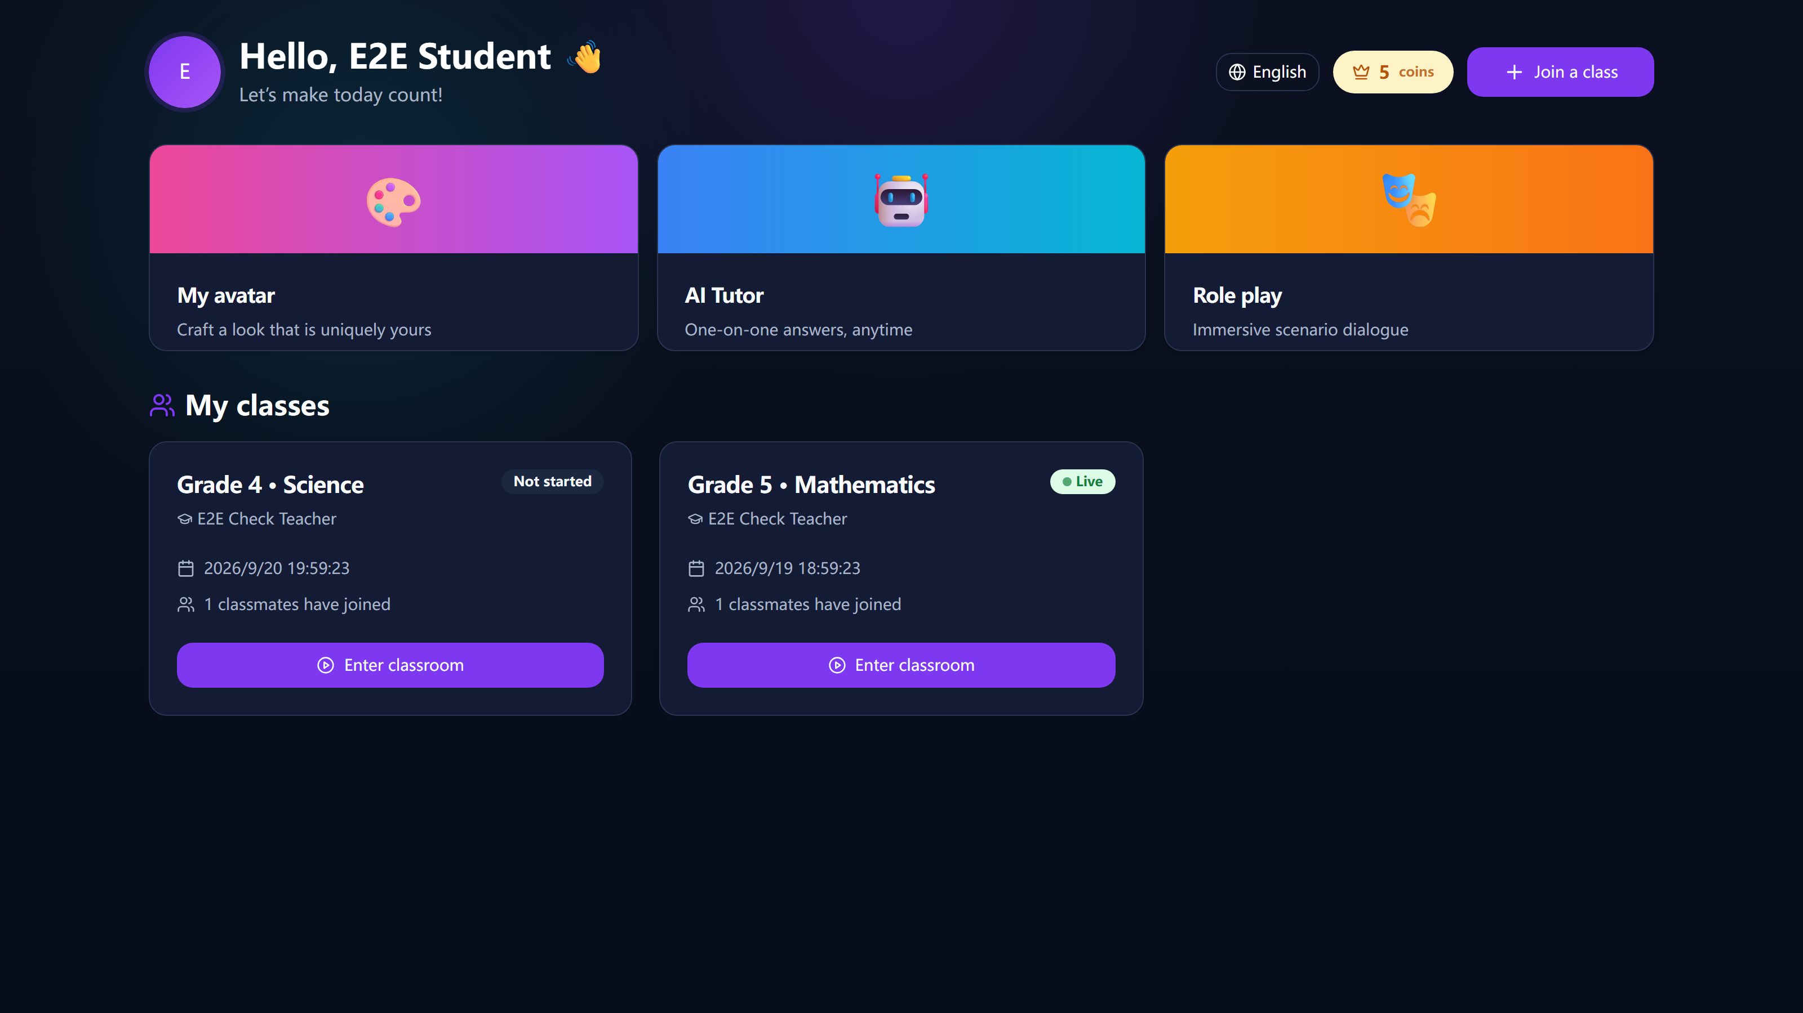
Student portal: progress you can feel
Join with a room code
Codes avoid look-alike characters (no 0, 1, I, O) and ignore letter case.
Coins for real effort
Joining a class, answering and practising all earn coins.
Weekly progress, made visible
Study time, answer accuracy and weak spots on one small card.
Enter the live classroom
Students watch the teacher, join the whiteboard and raise a hand.
Real product — weekly stats, coins and one-tap class joining
Agentic EduVerse · Roadshow 2026
05 / 14

Slide 6
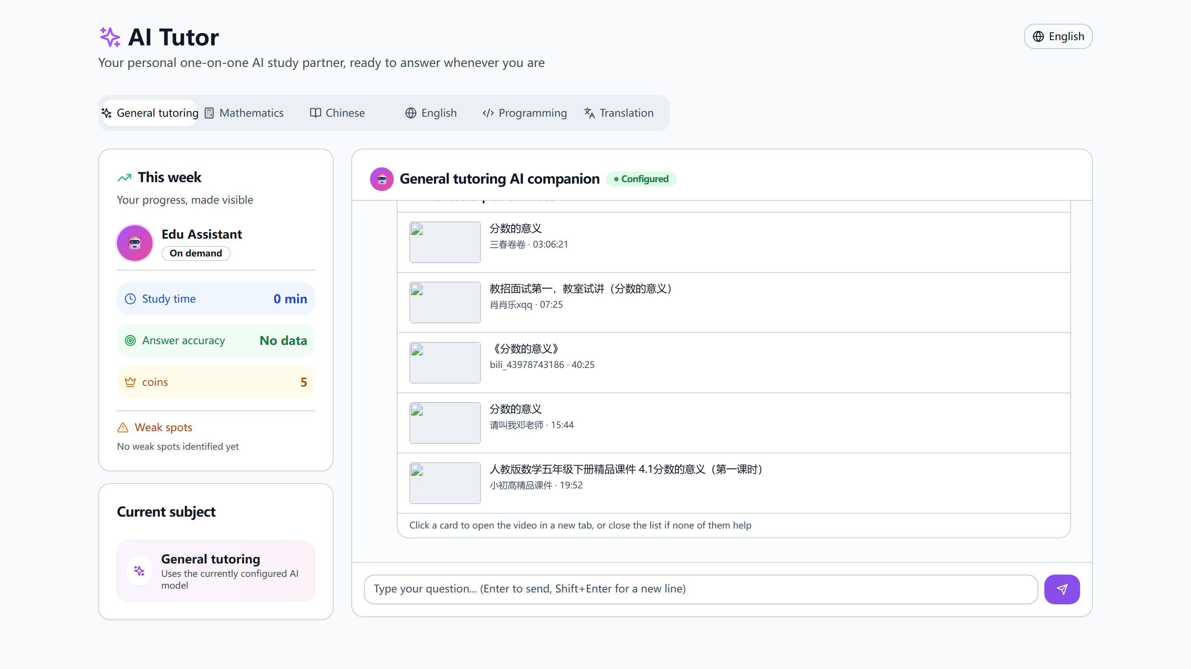
The AI companion teaches — it does not cheat
Guided, not instant
The AI asks questions back and gives a practice problem — the student still thinks.
Five subject companions
Maths, Chinese, English, coding and general — each keeps its own chat history.
Five real videos per answer
Found in about one second from public teaching videos. One click opens the video.
Nothing gets lost
Every session is saved per companion and can be reopened from history.
Real product — the answer comes with 5 real teacher videos below it
Agentic EduVerse · Roadshow 2026
06 / 14

Slide 7
From a question to the right video
3 · We search public videos
2 · AI finds the point
4 · Student clicks
1 · Student asks
The answer also carries 1–3 clean search words.
Real teacher videos, filtered and ranked.
A new tab opens the video. Not helpful? Just close the list.
"What does a fraction mean?"
5
~1s
0
videos suggested under every answer
to find them, with a 30-minute cache
paid search keys — open public data only
Agentic EduVerse · Roadshow 2026
07 / 14

Slide 8
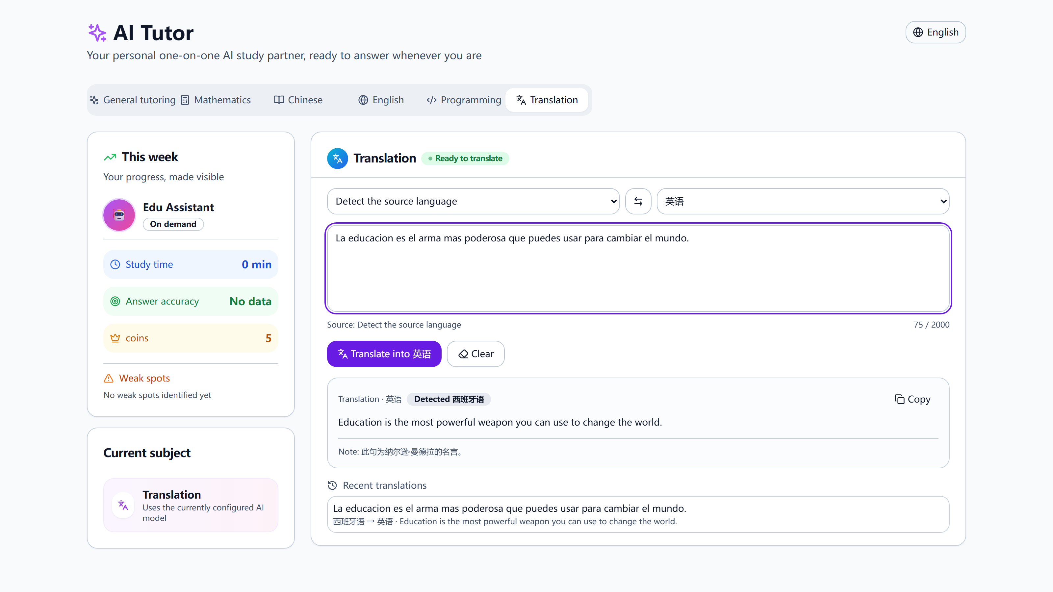
Built for many languages from day one
8
17
interface languages,
switched in one click
languages in the
built-in translator
Whole product, not a widget
Menus, buttons, forms and messages all follow the chosen language — even after refresh.
Two-way translator
Auto-detects the source language, swaps directions, copies the result with one click.
Real product — English, Japanese, French, German and 13 more, with auto-detect
Agentic EduVerse · Roadshow 2026
08 / 14

Slide 9
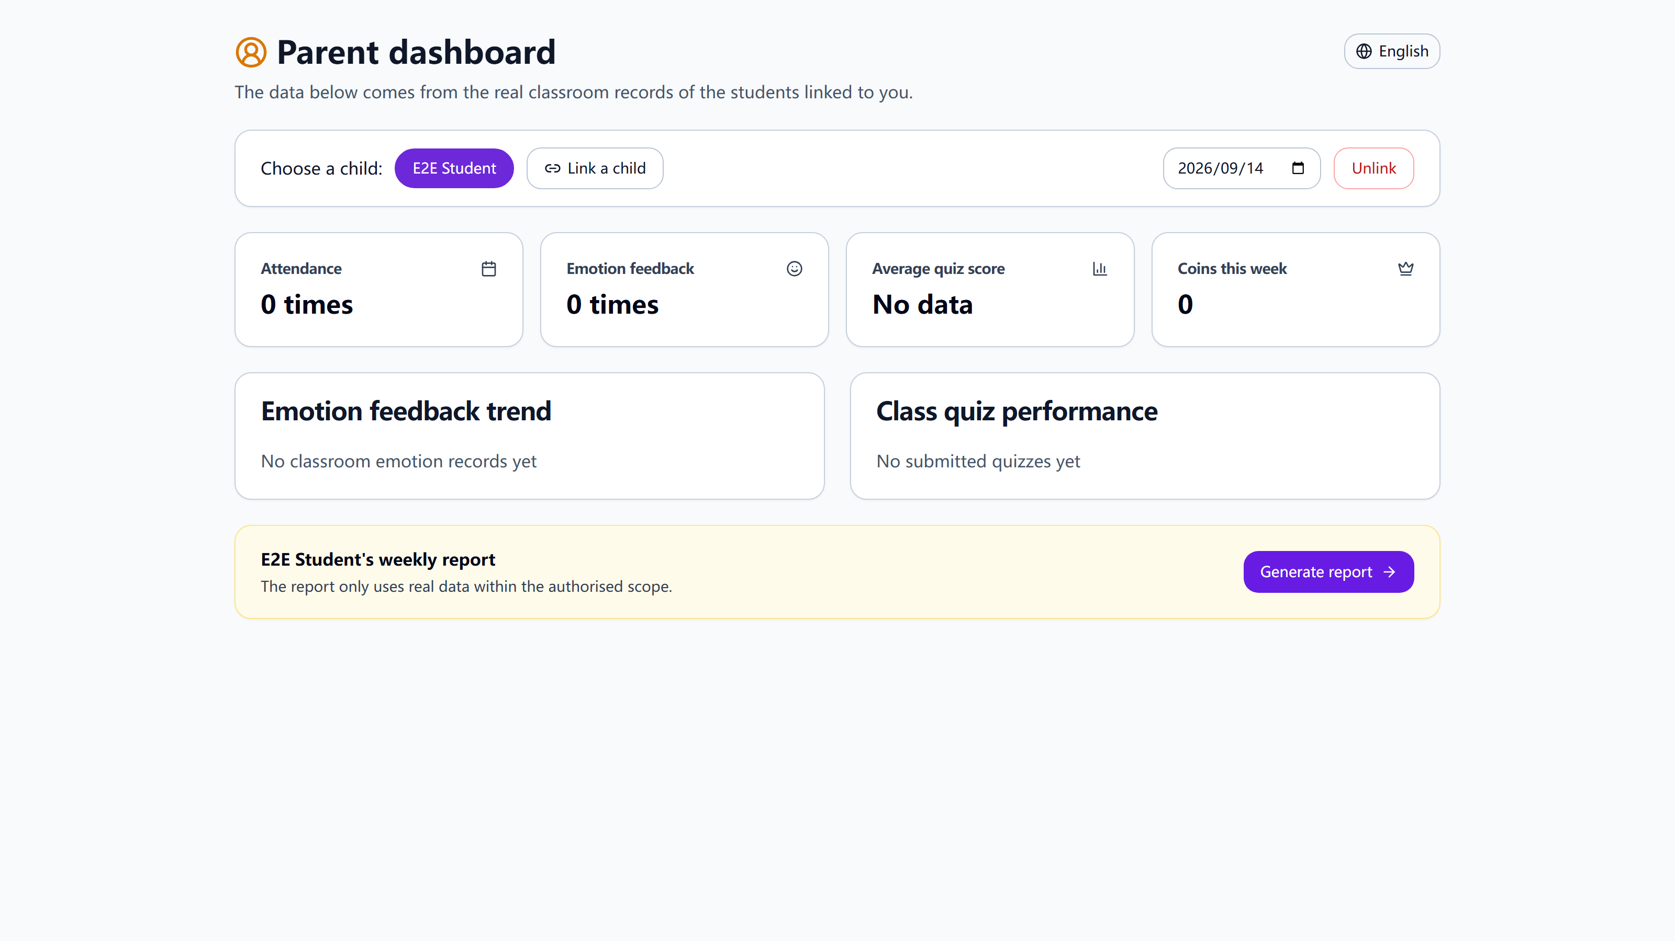
Parents stay in the loop — safely
A parent can never claim a child by typing a name. The teacher sends an invite; the link does the rest.
Invite-only link
Created by the teacher for one student, one email.
Expires in 24 hours
And works exactly once. Old links simply die.
Email must match
Only the invited parent account can accept it.
Weekly AI growth report
Effort, emotions and quiz results in plain words.
Real product — linked child, weekly window, one-tap AI report
Agentic EduVerse · Roadshow 2026
09 / 14

Slide 10
A live classroom that never loses a lesson
HD video & screen share
One-click recording
Playback with the whiteboard
Clear, honest errors
Teacher and students meet in the browser — camera, microphone and screen sharing, no app to install.
The lesson is recorded as one video. It auto-saves even if the page closes, and a heartbeat keeps the file safe.
Replay the video and watch the shared whiteboard redraw itself, stroke by stroke, in sync.
If a camera is blocked, the app says exactly which setting to fix — in the parent's language.
0
recordings lost in our final test round — close the tab, switch rooms or leave early, and the lesson still saves itself. Engineered for real classrooms, not perfect ones.
Agentic EduVerse · Roadshow 2026
10 / 14

Slide 11
What makes us different
Most AI tutors chat alone with a child. We put AI inside a real classroom, with a real teacher and real parents.
Typical AI tutor app
Classic LMS platform
Agentic EduVerse
Live classroom with video
No
Yes
Yes
AI that guides, not answers
Yes
No
Yes
Auto-suggested teacher videos
No
No
Yes
Parents verified & in the loop
No
Partly
Yes
Multilingual interface
Partly
No
Yes
Runs without paid AI keys
Yes
Yes
Yes
Agentic EduVerse · Roadshow 2026
11 / 14

Slide 12
A market that is already moving
$5.8B
$5.82B
AI-in-education spending by 2030 — up from $2.2B in 2024.
$2.21B
CAGR 17.5%
MarketsandMarkets, 2024
$1.78B
Faster views go higher: another analyst sees $34.6B by 2030 at 36.5% a year. Either way, the wave is real.
2023
2024
2030
Agentic EduVerse · Roadshow 2026
12 / 14

Slide 13
A simple way to grow
Free for teachers
Growth engine
Family plan
B2C revenue
School licence
B2B revenue
Parents pay a small monthly fee for the AI companion, the translator and weekly reports.
Teachers never pay. A free classroom brings the whole school through the door.
One contract per school: unlimited classes, admin tools and priority support.
Next 12 months
Pilot schools
Now
Mobile apps
+4 months
Content library
+12 months
Run free pilots with local schools and collect teacher feedback.
Bring the student portal and parent reports to phones.
Curated, teacher-approved video library inside the AI answers.
Agentic EduVerse · Roadshow 2026
13 / 14

Slide 14
Education works best when everyone
is in the same room.
We built the room. The AI is already teaching in it.
Thank you
Agentic EduVerse · HACKMIT Team Binary: Jenny & Elara

