Slide 1
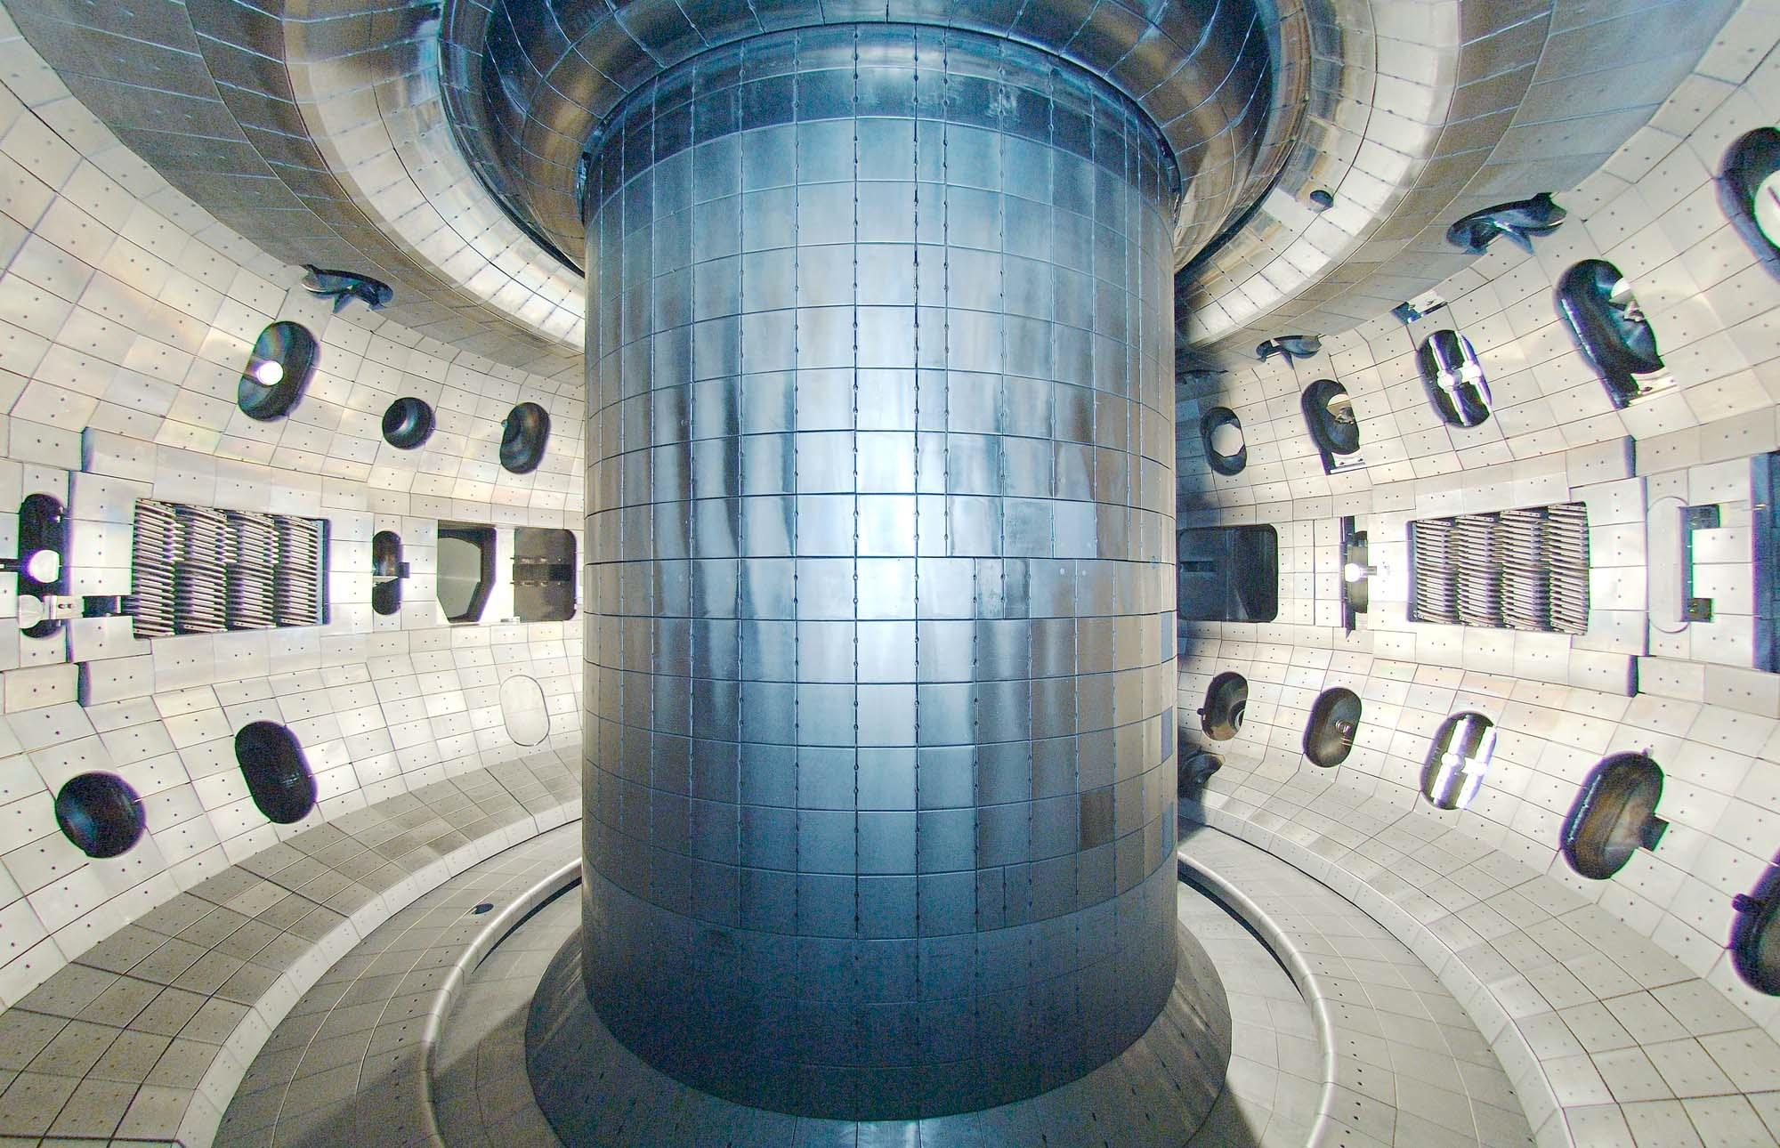






Building generalizable predictors to guide ITER operation: combining physics-based + data-driven models
Joe Abbate^{1,2,3}
with R. Conlin³, I. Char⁴ G. Tardini⁵, E. Fable⁵, A. Rothstein³,
K. Erickson², R. Shousha², H. Farre²,
A. Pankin², V. Mehta⁴, B. Grierson⁶,
A. Jalalvand³, E. Kolemen^{2,3}
¹KLA Corporation,
²PPPL, ³Princeton University,
⁴Carnegie Mellon,
⁵Max-Planck-Institut,
⁶General Atomics
APS DPP
November 2025

Slide 2
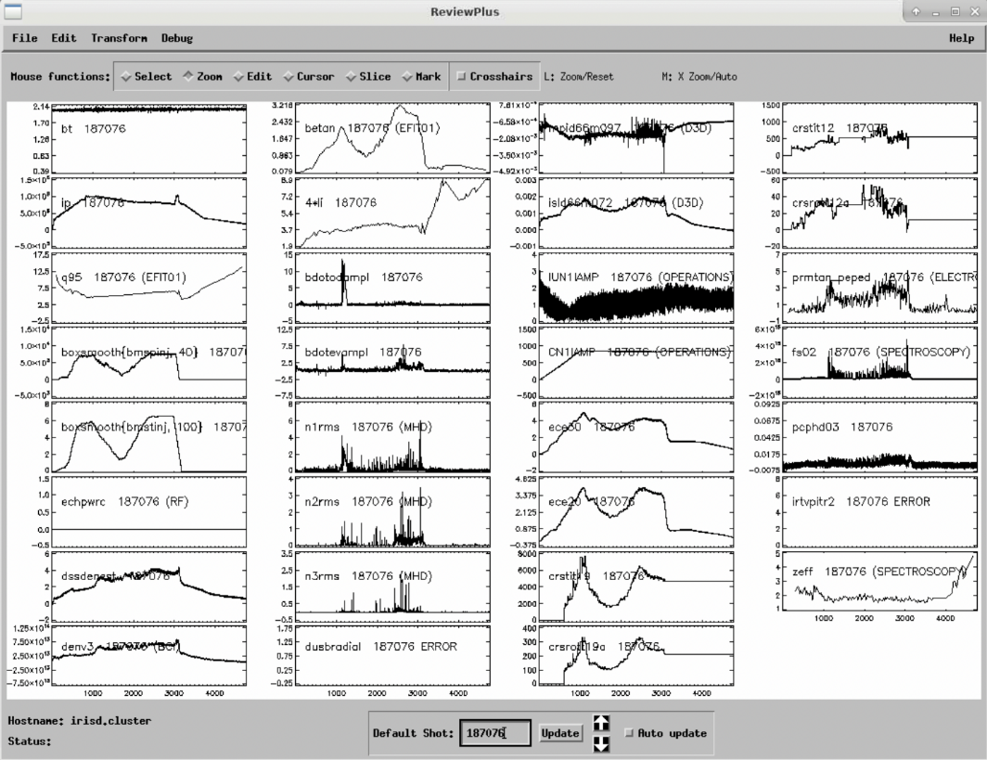
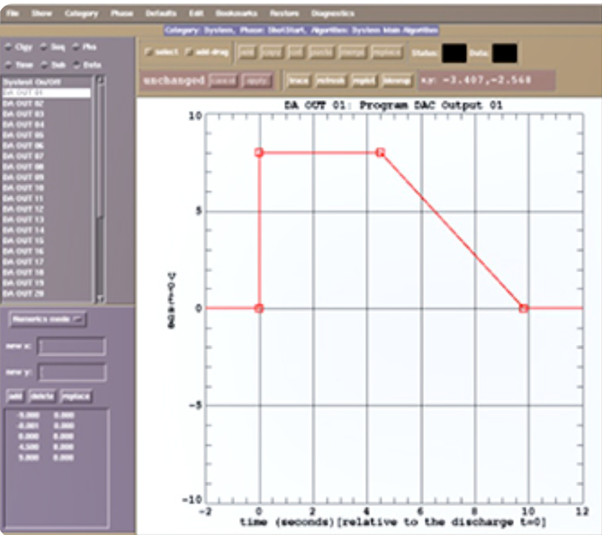
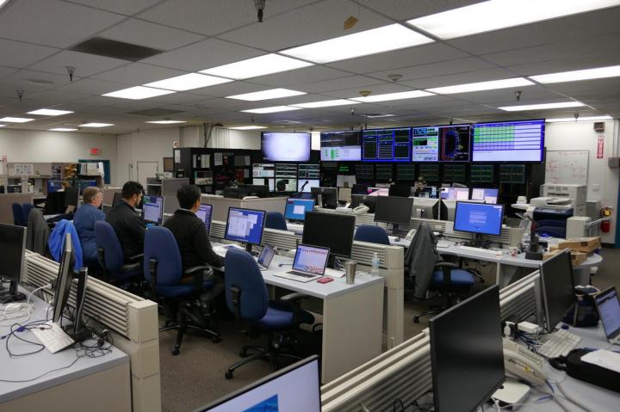

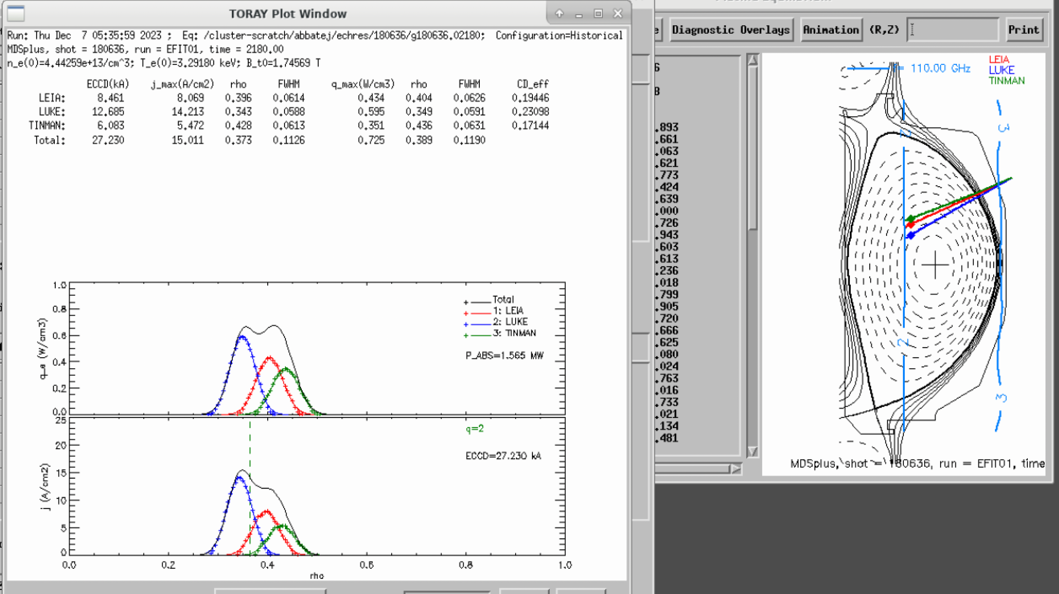

Operators use data + simulation to plan upcoming shots
ITER operation: use all information until now to predict (plan) next shot
Data from previous shots
Physics-based simulations
DATA
PLAN
Our ITER emulation: Given D3D lower-Ip shots,
predict on D3D higher-Ip shots
Plan higher-Ip shot
Given lower-Ip data + simulations
0
$$I_{p} (MA)$$
0.9
1.3
SIMULATION
Notes:
ITER thousands of diagnostics and hundreds of control knobs
Task is in just a couple years to go from 0 to 15MA, where in previous tokamaks we’ve only gone up to a few MA
DIII-D is less complicated but maybe the most similar thing we’ve done. There, a shot runs for a few seconds, then there are a few minutes for people to deliberate about how to proceed given what happened in the past shot, based on the rest of the runday,
talk about how ITER will scale up during commissioning – steps up to 15MA; spent 1:40 here (too long maybe)
Maybe add other machines to the figure (SPARC etc)

Slide 3
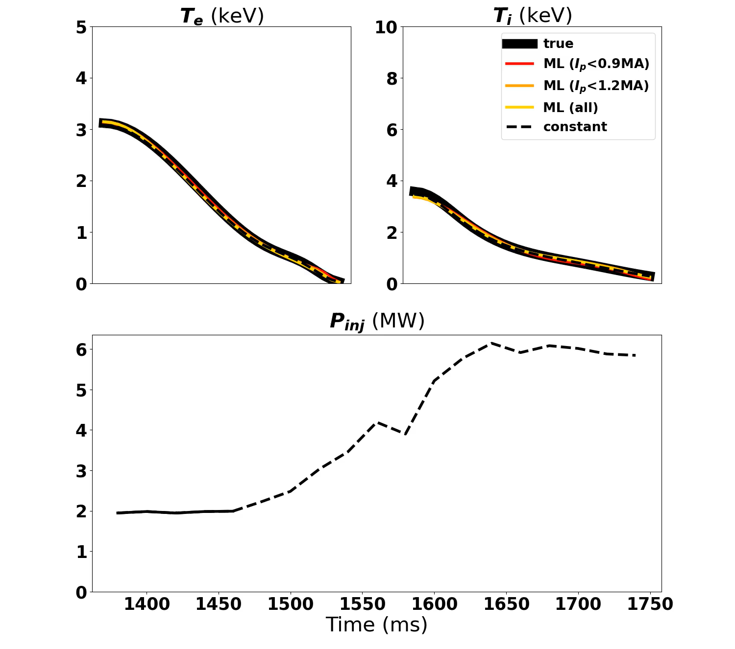
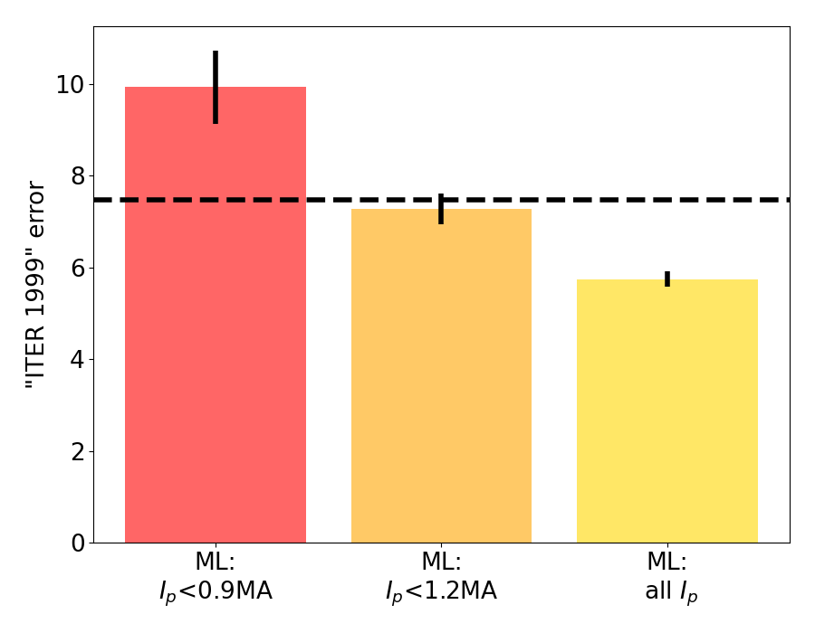

Profile evolution via fully data-driven Machine Learning (ML): bad extrapolation
Less extrapolation
Constant benchmark: “Safe predictor of future is the past”
(Predicting $I_{p}>1.3MA$)
Abbate, Conlin Nuclear Fusion 2021
Abbate, Conlin Physics of Plasmas 2023
Char, Abbate Learning for Discovery and Control 2023
Abbate Nuclear Fusion 2025
Notes:
Put an example for showing it doesn’t extrapolate well (show high-Ip movie for example)
Maybe pause video (it will be distracting) – black is truth, blue solid is prediction, other blue lines are errors effectively
Maybe add figure to right to second slide; or animations

Slide 4
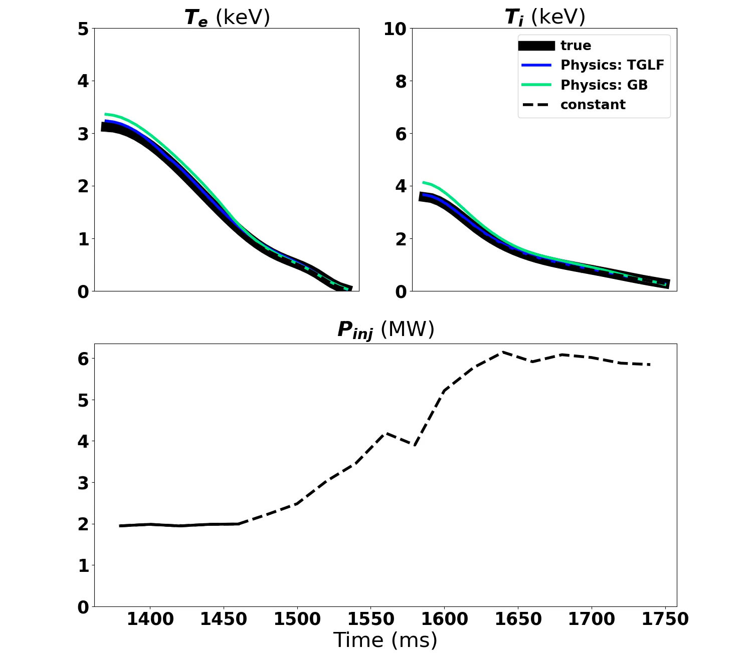
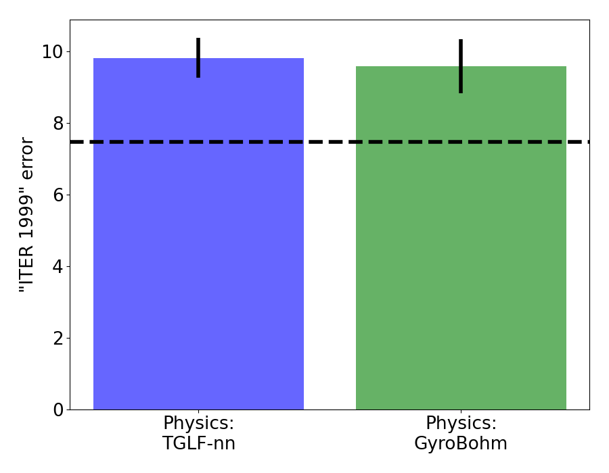

Profile evolution via “integrated physics models”: inaccurate
Constant benchmark: “Safe predictor of future is the past”
(Predicting $I_{p}>1.3MA$)
Low-fidelity comparison (TGLF-nn SAT0): Abbate Nuclear Fusion 2025 High-fidelity comparison (TGLF SAT2, TRANSP, etc): Abbate PoP 2024
ASTRA: Fable, Tardini Plasma Phys Cont Fus 2013
RABBIT: Weiland NF 2018
TGLF: Staebler PoP 2005
TGLF-nn: Meneghini NF 2017
GB: Erba Plasma Phys Cont Fus 1997
Notes:
Make black ones stand out, make colored ones a family of “having trouble making it” – keep it high level
The figure is grainy, just focus on the right figure
“We’re using transport models for profile evolution” – as a completement to ML we look at integrated sim with ASTRA using different transport models

Slide 5
This work extends model stacking to combine data+simulations
This work’s additions:
Built to extrapolate low to high Ip (not just “generalize”)
Consider physics and data-driven models on equal footing
Stacking: train multiple models, then meta-learner to combine their predictions
Low-Ip
ML 1
High-Ip
Data
Meta-learner
Prediction
ML 2
.
.
.
Simulation 1
Simulation 2
.
.
.
Abbate Nuclear Fusion 2025
Notes:
Do all data-driven in one shade, all ML in another, meta in another, constant in black – callout text would help
Plots should show: physics limited, AI limited, we have an advantage from both
Slide 6 should be clear about what we did
Be clear that ITER commissioning is in small steps
Make a bigger version of right figure; in general it’s not that helpful also (or replace with beta ramp / Ip ramp / P_aux ramp / etc)

Slide 6
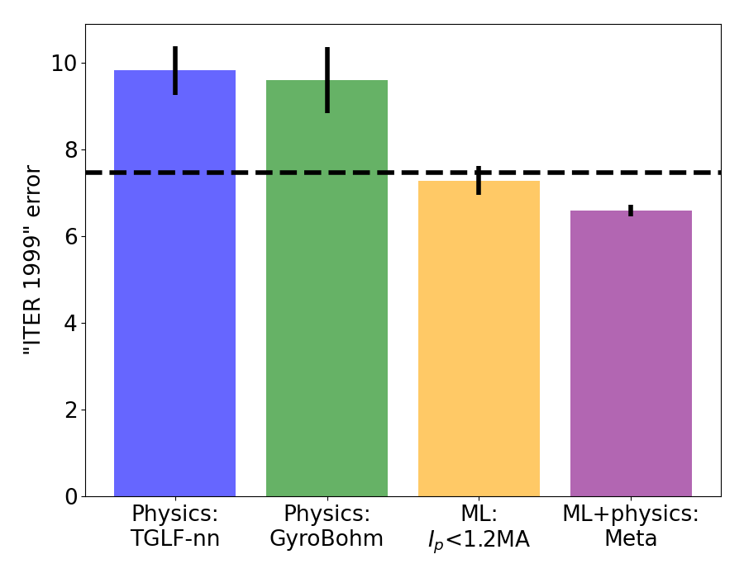
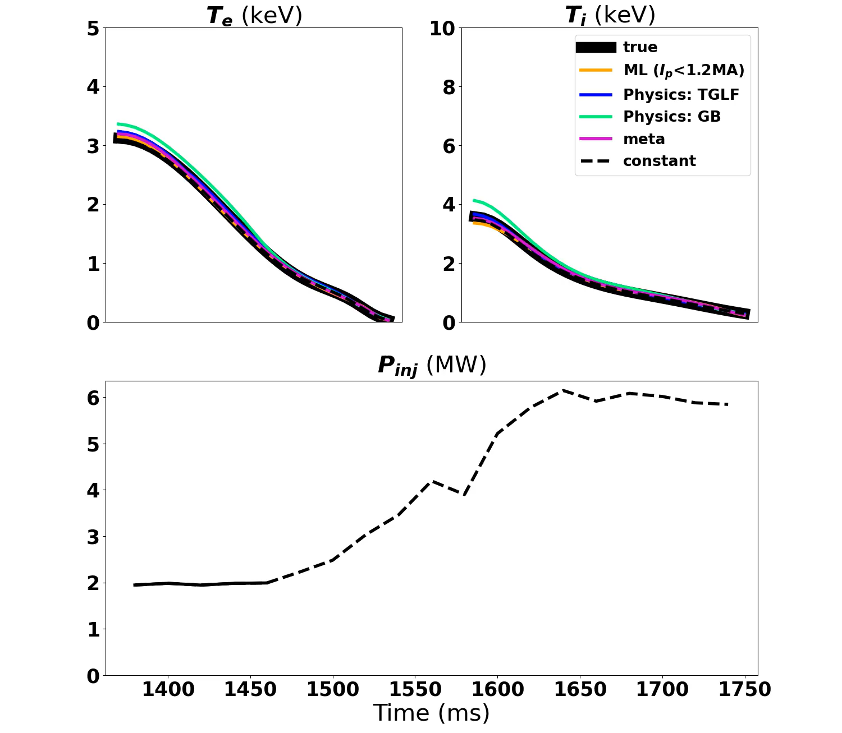
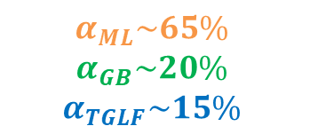

Meta-learner extrapolates better than any individual predictor
Constant benchmark: “Safe predictor of future is the past”
(Predicting $I_{p}>1.3MA$)
$$α_{ML}\sim 65\%$$
$$α_{GB}\sim 20\%$$
$$α_{TGLF}\sim 15\%$$
$$T_{meta}={α_{ML}T}_{ML}+α_{GB}T_{GB}+α_{TGLF}T_{TGLF}$$
Notes:
Do all data-driven in one shade, all ML in another, meta in another, constant in black – callout text would help
Plots should show: physics limited, AI limited, we have an advantage from both
Slide 6 should be clear about what we did
Either P1,P2,P3 or combine them into 1

Slide 7
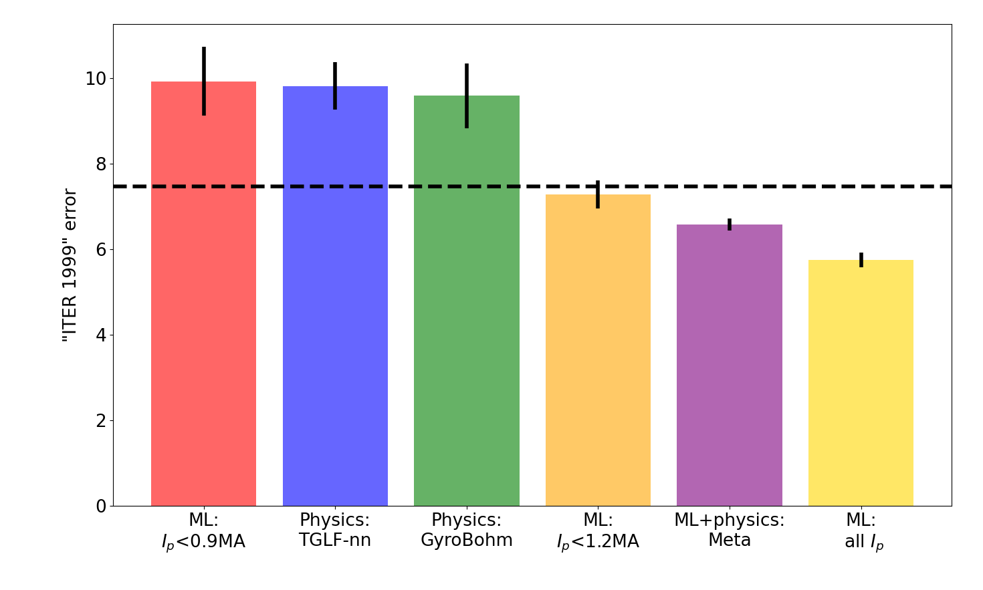

Building generalizable predictors to guide ITER operation: combining physics-based + data-driven models
Summary:
Physics predictors worse than benchmark
For extrapolation, ML also worse
Meta-learner better than either alone
Needs:
More large-database code comparisons
More “predict-first” experiments
Open tokamak data → ML competition?
For details: Abbate et al “Combining physics-based and data-driven models…” Nuclear Fusion 2025
Constant benchmark: “Safe predictor of future is the past”
(Predicting $I_{p}>1.3MA$)

Slide 8
Backup slides
Notes:
More efficient explaining the meta-learning model
Intro: have explicit statement for what we need to do on ITER / other reactors: campaign problem and control problem, be clear about what the control problem is (“be able to turn the knobs and see consequence to plan pulse”, need model predictive and fast – don’t know how predictive models are atm)
We already have doubt about accuracy of transport models on existing experiments
Big question: “why does it work”?
Big question: “are the sims really this bad?” others should repeat this
Say “meta is just taking a weighted sum”

Slide 9
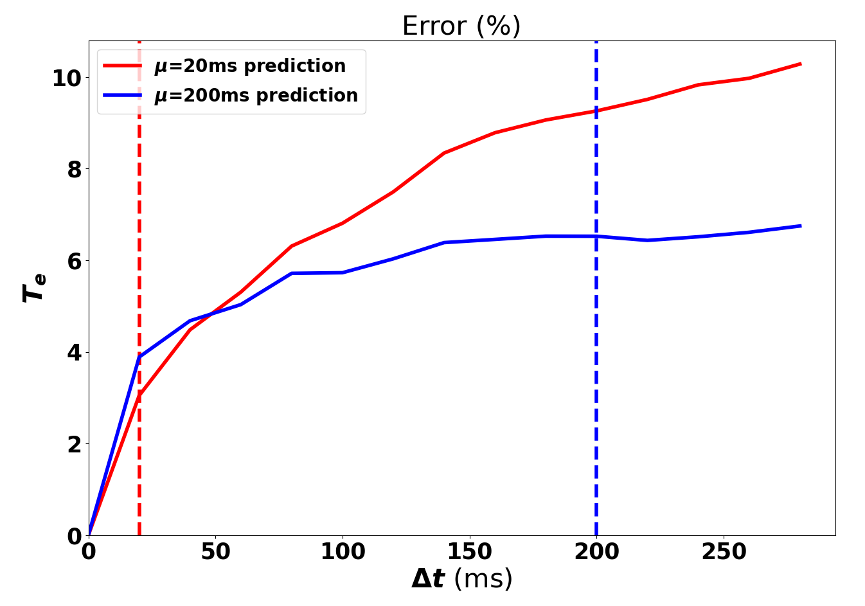


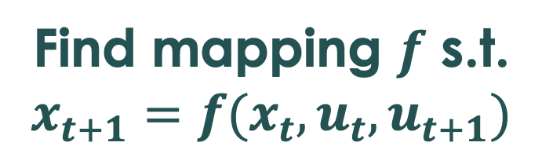

Architecture and training built to predict autoregressively
New architecture allows continuous predictions any step in future (Char, CMU), via autoregression
Additionally training model with autoregression allows tuning model for any time horizon
Trained w/out autoregression
High error
Low error
Trained w/ autoregression
Encoder
(1M)
RNN (0.5M)
Decoder (1M)
Find mapping $f$ s.t. $x_{t+1}=f(x_{t}, u_{t},u_{t+1})$
Autoregression
$x_{t}$=profiles
$x_{t+1}$=profiles
$u_{t}$,$u_{t+1}$=actuators

Slide 10
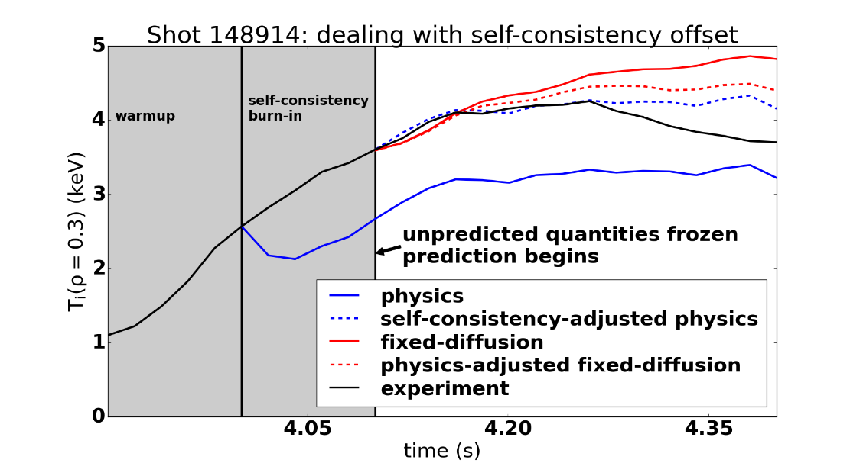
Predicting real shots from biased simulations requires adjustment

Slide 11
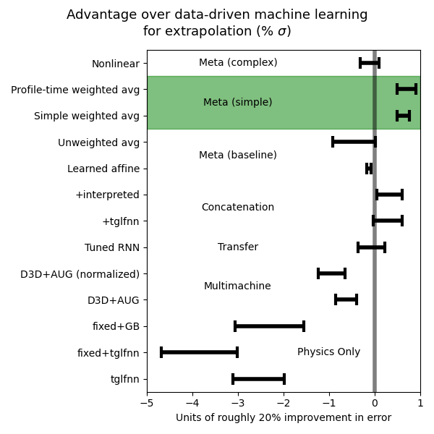


Simple averaging of simulation with data improves performance
Add data from more machines using physics-based normalization
Concatenate simulation context as additional input
Transfer learn by training on experimental data, tuning on simulation data
Meta-learned model taking output of data-driven and simulation models
Abbate, NF, in review
Notes:
- Bill’s work was starting from d3d, looking at performance on jet, then slowly bleeding in jet data; I would encourage future work in that area to start with the jet shots and look at performance, then add the d3d shots – and to be sure that their task is really extrapolation for the jet cases. I think that work showed that adding data from the same machine is helpful, not that adding data from a different machine is helpful. The same goes for a lot of the NIF work in this area.
- Open competition would also build morale
- Greg’s talk this morning: there’s a lot of good simulation info, let’s use it! Tons of people in ML community are dying to try latest tools and are at least more numerous if not more competent than our small community, let’s open it up and solve this altogether

Slide 12
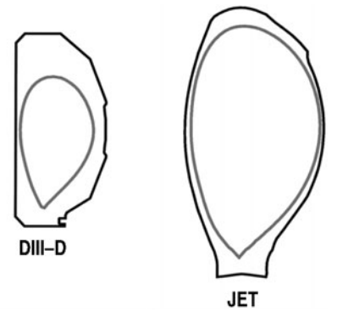
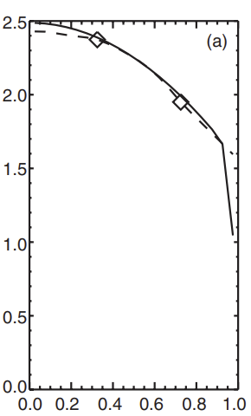
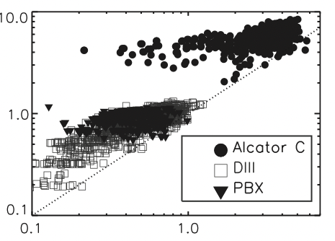

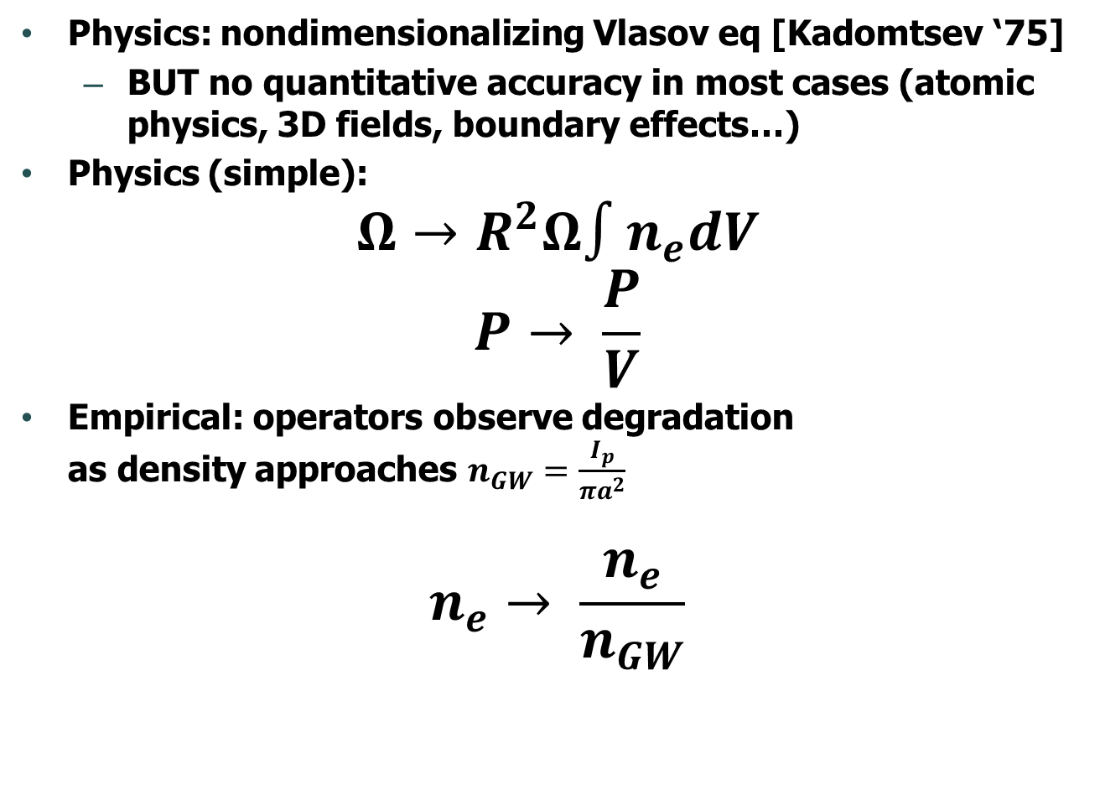

Hypothesize normalization aids cross-machine learning
Physics: nondimensionalizing Vlasov eq [Kadomtsev ‘75]
BUT no quantitative accuracy in most cases (atomic physics, 3D fields, boundary effects…)
Physics (simple):
$$Ω→R^{2}Ω∫n_{e}dV$$
$$P→ \frac{P}{V}$$
Empirical: operators observe degradation as density approaches $n_{GW}=\frac{I_{p}}{πa^{2}}$
$$n_{e}→ \frac{n_{e}}{n_{GW}}$$
na²
M. Greenwald 2002 Plasma Phys. Controlled Fusion 44
$$n_{GW}$$
Normalized radius
T.C. Luce et al 2002 Nucl. Fusion 42 1193
$$n_{e}$$
Notes:
- we use momentum instead of rotation itself; use volume-average power instead of power itself
- division by 0 is a problem
- intrinsic quantities like volume-veraged power; rotation to momentum which makes it match the torque
Hiro notes Greenwald shows power of data-driven; taue confinement is the same thing

Slide 13
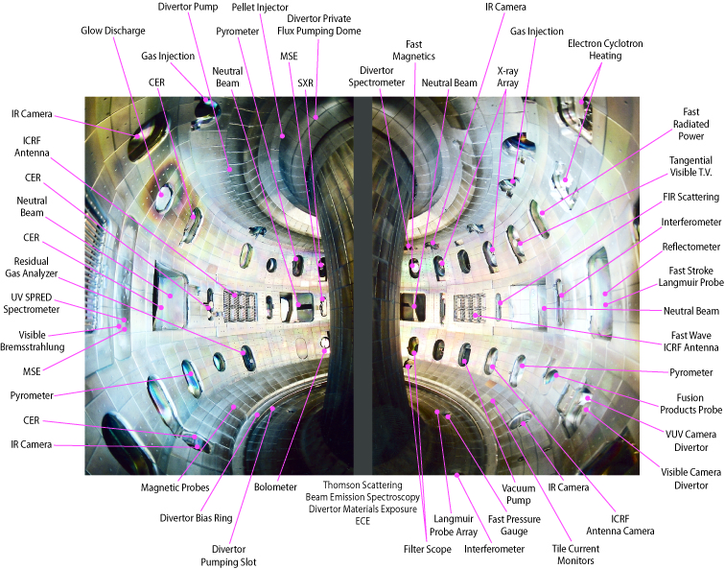
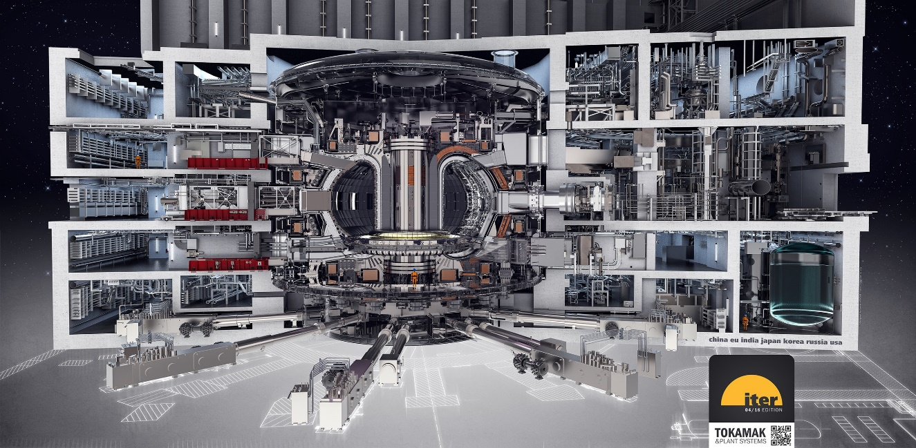
Building and ”driving” a tokamak reactor is wildly complex
>>$B to build, >>$M/day to operate
~hundreds of control knobs, ~thousands of diagnostics (comparable to aircraft)
Humphreys 2015, PoP 22 021806
Notes:
Example use-cases
Issues reliably repeating some scenarios (lack of control)
TFTR designed to achieve Q>1
DIII-D neutral beam tilt designed to increase β

Slide 14
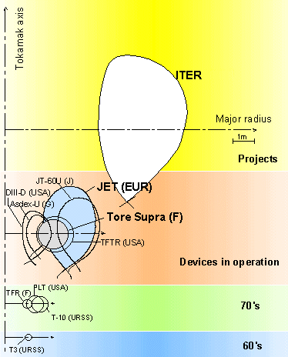
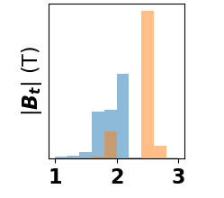

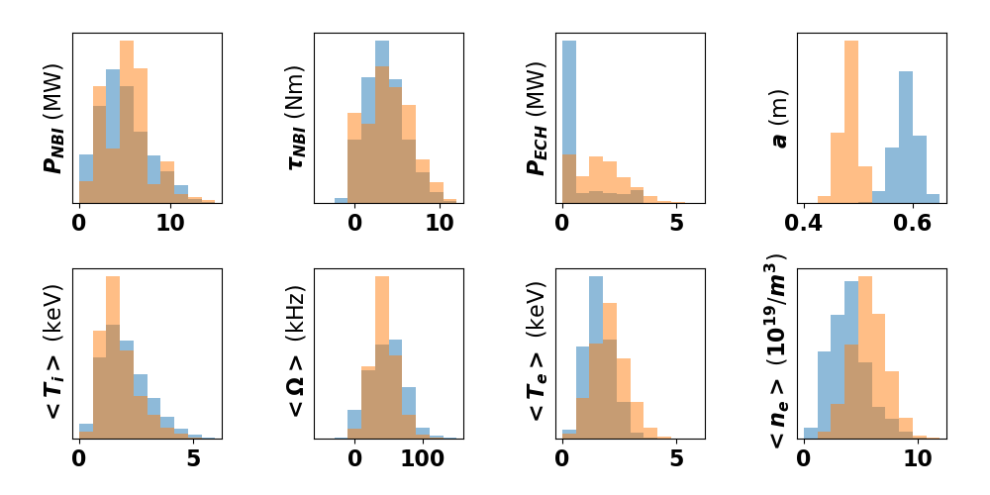
Add data from more machines: AUG data to enhance D3D predictions
Carbon
Tungsten
The main tokamaks in the world, French Atomic Energy Commission (CEA)
Notes:
- we ultimately need to extrapolate to ITER using current machines; for now we focus on the simpler task of extrapolating nearly identical machines

Slide 15
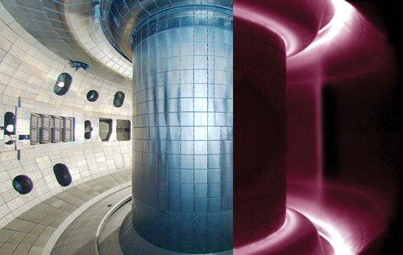
Reproducing and improving a discharge by trial-and-error
Experiment goal: reproduce and improve an experiment from 10 years before
“Many shots had MHD modes at 3 s… to try to improve that we changed Electron Cyclotron Heating deposition (180639-180642), and go to lower (180643-180646) and higher (180647) plasma current… none of which were successful.
We also tried lowering the voltage on the off-axis beams (180645) to get rid of the bursty modes and moving the BetaN ramp earlier (180646.)”
Ultimately, got “good reproduction of 133103, but no significant improvement”
DIII-D Tokamak Control Room
Nik Logan’s “overview” scope
Human operators combine simulations, heuristics, and experience to achieve desired state by trial-and-error
Notes:
- each experiment lasts 6 seconds, and for parts to cool there are about 10 minutes of downtime in between each one
- during this time, people deliberate in the control room about the best things to change
in between experimental campaigns, people also decide what’s needed

Slide 16
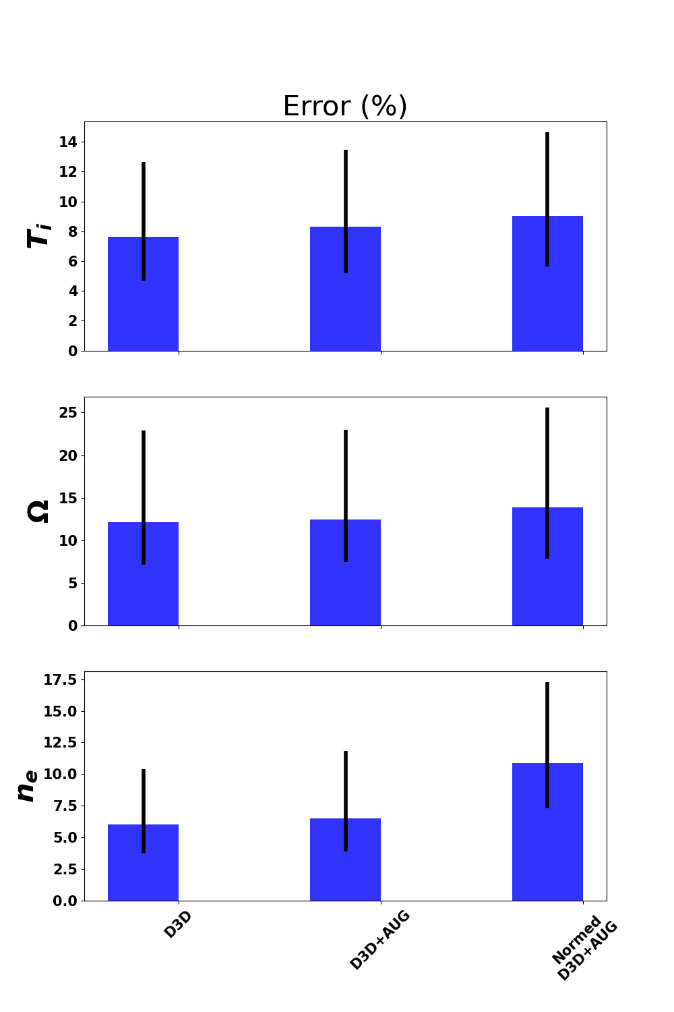

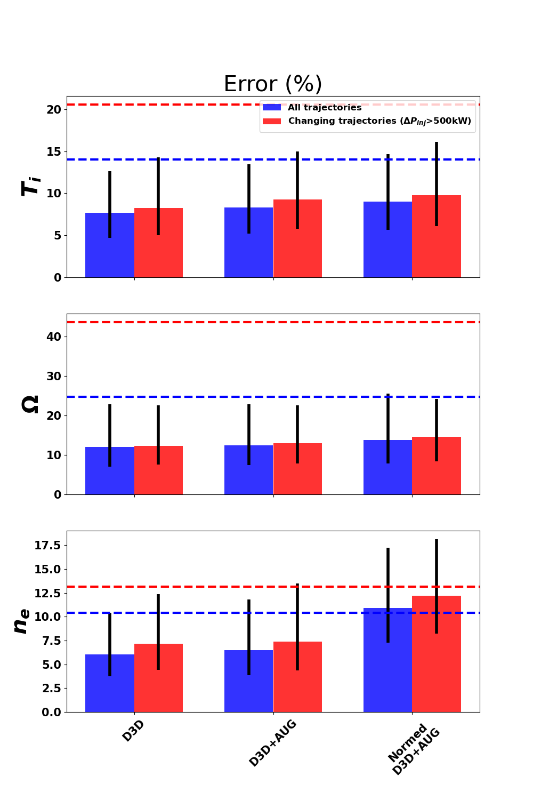
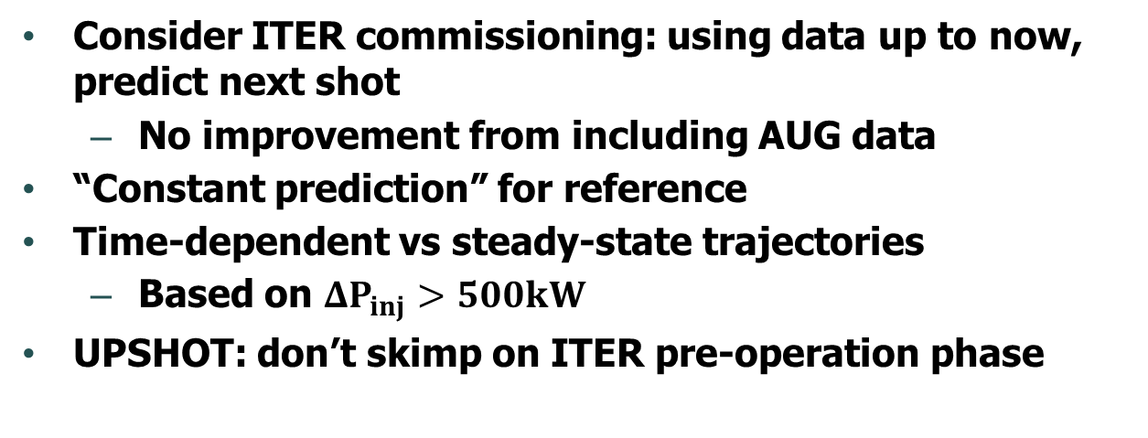

Add data from more machines: does not improve performance
Consider ITER commissioning: using data up to now, predict next shot
No improvement from including AUG data
“Constant prediction” for reference
Time-dependent vs steady-state trajectories
Based on $ΔP_{inj}>500kW$
UPSHOT: don’t skimp on ITER pre-operation phase
Train (D3D+AUG)
Test (D3D)
$$I_{p} (MA)$$
0.9
1.3
Notes:
- at it’s best, you’re getting more data that does the same thing
- at worst, you’re just giving it a second task to learn
- in this case, it seems we gave it a new task to learn

Slide 17
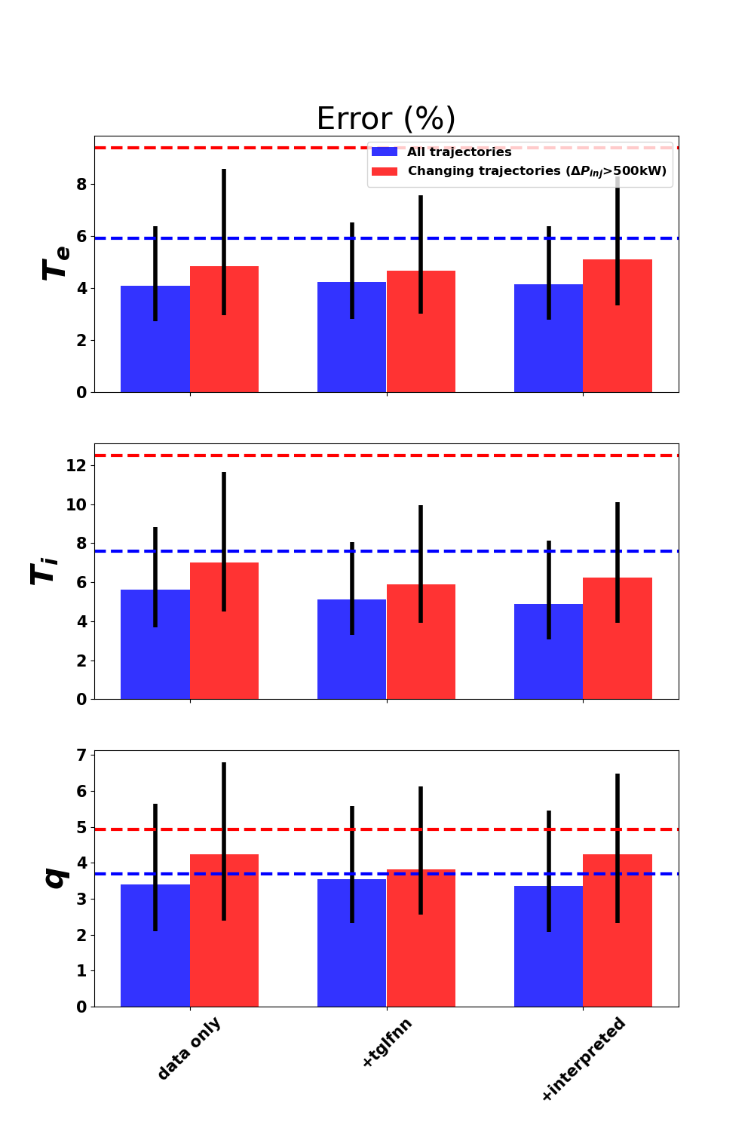

Concatenate simulation context as additional input
Predicted quantities
Core electron, ion temperature (TGLF-nn)
Interpreted quantities
Total heat to electrons, ions
Driven current
No statistically significant improvement over data-driven model for any signal
UPSHOT: details of heat and current deposition do not seem important (~profile consistency)
Train (D3D+simulations)
Test (D3D)
$$I_{p} (MA)$$
0.9
1.3

Slide 18
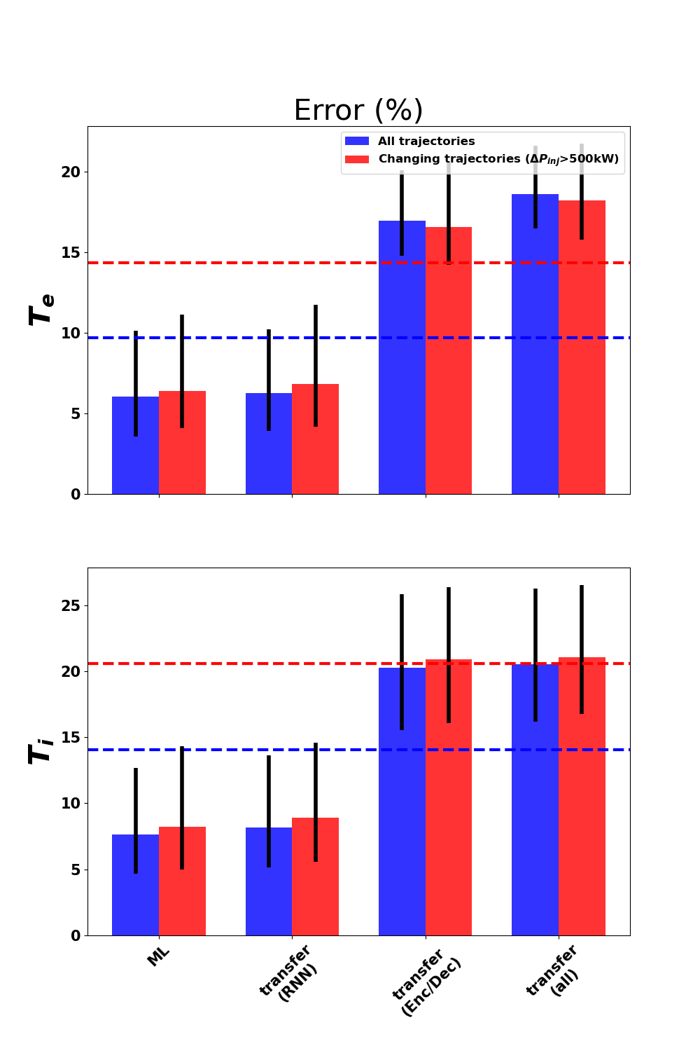

Transfer learn by training on experiment data, tuning on simulation
Pretend simulations are reality in regimes we haven’t yet seen
Once again: no significant improvement
UPSHOT: these simulations not quantitatively accurate
Encoder
(1M)
RNN (0.5M)
Decoder (1M)
2. Train portion of network (“tune”) (simulations)
1. Train (D3D)
3. Test (D3D)
$$I_{p} (MA)$$
0.9
1.3
Notes:
- Greg’s talk this morning highlighted a lot of great work in 5D simulations

Slide 19
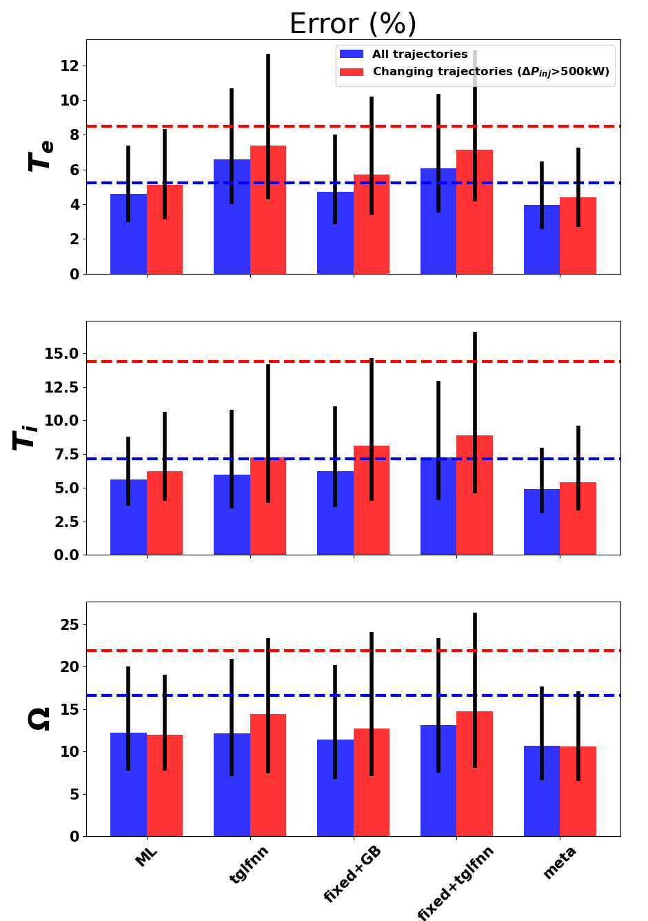
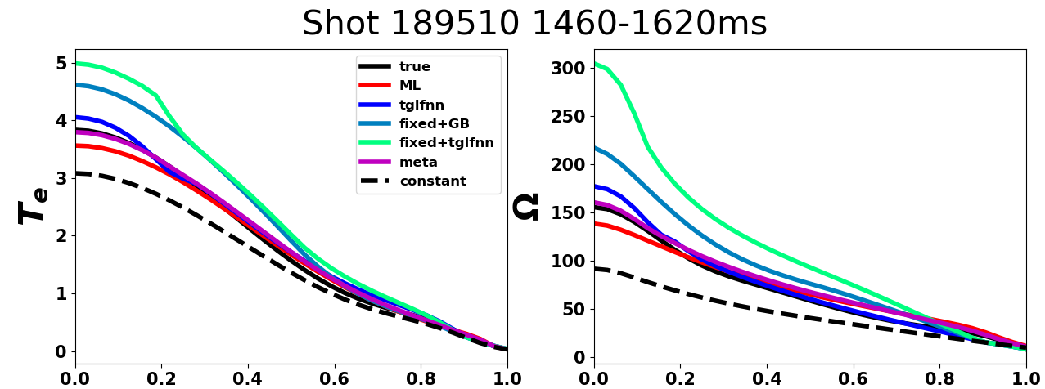
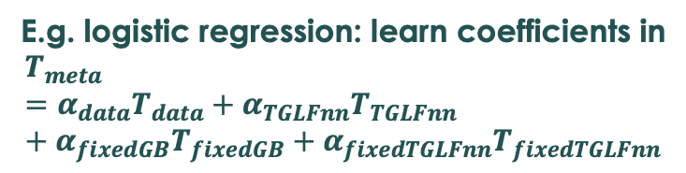
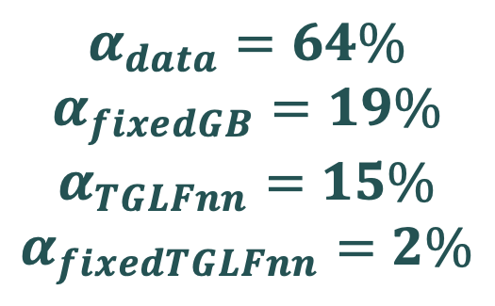

Meta-learned model outperforms data-driven or simulations alone!
$$α_{data}=64\%$$
$$α_{fixedGB}=19\%$$
$$α_{TGLFnn}=15\%$$
$$α_{fixedTGLFnn}=2\%$$
E.g. logistic regression: learn coefficients in
$$T_{meta}={α_{data}T}_{data}+{α_{TGLFnn}T}_{TGLFnn}+α_{fixedGB}T_{fixedGB}+α_{fixedTGLFnn}T_{fixedTGLFnn}$$
$$ρ$$
$$ρ$$

Slide 20
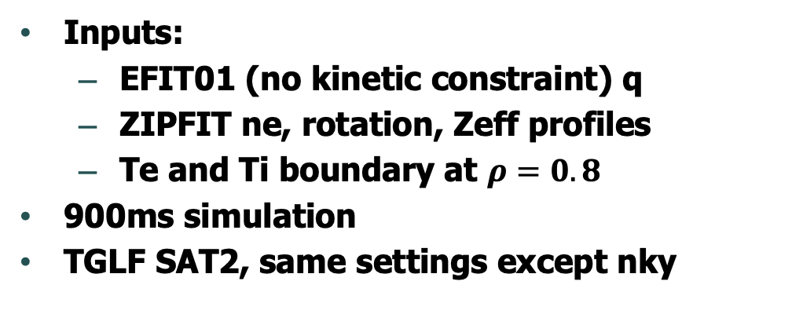
Predict core Te+Ti using ASTRA and TRANSP (w/ similar settings)
 | TRANSP | ASTRA
Fast ions | NUBEAM | RABBIT
Equilibrium | (input directly) | SPIDER
Ion heat | +viscosity +cold-neutral CX
Neoclassical diffusion | Modified Chang-Hinton | Angioni-Sauter (e) Galeev-Sagdeev (i)
TGLF nky | 12 | 19
Inputs:
EFIT01 (no kinetic constraint) q
ZIPFIT ne, rotation, Zeff profiles
Te and Ti boundary at $ρ=0.8$
900ms simulation
TGLF SAT2, same settings except nky
Notes:
Nky: number of poloidal modes in the high-k spectrum

Slide 21
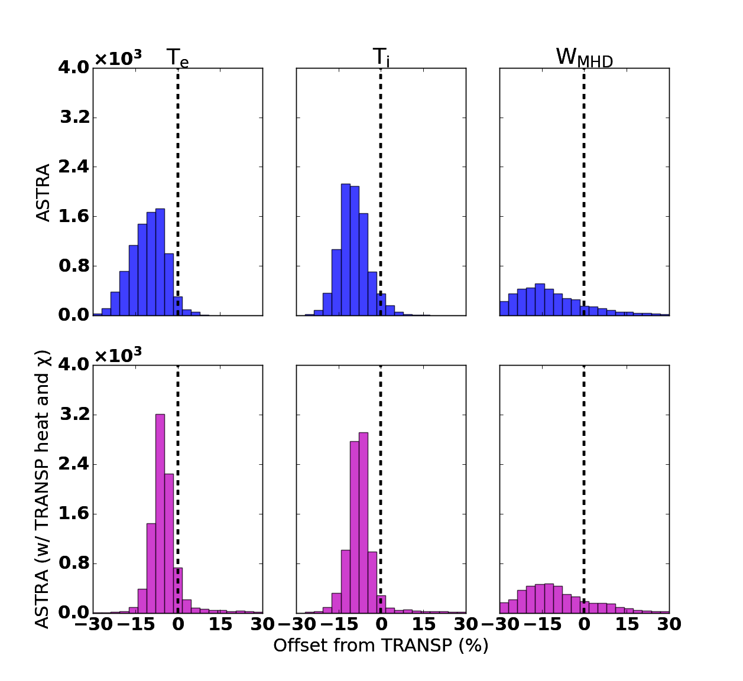
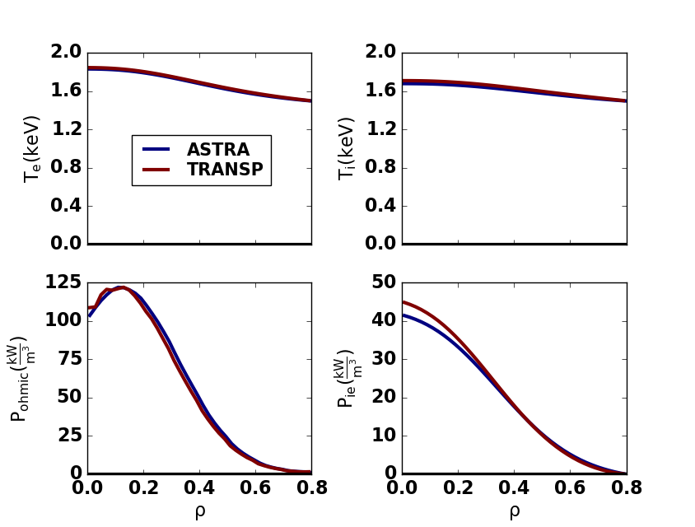


Integrated modeling verification: TRANSP and ASTRA yield different answers for realistic discharges
(ITER Physics Expert Group on Confinement and Transport, 1999)
$$f=\frac{{<T}_{prediction}−T_{truth}>}{{<T}_{truth}>_{RMS}}$$
Verify predictions of core Te/Ti and Wmhd
Simple case: ASTRA and TRANSP yield same result
Database comparison: ASTRA and TRANSP differ
seemingly the solver?
Bias
$$ρ$$

Slide 22
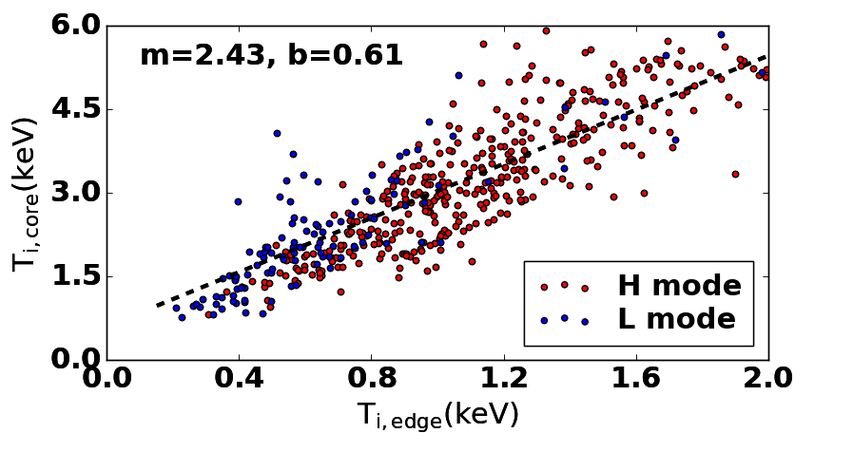
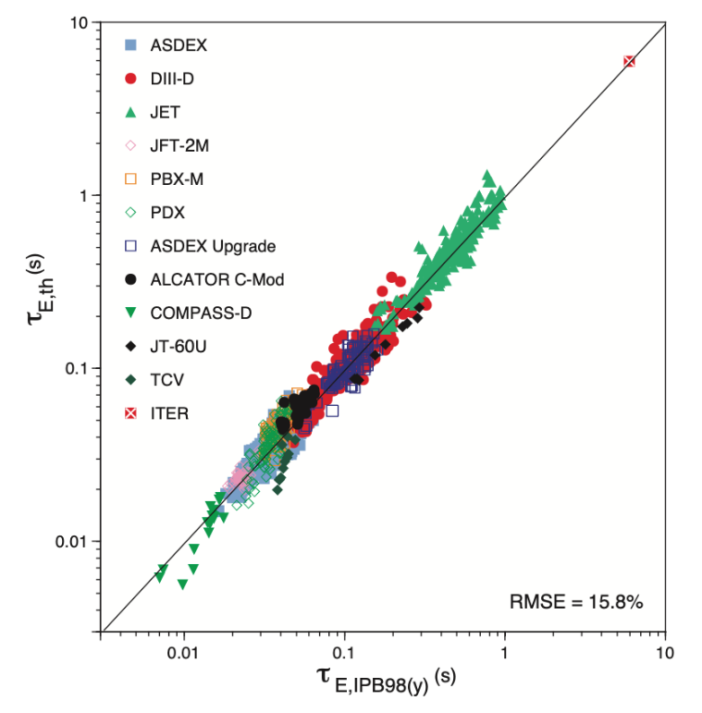
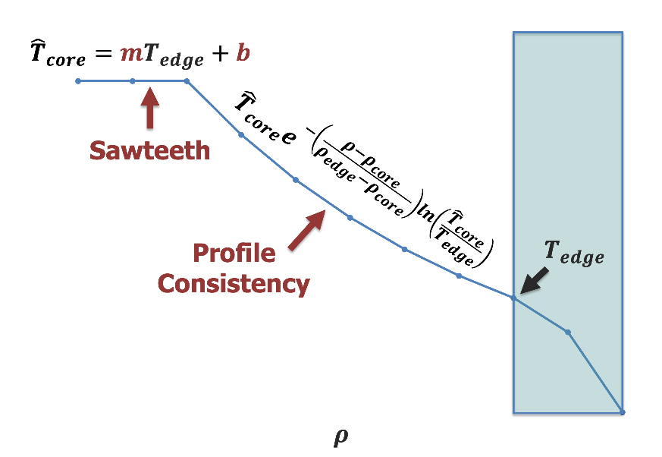

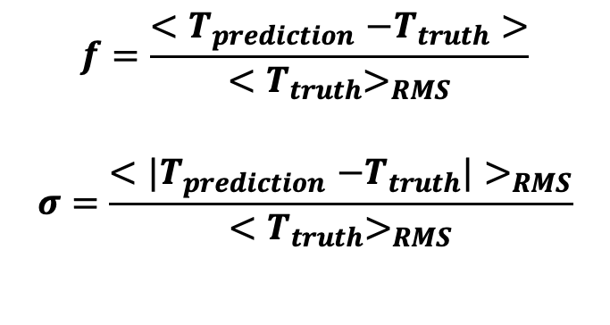
Integrated modeling validation: simple baselines of comparison
Validate predictions of core Te/Ti and Wmhd
Use multiple independent transport solvers (TRANSP + ASTRA)
Run on ~hundreds of cases automatically
Compare to empirical baselines:
$$f=\frac{{<T}_{prediction}−T_{truth}>}{{<T}_{truth}>_{RMS}}$$
$$σ=\frac{{<|T}_{prediction}−T_{truth}|>_{RMS}}{{<T}_{truth}>_{RMS}}$$
Bias
Error
(ITER Physics Expert Group on Confinement and Transport, 1999)
Te/Ti baseline: “Profile consistency”
Wmhd baseline: “H scaling”
$$W_{MHD}=τ_{E}P_{total}$$
$$ρ$$

Slide 23
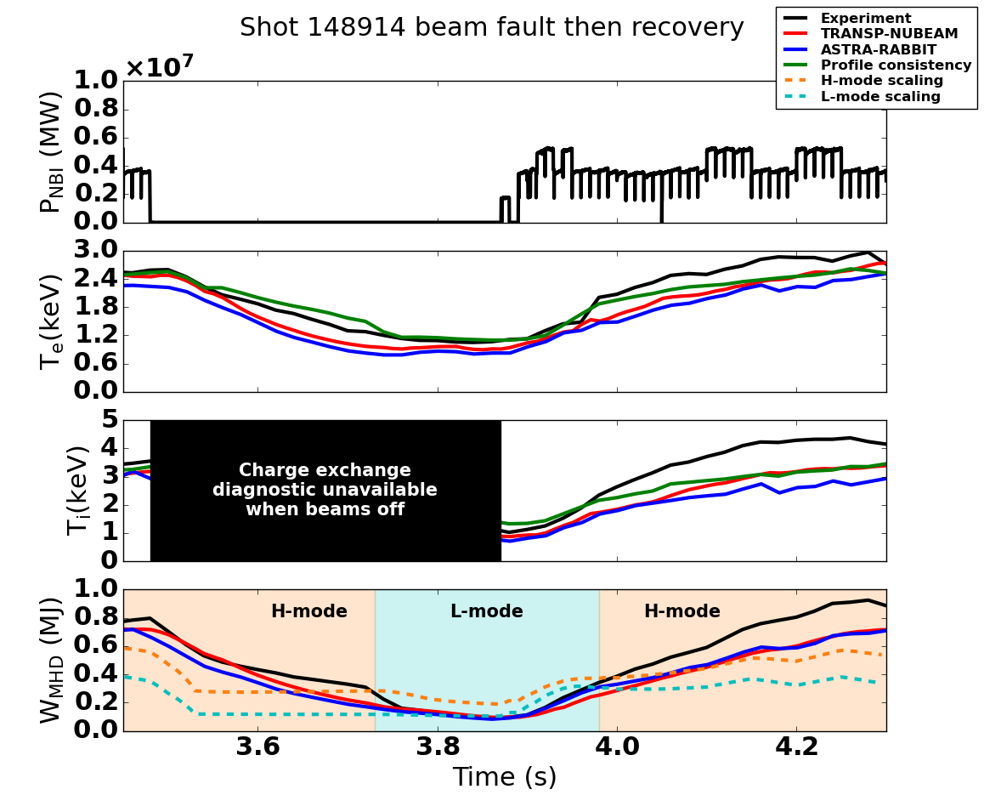
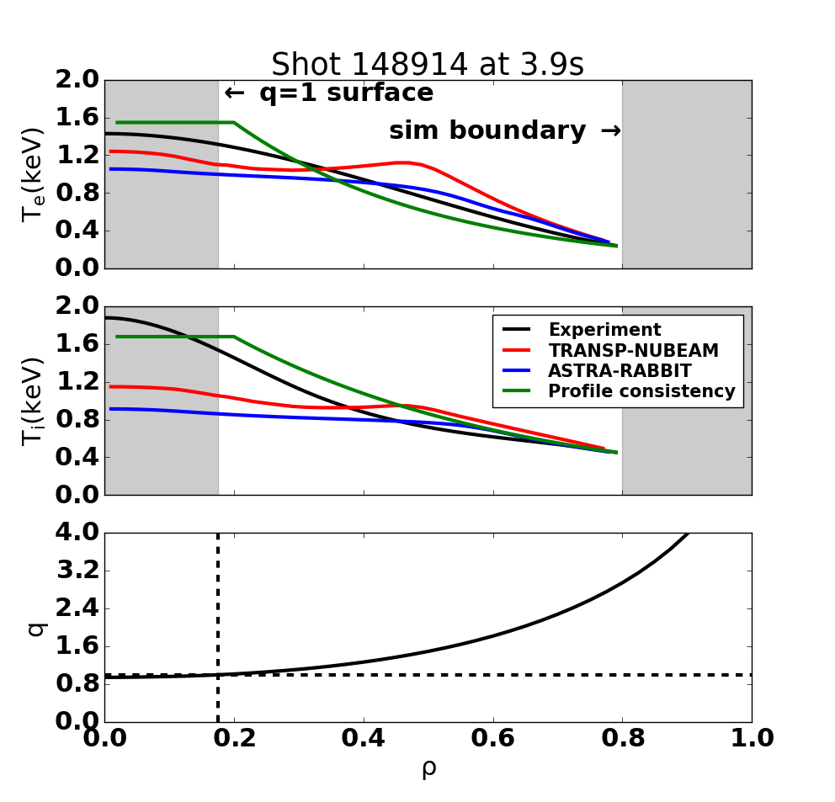
Time-dependent predictions made over 900ms window

Slide 24
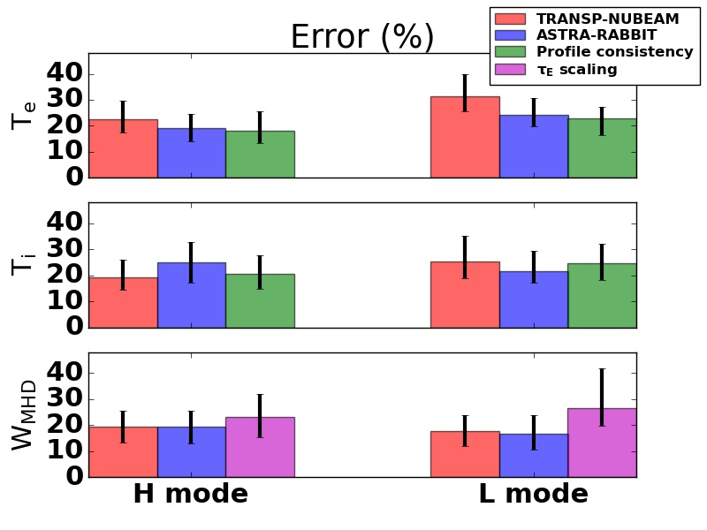
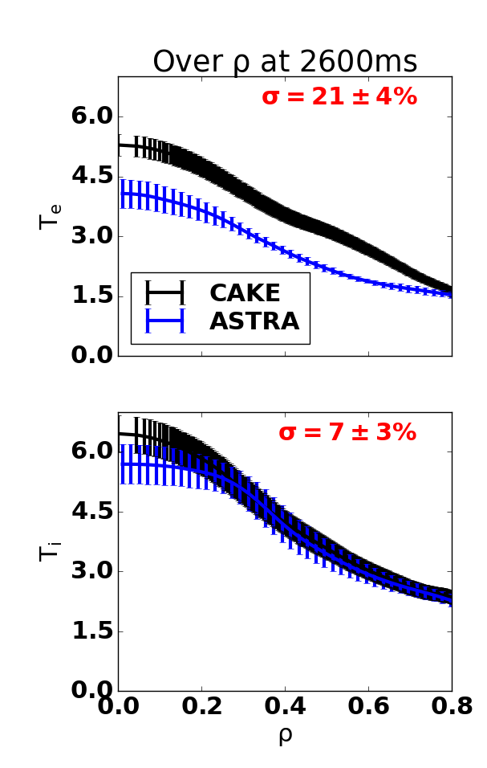
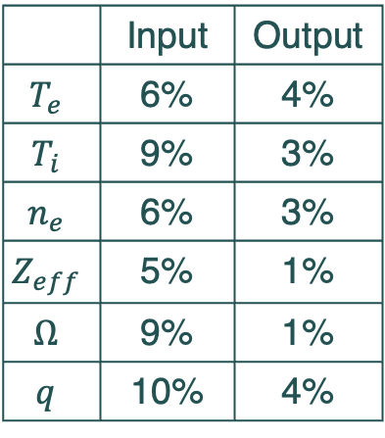
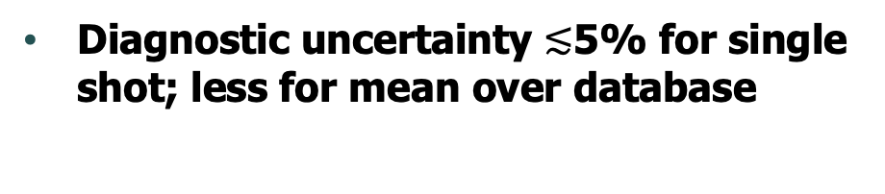
ASTRA/TRANSP perform no better than empirical baseline, large database with relatively low diagnostic uncertainty propagation gives confidence
Hypothesis: ASTRA/TRANSP performs significantly better than baseline
p<0.05 for Wmhd but not Te/Ti
Diagnostic uncertainty $≲$5% for single shot; less for mean over database
 | Input | Output
$$T_{e}$$ | 6% | 4%
$$T_{i}$$ | 9% | 3%
$$n_{e}$$ | 6% | 3%
$$Z_{eff}$$ | 5% | 1%
$$Ω$$ | 9% | 1%
$$q$$ | 10% | 4%
Notes:
P like 2e-5 for Wmhd and like 0.1 to 1

Slide 25
Thesis contributions: guidance
“Always have a baseline”: use hypothesis testing for validation
Database scans are useful (less bias, more confidence)
Simple simulation context doesn’t aid predictions
Like profile consistency: details of heat deposition don’t matter
ITER will need to rely largely on its own data for control development
Don’t sacrifice pre-operation commissioning time for sake of speed
Take a clear stance on spectrum of “end-to-end” to “interpretable” models
Setting low-level vs high-level control targets (e.g. gas vs target density)
Predicting diagnostics directly vs fitted profiles
Once we have a clear task to deploy, an open competition would be effective
If data access a problem, then at least within the fusion community

Slide 26



Thesis contributions: infrastructure
With Emiliano/Giovanni, upgraded ASTRA and made OMFIT interface
Pipeline for fetching standardized dataset (feat. Brian Sammuli’s toksearch)
With Rory, neural network control in DIII-D PCS
With Ian, arbitrary-timestep profile dynamics models
With Viraj/Allen/Andy/Ian, Chat-D3D
tinyurl.com/abbate-phd-defense
Notes:
https://docs.google.com/presentation/d/1JuMa7rn4nf-7gSp6BNdyWMPHKrjMe4WDi4AYSK6TCTI/edit#slide=id.g118ad53f056_1_7

Slide 27




Work in progress: Upgrades for profile prediction
Add uncertainty
Linear-state-space model
$x_{t}$=profiles
$u$=actuators
Encoder
Linear
Realtime adapt every 500ms
Char, Abbate in preparation
Decoder
$x_{t+1}$=profiles
Find mapping $f$ s.t. $x_{t+1}=f(x_{t}, u_{t},u_{t+1})$
Farre, Abbate et al in preparation
Jalalvand, Abbate et al 2022 IEEE TNNLS

Slide 28






Tokamak actuators (the knobs operators turn)
Power: 1kW → 1,000kW
Electron Cyclotron Heating (ECH)
1. Add microwaves
Ohmic transformer
2. Apply electrical current
Neutral Beams
3. Add hot particles
Notes:
- upfront note that there are different ways you can consider the knobs here: the lowest level actuator in an electric oven like this is the amount of current going through this coil. But instead of knobs that set the current directly, we have knobs that set the temperature and a feedback controller is used so that the current is adjusted so that temperature is achieved inside the oven. In contrast, in a stove the knobs are not temperature but instead correspond to the amount of gas and therefore the strength of the flame. This is something we’ll touch on later.

Slide 29





“Linear latent space” approach to leverage full Model-Predictive Control
$$z=f\left(x\right)$$
$$z_{t+1}={Az}_{t}+Bu_{t}$$
$$z_{t+2}={Az}_{t+1}+Bu_{t+1}={A^{2}z}_{t}+ABu_{t}+Bu_{t+1}$$
…
$$z_{t+N}=A^{N}z_{t}+A^{N−1}Bu_{t}+…+Bu_{t+N}$$
$x$=profiles
$u$=actuators
Encoder
Linear
Decoder
$x$=profiles
Model-Predictive Control:
Minimize ${(z−z_{target})}^{T}Q(z−z_{target})+u^{T}Ru$
s.t. $Du<d$
Encoded state at any time in future is linear function of the initial state and the trajectory of actuators

Slide 30


More details on ASTRA/TRANSP comparison

Slide 31

Kinetic plasma profile actuators
Total neutral beam power
Total neutral beam torque
Total ECH power
Target plasma current
Total deuterium gas puffed
Target toroidal magnetic field
Target plasma shape parameters

Slide 32
Relevant publications
Cross-verification and validation of predictive capabilities of the ASTRA and TRANSP codes Abbate, Fable et al Physics of Plasmas [in review] Created a novel benchmark (an empirical model) for validation and for the first time compared ASTRA 8
Towards LLMs as Operational Copilots for Fusion Reactors Mehta, Abbate et al 2023 NeurIPS Workshop AI4Science [in review] Applied large language models in a retrieval augmented generation system to assist tokamak operators. Deployed as a bot in the DIII-D tokamak operations Discord, and on an MIT server for the Alcator C-Mod tokamak.
A general infrastructure for data-driven control design and implementation in tokamaks Abbate, Conlin et al 2023 Journal of Plasma Physics 89(1) 895890102 Deployed the model below in a model-predictive framework on DIII-D (using finite set control) to achieve user-specified pressure and temperature profiles by varying injected power and torque.
Offline Model-Based Reinforcement Learning for Tokamak Control Char, Abbate et al 2023 Learning for Dynamics and Control Conference Trained similar model but with uncertainty output and more robust long-time dynamics, deployed in reinforcement learning controller at DIII-D to achieve user-specified betan by varying beam power
Real-Time and Adaptive Reservoir Computing With Application to Profile Prediction in Fusion Plasma Jalalvand, Abbate et al, 2022 IEEE Transactions on Neural Networks and Learning Systems vol. 33 no. 6 Rebuilt the model using Reservoir Computing Networks for realtime adaptability and towards a linear statespace
Data-driven profile prediction for DIII-D Abbate, Conlin et al 2021 Nuclear Fusion 61 046027 Developed a first-of-its-kind fully data-driven machine learning model to simulate plasma dynamics

