Slide 1
IIT PATNA USDC · GENAI DEVELOPMENT PROGRAM
Employee Knowledge
Assistant
Final Capstone — Project 2: Enterprise Knowledge Assistant with Advanced RAG
Hybrid retrieval · conversational memory · grounded citations or an honest refusal
PRESENTED BY
SUBMITTED
Ankit Bharti
September 2026

Slide 2
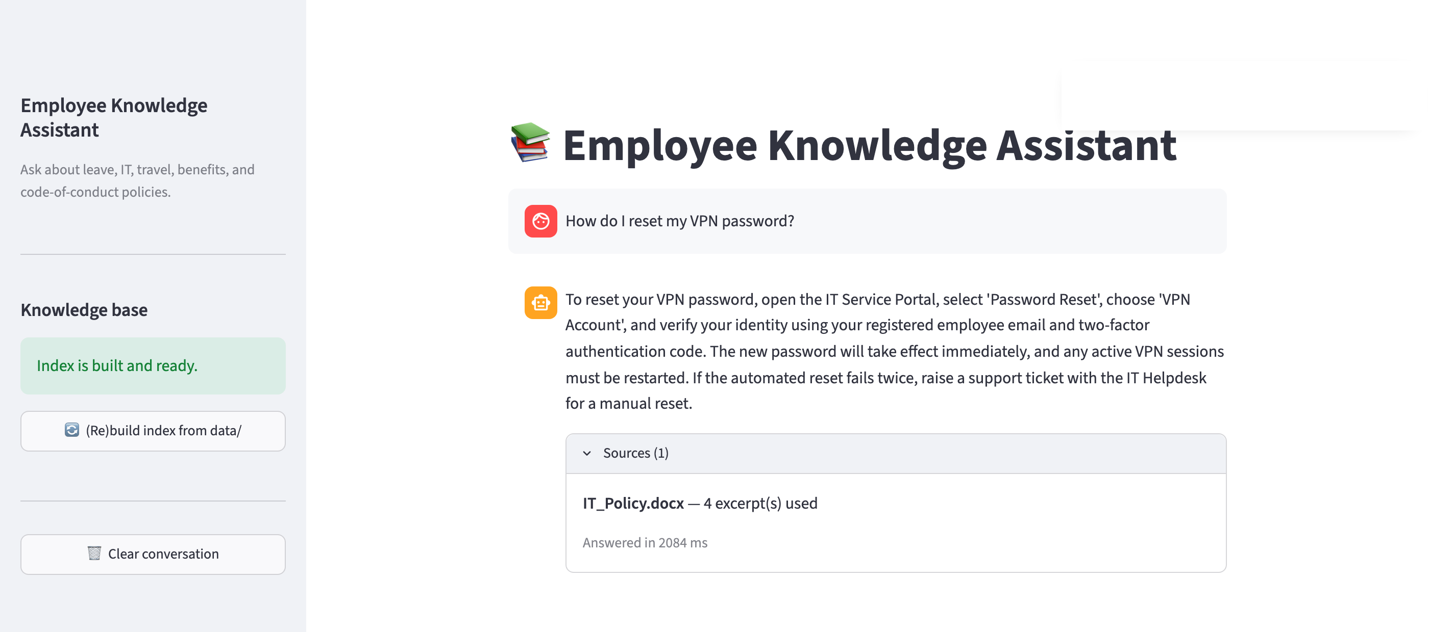
ENTERPRISE KNOWLEDGE ASSISTANT · ADVANCED RAG
Employee
Knowledge
Assistant
Answers policy questions from the company's own documents — retrieving twice, reranking locally, citing the passages it actually used, and refusing when the corpus has no answer.
app/streamlit_app.py · localhost:8501
Hybrid retrieval
Conversational memory
Grounded or refused
7 policy documents · 57 chunks · PDF / DOCX / TXT
18 curated eval questions · answerable, unanswerable, multi-turn
Employee Knowledge Assistant · IIT Patna USDC GenAI Capstone · Overview
01 02 03 04 05

Slide 3
THE GAP
Why "chat with your PDF" isn't enough
WHERE THE BASELINE BREAKS
WHAT THIS DOES INSTEAD
One retrieval pass. Pure vector search paraphrases well but blurs exact terms — a form code, a filename, a policy named verbatim.
Two passes, fused. Vector and BM25 run on every query, merge by Reciprocal Rank Fusion, then get reranked by a local cross-encoder.
No memory. "What about carry-forward?" retrieves noise, because nothing in that string says leave.
Condense, then retrieve. Each follow-up is rewritten into a standalone query against recent turns before retrieval runs.
Fills gaps by inventing. Asked about a sabbatical policy that doesn't exist, it writes one — and names sources it never read.
Refuses, and cites what it read. A two-stage guardrail declines on weak context; citations come from the chunks in the prompt.
LLM gpt-4o-mini Embeddings text-embedding-3-small Vector ChromaDB Keyword rank_bm25 Reranker ms-marco-MiniLM-L-6-v2 Memory LangChain UI Streamlit Packaging uv
Employee Knowledge Assistant · IIT Patna USDC GenAI Capstone · The gap
01 02 03 04 05

Slide 4
QUERY PATH · ONE USER TURN
Six stages between question and answer
gpt-4o-mini · 1,519 ms median turn
01
02a
03
04
05
Condense
Vector search
Fuse — RRF
Rerank
Guard & generate
→
→
→
→
02b
BM25 search
Fused by rank, not score
Reranked locally
Guarded, then cited
src/retrieval/hybrid.py
src/retrieval/reranker.py
src/guardrails/hallucination.py
Cosine similarity and BM25 weights live on incomparable scales, so RRF merges the two lists by rank position instead of inventing a normalization.
A CPU cross-encoder scores each candidate against the query jointly and narrows 20 → 4. No second paid API, at the cost of the slowest stage per unit of work.
A score floor skips the LLM when context is weak. Citations are taken from the chunks placed in the prompt, so they cannot be hallucinated.
WHERE A MEDIAN TURN SPENDS ITS TIME
1,519 ms total · p50 over 20 logged queries
Retrieval 298 ms
Rerank 170 ms
Generation 1,051 ms
Condensation contributes 0 ms at the median because it only runs on follow-up turns — its p95 is 783 ms. Measured from logs/app.log.
Employee Knowledge Assistant · IIT Patna USDC GenAI Capstone · Pipeline
01 02 03 04 05

Slide 5
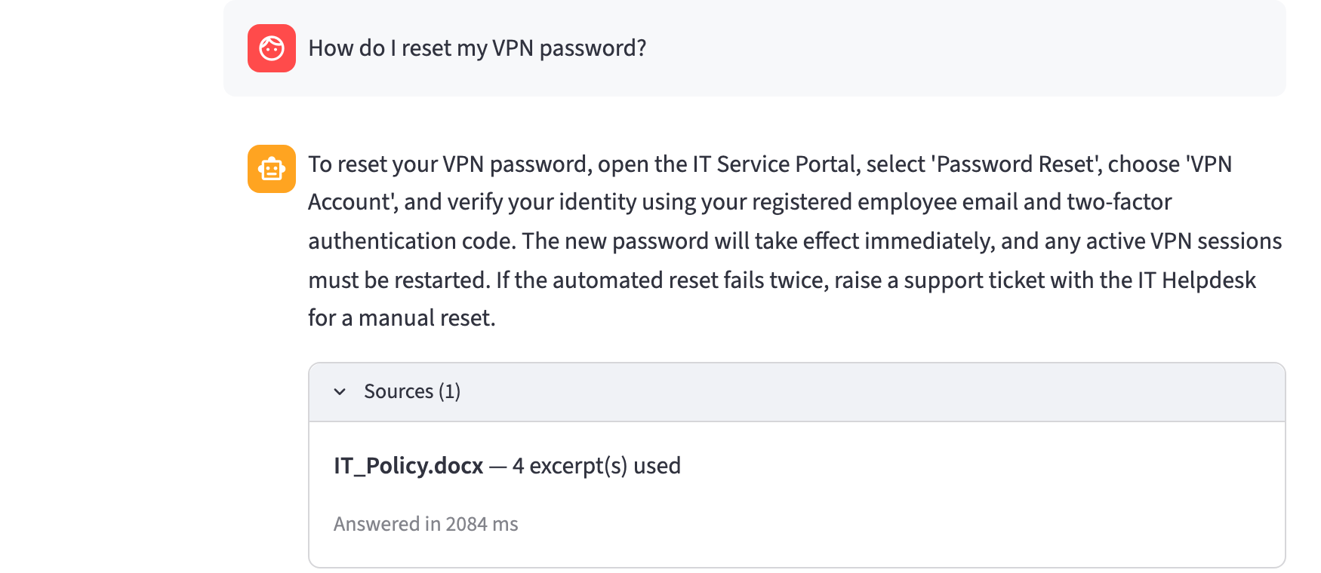
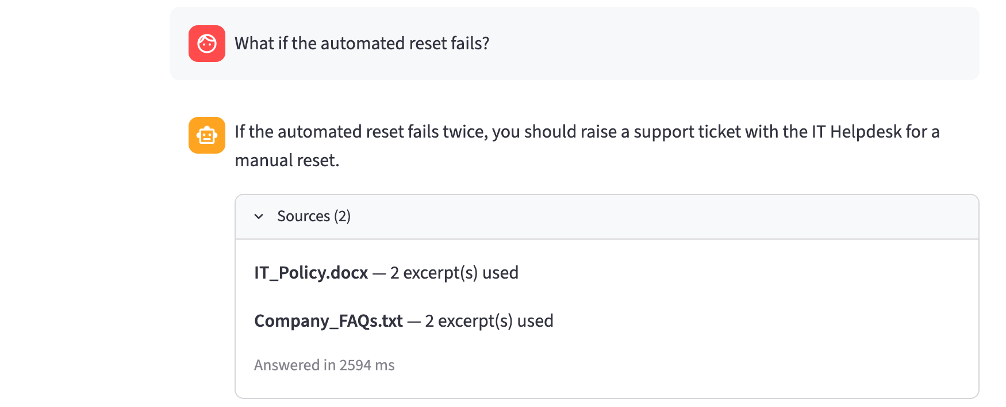

CAPTURED FROM THE RUNNING APP
Three turns, one session
localhost:8501
01
Grounded answer
"How do I reset my VPN password?" — answered from IT_Policy.docx in 2,084 ms. The Sources panel names the document and how many excerpts reached the prompt, because citations are built from the retrieved chunks rather than parsed out of the model's reply.
02
Follow-up memory
"What if the automated reset fails?" — the question has no subject of its own. Condensation resolves it against the previous turn before retrieval runs, and the answer now draws on two documents.
03
Honest refusal
"Does the company offer a sabbatical leave program?" — no such policy exists in the corpus. The guardrail stops on insufficient context, so the LLM is never given the chance to invent one.
Employee Knowledge Assistant · IIT Patna USDC GenAI Capstone · Live session
01 02 03 04 05

Slide 6
EVALUATION · EVAL/REPORT.MD
What the numbers say — and what they don't
RETRIEVAL · 13 QUESTIONS, K = 4
GENERATION · 16 QUESTIONS
METHOD
PASSAGE HIT@4
PASSAGE MRR@4
1.00
1.00
Vector only
1.00
0.88
Faithfulness
LLM-judge
Answer relevancy
LLM-judge
BM25 only
0.85
0.81
1.00
1.00
Hybrid + reranked
1.00
0.92
Citation coverage
expected source cited
Refusal accuracy
3 unanswerable
MRR 0
1.0
Document-level hit rate is 1.00 for all three arms — across seven documents it saturates. Passage-level, out of 57 chunks, is the metric with room to separate them.
1.00
Multi-turn memory
2 conversations
The judge is itself an LLM
The corpus is small
Known costs
Faithfulness and relevancy come from eval/run_generation_eval.py. Read them as directional signal, not ground truth.
57 chunks and 16 questions. Perfect scores at this size would not survive a real enterprise document set.
Condensation adds a round-trip per follow-up, the CPU reranker is the slowest stage, and build_index() has no incremental path.
Employee Knowledge Assistant · IIT Patna USDC GenAI Capstone · Evaluation
01 02 03 04 05

