Slide 1
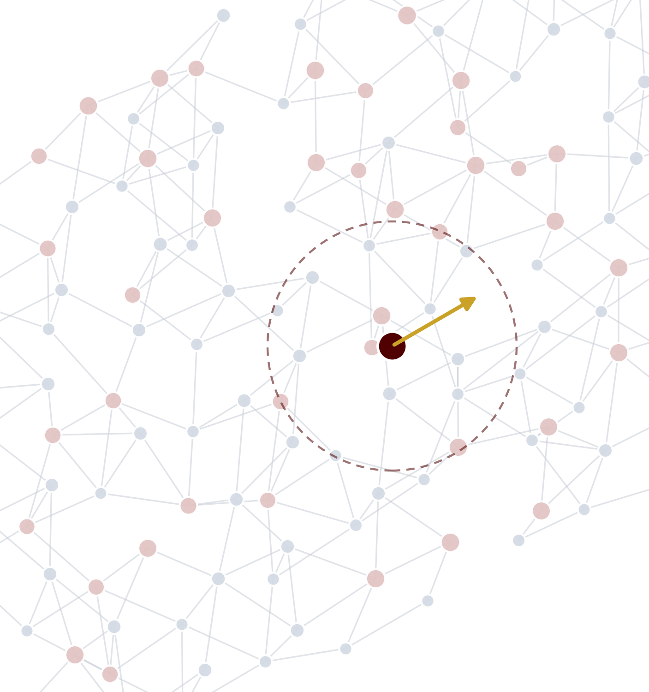
AGENTIC DISCOVERY & DEVELOPMENT · TEXAS A&M
MACE
Machine-learned atomic forces as an agent's physics engine
Joshua Jang · Fall 2026
Notes:
[0:00–0:15] Today: MACE, a machine-learned model of atomic forces, and why it is the kind of tool an AI agent needs to do real materials and chemistry discovery. Five minutes of slides, then a live demo where Claude Code drives MACE on this laptop.

Slide 2
PART 1 · THE MODEL
What is MACE?
A machine-learned interatomic potential: quantum-level accuracy at force-field speed
MACE
equivariant graph
neural network
E
total energy eV
F_{i}
force on every atom eV/Å
Atoms in
σ
stress on the cell GPa
positions r_{i} + elements Z_{i}
WHO USES IT
Li
C
MD
AI
Materials scientists
Chemists & pharma
Simulation engineers
AI agents
batteries, catalysts, alloys
molecules, liquids, drug-like systems
10⁴–10⁶ atoms, nanoseconds of motion
a fast, callable physics oracle
Batatia et al., NeurIPS 2022 (MACE); MACE-MP-0 foundation model covers 89 elements
02
Notes:
[0:15–0:45] MACE is a machine-learned interatomic potential. You give it atoms (where they are and what element they are) and it returns the energy, the force on every atom, and the stress on the cell. It is trained on quantum-mechanical DFT calculations, so it is close to DFT accuracy but thousands of times faster. Users: materials scientists, chemists, simulation engineers, and increasingly AI agents that need a physics tool they can call.

Slide 3
PART 1 · THE MODEL
Where MACE sits: accuracy vs. cost
Learn from expensive quantum calculations once, then predict cheaply forever
trained on DFT
Coupled cluster
DFT
10⁹× gap
at 10k atoms
MACE
accuracy →
Sweet spot: near-DFT accuracy at a tiny fraction of the cost
Classical force fields
compute cost per calculation (log scale) →
MACE scales linearly: big systems and long simulations become possible
Scaling curves are illustrative (DFT ~ O(N³), local ML potentials ~ O(N)); constants vary by code and hardware
03
Notes:
[0:45–1:15] Trade-off map. Classical force fields are fast but crude. DFT is accurate but expensive and scales as N cubed. Coupled cluster is the gold standard and even slower. MACE learns from DFT once, then predicts at a tiny fraction of the cost, and it scales linearly with the number of atoms, so the gap grows with system size.

Slide 4
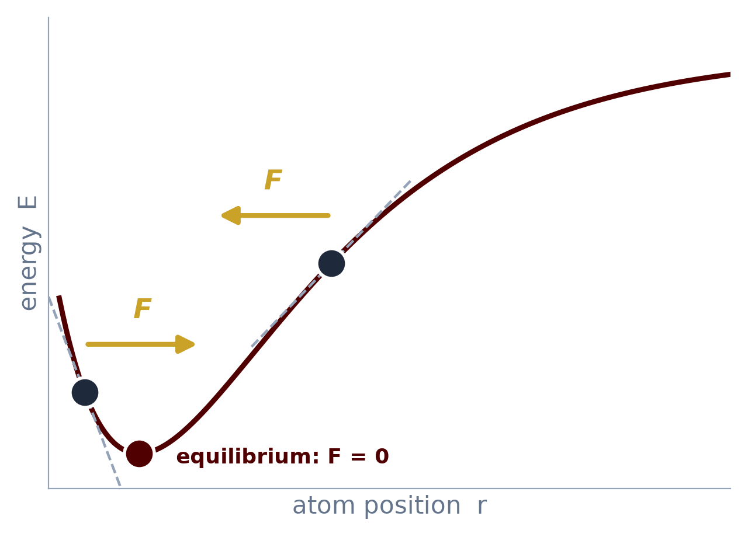
PART 1 · THE MODEL
Forces are the slope of the energy
Learn one function, the energy, and every force follows by differentiation
r_{c} ≈ 6 Å
E = Σ_{i} E_{i}( neighbors within r_{c} )
Total energy is a sum of local atomic contributions, so cost grows linearly
F_{i} = − ∂E / ∂r_{i}
−∇E
Forces by automatic differentiation: energy is conserved, so dynamics stay stable
Train on DFT energies + forces → predict both for brand-new structures in milliseconds
04
Notes:
[1:15–1:55] The core physics. Atoms sit on a potential energy surface. The force is the negative slope: stretch a bond and the force pulls it back; at the minimum the force is zero. MACE writes the total energy as a sum of atomic energies, each depending only on neighbors within a cutoff of about 6 angstroms. Forces come from differentiating that energy automatically, which guarantees energy conservation in molecular dynamics.

Slide 5
PART 1 · THE MODEL
Inside MACE: many-body equivariant messages
A graph neural network where atoms are nodes and neighbors within r_{c} are edges
1
2
3
4
Embed
Neighbor basis
Many-body product
Update + readout
h_{j} = W · onehot(Z_{j})
A_{i} = Σ_{j} R(r_{ij}) Y_{lm}(r̂_{ij}) h_{j}
B_{i} = A_{i} ⊗ A_{i} ⊗ A_{i}
E_{i} = MLP(h_{i}⁽²⁾)
each element becomes a learned vector
distance × direction (spherical harmonics)
tensor products build 4-body terms in one step
two layers, then a per-atom energy
E(3)
Equivariant
ν=3
High body order
2L
Small + fast
rotate the molecule → forces rotate with it
rich physics with only 2 layers
local, parallel, GPU-friendly
Batatia, Kovács, Simm, Ortner, Csányi, “MACE: Higher Order Equivariant Message Passing Neural Networks,” NeurIPS 2022
05
Notes:
[1:55–2:40] The engineering. MACE is a graph neural network: atoms are nodes, neighbors within the cutoff are edges. Step 1 embeds each element. Step 2 builds a neighbor basis from distances (radial functions) and directions (spherical harmonics). Step 3 is the key idea from the Atomic Cluster Expansion: tensor products of that basis create 4-body interactions in a single message. Step 4 updates and reads out per-atom energy. Everything is equivariant, so rotating the input rotates the forces correctly, and high body order means only two layers are needed, which makes it fast.

Slide 6
PART 2 · THE AGENT
MACE as the agent's physics tool
The LLM plans and reasons; MACE answers “what would the atoms do?” in milliseconds
Plan
hypothesis
10⁶ ideas generated
agent / generative model
10⁴ screened with MACE
milliseconds each
LLM
agent
Analyze
rank · decide
Build
ASE · pymatgen
10² checked with DFT
hours each
10 made in the lab
weeks each
Simulate
MACE: relax · MD
Physics cheap enough for an agent to think with
06
Notes:
[2:40–3:20] Where agents come in. The LLM is good at planning and reasoning but cannot know what atoms will do. MACE is a tool it can call: build a structure, relax it or run dynamics, read the energies and forces, decide what to try next. In a discovery funnel, the agent can generate a million ideas, MACE screens ten thousand in milliseconds each, DFT checks the top hundred, and only ten go to the lab.

Slide 7
PART 2 · THE AGENT
Evolution with MACE as the fitness function
Generate, score, select, repeat: the LLM can be the mutation operator
Population
candidate structures
Select
keep the fittest
Mutate
GA swaps or LLM ideas
× generations
Score
MACE energy
GENOME: 32 SITES, 4 LAYERS (shown: L1₀ CuAu, the known stable phase)
■ Cu ■ Au
Real run from today's demo: 32-atom Cu/Au cell, MACE-MP-0 (small), 235 MACE calls in 17 s on a laptop CPU
07
Notes:
[3:20–4:00] An evolutionary workflow. A population of candidate structures, mutate them, score every child with MACE, keep the fittest, repeat. The chart is a real run on this laptop: 32-atom copper-gold alloys, 235 MACE calls in 17 seconds. The blind GA improves a lot, from about +50 to +18 meV per atom, but it stalls. The known stable phase, L1-zero, is at −18. That gap is the opening for an LLM: replace random mutation with an agent that proposes chemically sensible changes. You'll see exactly this in the demo.

Slide 8
PART 2 · THE AGENT
More ways to pair MACE with an agent
Same tool, four workflow shapes
1
Active learning
2
MCP tool server
MACE unsure?
DFT labels it
fine-tune MACE
Claude
relax · md · phonons
MACE
the agent decides where the model needs more data
expose MACE as tools any agent can call
3
Multi-agent team
4
Property prediction
Planner
Simulator (MACE)
Critic
Agent sets T, P
MACE dynamics
diffusion, strength
one proposes, one computes, one checks
long simulations that DFT can't afford
08
Notes:
[4:00–4:30] Other patterns. Active learning: the agent watches MACE's uncertainty and sends only the uncertain structures to DFT, then fine-tunes. An MCP server wraps MACE as tools that Claude or any agent can call. A multi-agent team splits planning, simulation, and critique. And for properties like diffusion or mechanical strength, the agent sets up long MACE molecular-dynamics runs that DFT could never afford.

Slide 9
PART 2 · THE AGENT
Trust, but verify
Pressure-test MACE before an agent acts on it
?
DFT
≈
r_{c}
Out of distribution
Inherits DFT errors
Softened surface
Local by design
Chemistry far from the training data fails silently. Watch uncertainty.
Trained on PBE-level DFT, so its known biases carry over.
Universal models tend to under-predict stiffness. Fine-tune for production.
A ~6 Å cutoff misses long-range electrostatics without add-ons.
Agent rule: MACE proposes, DFT disposes. Spot-check every winner.
09
Notes:
[4:30–4:50] Four cautions before an agent trusts MACE. It can fail silently outside its training data. It inherits the errors of the DFT it learned from. Universal models are known to be a bit too soft. And it is local, so long-range electrostatics need extra terms. The rule for an agent: MACE screens, DFT confirms the winners.

Slide 10
LIVE DEMO
Claude Code × MACE
An LLM agent in VS Code using MACE as its physics tool, live on this laptop
1
2
3
Forces
Blind evolution
Agent evolution
Stretch a water molecule, read the forces, watch it relax
A genetic algorithm scores 235 Cu/Au alloys in 17 s
Claude proposes structures, MACE judges them
10
Notes:
[4:50–5:00] Switch to VS Code. Follow DEMO_SCRIPT.md: Act 1 forces, Act 2 blind GA, Act 3 Claude as the mutation operator.

Slide 11
Key takeaways
Four ideas to leave with
E→F
1
ν
2
AI
3
✓
4
One model, all forces
Physics built in
Agents need cheap physics
Close the loop
Learn the energy; forces and stress come free by differentiation.
Equivariant, many-body messages make it accurate and fast.
MACE turns an LLM's hypotheses into numbers in milliseconds.
Evolve with MACE, verify winners with DFT and the lab.
Questions?
11
Notes:
[after demo, ~20 s] Recap: MACE learns the energy and gets forces for free; its equivariant many-body design is why it's accurate and fast; agents need exactly this kind of cheap, callable physics; and the loop closes with DFT and lab verification. Questions?

