Slide 1
Phase 2 — Deep Learning Foundations
The Transformer Architecture: A Deep Dive
Self-attention, multi-head attention, positional encoding, and the encoder-decoder stack
Chapter 2.5

Slide 2
Agenda
01 | TL;DR
02 | High-Level: self-attention, multi-head attention, positional encoding
03 | Deep-Dive: scaled dot-product attention, masking, the full block
04 | Comparison & Related Concepts
05 | Reference Architecture: the encoder-decoder stack
06 | Industry Use Cases (Finance, Healthcare, Telecom)
07 | Check Your Understanding
RegAITraining · Chapter 2.5
2 / 15

Slide 3
TL;DR
An RNN (2.4), even with LSTM or GRU gating, still processes a sequence one step at a time, so information connecting two distant positions has to travel through every step in between.
The Transformer removes recurrence entirely and replaces it with self-attention: every position looks directly at every other position in a single step.
Because attention alone has no built-in sense of order, a positional encoding is added to each token so the model can recover word order.
Multi-head attention runs several attention computations in parallel with different learned projections, and stacked attention plus feedforward layers, each wrapped in a residual connection and layer normalization, form the encoder and decoder stacks.
RegAITraining · Chapter 2.5
3 / 15

Slide 4
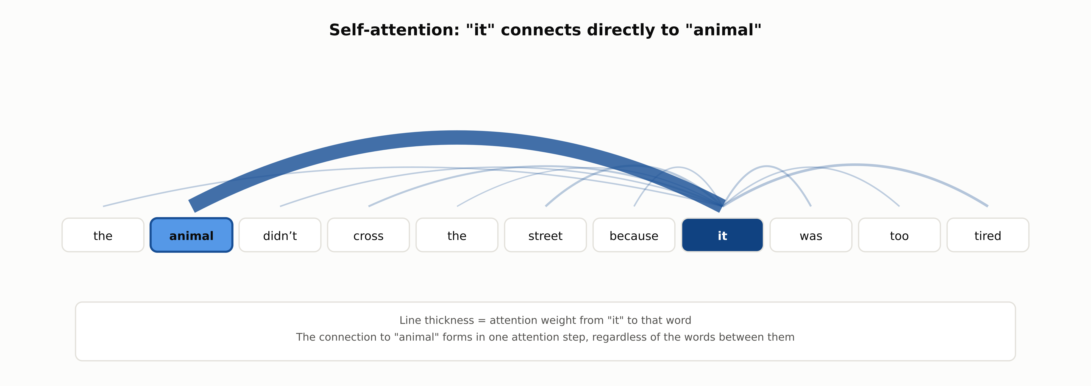
Self-attention connects distant words in one step
The connection from "it" to "animal" forms in one attention step, regardless of the words between them.
RegAITraining · Chapter 2.5
4 / 15

Slide 5
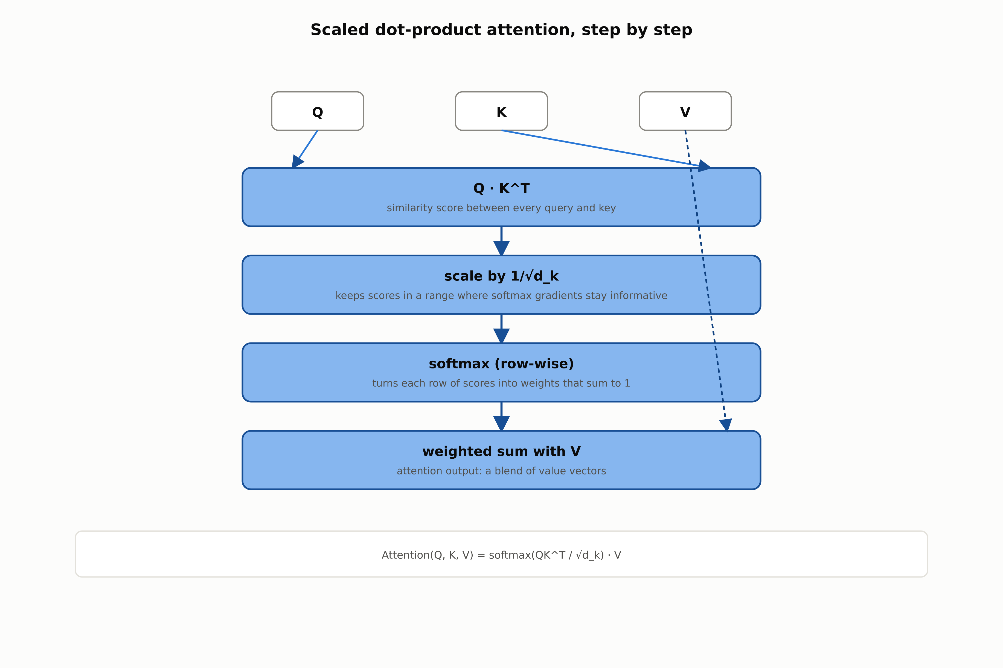
Scaled dot-product attention, step by step
Attention(Q, K, V) = softmax(QK^T / sqrt(d_k)) times V.
RegAITraining · Chapter 2.5
5 / 15

Slide 6
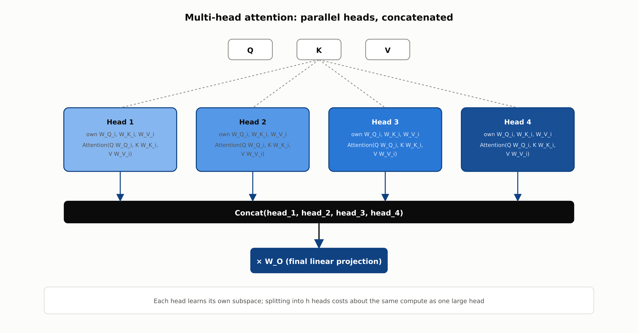
Multi-head attention: parallel heads, concatenated
Each head learns its own subspace; splitting into h heads costs about the same compute as one large head.
RegAITraining · Chapter 2.5
6 / 15

Slide 7
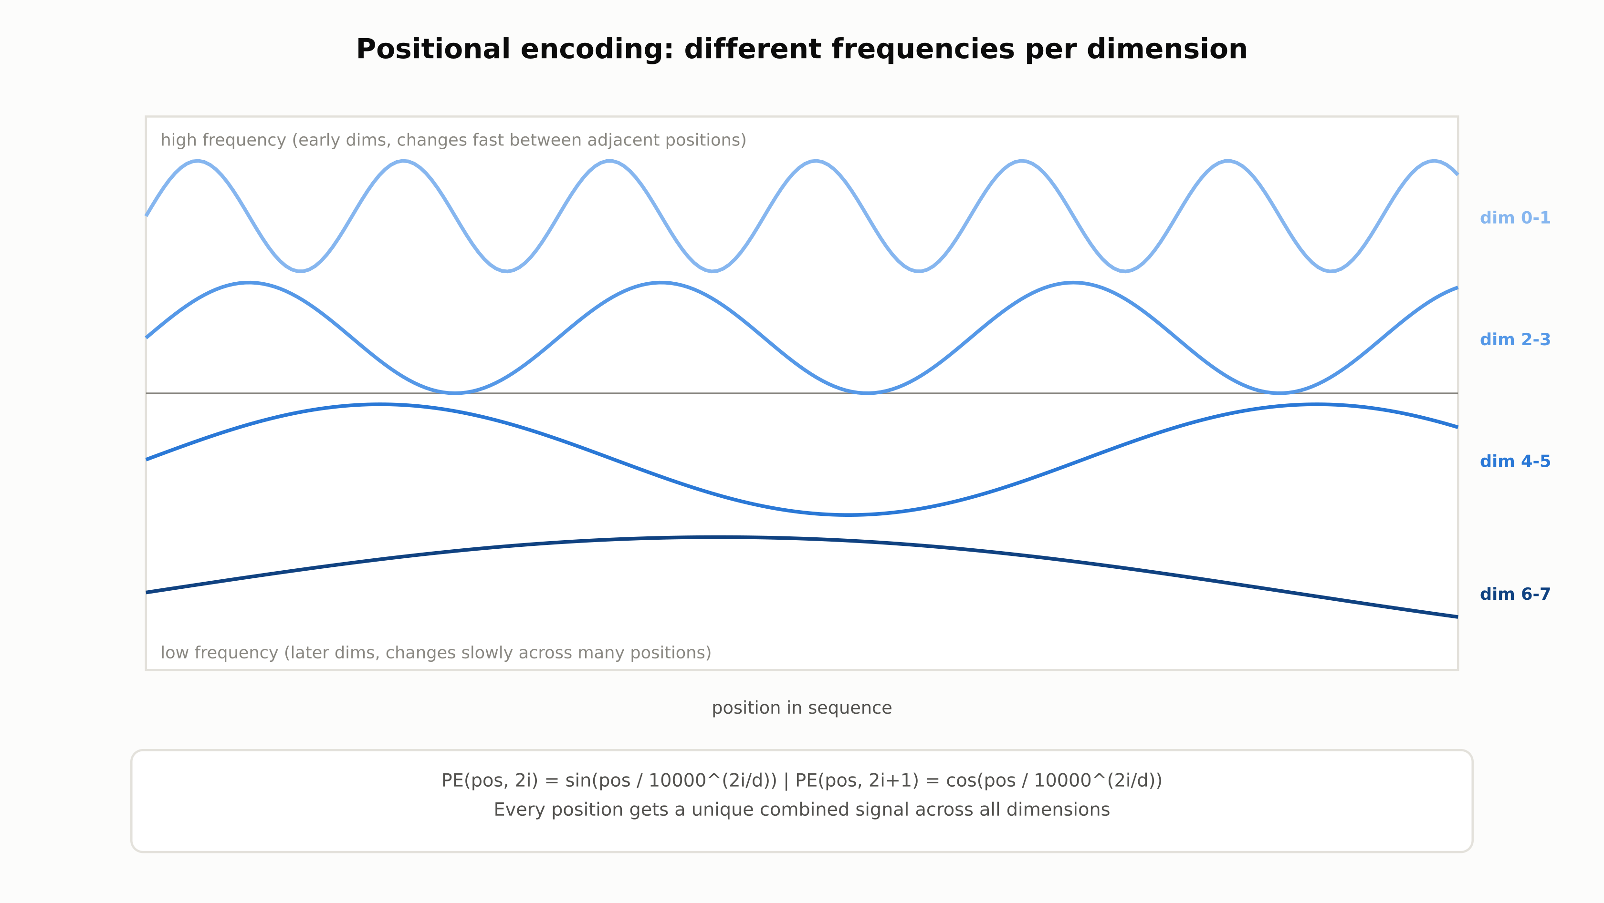
Positional encoding: different frequencies per dimension
Every position gets a unique combined signal across all embedding dimensions.
RegAITraining · Chapter 2.5
7 / 15

Slide 8
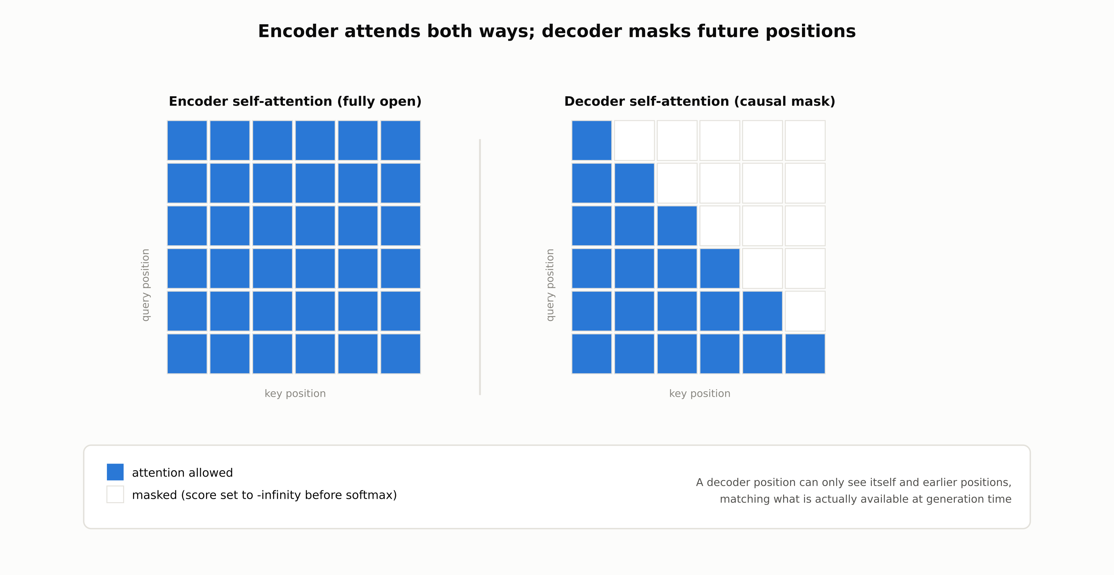
The decoder masks future positions
A decoder position can only see itself and earlier positions, matching what is actually available at generation time.
RegAITraining · Chapter 2.5
8 / 15

Slide 9
Comparison & Related Concepts
Aspect | RNN / LSTM / GRU (2.4) | Transformer
Path length between any two positions | O(n): information travels through every intermediate step | O(1): every position attends directly to every other position
Parallelization across sequence positions during training | Limited: step t needs step t-1's output | Full: all positions processed simultaneously
Compute cost per layer | O(n times d^2) | O(n^2 times d), quadratic in sequence length
How order is represented | Implicit in the order of recurrent steps | Explicit positional encoding added to embeddings
The Transformer trades an RNN's sequential-but-cheaper-per-token computation for a fully parallel but quadratic-in-length computation, and trades an implicit sense of order for an explicit one.
RegAITraining · Chapter 2.5
9 / 15

Slide 10

RegAITraining · Chapter 2.5
10 / 15

Slide 11

RegAITraining · Chapter 2.5
11 / 15

Slide 12

RegAITraining · Chapter 2.5
12 / 15

Slide 13
Check Your Understanding
1. What specific limitation of RNNs (2.4) does self-attention remove, and how?
2. Why is attention scaled by the square root of the key dimension before the softmax?
3. What does multi-head attention add beyond a single attention computation?
4. Why does the Transformer need an explicit positional encoding?
5. What is the causal mask in a decoder's self-attention, and why is it necessary?
RegAITraining · Chapter 2.5
13 / 15
Notes:
Q1: What specific limitation of RNNs (2.4) does self-attention remove, and how? A1: An RNN must process a sequence step by step, so the path length between two positions grows with the distance between them. Self-attention lets every position attend directly to every other position in a single step, making the path length constant (O(1)) regardless of distance, and allows all positions to be processed in parallel during training. Q2: Why is attention scaled by the square root of the key dimension before the softmax? A2: As the key dimension grows, dot products between queries and keys tend to grow large in magnitude simply from summing more terms, which pushes the softmax into a region where its gradient is very small. Dividing by the square root of the key dimension keeps the scores in a range where softmax gradients stay informative. Q3: What does multi-head attention add beyond a single attention computation? A3: Multi-head attention runs several attention computations in parallel, each with its own learned projections into a smaller subspace, then concatenates the results. This gives the model several separate subspaces in which to learn distinct kinds of relationships rather than averaging everything into one pattern. Q4: Why does the Transformer need an explicit positional encoding? A4: Self-attention compares a sequence as a set of positions rather than processing it in order, so on its own it has no notion of which token came first, second, or last. A positional encoding injects a position-dependent signal into each token's embedding so order can be recovered. Q5: What is the causal mask in a decoder's self-attention, and why is it necessary? A5: The causal mask sets the attention score to negative infinity for any position after the current one, before the softmax, so a decoder position cannot attend to tokens that have not been generated yet. This is necessary because at inference time those future tokens do not exist yet, and training must match that same autoregressive constraint.

Slide 14
Key Takeaways
The Transformer replaces recurrence with self-attention, giving every pair of positions a constant-length path and allowing full parallelization across positions during training.
Scaled dot-product attention computes similarity between queries and keys, scales to keep softmax gradients informative, and produces a weighted sum of values.
Multi-head attention runs several attention computations in parallel subspaces, letting different heads specialize in different relationships.
Since attention has no inherent sense of order, a positional encoding is added to each token's embedding; the decoder additionally uses a causal mask so it cannot attend to future tokens.
An encoder layer stacks self-attention and a feedforward network; a decoder layer adds a third sublayer, cross-attention to the encoder's output, with every sublayer wrapped in a residual connection and layer normalization.
RegAITraining · Chapter 2.5
14 / 15

Slide 15
Sources
Vaswani, A., Shazeer, N., Parmar, N., Uszkoreit, J., Jones, L., Gomez, A. N., Kaiser, L., and Polosukhin, I. (2017). Attention Is All You Need. NeurIPS. — https://arxiv.org/abs/1706.03762
Bahdanau, D., Cho, K., and Bengio, Y. (2015). Neural Machine Translation by Jointly Learning to Align and Translate. ICLR. — https://arxiv.org/abs/1409.0473
Ba, J. L., Kiros, J. R., and Hinton, G. E. (2016). Layer Normalization. — https://arxiv.org/abs/1607.06450
Sennrich, R., Haddow, B., and Birch, A. (2016). Neural Machine Translation of Rare Words with Subword Units. ACL. — https://aclanthology.org/P16-1162/
RegAITraining · Chapter 2.5
15 / 15

