Slide 1
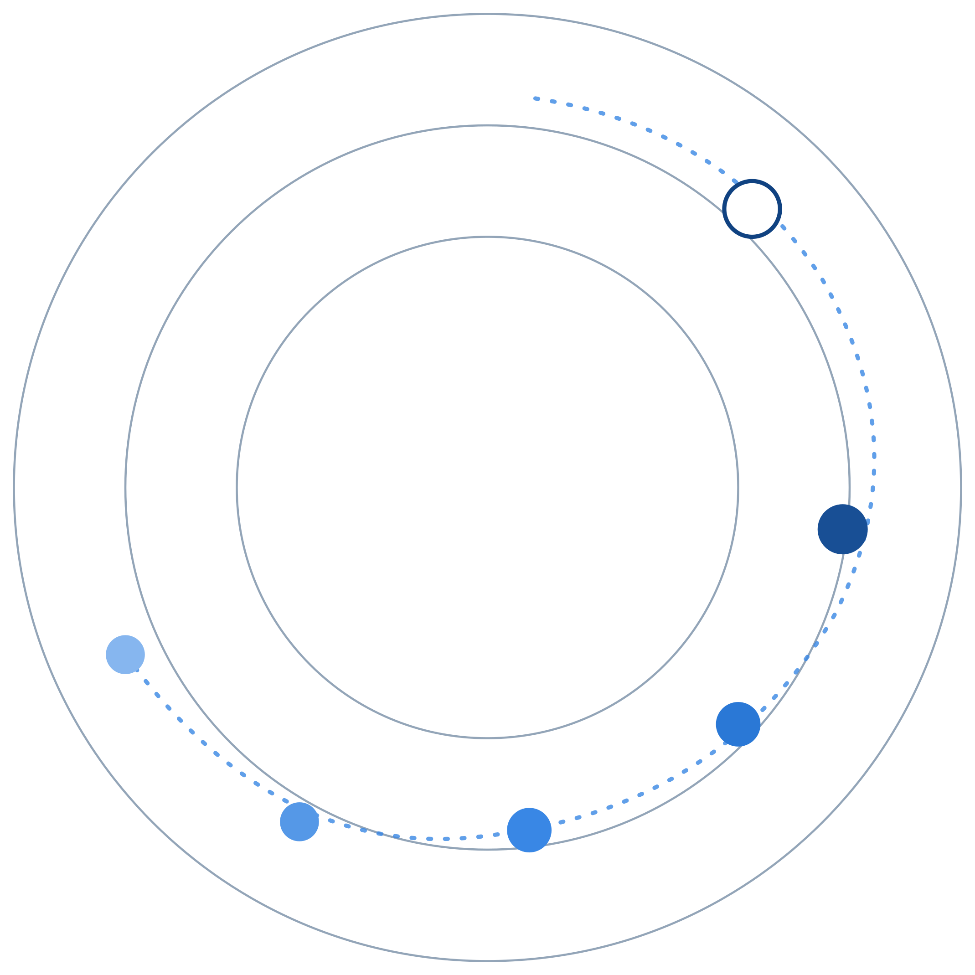
REGAITRAINING · PHASE 1 -- AI & MACHINE LEARNING FOUNDATIONS
CHAPTER 1.5
Classical ML Algorithms Landscape
A Comparison of Linear Models, Trees, Ensembles, k-NN, SVM, and Naive Bayes
A teaching-slide walkthrough of the chapter: what inductive bias means, how six classical families differ, and how to choose among them with the tools from chapter 1.4.
Instructor deck · 15 slides · based on docs/01-ai-ml-foundations/1-5-classical-ml-algorithms.mdx

Slide 2
ROADMAP
What We'll Cover
1
Inductive bias
5
A model-selection pipeline
The one question every algorithm family answers differently
Choosing a family honestly with cross-validation
2
Decision trees, mechanism
6
Comparison table
CART, purity gain, and stopping conditions
Bias-variance profile, boundary shape, interpretability, cost
3
Bagging vs boosting
7
Industry use cases
Two ways to combine trees, two different fixes
Finance, Healthcare, and Telecom - 4 each
4
k-NN and the curse of dimensionality
Why nearest stops meaning much
1.5 | Phase 1 - AI & Machine Learning Foundations
2

Slide 3
TL;DR
No Algorithm Is Universally Best
A handful of classical algorithm families cover most tabular ML problems. Each makes a different structural assumption, called an inductive bias, about how inputs map to outputs.
Linear models, decision trees, ensembles, k-NN, SVMs, and Naive Bayes each sit differently on chapter 1.4's bias-variance spectrum. That is what determines fit, interpretability, and cost.
THE PRACTICAL TAKEAWAY
Choosing among them is a practical decision driven by data size, feature types, interpretability requirements, and how much non-linearity the true relationship actually has.
1.5 | Phase 1 - AI & Machine Learning Foundations
3

Slide 4
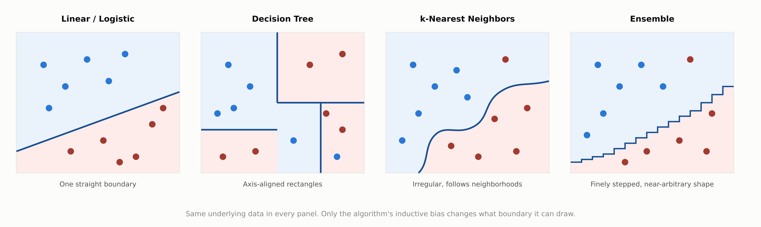
HIGH-LEVEL
Four Families, Four Decision Boundaries
1.5 | Phase 1 - AI & Machine Learning Foundations
4

Slide 5
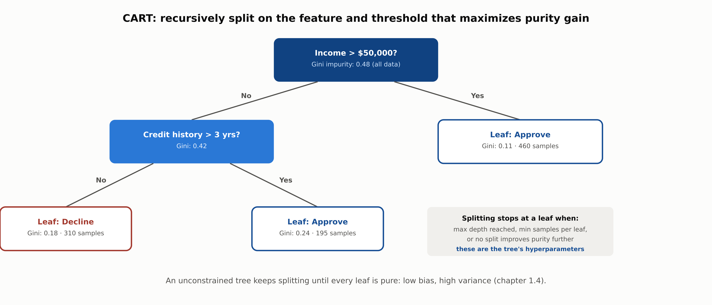
DEEP-DIVE
CART: Recursive Splitting on Purity Gain
1.5 | Phase 1 - AI & Machine Learning Foundations
5

Slide 6
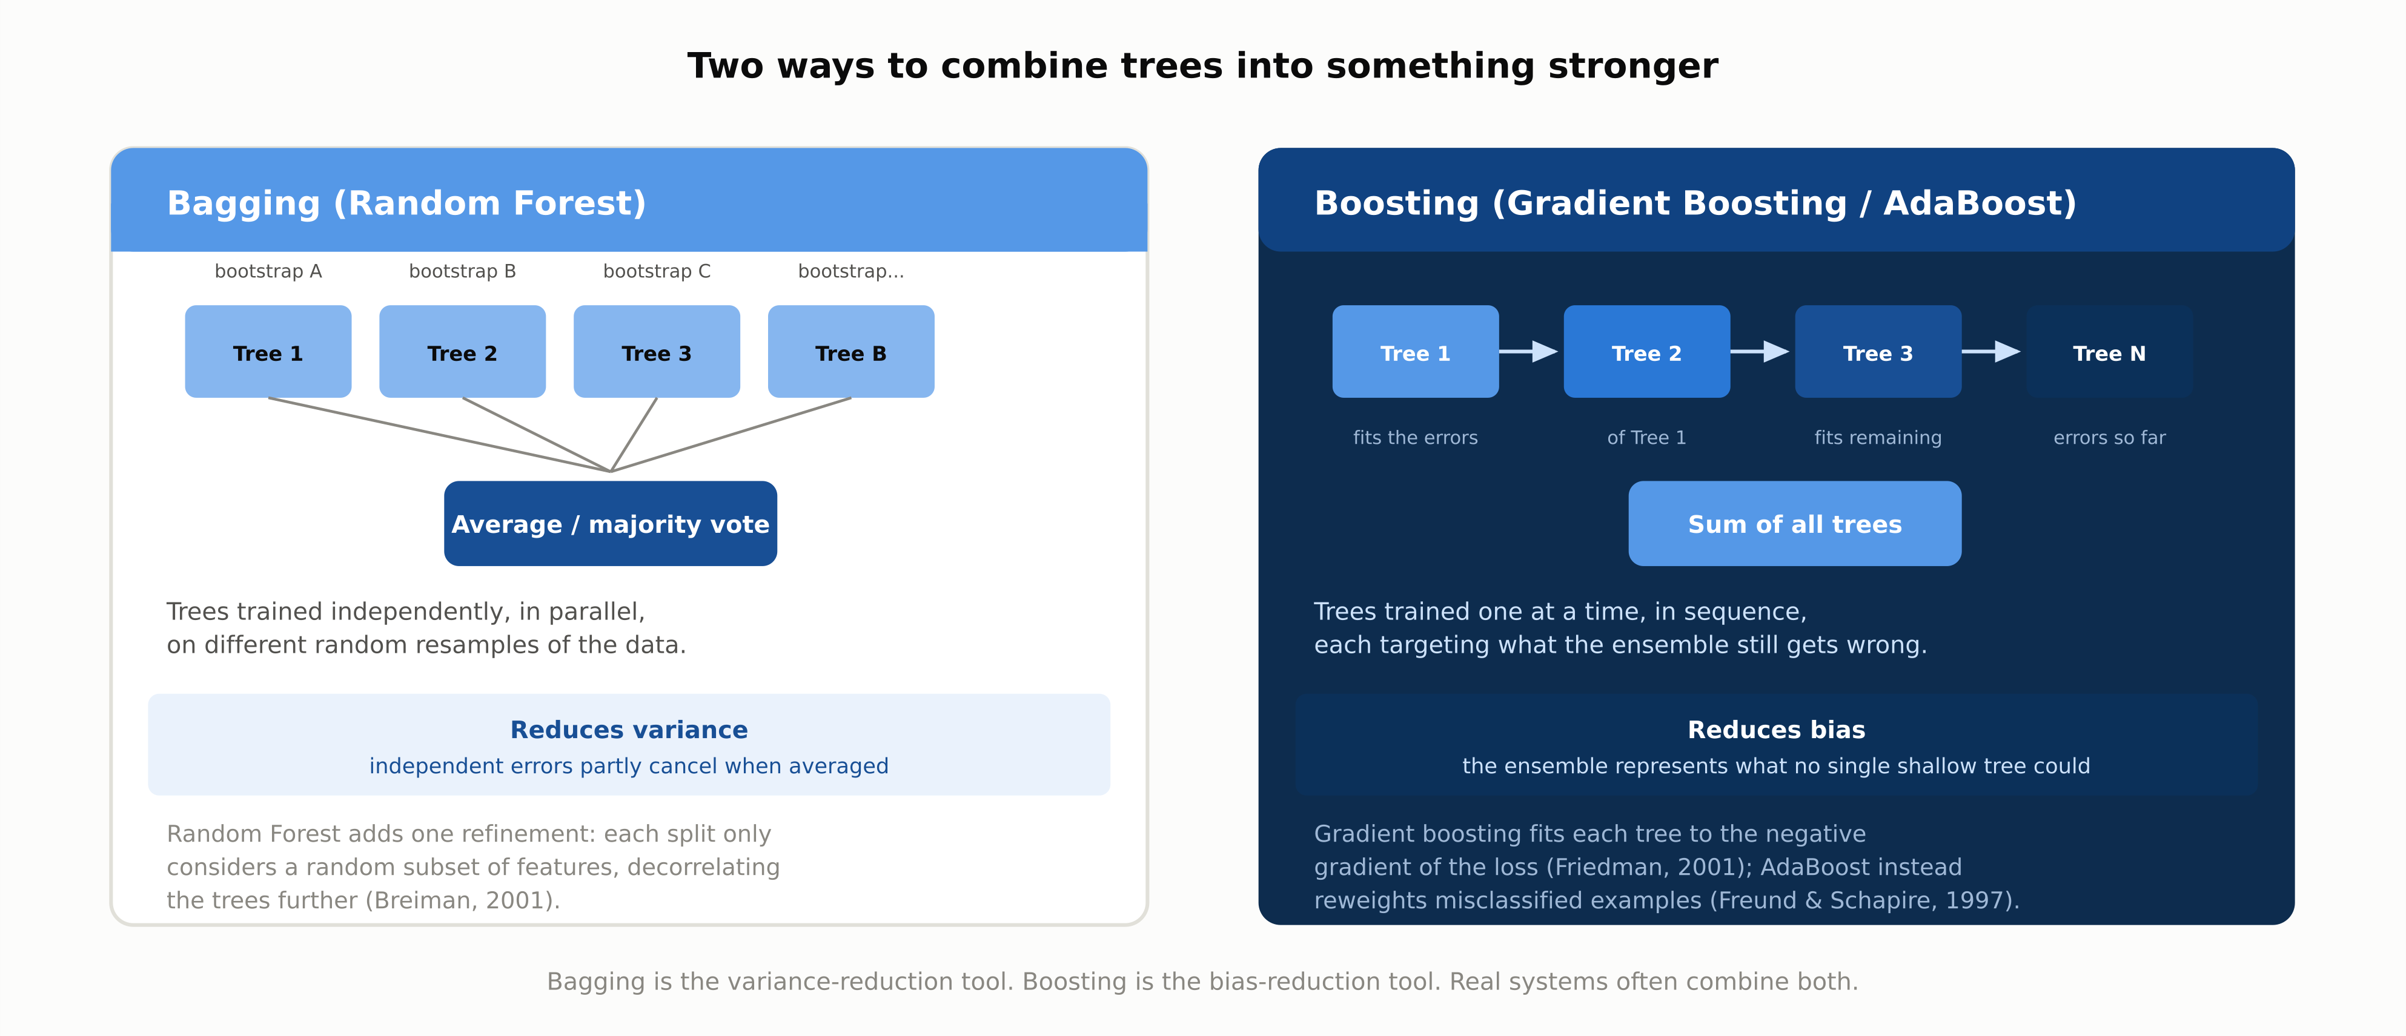
DEEP-DIVE
Bagging Reduces Variance, Boosting Reduces Bias
1.5 | Phase 1 - AI & Machine Learning Foundations
6

Slide 7
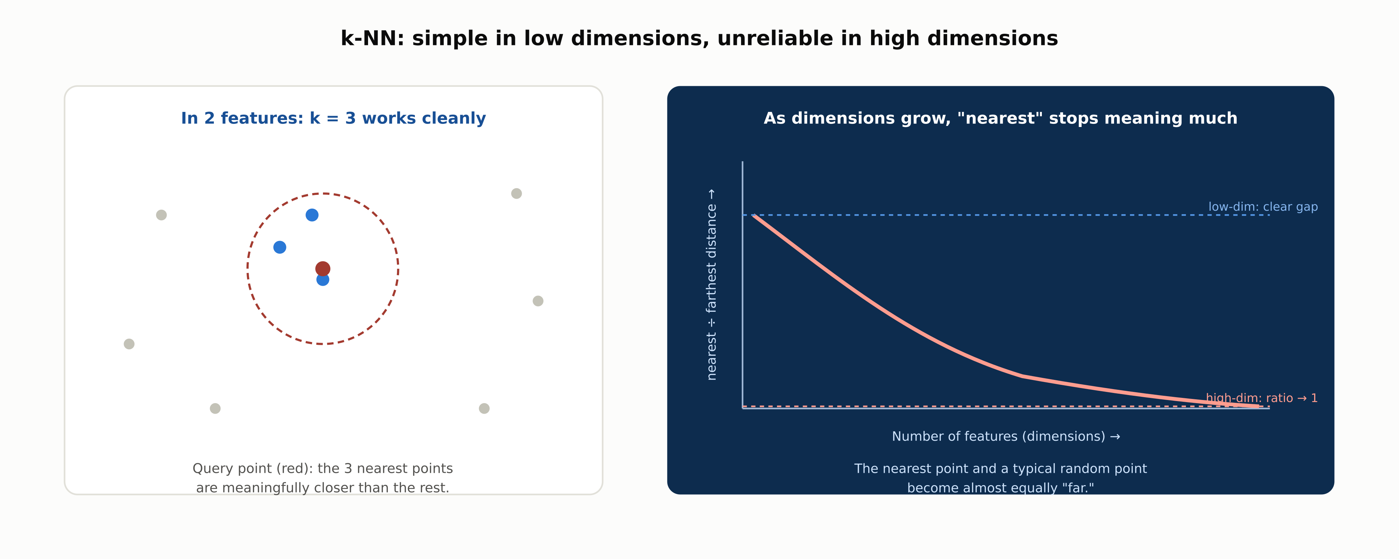
DEEP-DIVE
k-NN and the Curse of Dimensionality
1.5 | Phase 1 - AI & Machine Learning Foundations
7

Slide 8
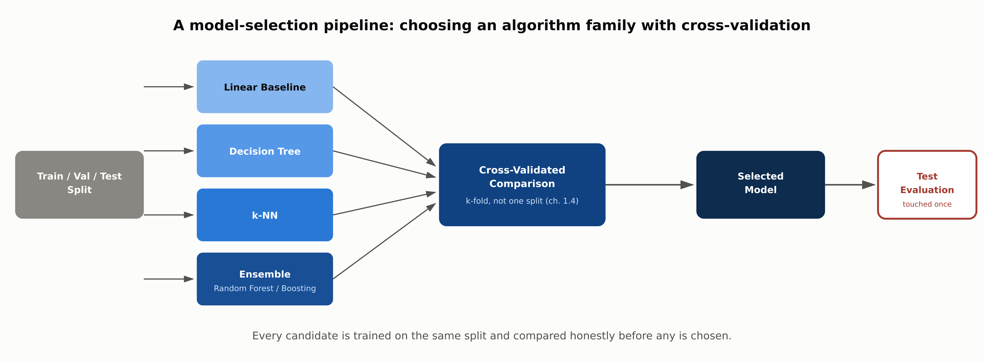
REFERENCE ARCHITECTURE
Choosing an Algorithm Family with Cross-Validation
1.5 | Phase 1 - AI & Machine Learning Foundations
8

Slide 9
COMPARISON & RELATED CONCEPTS
Four Families, Side by Side
 | Linear / Logistic | Decision Trees | k-Nearest Neighbors | Ensembles
Bias-variance profile | High bias, low variance | Low bias, high variance | Tunable via k | Bagging lowers variance; boosting lowers bias
Boundary shape | Straight line or plane | Axis-aligned rectangles | Irregular, local | Finely stepped, near-arbitrary shape
Interpretability | High: explicit weights | High if shallow; rule-like | Low: no explicit model | Low: hundreds of trees combined
Training cost | Low | Low to moderate | Near zero (expensive at query) | Higher; sequential for boosting
The decisive difference is where each family sits on the bias-variance spectrum from chapter 1.4, because that determines how it fails, not just how it succeeds.
1.5 | Phase 1 - AI & Machine Learning Foundations
9

Slide 10
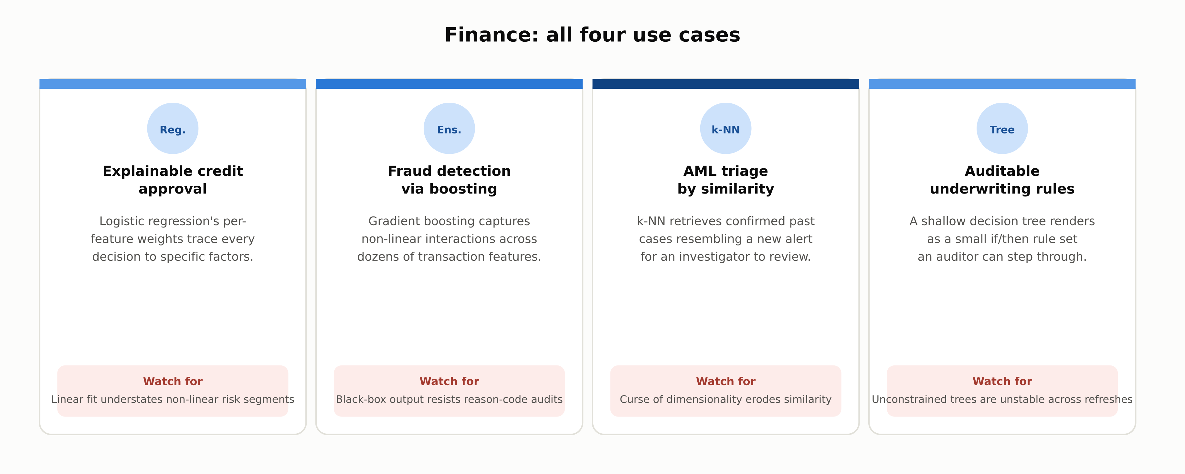
INDUSTRY USE CASES · 1 OF 3
Finance
1.5 | Phase 1 - AI & Machine Learning Foundations
10

Slide 11
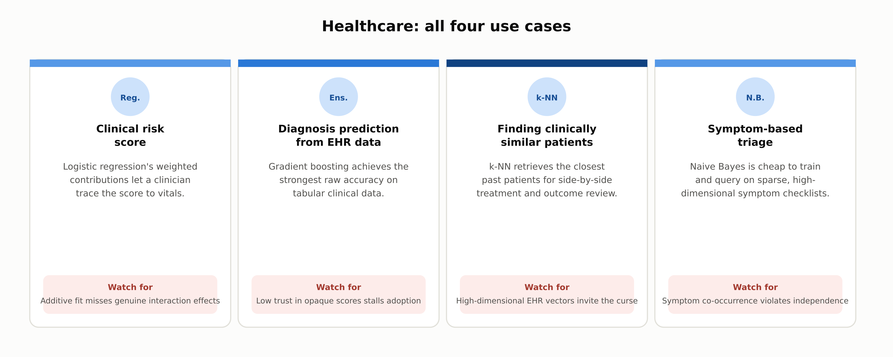
INDUSTRY USE CASES · 2 OF 3
Healthcare
1.5 | Phase 1 - AI & Machine Learning Foundations
11

Slide 12
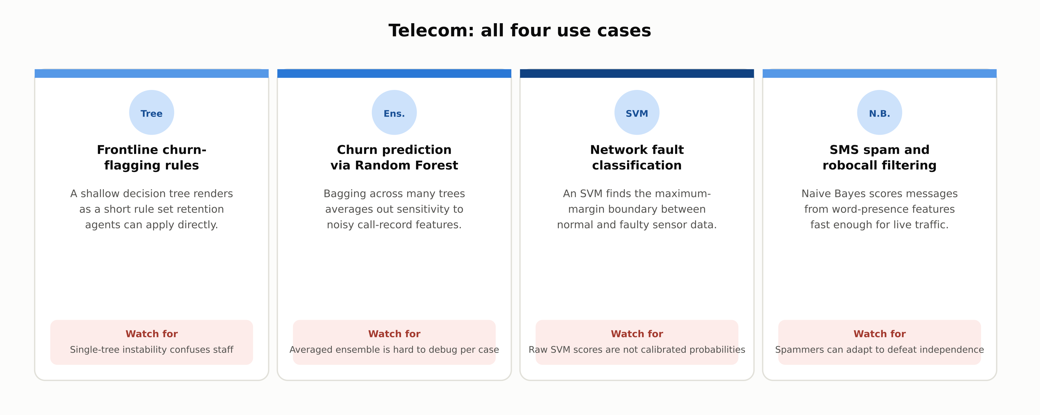
INDUSTRY USE CASES · 3 OF 3
Telecom
1.5 | Phase 1 - AI & Machine Learning Foundations
12

Slide 13
DISCUSS AS A CLASS
Check Your Understanding
Q1
Why does a single, unconstrained decision tree tend to have low bias but high variance, and how does bagging address that?
Q2
Why does gradient boosting reduce bias rather than variance?
Q3
Why does k-NN performance degrade as the number of features grows, even when k is chosen well?
Q4
A regulator requires that a credit decision be explainable in terms of which specific factors drove it. Which algorithm family is the safest default, and why?
Q5
Naive Bayes assumes features are conditionally independent given the class, which is almost always false. Why does the algorithm still work well?
Answers are in the speaker notes for this slide.
1.5 | Phase 1 - AI & Machine Learning Foundations
13
Notes:
Q1: Why does a single, unconstrained decision tree tend to have low bias but high variance, and how does bagging address that? A1: An unconstrained tree can split down to individual points, so it can represent almost any relationship (low bias) but is highly sensitive to which specific points it saw (high variance). Bagging trains many trees on different bootstrap samples and averages predictions, and because their errors are only partly correlated, averaging cancels out much of that variance. Q2: Why does gradient boosting reduce bias rather than variance? A2: Each new tree in a boosted ensemble is trained specifically to correct the errors the ensemble so far is still making, rather than trained independently like in bagging. That sequential error-correction lets the ensemble represent relationships no single shallow tree could capture, which is what reducing bias means. Q3: Why does k-NN performance degrade as the number of features grows, even when k is chosen well? A3: In high-dimensional space, the distance between a query point and its nearest neighbor and the distance to a typical random point converge, so the closest points stop being meaningfully more similar than arbitrary ones. No choice of k fixes this, because the problem is the distance metric itself becoming uninformative. Q4: A regulator requires that a credit decision be explainable in terms of which specific factors drove it. Which algorithm family is the safest default, and why? A4: Linear or logistic regression, because each prediction decomposes into an explicit, quantified contribution from each feature's weight. Tree ensembles and k-NN can be more accurate but are far harder to reduce to a specific, defensible per-decision explanation. Q5: Naive Bayes assumes features are conditionally independent given the class, which is almost always false. Why does the algorithm still work well? A5: The algorithm only needs to rank or threshold classes correctly, not produce perfectly calibrated probabilities. Even when the independence assumption distorts the exact probability values, the relative ranking across classes is often still correct, which is enough for classification decisions.

Slide 14
SUMMARY
Key Takeaways
✓
Inductive bias is the core idea: every family assumes a different shape for the input-output relationship.
✓
Linear models trade flexibility for stability and explicit, traceable feature contributions.
✓
Decision trees are flexible but unstable alone; bagging cancels variance, boosting cancels bias.
✓
k-NN needs no training but degrades sharply as dimensionality grows: the curse of dimensionality.
✓
Choosing a family is a cross-validated comparison (chapter 1.4), not a single-split guess.
1.5 | Phase 1 - AI & Machine Learning Foundations
14

Slide 15
FURTHER READING
Sources Cited in This Chapter
Breiman, Friedman, Olshen & Stone, Classification and Regression Trees
Wadsworth, 1984
Breiman, Random Forests
Machine Learning, 2001
Friedman, Greedy Function Approximation: A Gradient Boosting Machine
Annals of Statistics, 2001
Freund & Schapire, A Decision-Theoretic Generalization of On-Line Learning and an Application to Boosting
J. Computer and System Sciences, 1997
Cover & Hart, Nearest Neighbor Pattern Classification
IEEE Trans. Information Theory, 1967
Cortes & Vapnik, Support-Vector Networks
Machine Learning, 1995
Chapter 1.4
docs/01-ai-ml-foundations/1-4-core-ml-concepts.mdx
Full chapter with inline links: docs/01-ai-ml-foundations/1-5-classical-ml-algorithms.mdx
1.5 | Phase 1 - AI & Machine Learning Foundations
15

