Slide 1
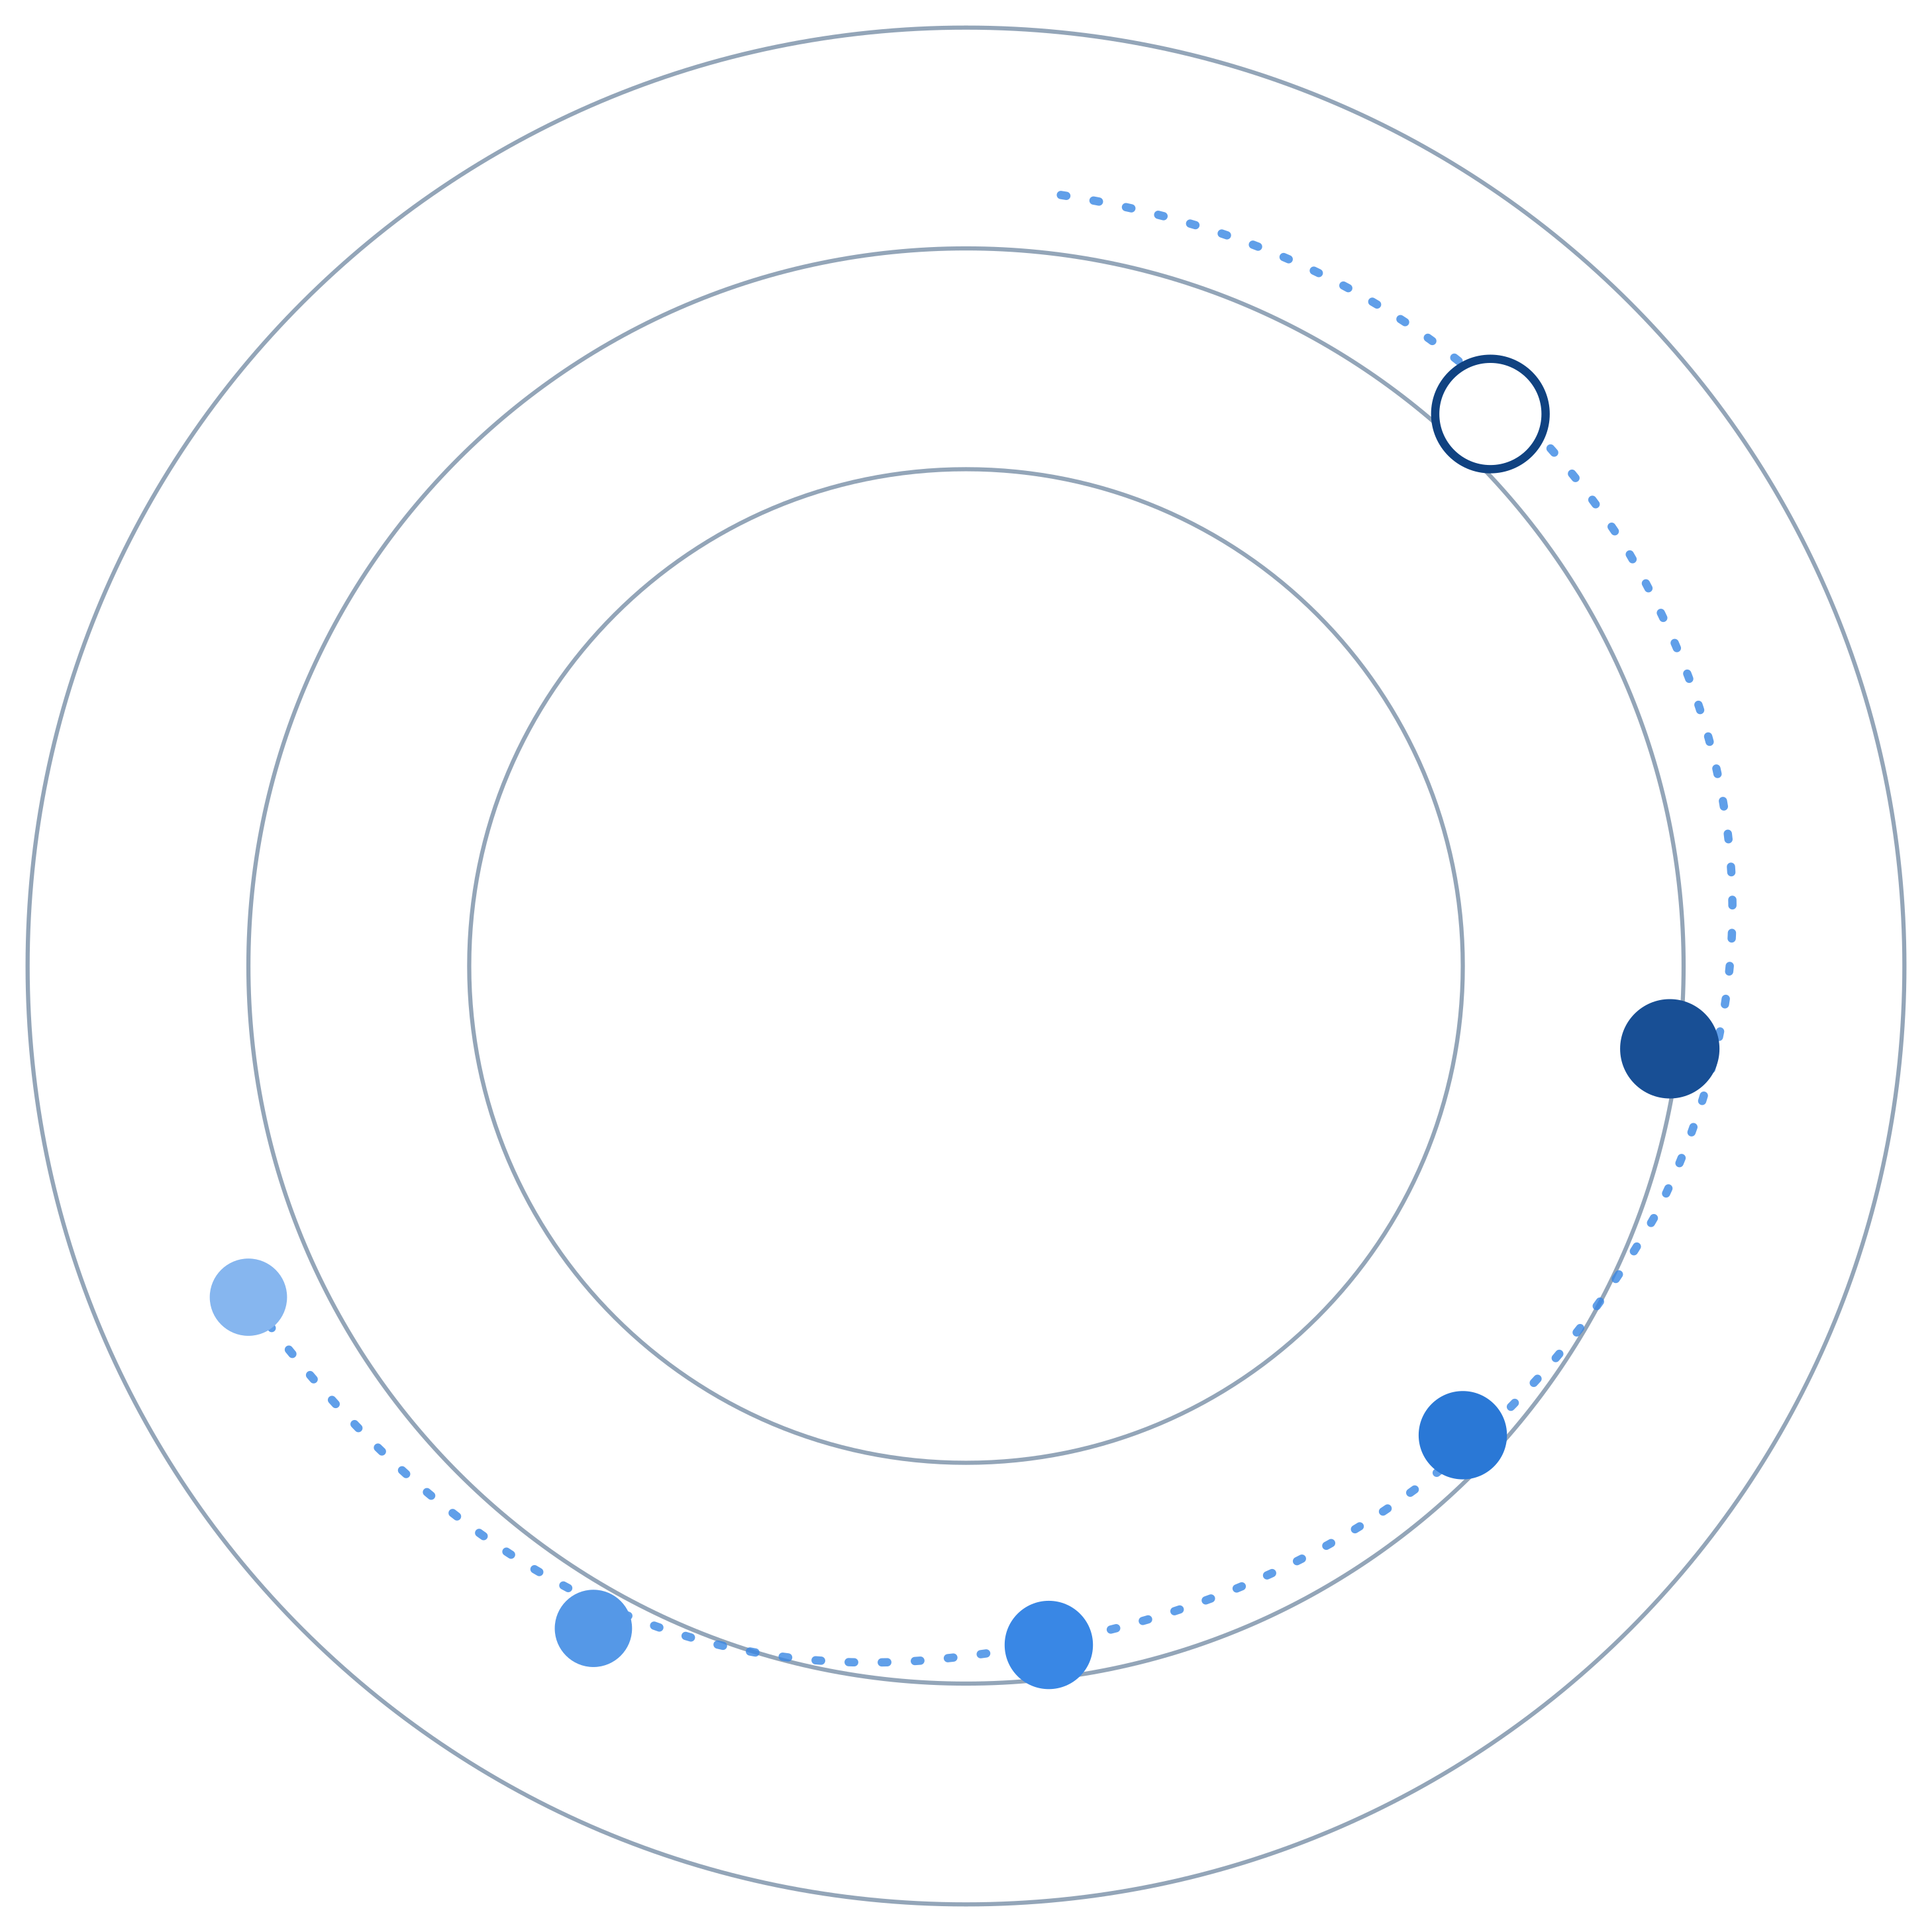
REGAITRAINING · PHASE 1 — AI & MACHINE LEARNING FOUNDATIONS
CHAPTER 1.1
What Is Artificial Intelligence?
History, AI Winters, and Narrow vs. General AI
A teaching-slide walkthrough of the chapter: how the field's definition keeps moving, why funding collapsed twice, and what “narrow AI” actually means.
Instructor deck · 19 slides · based on docs/01-ai-ml-foundations/1-1-what-is-ai.mdx

Slide 2
ROADMAP
What We'll Cover
1
The TL;DR and the “AI effect”
5
How AI / ML / DL / GenAI relate
Why the label keeps moving
Nested specializations, not rivals
2
Six eras of AI history
6
Industry use cases
One timeline, symbolic AI to agentic AI
Finance, Healthcare, and Telecom — 4 each
3
Two AI winters, explained
7
Check your understanding
What actually caused each collapse
Five questions to discuss as a class
4
Narrow AI vs. AGI vs. ASI
A generality spectrum, not a smartness one
1.1 · Phase 1 — AI & Machine Learning Foundations
2

Slide 3
TL;DR
One Idea to Start With
AI is a moving target. Once a task is reliably automated — OCR, chess, spam filtering — it quietly stops being called “AI” and becomes “just software.”
The systems we call “AI” today are still narrow: extremely capable at specific tasks, not generally intelligent the way a human is.
THE RELAY-RACE ANALOGY
Think of AI's history less as one continuous invention and more like a relay race — each runner hands off the baton once the previous approach hits its ceiling.
1.1 · Phase 1 — AI & Machine Learning Foundations
3

Slide 4
WHY THE DEFINITION MOVES
The “AI Effect”
1
Optical character recognition
Cutting-edge AI in the 1990s. Now: “just software.”
DEFINITION
AI Effect
2
Chess engines
The tendency for a task to stop being called “AI” once it's reliably automated — so the label keeps shifting to whatever capability is still unsolved.
Beat world champions in 1997. Now: a phone app.
3
Spam filtering
Statistical AI in the 2000s. Now: invisible plumbing.
Added to the site glossary — 0.5 Glossary & Notation Conventions
Class discussion: what's a technology in your own industry that used to be called “AI” and now just isn't?
1.1 · Phase 1 — AI & Machine Learning Foundations
4

Slide 5
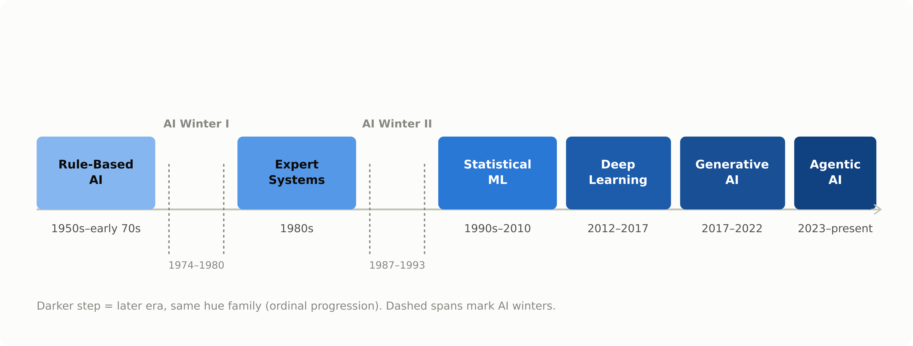
SIX ERAS, ONE TIMELINE
The Full Arc of AI History
1.1 · Phase 1 — AI & Machine Learning Foundations
5

Slide 6
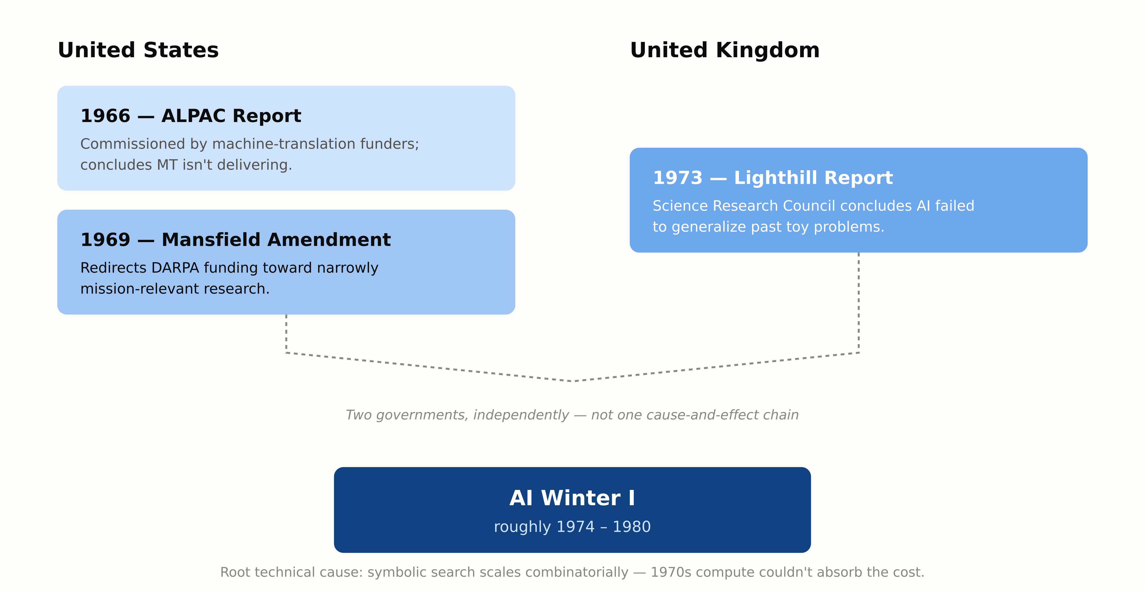
DEEP-DIVE
What Actually Caused AI Winter I
1.1 · Phase 1 — AI & Machine Learning Foundations
6

Slide 7
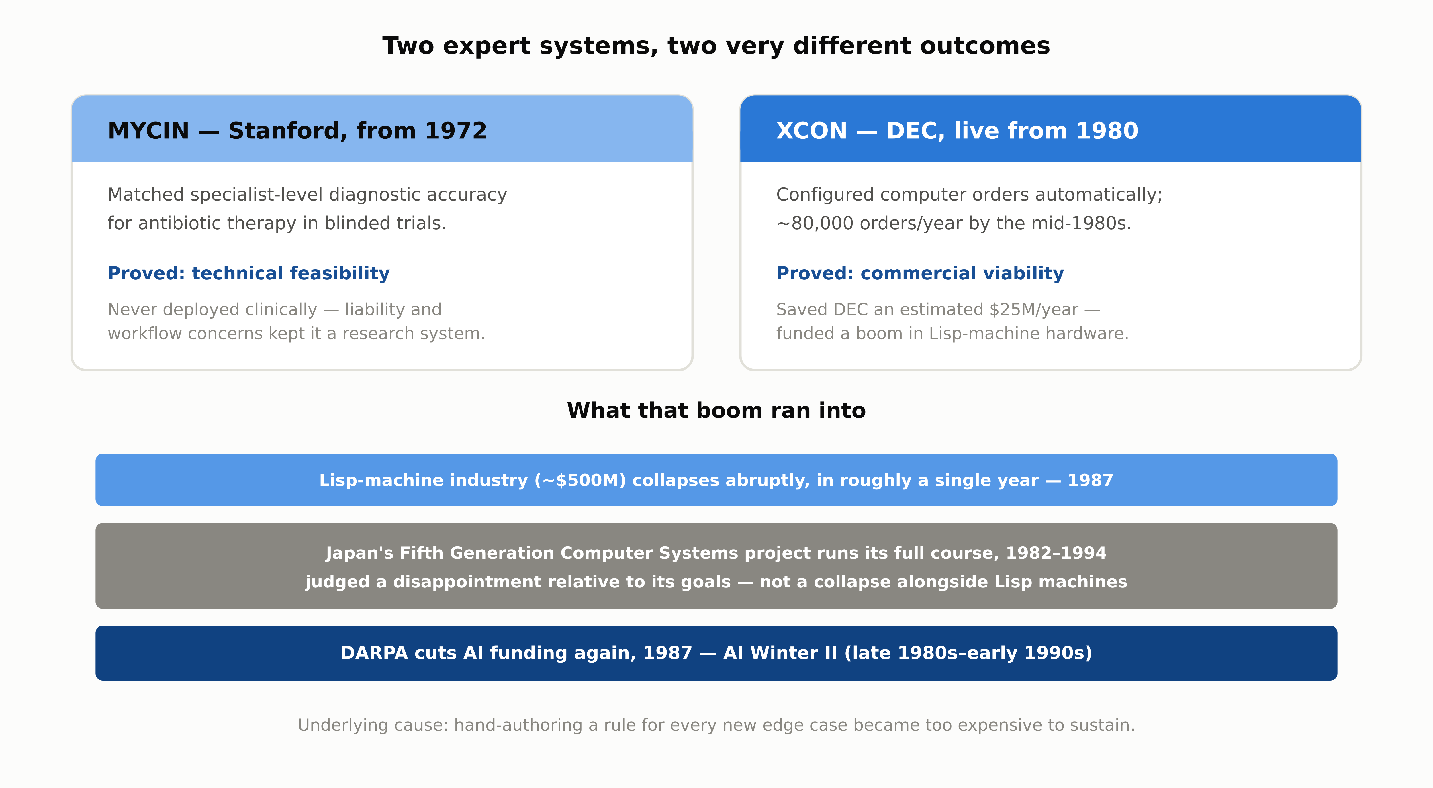
DEEP-DIVE
Expert Systems — and AI Winter II
1.1 · Phase 1 — AI & Machine Learning Foundations
7

Slide 8
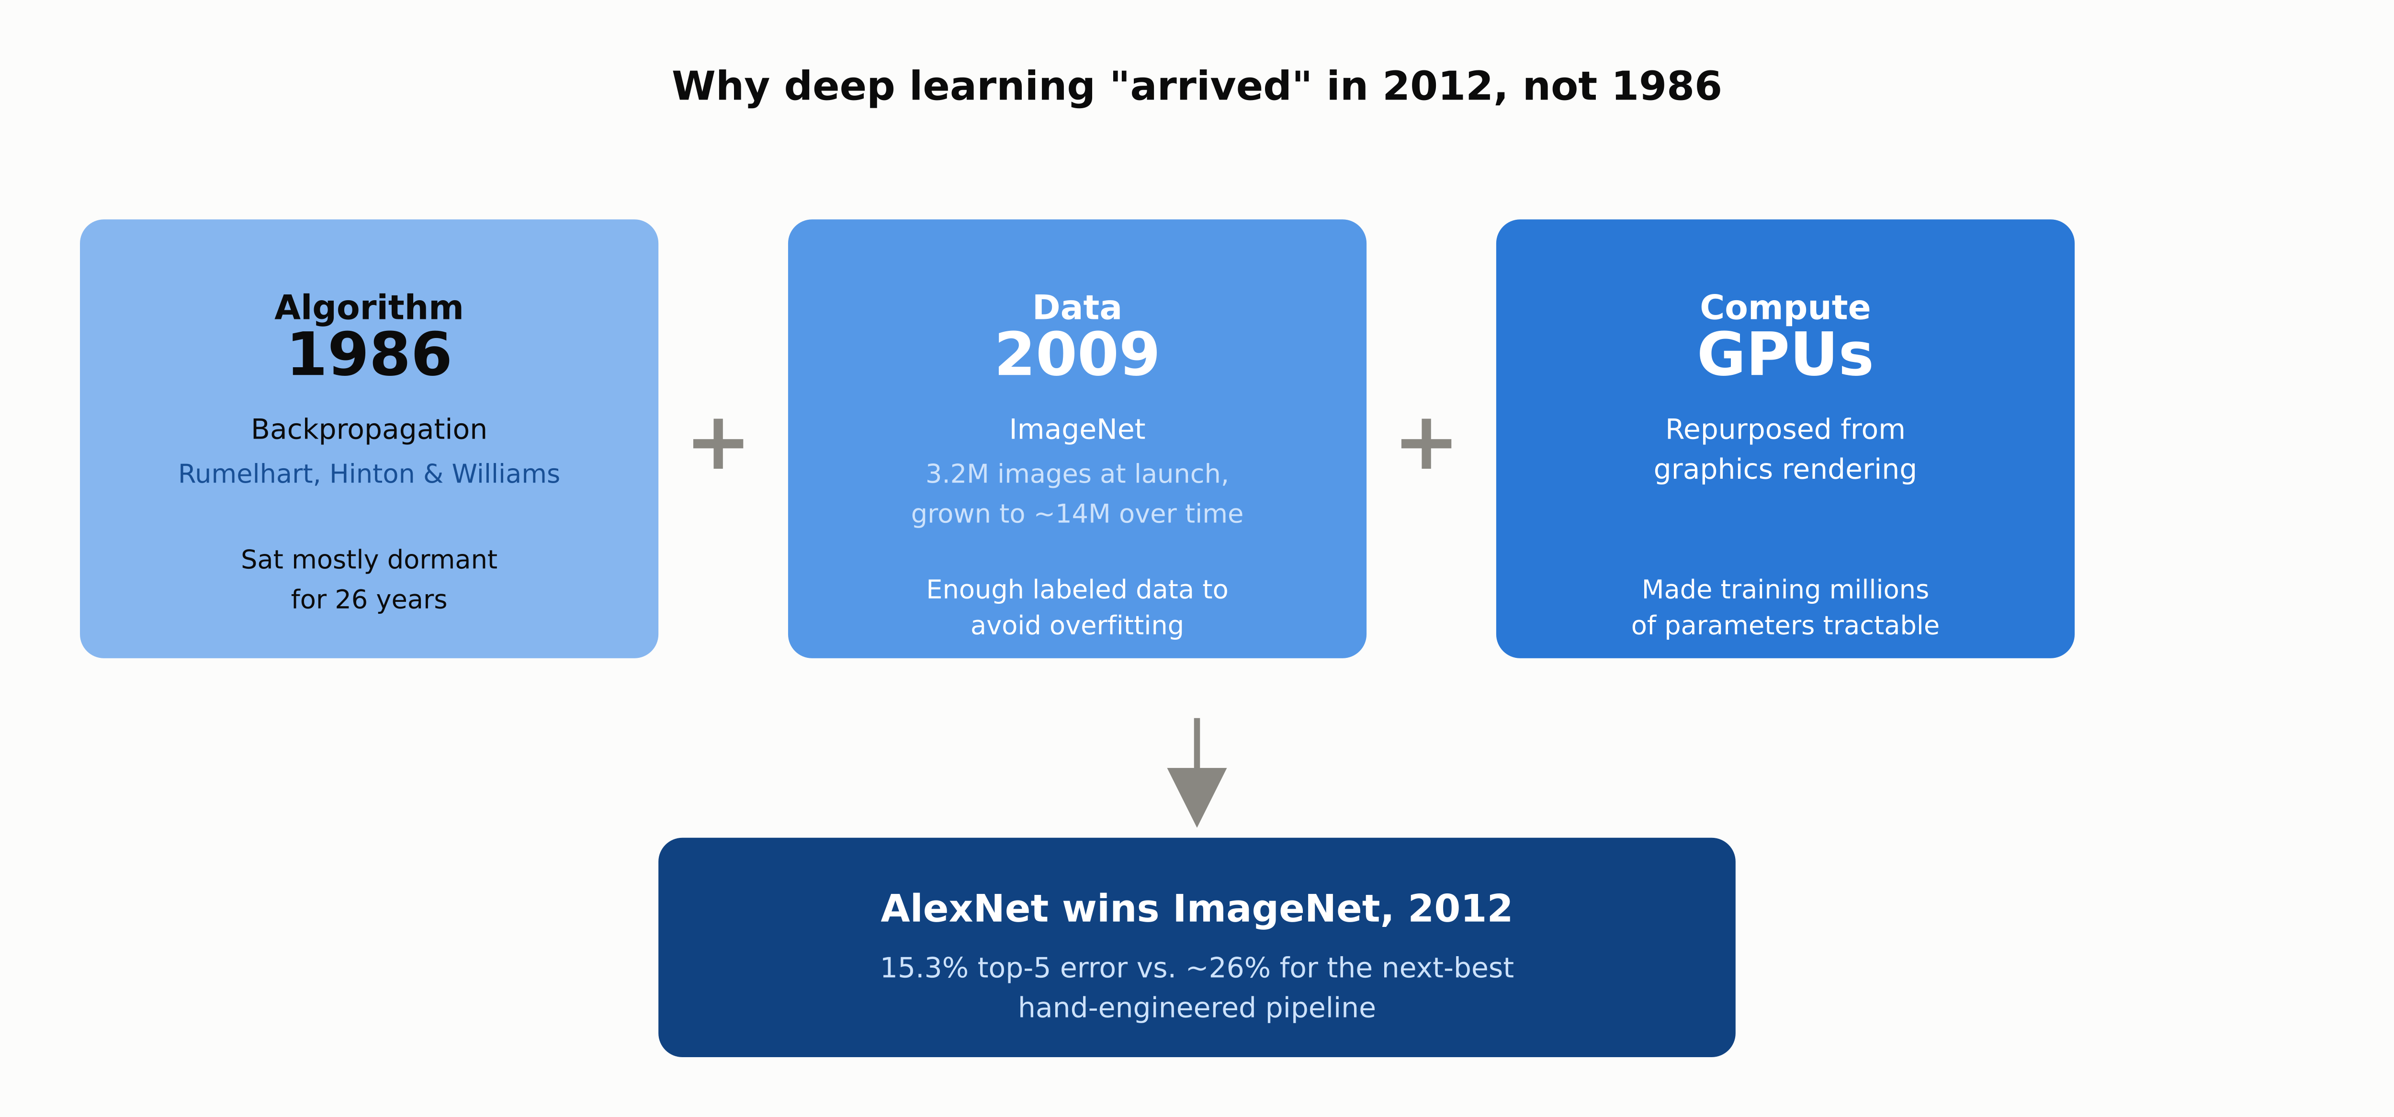
DEEP-DIVE
Why Deep Learning “Arrived” in 2012
1.1 · Phase 1 — AI & Machine Learning Foundations
8

Slide 9
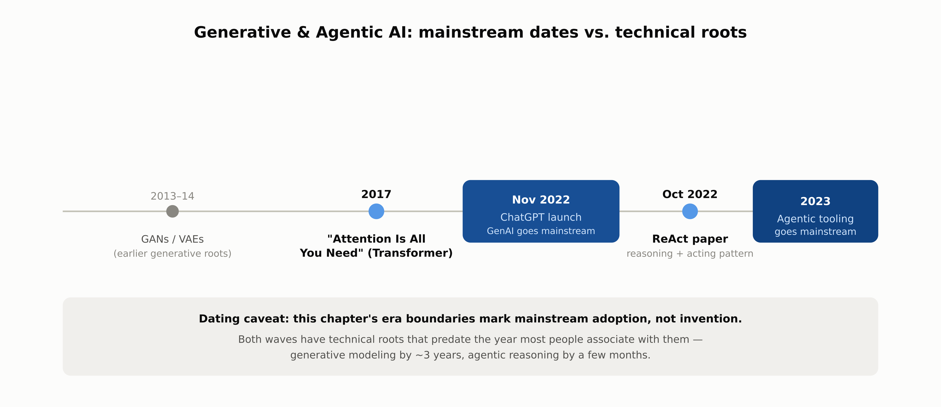
DATING CAVEAT
Generative AI & Agentic AI: Roots vs. Mainstream
1.1 · Phase 1 — AI & Machine Learning Foundations
9

Slide 10
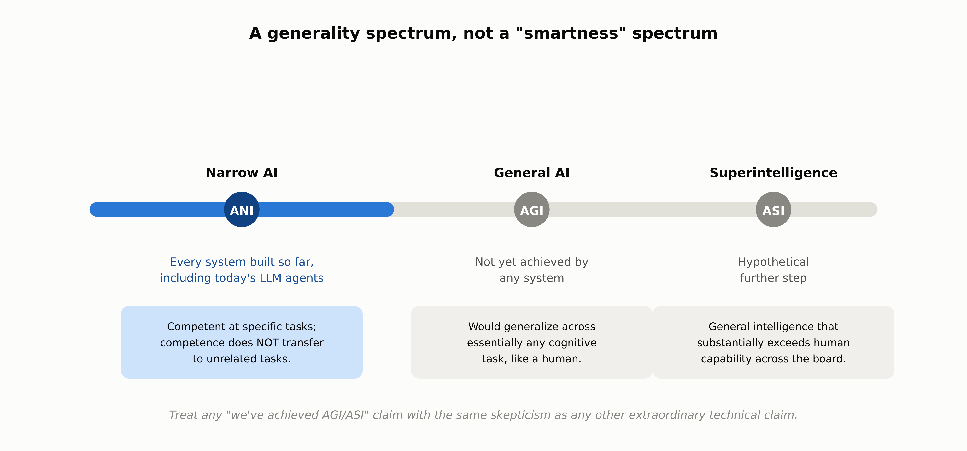
NARROW VS. GENERAL
ANI, AGI, and ASI
1.1 · Phase 1 — AI & Machine Learning Foundations
10

Slide 11
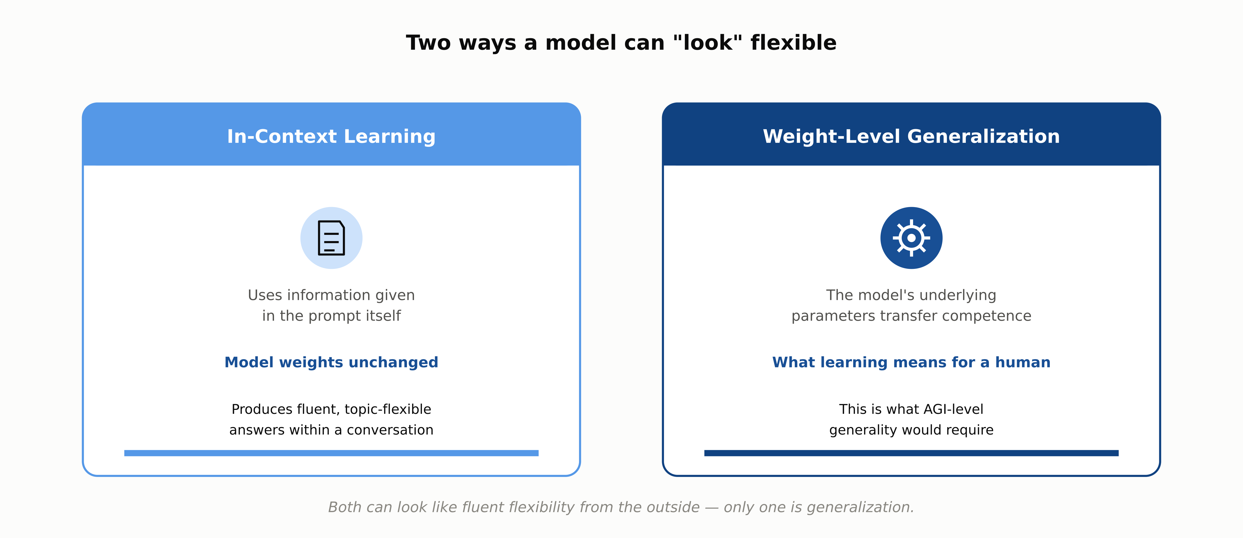
MECHANISM
How Narrowness Is Actually Measured
1.1 · Phase 1 — AI & Machine Learning Foundations
11

Slide 12
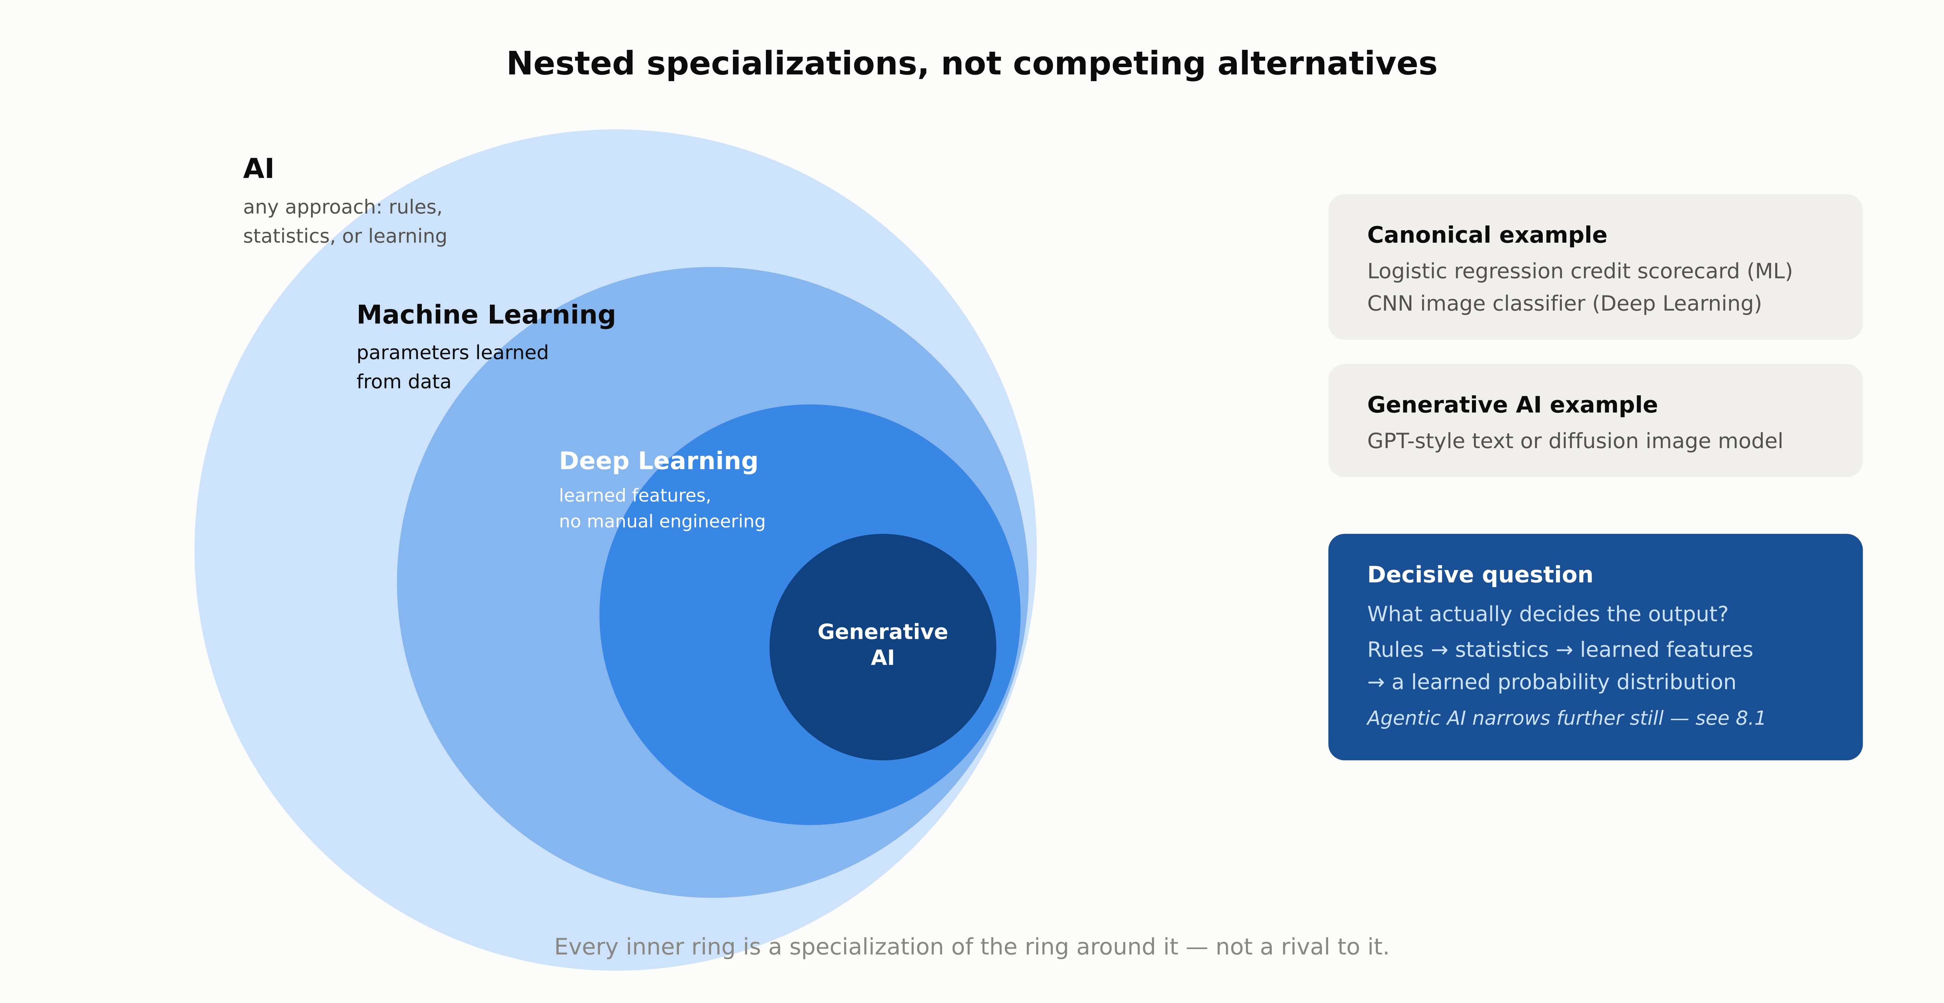
COMPARISON
AI vs. ML vs. Deep Learning vs. Generative AI
1.1 · Phase 1 — AI & Machine Learning Foundations
12

Slide 13
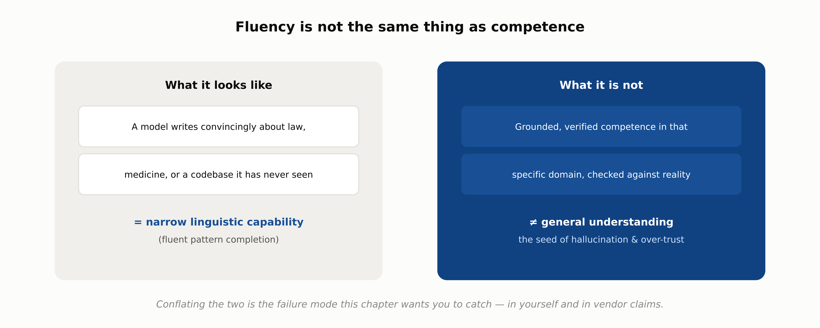
FAILURE MODE TO WATCH FOR
Fluency Is Not the Same as Competence
1.1 · Phase 1 — AI & Machine Learning Foundations
13

Slide 14
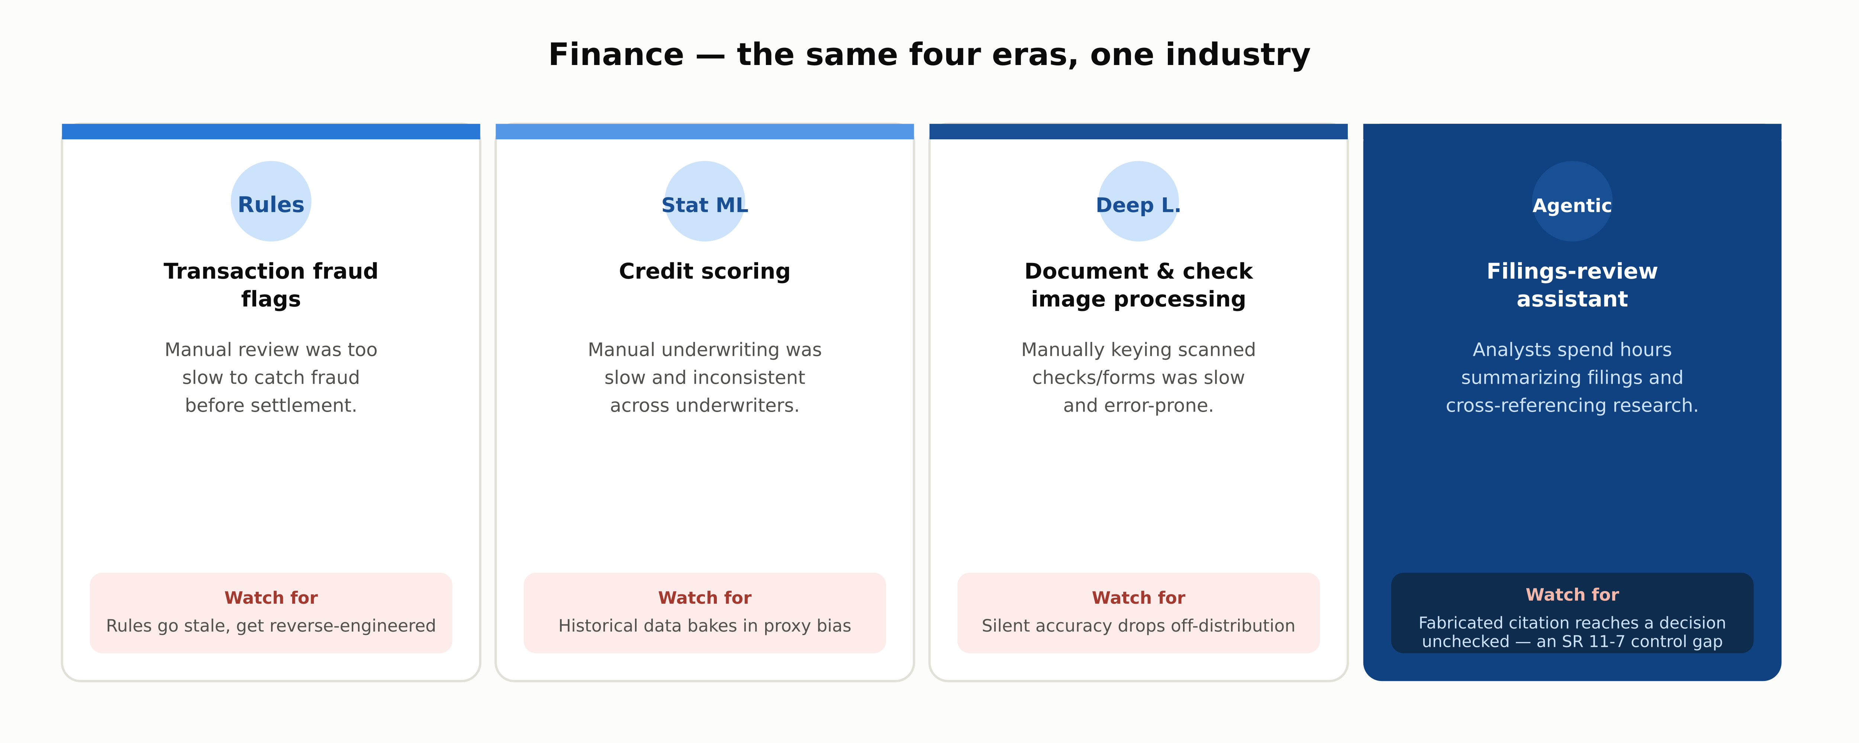
INDUSTRY USE CASES · 1 OF 3
Finance
1.1 · Phase 1 — AI & Machine Learning Foundations
14

Slide 15
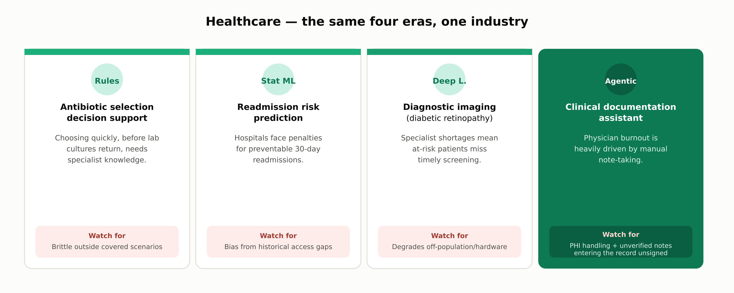
INDUSTRY USE CASES · 2 OF 3
Healthcare
1.1 · Phase 1 — AI & Machine Learning Foundations
15

Slide 16
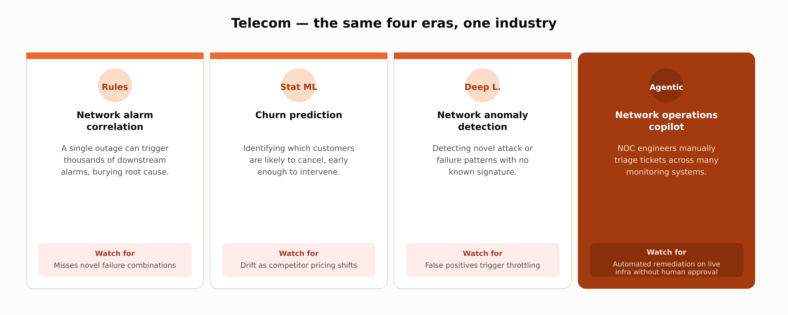
INDUSTRY USE CASES · 3 OF 3
Telecom
1.1 · Phase 1 — AI & Machine Learning Foundations
16

Slide 17
DISCUSS AS A CLASS
Check Your Understanding
Q1
What triggered the first AI winter, and what ended it?
Q2
What is the difference between narrow AI and AGI?
Q3
Backprop was popularized in 1986. Why did deep learning only take off in 2012?
Q4
Why does the definition of “AI” keep shifting over time?
Q5
A vendor claims their chatbot has “achieved AGI.” What should you check first?
Answers are in the speaker notes for this slide.
1.1 · Phase 1 — AI & Machine Learning Foundations
17
Notes:
Q1: What triggered the first AI winter, and what ended it? A1: Two separate national retrenchments: the US 1966 ALPAC report and 1969 Mansfield Amendment, and the UK's 1973 Lighthill Report, both concluding symbolic AI had failed to scale past toy problems. It thawed as XCON proved the commercial case for expert systems from 1980. Q2: What is the difference between narrow AI and AGI? A2: Narrow AI performs well at a specific, bounded task without that competence transferring to unrelated tasks. AGI, not yet achieved by any system, would generalize across essentially any cognitive task the way a human does. Q3: Backprop was popularized in 1986. Why did deep learning only take off in 2012? A3: The algorithm existed, but training a deep network well requires large labeled datasets and heavy parallel compute; neither was available at scale until ImageNet (2009, grown to ~14M images) and GPUs arrived, culminating in AlexNet's 2012 win. Q4: Why does the definition of “AI” keep shifting over time? A4: A task that gets reliably automated tends to get relabeled as “just software” rather than “AI” (the AI effect), so the label keeps moving to whatever capability is still unsolved. Q5: A vendor claims their chatbot has “achieved AGI.” What should you check first? A5: Whether the claim is about generalization across genuinely unrelated cognitive tasks (the real AGI bar) or just fluency within language tasks, often in-context learning rather than weight-level generalization. Check the date and source too.

Slide 18
SUMMARY
Key Takeaways
✓
“AI” is a moving label — solved tasks quietly become “just software” (the AI effect).
✓
Two AI winters happened when ambition outran the era's compute and data, not because the ideas were wrong.
✓
Every system built so far, including today's LLM agents, is narrow — competence doesn't transfer across unrelated tasks.
✓
AI, ML, Deep Learning, and Generative AI are nested specializations, not rival technologies.
✓
Fluency is not competence — conflating the two is the seed of hallucination and over-trust.
1.1 · Phase 1 — AI & Machine Learning Foundations
18

Slide 19
FURTHER READING
Sources Cited in This Chapter
Lighthill Report (1973)
ALPAC Report (1966)
en.wikipedia.org/wiki/Lighthill_report
nap.edu — Language and Machines
Mansfield Amendment (1969)
MYCIN
en.wikipedia.org/wiki/Mansfield_Amendment
en.wikipedia.org/wiki/Mycin
XCON
Rumelhart, Hinton & Williams (1986)
en.wikipedia.org/wiki/Xcon
nature.com/articles/323533a0
ImageNet
AlexNet (Krizhevsky et al., 2012)
image-net.org
papers.nips.cc, NeurIPS 2012
“Attention Is All You Need” (2017)
ReAct (Yao et al., 2022)
arxiv.org/abs/1706.03762
arxiv.org/abs/2210.03629
ChatGPT launch (Nov 2022)
openai.com/index/chatgpt
Full chapter with inline links: docs/01-ai-ml-foundations/1-1-what-is-ai.mdx
1.1 · Phase 1 — AI & Machine Learning Foundations
19

