Slide 1
CHAPTER 6.3 · PHASE 6
Vector Databases Compared
An ANN index answers one question. A vector database is everything production wraps around it, and different products wrap it very differently.
Retrieval-Augmented Generation & Knowledge Systems

Slide 2
AGENDA
What this chapter covers
What a vector database adds on top of the bare ANN index from Chapter 6.2
Four deployment archetypes: managed serverless, self-hosted distributed, added to an existing database, and embedded
Why metadata filtering is often the deciding factor, not an afterthought
Hybrid search: combining dense vector search with keyword search
How to benchmark a vector database across more than one axis at once
A selection framework, not a single winner

Slide 3
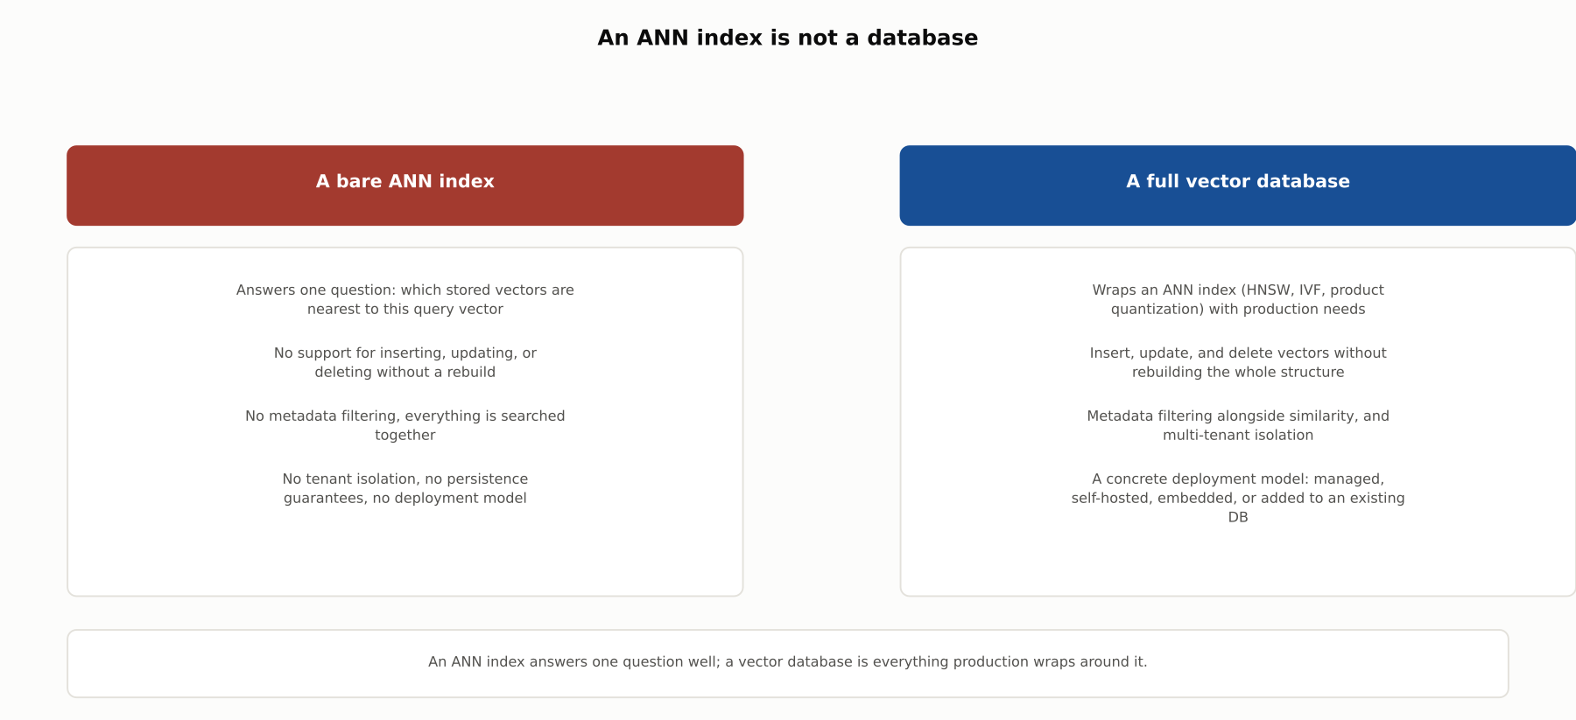
HIGH-LEVEL
An ANN index is not a database
An ANN index answers one question well; a vector database is everything production wraps around it.

Slide 4
DEEP-DIVE
A vector database is the ANN index, plus everything production needs
HNSW, IVF, and product quantization are algorithms, not products
None of them say what happens when a document gets updated
None of them isolate one tenant's data from another's
None of them survive a process restart on their own
A vector database is the software layer that answers all of these questions
The answers it gives, more than the algorithm underneath, usually decide which product a team picks

Slide 5
DEEP-DIVE
Pinecone: fully managed, serverless
Data organized into "immutable files called slabs" in distributed object storage
"Virtually unlimited scalability and high availability"
Write and read paths "scale independently based on demand"
New writes land in memory first, then merge into progressively larger, better-indexed slabs
A team writes essentially no infrastructure code, in exchange for running on someone else's cloud

Slide 6
DEEP-DIVE
Milvus: self-hosted, distributed
"Fully disaggregated storage and compute layers" that "enable horizontal scaling of compute nodes"
Deployed on a team's own Kubernetes cluster, not a vendor's managed service
Splits workloads by kind: Streaming Node, Query Node, and Data Node
Worker nodes are "stateless," which makes scale-out and disaster recovery straightforward to automate
Built on the same algorithms Chapter 6.2 covered directly: Faiss, HNSW, DiskANN, and SCANN
Full control over data location and cost, at the price of operating it yourself

Slide 7
DEEP-DIVE
pgvector: added to an existing database
A PostgreSQL extension, not a separate system
Vectors live in the same tables as the relational data they describe
Ordinary SQL joins, plus the ACID guarantees and backups Postgres already provides
Supports HNSW (better query performance, slower build, more memory) and IVFFlat (faster build, less memory, less recall)
Keeps existing operational tooling; gives up the specialized performance a purpose-built system offers

Slide 8
DEEP-DIVE
Chroma: embedded and lightweight
Runs embedded, in-process inside an application, or as a lightweight local server
Built on the same economics as Pinecone: object storage is "an order of magnitude cheaper" than replicated SSDs
A system built on object storage from the start serves far more data per dollar
Ideal for prototyping, local-first apps, and small-scale deployments
A team can start embedded and migrate to managed or self-hosted later without changing how the app queries it

Slide 9
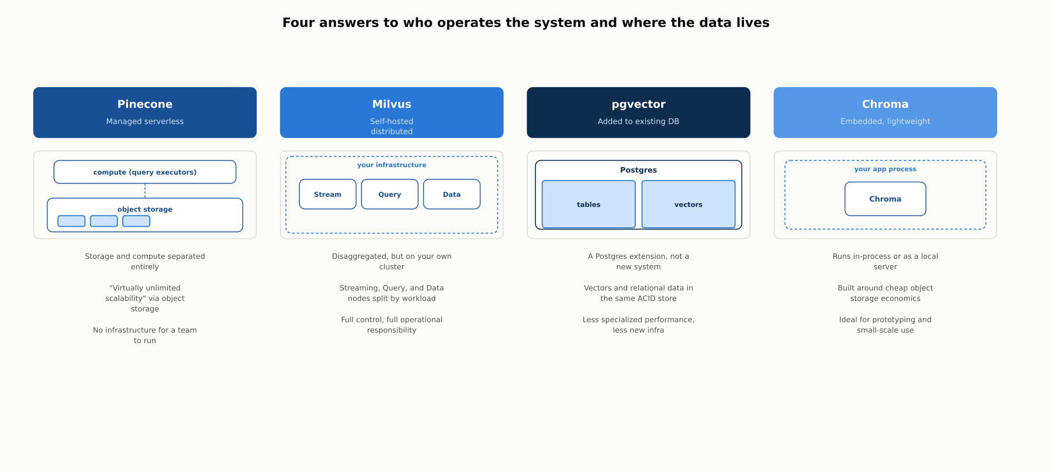
DEEP-DIVE
Four answers to who operates the system and where the data lives
Four deployment archetypes, distinguished by who operates the system and where the data lives, not by which ANN algorithm runs underneath.

Slide 10
DEEP-DIVE
Metadata filtering is often the deciding factor
"The nearest similar support ticket" is meaningless if it can return another customer's ticket
Qdrant attaches "any JSON payload" to vectors, filtered with a "rich set of conditions"
Keyword matching, full-text, numeric ranges, geo-locations, combined with should, must, and must_not clauses
Filtering happens alongside the vector search itself, not as a separate pass afterward
Quantization can cut memory use "by up to 97%" while tuning the speed-precision trade-off directly
A database without expressive filtering is unusable the moment multi-tenancy or access control matters

Slide 11
DEEP-DIVE
Hybrid search: combining dense and sparse search
Dense vectors match meaning well but struggle to force an exact term match
Sparse, keyword-based search (e.g. BM25) is the reverse
Both run "in parallel," then get combined by a fusion algorithm such as Reciprocal Rank Fusion
RRF sums 1 / (k + rank) across lists, which "penalizes documents ranked lower in the list"
Weaviate's example: "catch an Alaskan Pollock" needs both the fishing sense of "catch" and the exact phrase
Hybrid search "reduces the need for perfectly phrased queries" without losing exact-term precision

Slide 12
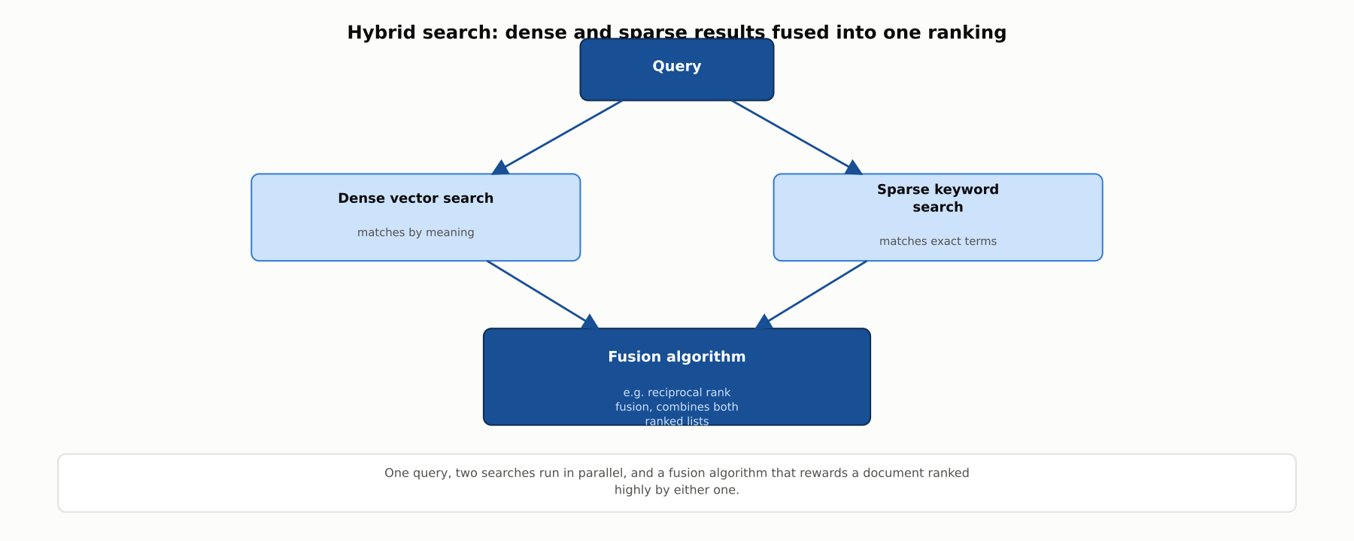
DEEP-DIVE
Hybrid search: dense and sparse results fused into one ranking
One query, two searches run in parallel, and a fusion algorithm that rewards a document ranked highly by either one.

Slide 13
DEEP-DIVE
Benchmarking means weighing several axes at once
VectorDBBench (Zilliz): an open benchmark comparing vector databases
Measures queries per second, P99 latency, recall, serial search latency, and behavior under continuous ingestion
Reports comparisons at matched cost points, not in isolation
A database tuned for the highest recall is rarely also the lowest-latency option at the same cost
Static, pre-loaded performance can look very different once vectors are being written continuously
The honest answer to "which is fastest" is: it depends which axis, and at what cost, a workload cares about most

Slide 14
COMPARISON & RELATED CONCEPTS
Four deployment archetypes
Aspect | Managed serverless (Pinecone) | Self-hosted distributed (Milvus) | Added to existing DB (pgvector) | Embedded / lightweight (Chroma)
Who operates it | The vendor, storage and compute scale independently | The team, typically on its own Kubernetes cluster | Whoever already runs the underlying Postgres | No one, runs in-process or a local server
Scaling approach | Object storage plus independent read/write scaling | Disaggregated storage, stateless compute nodes | Whatever the host Postgres instance scales to | Cheap object storage, scales up before out
Best suited for | Zero infrastructure to operate | Full control at scale | Vector search as one feature of an existing system | Prototyping and small-scale deployments
Cost profile | Usage-based, no idle infrastructure | Infrastructure plus operational time | Marginal cost on an already-running database | Near zero at small scale
Four deployment archetypes, distinguished by who operates the system and where the data lives, not by which ANN algorithm runs underneath.

Slide 15
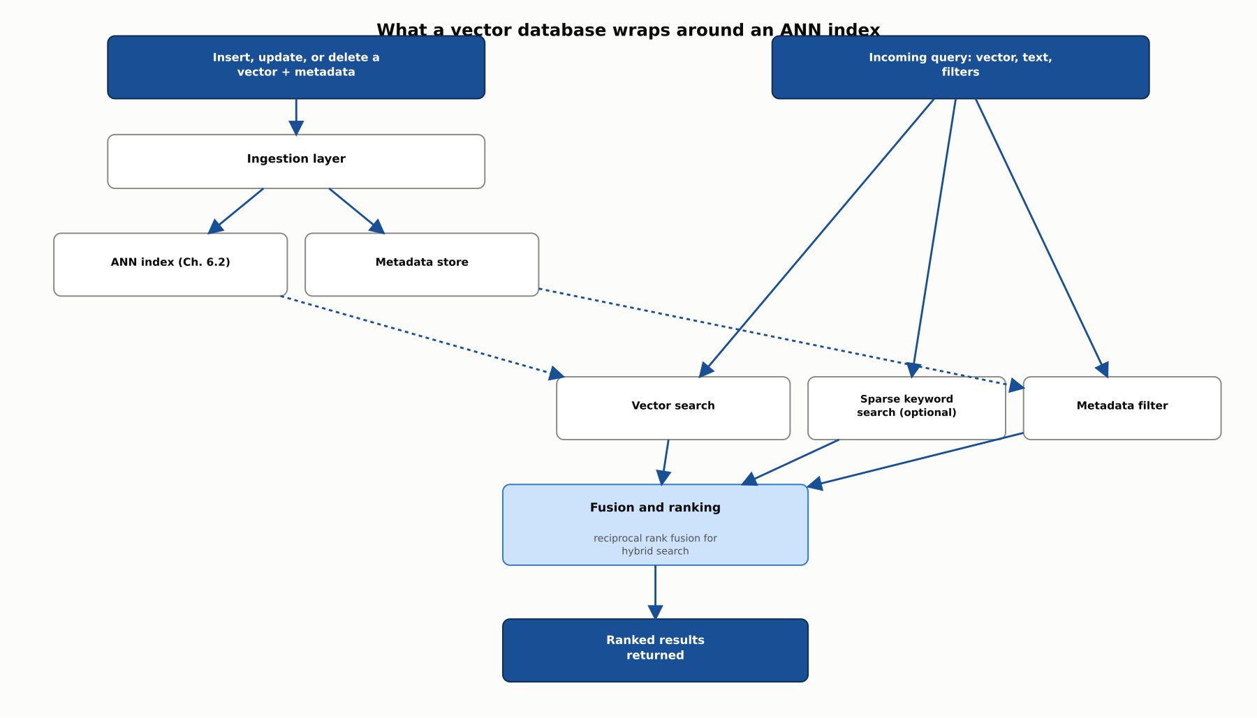
REFERENCE ARCHITECTURE
What a vector database wraps around an ANN index
This chapter stops at how a vector database is built and chosen; Chapter 6.4 covers chunking, reranking, and generation, what happens before and after this diagram.

Slide 16
CHECK YOUR UNDERSTANDING
Discuss before moving on
1. What does a vector database add on top of the bare ANN index from Chapter 6.2?
2. How does Pinecone's serverless architecture separate storage from compute, and what benefit does that bring?
3. What deployment model does pgvector represent, and what does a team trade away by choosing it?
4. What is hybrid search, and how does reciprocal rank fusion combine dense and sparse search results?
5. Name the axes VectorDBBench measures, and explain why comparing vector databases needs more than one.

