Slide 1
CHAPTER 7.3 · PHASE 7
Alignment Techniques Deep Dive:
Instruction Tuning, RLHF, RLAIF, DPO
Chapter 7.2 covered how to fine-tune efficiently. This chapter covers teaching a model to behave the way people actually want, through four techniques that each build on the one before it.
Fine-Tuning, Alignment & Model Customization

Slide 2
AGENDA
What this chapter covers
• The InstructGPT result that proved aligning a model matters more than raw parameter count
• RLHF: a reward model trained on human preference comparisons, then reinforcement learning against it
• RLAIF: the same structure, with an AI model standing in for the human labeler
• DPO: removing the reward model and RL loop entirely, down to a single classification loss
• A hands-on DPO loss computed by hand, with no reward model or RL loop in sight
• Where all four techniques fit in one pipeline, and what each one costs operationally

Slide 3
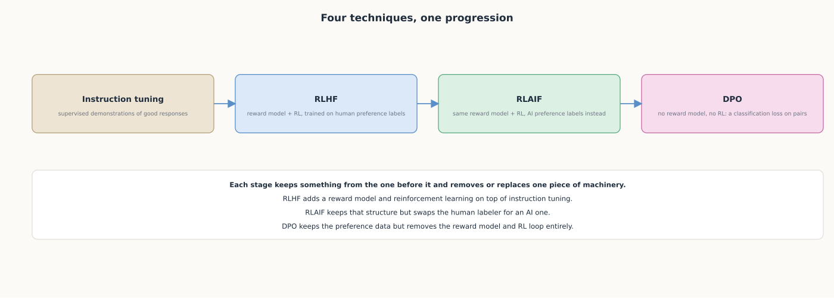
HIGH-LEVEL
A four-stage progression, not four unrelated techniques
Each technique keeps something from the one before it and removes or replaces one piece of machinery.

Slide 4
DEEP-DIVE
Instruction tuning is the supervised foundation everything else builds on
• "Making language models bigger does not inherently make them better at following a user's intent" (Ouyang et al.)
• "We collect a dataset of labeler demonstrations of the desired model behavior...to fine-tune GPT-3"
• "Outputs from the 1.3B parameter InstructGPT model are preferred to outputs from the 175B GPT-3"
• Raw parameter count was never the bottleneck; alignment to what a user wanted was
• "Improvements in truthfulness and reductions in toxic output" with minimal quality tax

Slide 5
DEEP-DIVE
RLHF trains a reward model to stand in for a human judgment call
• "We collect a dataset of rankings of model outputs...using reinforcement learning from human feedback"
• A reward model predicts which of two outputs human labelers would rank higher
• The policy model is then optimized with RL, typically PPO, against that reward model
• The cost: an ongoing supply of human comparisons, a maintained reward model, a harder-to-stabilize RL loop
• InstructGPT's 100x-fewer-parameters result depended on this stage, not supervised tuning alone

Slide 6
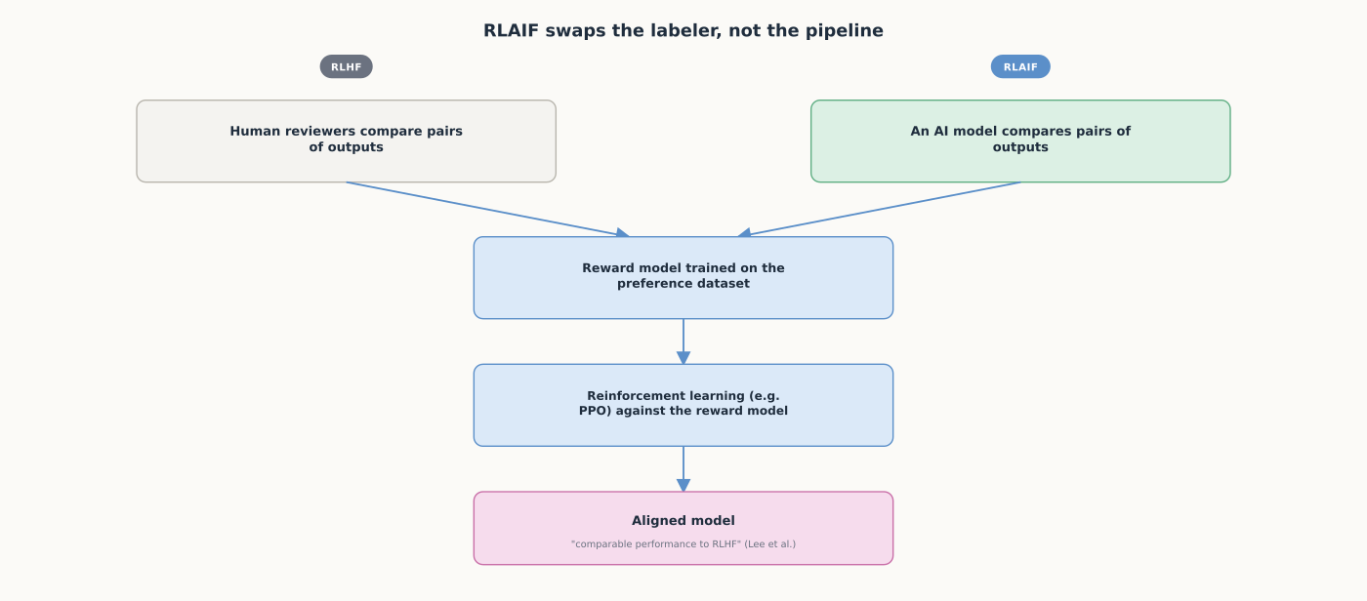
DEEP-DIVE
RLAIF keeps RLHF's structure, swaps who supplies the labels
RLAIF is not a different pipeline from RLHF; it is the same pipeline with an AI model as the labeler.

Slide 7
DEEP-DIVE
RLAIF trades human grounding for scale, and the evidence holds up
• "In the RL phase...train a preference model from this dataset of AI preferences" (Constitutional AI)
• "RLAIF can achieve performance on-par with using human feedback" (Lee et al.)
• "Comparable performance to RLHF" across summarization, helpful dialogue, and harmless dialogue
• "RLAIF can outperform a supervised fine-tuned baseline even when the AI labeler is the same size as the policy"
• A model can meaningfully improve on itself using its own preference judgments as signal

Slide 8
DEEP-DIVE
DPO removes the reward model and RL loop entirely
• The paper's own title: the language model being trained is "secretly a reward model" already
• "Allowing us to solve the standard RLHF problem with only a simple classification loss"
• "Eliminating the need for sampling from the LM during fine-tuning or...hyperparameter tuning"
• "Exceeds PPO-based RLHF in ability to control sentiment...while being substantially simpler"
• Still needs the same preference pairs RLHF/RLAIF need; removes everything downstream of that data

Slide 9
HANDS-ON
Compute a DPO loss by hand
• Step 1: start from a preference pair, a prompt, a chosen response, and a rejected response
• Step 2: get log-probabilities for each response under the policy model and a frozen reference model
• Step 3: compute the DPO loss, beta times the shift in relative preference versus the reference model
• Step 4: the loss shrinks exactly when the policy increases its preference for chosen over rejected
• No reward model, no PPO, no sampled rollouts anywhere in the loop

Slide 10
COMPARISON & RELATED CONCEPTS
Four techniques, each removing one more piece of machinery
Aspect | Instruction tuning (SFT) | RLHF | RLAIF | DPO
What supervises training | Human-written demonstrations | Reward model on human comparisons | Reward model on AI comparisons | Preference pairs via classification loss
Extra machinery needed | None beyond standard SFT | Reward model + RL loop (PPO) | Same as RLHF, AI labeler | None: no reward model, no RL loop
Labeling cost at scale | One-time demonstration writing | Ongoing human comparison labeling | AI-generated, far more scalable | Same pairs RLHF/RLAIF need
Reported outcome | Necessary foundation alone | 1.3B beats 175B GPT-3 (Ouyang et al.) | "On-par" with RLHF, sometimes better | Exceeds PPO-RLHF on sentiment control
Each column keeps the preference-comparison idea and removes one more piece of RLHF's original machinery.

Slide 11
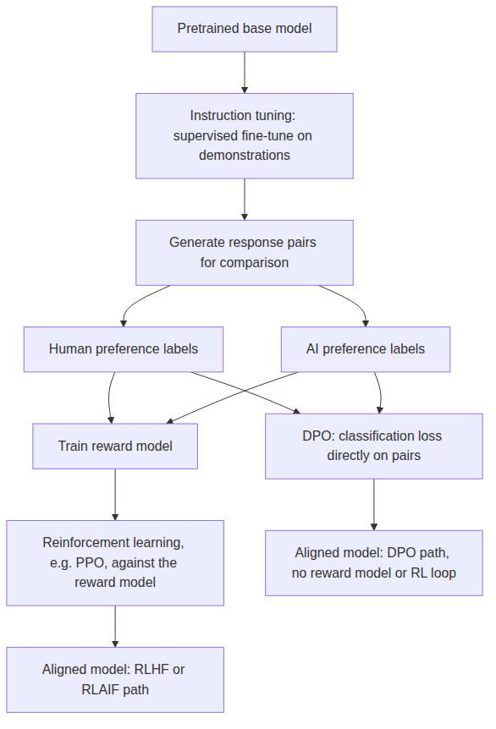
REFERENCE ARCHITECTURE
Where all four techniques fit in one pipeline
RLHF and RLAIF both carry a reward model and an RL loop; DPO carries neither.

Slide 12
CHECK YOUR UNDERSTANDING
Discuss before moving on
• 1. What did the InstructGPT result actually show, and why does it matter for how "alignment" is defined?
• 2. What does RLHF add on top of instruction tuning, and what does that addition cost operationally?
• 3. What does RLAIF change relative to RLHF, and what did the dedicated comparison study find?
• 4. What specifically does DPO remove that RLHF and RLAIF both still require, and what is left?
• 5. In the Hands-On DPO loss calculation, what two quantities does the loss compare, and why is a reference model needed?

