Slide 1
CHAPTER 7.4 · PHASE 7
Domain Adaptation &
Continual Pretraining
Chapter 7.3 covered teaching a model to behave the way people want. This chapter covers giving a model knowledge it did not have, and keeping that knowledge from quietly decaying as it learns more.
Fine-Tuning, Alignment & Model Customization

Slide 2
AGENDA
What this chapter covers
• The knowledge-adaptation spectrum: from retrieval at inference time to full continual pretraining
• DAPT and TAPT: continuing the pretraining objective on unlabeled domain or task text
• Catastrophic forgetting, and the counterintuitive finding that it gets worse as models scale up
• Elastic Weight Consolidation: slowing learning on the weights that mattered for earlier tasks
• A simple, scalable recipe for continual pretraining: LR re-warm, LR re-decay, and replay
• A hands-on measurement of forgetting, with and without a replay buffer

Slide 3
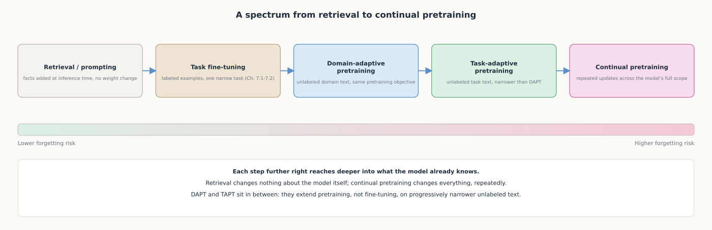
HIGH-LEVEL
A spectrum from inference-time facts to full continual pretraining
Each step further along reaches deeper into what the model knows, and carries more forgetting risk.

Slide 4
DEEP-DIVE
DAPT and TAPT extend pretraining onto new text, no labels required
• Gururangan et al. spanned "four domains...and eight classification tasks"
• "A second phase of pretraining in-domain (domain-adaptive pretraining) leads to performance gains"
• "Adapting to the task's unlabeled data (task-adaptive pretraining) improves performance even after DAPT"
• DAPT and TAPT are not substitutes for each other; a team that ran DAPT still gains more from TAPT
• "Multi-phase adaptive pretraining offers large gains in task performance," consistently across settings

Slide 5
DEEP-DIVE
Every further training pass risks catastrophic forgetting
• "It has been widely thought that catastrophic forgetting is an inevitable feature of connectionist models"
• A network trained sequentially on a new task overwrites weights an earlier task depended on
• 2023 study: "as the model scale increases, the severity of forgetting intensifies" (counterintuitive)
• Larger models have more initial performance for later training to erode
• A decoder-only model retained more prior knowledge than a comparable encoder-decoder model

Slide 6
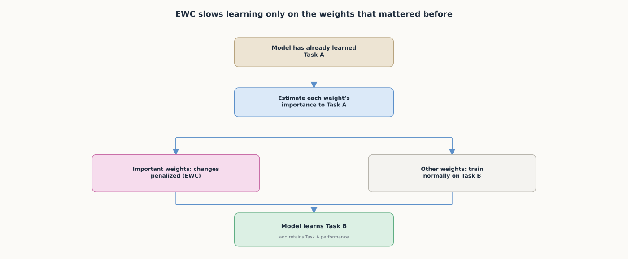
DEEP-DIVE
EWC slows learning specifically on the weights that mattered before
EWC does not freeze the whole model; it identifies which weights mattered and slows learning there.

Slide 7
DEEP-DIVE
Continual pretraining needs a recipe that avoids forgetting and full retraining
• "A simple and scalable combination of LR re-warming, LR re-decaying, and replay...is sufficient to match" full retraining (Ibrahim et al.)
• Re-warming lets the model actually absorb new data after the original LR decayed toward zero
• Re-decaying stabilizes training on the combined old-and-new distribution
• Replay directly counters forgetting by continuing to show the model what it already knew
• The standard cosine LR schedule assumes a fixed token budget; the team proposed alternatives

Slide 8
HANDS-ON
Measure catastrophic forgetting with a replay buffer
• Step 1: set up a base model, a narrow domain corpus, and a small general-purpose sample
• Step 2: write a perplexity function; rising perplexity on general text is the forgetting signal
• Step 3: fine-tune one copy on domain text only, no replay, the condition expected to forget most
• Step 4: fine-tune a second copy the same way, but mix in a replayed slice of general text
• Result: the no-replay model's perplexity on general text rises noticeably more than the replay model's

Slide 9
COMPARISON & RELATED CONCEPTS
Four levels of reaching deeper into what a model knows
Aspect | Task fine-tuning | DAPT | TAPT | Full continual pretraining
What it trains on | Labeled examples for one task | Unlabeled target-domain text | Unlabeled task-own corpus | New data across the model's scope
Training objective | Task-specific loss | Same self-supervised objective | Same self-supervised objective | Same self-supervised objective
Forgetting risk | Low to moderate | Moderate, outside the domain | Moderate, even narrower | Highest: repeated full-scope updates
Typical mitigation | Small LR, few epochs, held-out eval | Mix in general pretraining data | Usually run after DAPT | LR re-warm/re-decay plus replay
Moving right reaches deeper into what a model knows, and raises the stakes of skipping a mitigation.

Slide 10
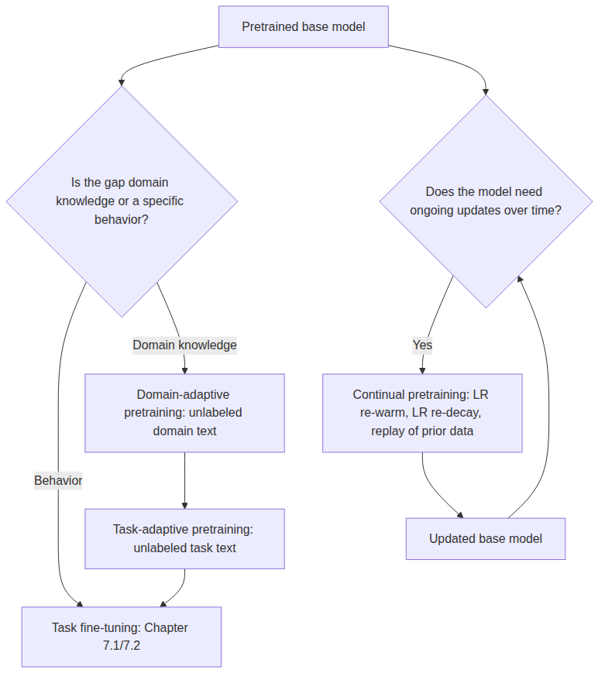
REFERENCE ARCHITECTURE
Where domain adaptation and continual pretraining fit relative to fine-tuning
DAPT and TAPT feed into task fine-tuning; continual pretraining is a separate, ongoing update loop.

Slide 11
CHECK YOUR UNDERSTANDING
Discuss before moving on
• 1. What is the difference between DAPT and TAPT, and does running one make the other unnecessary?
• 2. What did the 2023 study find about model scale and forgetting, and why is that counterintuitive?
• 3. How does Elastic Weight Consolidation prevent catastrophic forgetting, mechanically?
• 4. What three components make up the continual pretraining recipe from Ibrahim et al., and what does each address?
• 5. In the Hands-On exercise, what specifically differed between the no-replay and replay runs, and what did it produce?

