Slide 1
CHAPTER 7.5 · PHASE 7
Model Compression:
Distillation, Quantization, Pruning
The last two chapters covered giving a model new behavior and new knowledge. This chapter covers making a model smaller and cheaper to run, without giving up much of either.
Fine-Tuning, Alignment & Model Customization

Slide 2
AGENDA
What this chapter covers
• Distillation: training a small student model to reproduce a large teacher's behavior
• Quantization: representing the same weights with fewer bits, no architecture change
• Pruning: removing weights outright, at scale, without retraining
• Why these three techniques compose rather than compete
• A hands-on INT8 quantization, with the size reduction and prediction match both measured
• How the three techniques stack into one compressed, deployed model

Slide 3
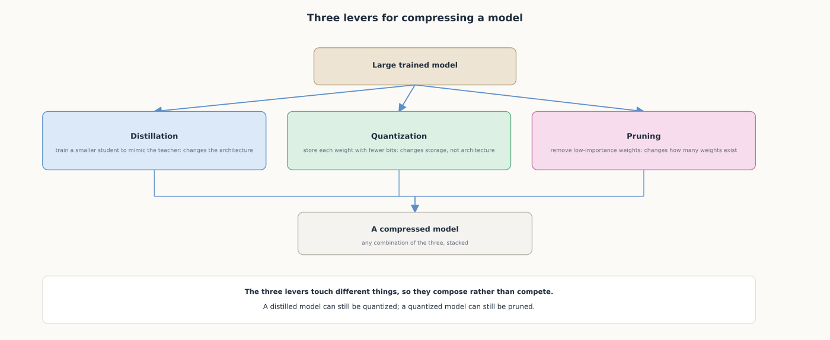
HIGH-LEVEL
Three levers, each changing a different part of the model
Distillation changes the architecture, quantization changes storage, pruning changes weight count.

Slide 4
DEEP-DIVE
Distillation trains a smaller model on a larger one's outputs
• Hinton et al.: "compress the knowledge in an ensemble into a single model...easier to deploy" (building on Caruana et al.)
• A small student learns from the teacher's softened output probabilities, not just hard labels
• Those probabilities carry information about which wrong answers the teacher considered plausible
• "Improving the acoustic model of a heavily used commercial system" was a real production win
• DistilBERT: "reduce the size of a BERT model by 40%, while retaining 97%...and being 60% faster"

Slide 5
DEEP-DIVE
Quantization shrinks storage per weight, in hours not a training run
• GPTQ: "quantize GPT models with 175 billion parameters in approximately four GPU hours"
• "Reducing the bitwidth down to 3 or 4 bits per weight, with negligible accuracy degradation"
• "End-to-end inference speedups...around 3.25x" on A100s, "4.5x" on cost-effective A6000s
• Precise enough to "execute an 175 billion-parameter model inside a single GPU"
• Usually the cheapest of the three to apply; commonly layered on top of a distilled or pruned model

Slide 6
DEEP-DIVE
Pruning removes weights outright, without the retraining it used to need
• SparseGPT: "pruned to at least 50% sparsity in one-shot, without any retraining, at minimal loss"
• On OPT-175B and BLOOM-176B: "60% unstructured sparsity with negligible increase in perplexity"
• More than half the weights in those models can be zeroed out and ignored at inference time
• "Generalizes to semi-structured (2:4 and 4:8) patterns," matching what hardware actually accelerates
• "Compatible with weight quantization approaches"; pruning and quantization stack on the same model

Slide 7
HANDS-ON
Quantize a model to INT8 and check what it costs
• Step 1: load DistilBERT (ordinary nn.Linear layers, unlike GPT-2-style Conv1D projections)
• Step 2: apply dynamic quantization to every nn.Linear layer and measure the new model size
• Step 3: check whether the quantized model still predicts the same masked-word answers
• Step 4: the size drops substantially, while top-1 predictions typically agree across sentences
• The same shape of tradeoff GPTQ reported at 175B scale: meaningfully smaller, small bounded cost

Slide 8
COMPARISON & RELATED CONCEPTS
Three techniques, each touching a different part of the model
Aspect | Distillation | Quantization | Pruning
What changes | The architecture: a smaller student | How each weight is stored | How many weights exist
When it happens | During training | Usually after training | One-shot or during training
Reported result | 40% smaller, 97% capability (DistilBERT) | 3-4 bits/weight, negligible loss (GPTQ) | 50%+ sparsity, no retraining (SparseGPT)
Combines with the others? | Yes: can still be quantized and pruned | Yes: SparseGPT compatible with it | Yes: commonly stacked with quantization
Each technique touches a different part of the model, which is why production systems stack them.

Slide 9
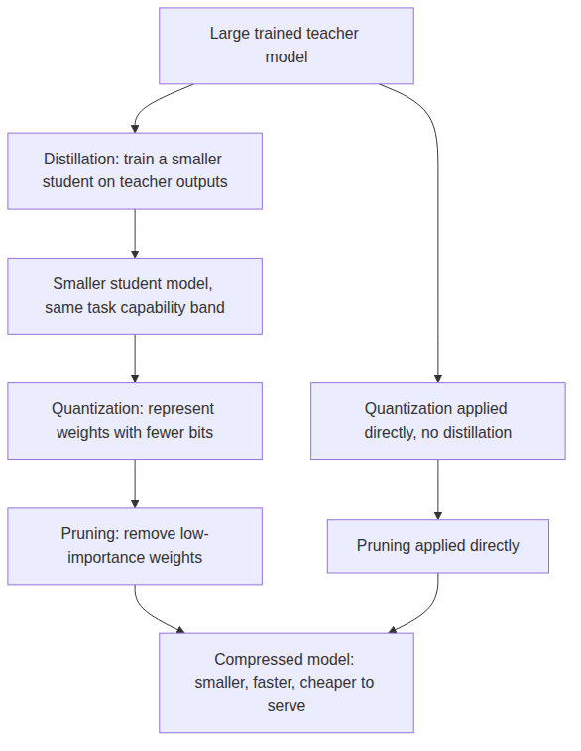
REFERENCE ARCHITECTURE
How the three techniques compose into one compressed model
No stage requires all three; a team can distill only, quantize only, prune only, or chain any combination.

Slide 10
CHECK YOUR UNDERSTANDING
Discuss before moving on
• 1. What does distillation actually change about a model, and how does that differ from quantization?
• 2. What specific tradeoff did DistilBERT report, and why are those specific numbers useful?
• 3. What did SparseGPT show about pruning relative to how pruning had traditionally been done?
• 4. Why does the Hands-On exercise use DistilBERT rather than a GPT-2-style model for quantization?
• 5. Why do production systems commonly apply all three techniques together rather than choosing just one?

