Slide 1
CHAPTER 7.6 · PHASE 7
Evaluating & Benchmarking
Fine-Tuned Models
Every technique in this phase changes a model. This chapter covers how to tell whether a change was actually an improvement, and why no single check answers that question alone.
Fine-Tuning, Alignment & Model Customization

Slide 2
AGENDA
What this chapter covers
• Task-specific held-out evals: did the fine-tune improve the behavior it targeted
• General-capability benchmarks like MMLU: did the fine-tune cost anything outside that behavior
• LLM-as-judge and human evaluation for open-ended output quality
• Contamination: why no benchmark score means anything until it is ruled out
• A hands-on regression eval harness, run before and after a narrow fine-tune
• Where all three checks, and the contamination gate, fit before a model ships

Slide 3
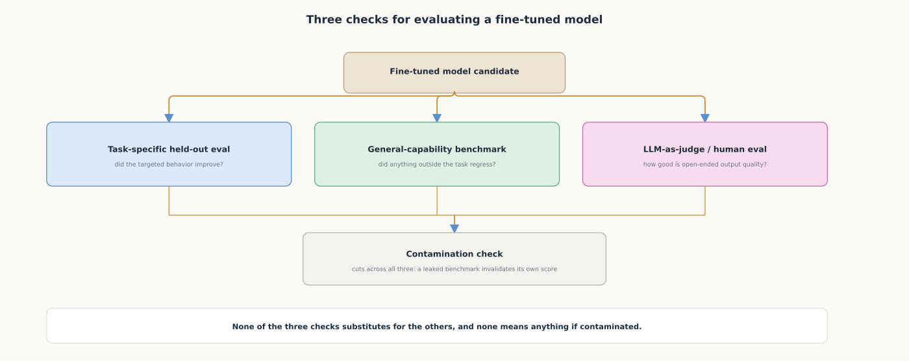
HIGH-LEVEL
Three checks, and a contamination gate that cuts across all of them
None of the three checks substitutes for the others, and none means anything if contaminated.

Slide 4
DEEP-DIVE
General-capability benchmarks catch regressions a narrow task never would
• MMLU: "a new test to measure a text model's multitask accuracy...57 tasks" (Hendrycks et al.)
• A fine-tuned model's MMLU score dropping vs. its base model is a direct regression signal
• The largest GPT-3 tested "improves over random chance by almost 20 percentage points"
• Yet models show "near-random accuracy on some socially important subjects such as morality and law"
• A benchmark this far from saturated is a genuinely useful regression signal

Slide 5
DEEP-DIVE
Open-ended output usually needs a judge, and it works, with real caveats
• "Evaluating LLM based chat assistants is challenging due to...the inadequacy of existing benchmarks" (Zheng et al.)
• "Strong LLM judges like GPT-4 can match...human preferences well, achieving over 80% agreement"
• That is the same level of agreement between two human raters
• "Position, verbosity, and self-enhancement biases, as well as limited reasoning ability" documented too
• Not useless; a tool whose known biases need active controlling for, not blind trust

Slide 6
DEEP-DIVE
No benchmark score means anything until contamination is ruled out
• "In the MMLU benchmark, ChatGPT and GPT-4...52% and 57%...in guessing the missing options"
• A rate far above what genuine reasoning over an unfamiliar question would predict
• Evidence consistent with the benchmark's exact text having appeared in training data
• "A disparity between the inflated benchmark scores and the actual performance of LLMs"
• A fine-tuning dataset can also accidentally include benchmark questions scraped from public sources

Slide 7
HANDS-ON
Build a regression eval harness
• Step 1: define a small general-knowledge eval set, unrelated to the fine-tuning domain
• Step 2: score each answer choice by the model's log-probability of its letter (MMLU-style scoring)
• Step 3: fine-tune a copy on narrow domain text, then run the identical eval set against it
• Step 4: read the result as a regression signal, not a capability score, at this toy scale
• The same eval set, before and after, turns forgetting into a concrete before-and-after number

Slide 8
COMPARISON & RELATED CONCEPTS
Three checks, each catching what the others miss
Aspect | Task-specific held-out eval | General-capability benchmark | LLM-as-judge / human eval
What it measures | Whether the targeted behavior improved | Whether anything else regressed | Open-ended quality scoring can't capture
Scoring method | Task-specific metric | Multiple-choice / exact-match | Pairwise or scored judgment
What it misses | Regressions outside its own task | Open-ended quality, task nuance | Position, verbosity, self-enhancement bias
Contamination risk | Real, if data overlaps held-out set | Real: MMLU recovered by guessing | Lower, but a biased judge can still favor it
No single check answers all three questions; passing one can still fail silently on the other two.

Slide 9
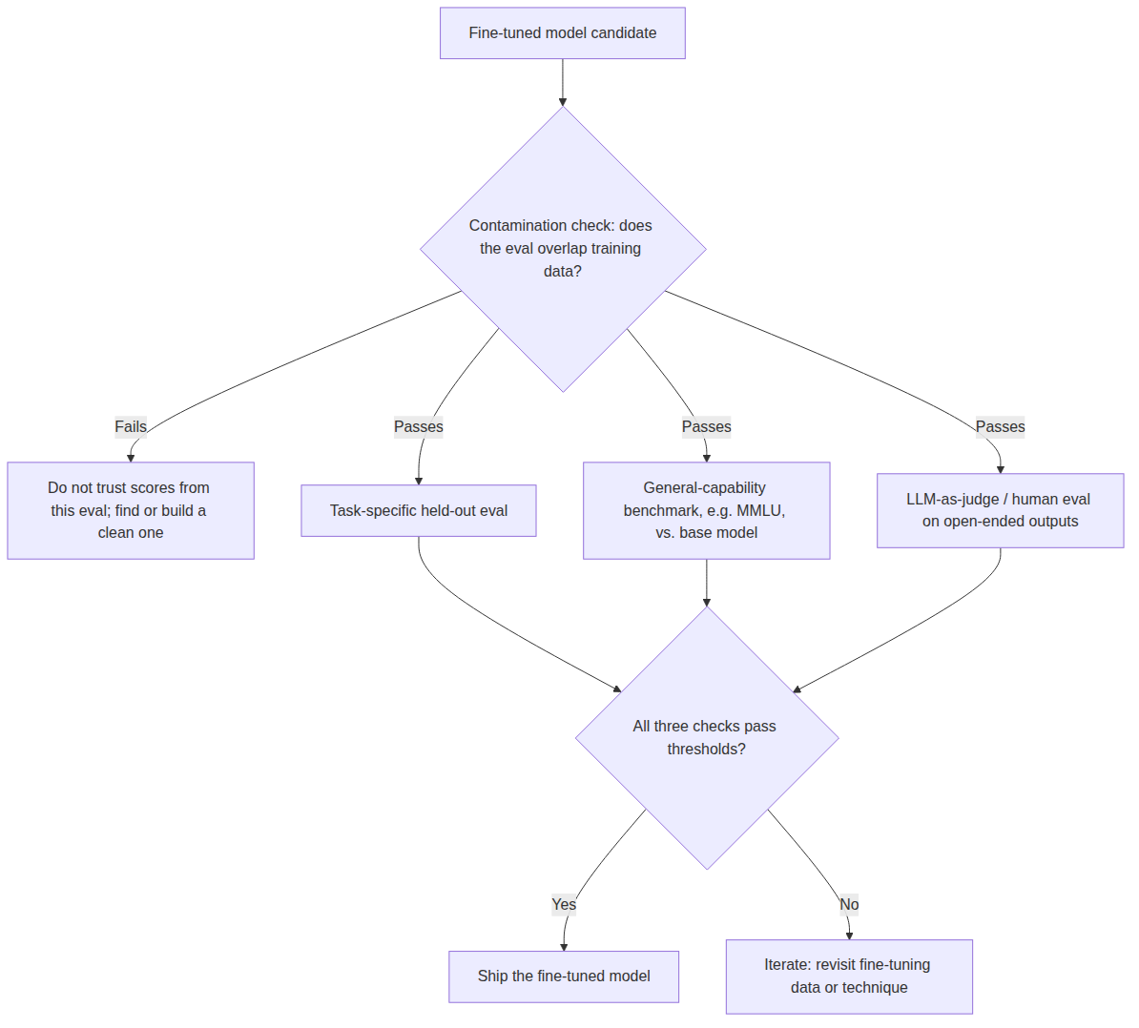
REFERENCE ARCHITECTURE
Where each evaluation check fits before a model ships
A contamination check gates every other check; a score from a contaminated eval proves nothing.

Slide 10
CHECK YOUR UNDERSTANDING
Discuss before moving on
• 1. Why is a task-specific held-out eval not sufficient on its own to decide whether a fine-tune should ship?
• 2. What did Zheng et al. find about GPT-4-as-judge agreement, and what biases did they document alongside it?
• 3. What did the contamination study find about guessing MMLU's missing options, and why does that matter here?
• 4. In the Hands-On harness, what specifically changed between the base-model and fine-tuned-model accuracy runs?
• 5. Why does a contamination check need to come before the other checks are trusted, not just be one more check?

