Slide 1
CHAPTER 7.7 · PHASE 7
Deployment Considerations
for Custom Models
A fine-tuned model that has passed Chapter 7.6's evaluation gate still is not ready for every user at once. Two decisions, how it is served and how the rollout proceeds, shape how safely it gets there.
Fine-Tuning, Alignment & Model Customization

Slide 2
AGENDA
What this chapter covers
• Merging a LoRA adapter into the base model, versus serving many adapters unmerged (S-LoRA)
• Why merging stops scaling once there is more than one fine-tune to serve
• Train-serve skew: how a prompt template or tokenizer mismatch can look like a model problem
• Shadow deployment: validating against real traffic with zero user-facing risk
• Canary release and rollback: ramping real users gradually, with a fast way back
• A hands-on canary rollout simulator with an automatic rollback gate

Slide 3
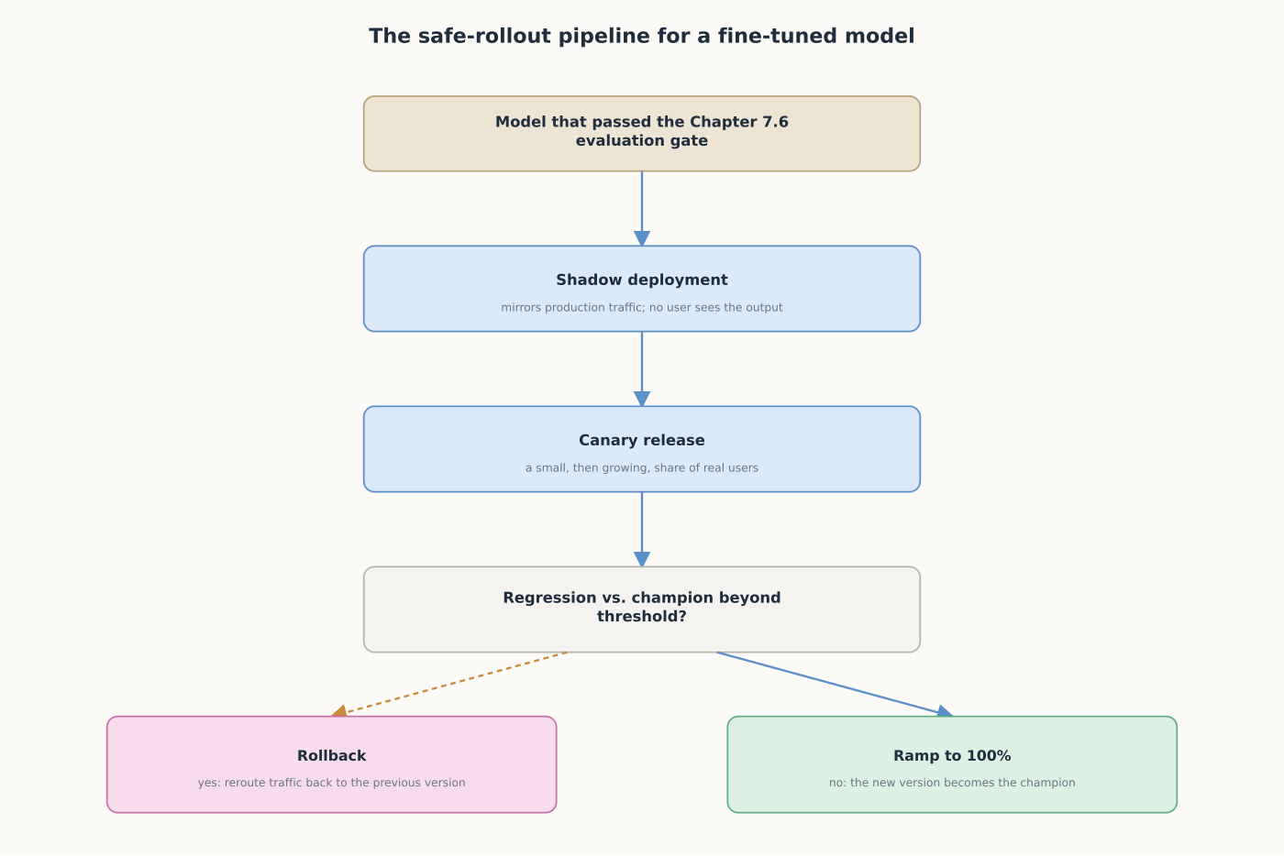
HIGH-LEVEL
An evaluation gate answers if a model is good; rollout answers if it's safe to find out
A model moves through shadow deployment, then a canary ramp, with rollback ready at each stage.

Slide 4
DEEP-DIVE
Merge for one tenant's speed, or serve many adapters unmerged for scale
• Merging a LoRA adapter into the base model adds no extra inference latency for one fine-tune
• S-LoRA: at scale, "training and serving costs can become substantial"
• "Directly merging the models requires maintaining many copies of the full language model"
• S-LoRA keeps adapters unmerged: "Unified Paging" pools memory across many adapters on one base model
• Reported gain: "improve the throughput by up to 4 times" and serve orders of magnitude more adapters

Slide 5
DEEP-DIVE
A model can be correct in eval and wrong in production for reasons outside it
• Zinkevich: "the best way to make sure that you train like you serve is to...pipe those features to a log"
• "Re-use code between your training pipeline and your serving pipeline whenever possible"
• A prompt template, tokenizer version, or chat-formatting mismatch can silently reshape every input
• None of this would show up by re-reading the model's weights, only by comparing what reaches the model
• "Do sanity checks right before you export the model" is what Chapter 7.6's eval gate exists to satisfy

Slide 6
DEEP-DIVE
Shadow deployment, then canary release, close the gap an offline eval can't
• Fowler: "deploy the new model side-by-side...send the same production traffic" with no user impact
• Canary: "slowly rolling out the change to a small subset of users before...the entire infrastructure"
• Once a shadow run looks healthy, canary exposes a small, then growing, share of real users
• Rollback: "simply to reroute users back to the old version until you have fixed the problem"
• That only works quickly if the previous version is still deployed and warm, not archived

Slide 7
HANDS-ON
Build a canary rollout simulator with an automatic rollback gate
• Step 1: load a champion model and a small sample standing in for production requests
• Step 2: score each candidate model by log-probability of its answer letter, same method as Ch. 7.6
• Step 3: build a challenger by fine-tuning a copy on narrow domain text (deliberately regressed)
• Step 4: ramp through canary stages, re-checking for regression, and roll back past a threshold
• The same regression from Chapters 7.4 and 7.6 becomes a live, automatic rollout decision here

Slide 8
COMPARISON & RELATED CONCEPTS
Three ways real traffic can reach a new model
Aspect | Shadow deployment | Canary release | Full cutover
What real users see | Nothing; outputs are logged only | A small, then growing, share of requests | Every request, immediately
Risk if there's a hidden regression | None; the shadow never serves a response | Limited to the canary share, fast rollback | Full-blown; everyone affected at once
What it actually validates | Performance against real traffic patterns | Performance under real user behavior at scale | Nothing in advance
Typical use | Right after Ch. 7.6's eval gate passes | After a shadow run looks healthy | Rarely a fine-tune
Shadow and canary exist because Chapter 7.6's evaluation gate is still an offline proxy for real traffic.

Slide 9
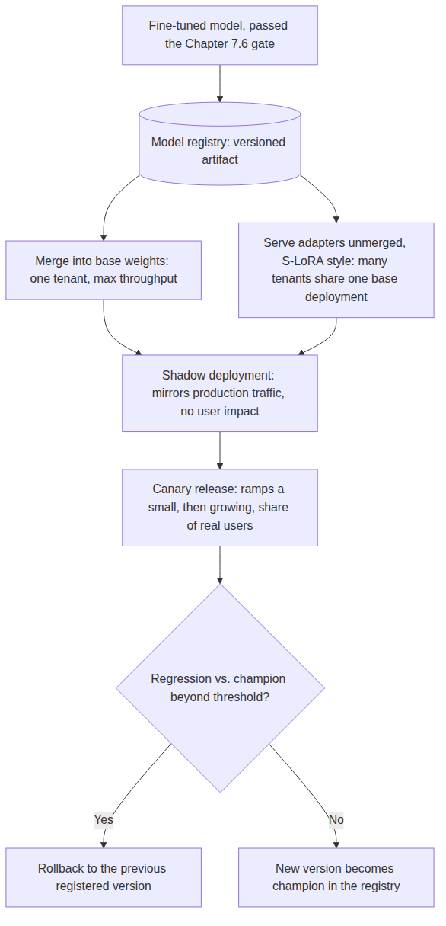
REFERENCE ARCHITECTURE
Where serving architecture and safe rollout fit for a custom model
A model registry tracks the current champion, so rollback always has an exact version to revert to.

Slide 10
CHECK YOUR UNDERSTANDING
Discuss before moving on
• 1. Why might a team with one fine-tuned model merge its adapter, and why does that stop making sense at scale?
• 2. What does Zinkevich recommend for train-serve consistency, and what LLM-specific failure does it prevent?
• 3. What's the difference between a shadow deployment and a canary release, and why use both?
• 4. What does Fowler describe as the rollback strategy, and what has to be true for it to actually be fast?
• 5. In the Hands-On simulator, what triggers a rollback, and how does that differ from Ch. 7.6's evaluation gate alone?

