Slide 1
CHAPTER 6.1 · PHASE 6
Why RAG? The Limits of Parametric Knowledge
A pretrained model genuinely knows things. What it cannot do is stay current, cite a source, cover the long tail evenly, or update itself safely, and RAG exists to fix all four.
Retrieval-Augmented Generation & Knowledge Systems

Slide 2
AGENDA
What this chapter covers
How much knowledge a pretrained model actually stores, and how unevenly it stores it
The four specific limits of parametric knowledge this chapter names
Why a fact baked into weights carries no source, per Lewis et al.'s original RAG paper (2020)
Why "just retrain it" is neither cheap nor safe: catastrophic forgetting and knowledge editing
How pairing parametric memory with a non-parametric knowledge store answers all four limits
Where this leaves off: Phase 6's later chapters build the retrieval pipeline itself

Slide 3
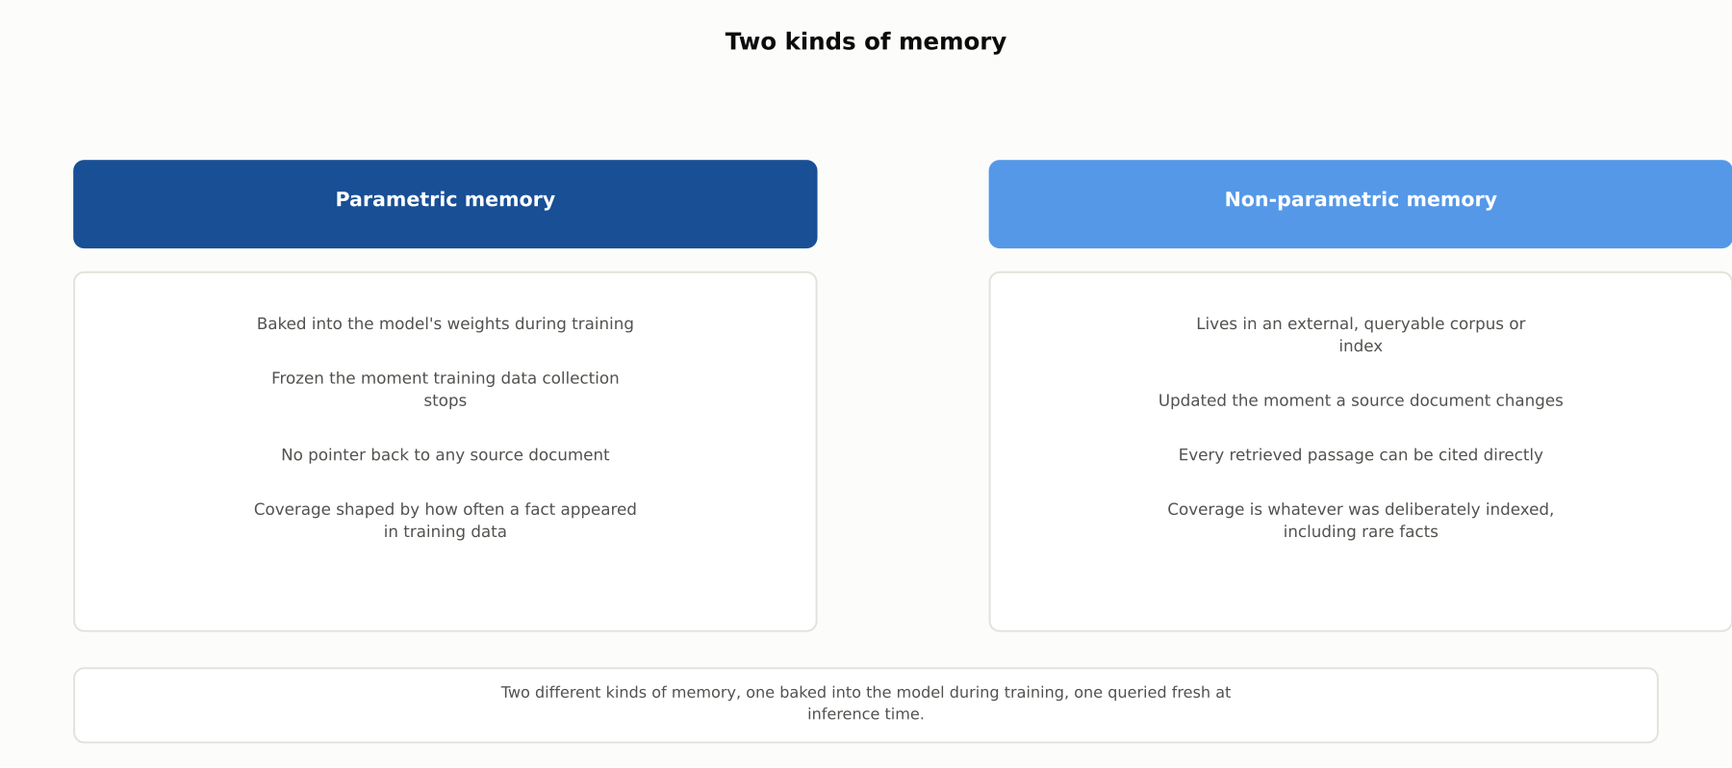
HIGH-LEVEL
Two kinds of memory
Parametric memory is baked into the model during training; non-parametric memory is queried fresh at inference time, and can be updated, cited, and curated independently of the model.

Slide 4
DEEP-DIVE
Parametric knowledge is real, and it is uneven
Petroni et al. (2019): "BERT contains relational knowledge competitive with traditional NLP methods that have some access to oracle knowledge"
Language models need "no schema engineering," can "query about an open class of relations," and need "no human supervision to train"
Roberts et al. (2020): this ability "scales with model size" and performs "competitively with open-domain systems that explicitly retrieve" answers
But coverage is not uniform: "certain types of factual knowledge are learned much more readily than others"
A fact repeated across thousands of pages is learned solidly; a fact that appeared once is learned poorly or not at all

Slide 5
DEEP-DIVE
Limit 1: knowledge is frozen at the training cutoff
Every model ships with a training cutoff, the last date its pretraining corpus reflects
Nothing about the model's architecture lets it look past that date on its own
Asked about a post-cutoff event, price, regulation, or policy, the model answers anyway
There is no internal signal telling the model that the world has since moved on
This is the most visible of the four limits, and the one most directly tied to confident wrong answers

Slide 6
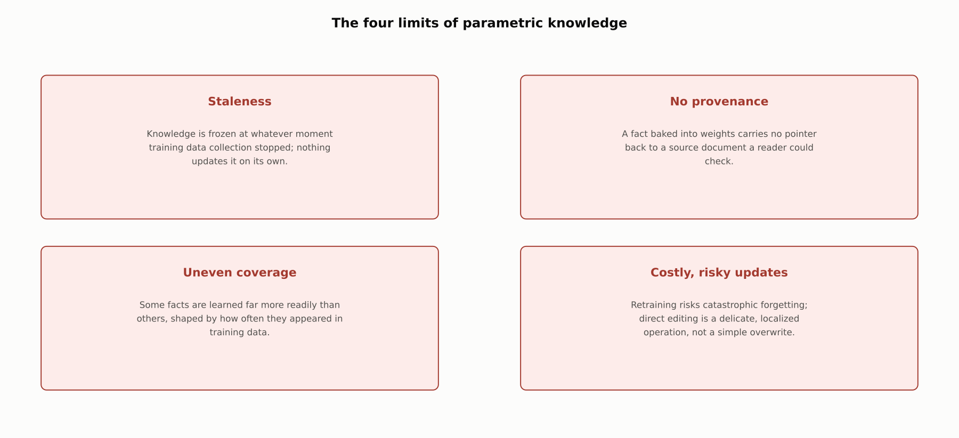
DEEP-DIVE
The four limits of parametric knowledge
Staleness, no provenance, uneven coverage, and costly, risky updates, all four a direct consequence of how parametric knowledge is learned and stored.

Slide 7
DEEP-DIVE
Limit 2: no pointer back to a source
Lewis et al. (2020), the paper that named RAG: a pretrained model's "ability to access and precisely manipulate knowledge is still limited"
On knowledge-intensive tasks, "their performance lags behind task-specific architectures"
"Providing provenance for their decisions and updating their world knowledge remain open research problems"
A number and the sentence it appeared in are compressed into the same undifferentiated set of weights
Ask a fine-tuned model why it believes a claim, and there is no document it can point to, because none was ever attached to the fact
Google Cloud's framing: RAG produces "grounded generation" precisely because "LLMs are limited to their pre-trained data"

Slide 8
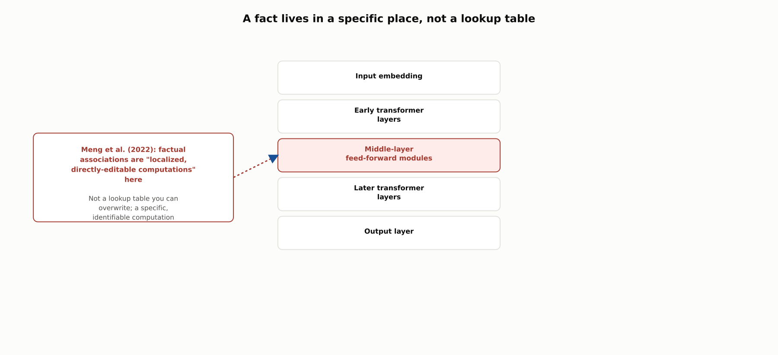
DEEP-DIVE
A fact lives in a specific place, not a lookup table
Meng et al. (2022): factual associations correspond to "localized, directly-editable computations" concentrated in "middle-layer feed-forward modules."

Slide 9
DEEP-DIVE
Limit 3 and 4: updating knowledge is neither cheap nor safe
Kirkpatrick et al. (2017): "it has been widely thought that catastrophic forgetting is an inevitable feature of connectionist models"
A network can lose what it already knew while being trained on something new, unless specifically protected against it
A more surgical fix, editing one fact directly, sounds simpler but is not
Meng et al. (2022) found facts localized in specific, identifiable computations, not a table you can look up and overwrite
Editing well enough that the new fact sticks, without corrupting nearby facts, is itself an active research problem
ROME is notable specifically for maintaining "both specificity and generalization, whereas other methods sacrifice one or another"

Slide 10
DEEP-DIVE
RAG addresses all four limits at once
Anthropic: RAG "combines information retrieval with language model generation" to "better ground the model's response in evidence"
Relevant information is "retrieved at runtime" and "passed to the model along with the original query"
Staleness: update the knowledge store the moment a source changes
Provenance: cite the exact passage retrieval returned
Uneven coverage: curate the knowledge store directly, independent of training-data frequency
Update cost and risk: add or replace a document, with none of fine-tuning's forgetting risk
AWS: RAG is "a pragmatic and effective approach to using LLMs in an enterprise"

Slide 11
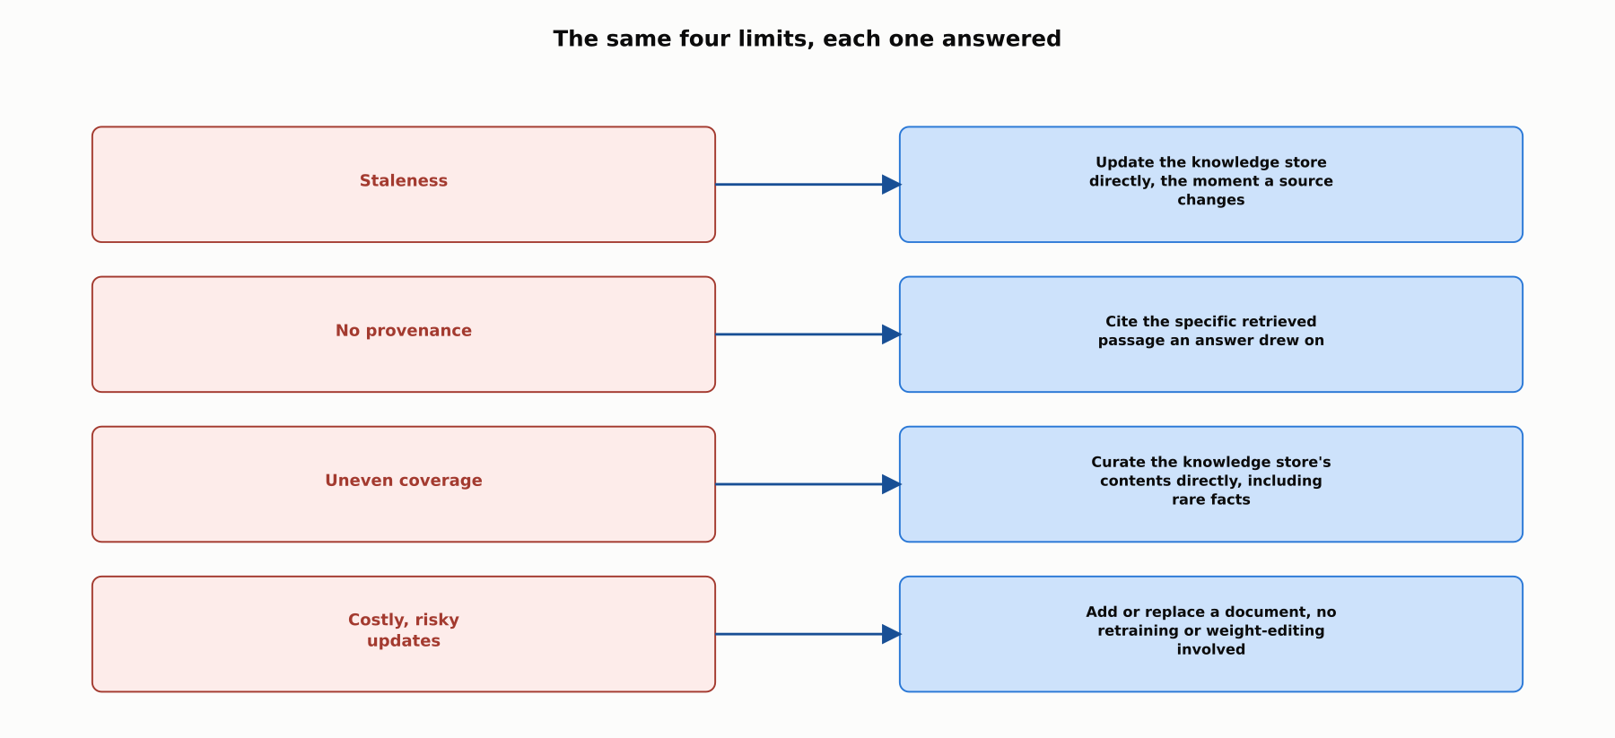
DEEP-DIVE
The same four limits, each one answered
None of this is free: a retrieval pipeline, an index to maintain, and new failure modes of its own, covered in Phase 6's later chapters.

Slide 12
COMPARISON & RELATED CONCEPTS
Three relationships to the same problem
Aspect | Parametric memory alone | Non-parametric memory (RAG) | Retraining or knowledge editing
Where the knowledge lives | Compressed into the model's own weights | An external, queryable corpus or index | Still the model's weights, changed after the fact
How current it can be | Frozen at the training cutoff | As current as the underlying document store | As current as the last retrain or edit, no fresher
Can it cite a source | No, a fact baked into weights has no pointer | Yes, this is retrieval's defining advantage | No, an edited fact still carries no provenance
Cost and risk of an update | N/A, nothing updates on its own | Add or replace a document, no model training | Real risk of catastrophic forgetting or side effects
Three different relationships to the same underlying problem, what a model knows and how that knowledge can change.

Slide 13
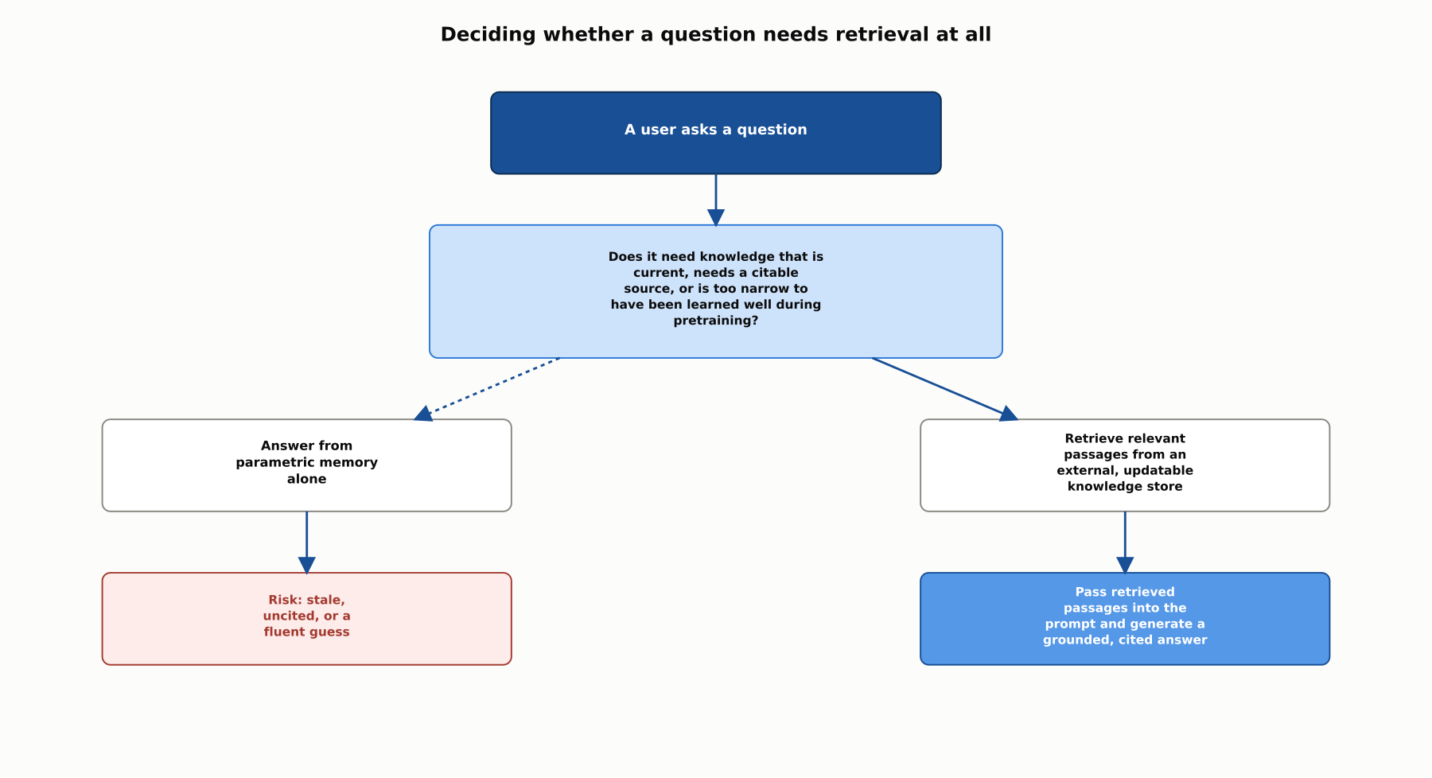
REFERENCE ARCHITECTURE
Deciding whether a question needs retrieval at all
This chapter stops at the motivating question; Phase 6's later chapters build the retrieval pipeline itself, starting with embeddings and vector search in 6.2.

Slide 14
CHECK YOUR UNDERSTANDING
Discuss before moving on
1. What did Petroni et al. (2019) find about how much factual knowledge a pretrained model stores, and what limitation did they find alongside it?
2. According to Lewis et al.'s original RAG paper (2020), what two things do pretrained models struggle with regarding the knowledge in their weights?
3. What is catastrophic forgetting, and why does it make "just retrain the model" a risky answer to stale knowledge?
4. What did Meng et al. (2022) find about where a specific fact lives inside a transformer's weights?
5. Name the four limits of parametric knowledge, and how RAG addresses each one.

