Slide 1
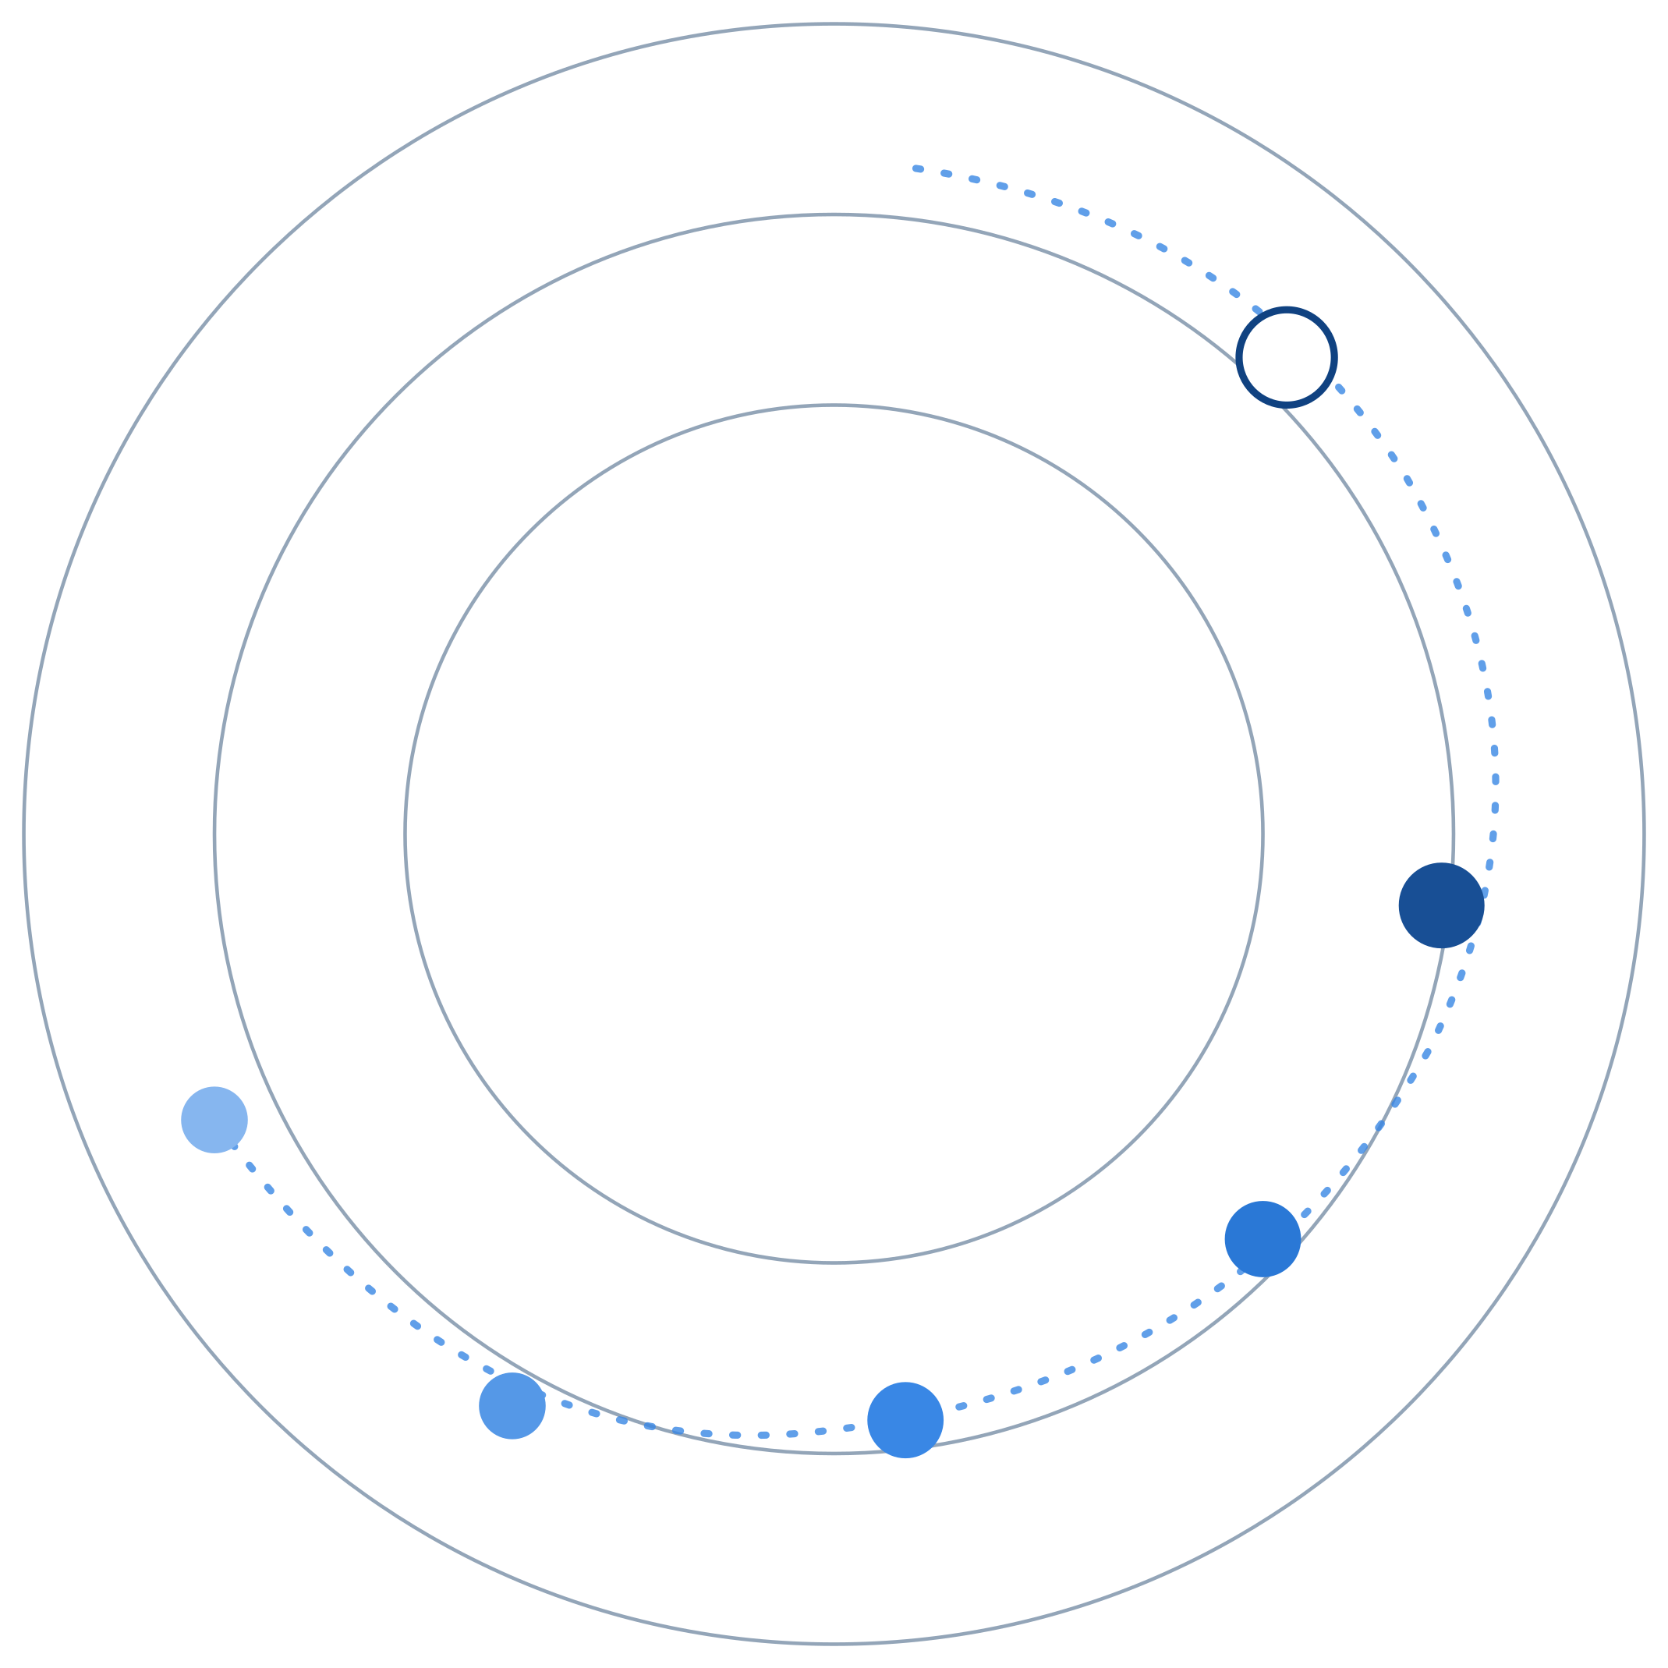
REGAITRAINING · PHASE 1 — AI & MACHINE LEARNING FOUNDATIONS
CHAPTER 1.4
Core ML Concepts
Features, Train/Validation/Test, Bias-Variance, and Overfitting
A teaching-slide walkthrough of the chapter: how to get an honest read on generalization, and the bias-variance math behind why models fail in two opposite directions.
Instructor deck · 15 slides · based on docs/01-ai-ml-foundations/1-4-core-ml-concepts.mdx

Slide 2
ROADMAP
What We'll Cover
1
Features and splits
5
A reference pipeline
What a model sees, and how to hold data out honestly
Where the split sits in real training
2
Splits and cross-validation
6
Comparison table
Hold-out vs k-fold, in detail
Underfit, overfit, good fit, and data leakage
3
Underfitting vs overfitting
7
Industry use cases
Same data, three different fits
Finance, Healthcare, and Telecom — 4 each
4
Regularization
L2, L1, and early stopping compared
1.4 · Phase 1 — AI & Machine Learning Foundations
2

Slide 3
TL;DR
Generalization Is the Whole Game
A model isn't graded on how well it fits the data it trained on. It's graded on how well it performs on data it has never seen.
Features are the inputs a model sees. Train/validation/test splits get an honest read on unseen-data performance. The bias-variance tradeoff explains why models fail in two opposite directions.
THE PRACTICAL TAKEAWAY
Comparing training performance to validation performance is the standard way to tell whether a model is underfitting, overfitting, or neither.
1.4 · Phase 1 — AI & Machine Learning Foundations
3

Slide 4
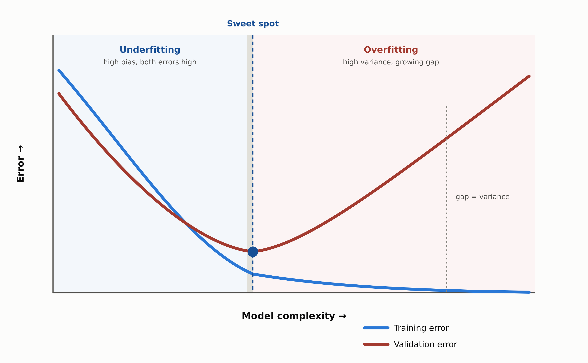
HIGH-LEVEL
Where Overfitting Begins
1.4 · Phase 1 — AI & Machine Learning Foundations
4

Slide 5
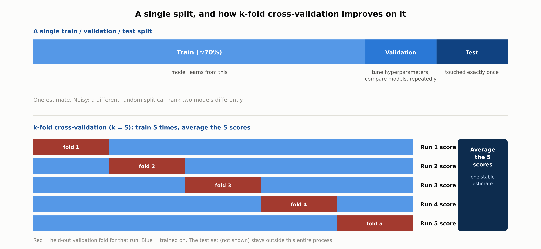
DEEP-DIVE
A Single Split, and k-Fold Cross-Validation
1.4 · Phase 1 — AI & Machine Learning Foundations
5

Slide 6
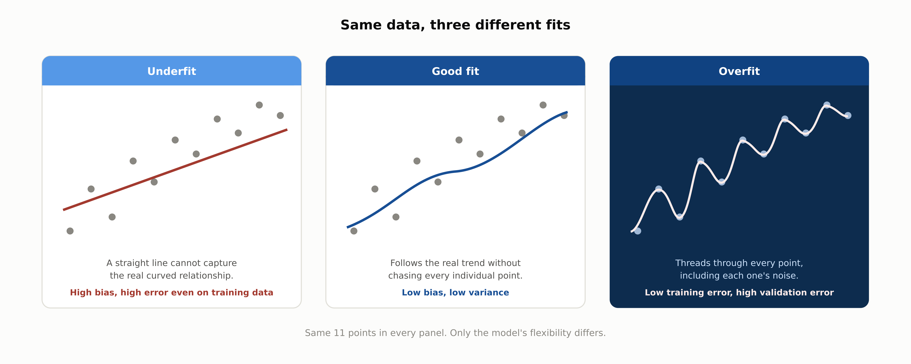
DEEP-DIVE
Same Data, Three Different Fits
1.4 · Phase 1 — AI & Machine Learning Foundations
6

Slide 7
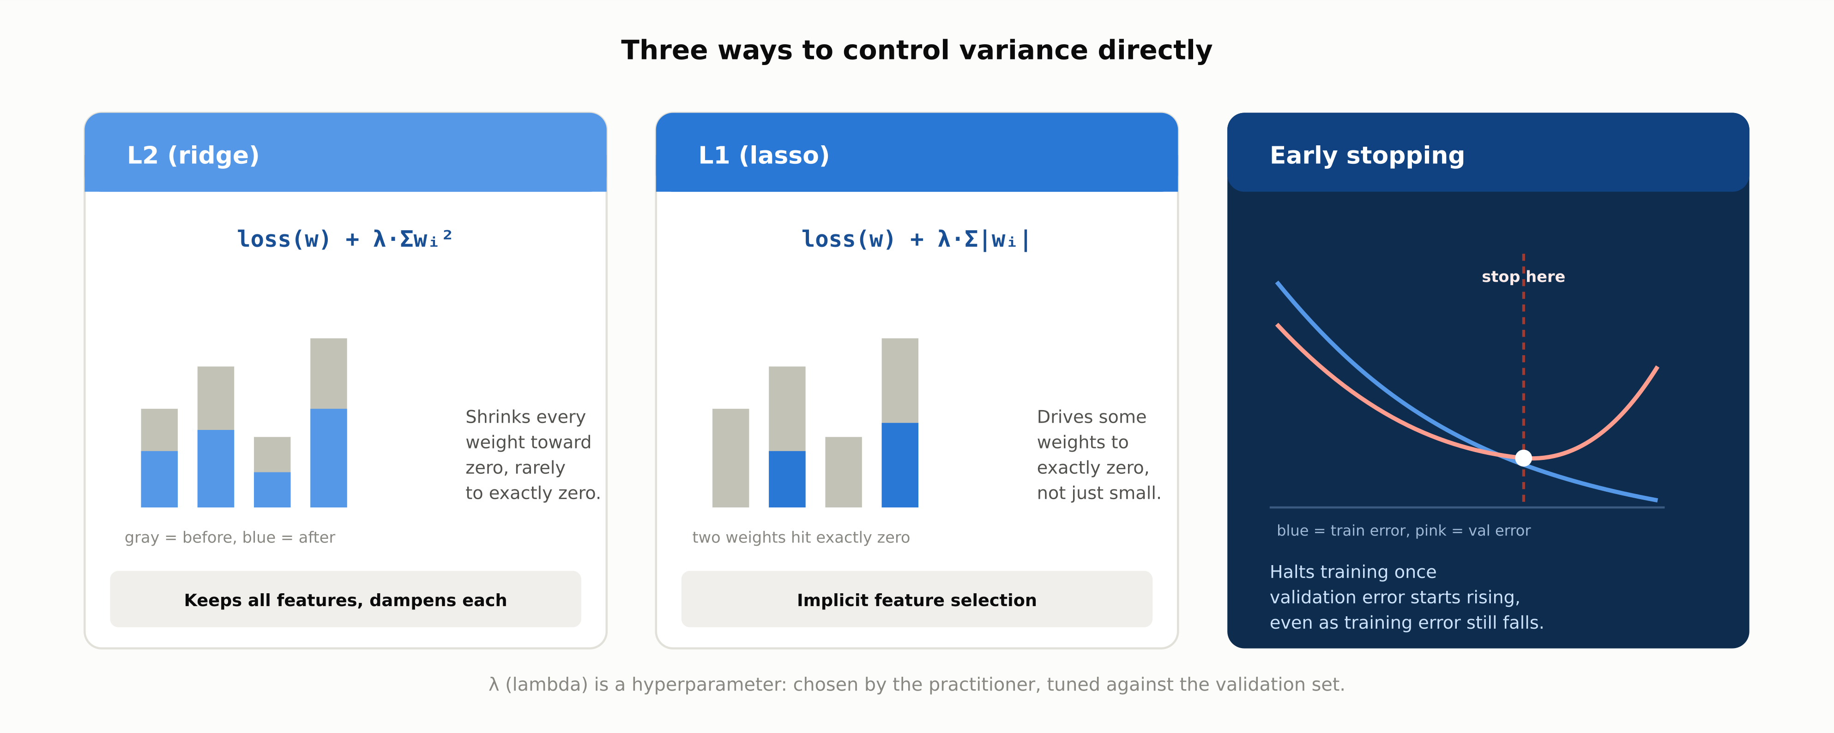
DEEP-DIVE
Three Ways to Control Variance Directly
1.4 · Phase 1 — AI & Machine Learning Foundations
7

Slide 8
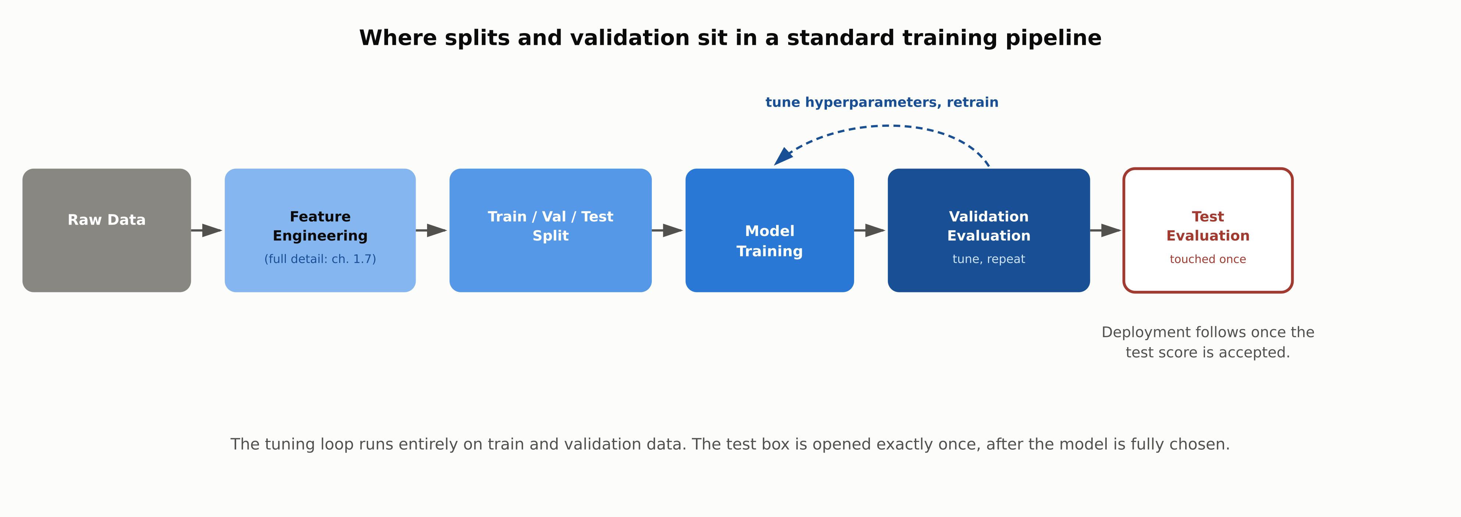
REFERENCE ARCHITECTURE
Where Splits and Validation Sit in a Training Pipeline
1.4 · Phase 1 — AI & Machine Learning Foundations
8

Slide 9
COMPARISON & RELATED CONCEPTS
Four Ways a Model Can Look
 | Underfitting | Overfitting | Good Fit | Data Leakage
Training error | High | Low | Low | Often suspiciously low
Gap to validation error | Small (both high) | Large | Small (both low) | Small, but validation is dishonest
Root cause | Model too simple | Fit noise in the sample | Capacity matches signal | Future/label info reached training
Fix | More capacity, better features | More data, more regularization | None needed | Audit the pipeline, rebuild the split
The decisive tell is the training-to-validation gap, with one exception: leakage can produce a small gap while still being wrong, because it corrupts the validation estimate itself.
1.4 · Phase 1 — AI & Machine Learning Foundations
9

Slide 10
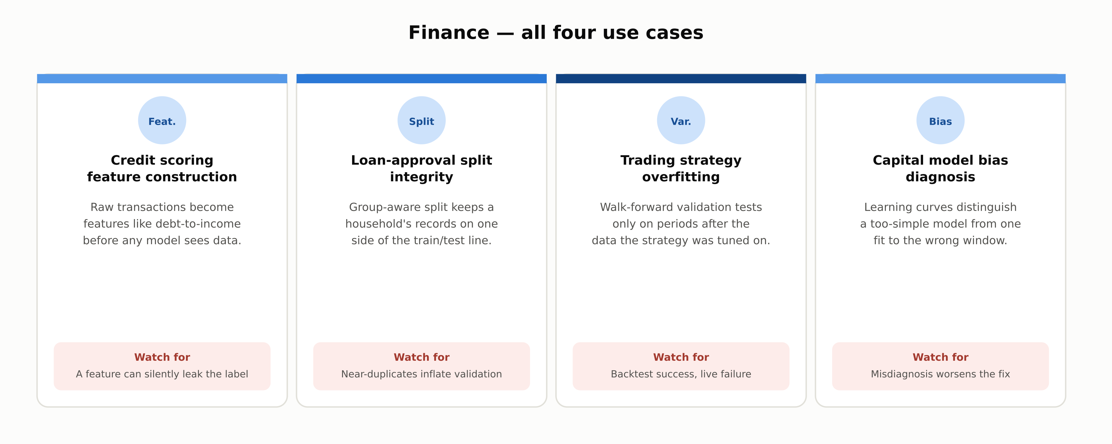
INDUSTRY USE CASES · 1 OF 3
Finance
1.4 · Phase 1 — AI & Machine Learning Foundations
10

Slide 11
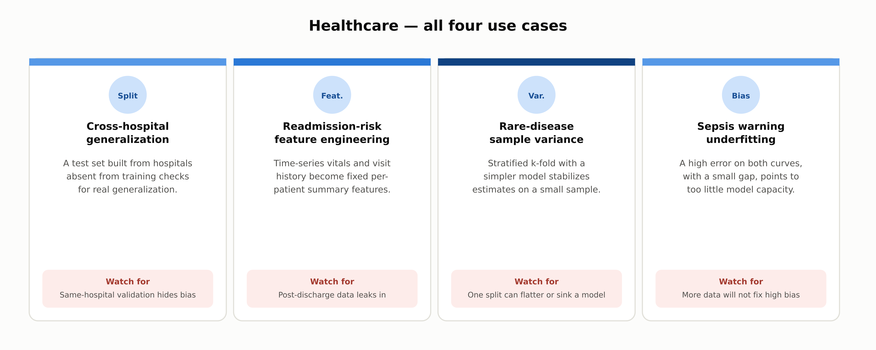
INDUSTRY USE CASES · 2 OF 3
Healthcare
1.4 · Phase 1 — AI & Machine Learning Foundations
11

Slide 12
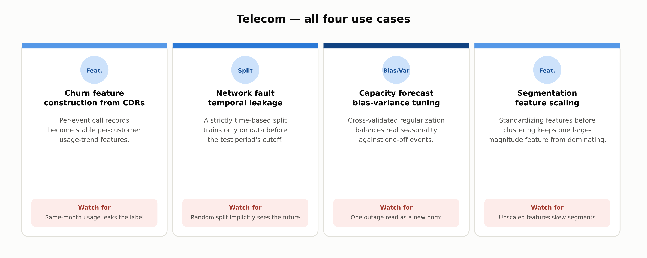
INDUSTRY USE CASES · 3 OF 3
Telecom
1.4 · Phase 1 — AI & Machine Learning Foundations
12

Slide 13
DISCUSS AS A CLASS
Check Your Understanding
Q1
A model achieves 98% training accuracy and 71% validation accuracy. Underfitting or overfitting, and what's the standard first fix?
Q2
Why is the test set used only once, at the very end, rather than checked periodically like the validation set?
Q3
A validation set shows unusually high accuracy the team can't explain. What should be checked first, and why?
Q4
What specifically does the bias-variance decomposition say happens when a model's capacity is increased?
Q5
Why does k-fold cross-validation give a more reliable estimate than a single split, and what does that cost?
Answers are in the speaker notes for this slide.
1.4 · Phase 1 — AI & Machine Learning Foundations
13
Notes:
Q1: A model achieves 98% training accuracy and 71% validation accuracy. Underfitting or overfitting, and what's the standard first fix? A1: Overfitting: a large gap between low training error and much higher validation error is the signature of high variance. Standard fixes are more data, stronger regularization, reduced capacity, or early stopping. Q2: Why is the test set used only once, at the very end, rather than checked periodically like the validation set? A2: Any dataset used repeatedly to make modeling decisions stops being an honest estimate, because the choices made in response to it start to fit that specific dataset. The test set is reserved to avoid this. Q3: A validation set shows unusually high accuracy the team can't explain. What should be checked first, and why? A3: Data leakage should be checked first: a feature encoding label or future information, or a split allowing correlated/duplicate records across the boundary. Suspiciously good performance is a common leakage symptom. Q4: What specifically does the bias-variance decomposition say happens when a model's capacity is increased? A4: Bias (error from a too-simple model) tends to decrease, but variance (sensitivity to the specific training sample) tends to increase, because a more flexible model has more freedom to fit the sample's noise. Q5: Why does k-fold cross-validation give a more reliable estimate than a single split, and what does that cost? A5: A single split gives one noisy estimate depending on which examples landed in validation; k-fold averages k such estimates. The cost is k times the training compute, since the model retrains once per fold.

Slide 14
SUMMARY
Key Takeaways
✓
The test set is touched exactly once; the validation set absorbs all the repeated tuning decisions.
✓
Underfitting is high bias (both errors high); overfitting is high variance (a growing train-validation gap).
✓
Bias and variance trade off: more model flexibility typically lowers one and raises the other.
✓
Regularization (L2, L1, early stopping) controls variance directly, without limiting raw model capacity.
✓
Data leakage is a distinct failure from overfitting: it corrupts the evaluation itself, not just the fit.
1.4 · Phase 1 — AI & Machine Learning Foundations
14

Slide 15
FURTHER READING
Sources Cited in This Chapter
Geman, Bienenstock & Doursat, Neural Networks and the Bias/Variance Dilemma
Neural Computation, 1992
Kohavi, A Study of Cross-Validation and Bootstrap for Accuracy Estimation and Model Selection
IJCAI, 1995
Chapter 1.3
docs/01-ai-ml-foundations/1-3-ml-foundations.mdx
Glossary: Feature, Hyperparameter, Regularization, Bias-variance tradeoff, Data leakage, Cross-validation
docs/00-orientation/0-5-glossary-notation-conventions.md
Chapter 1.7
full feature-engineering treatment
Full chapter with inline links: docs/01-ai-ml-foundations/1-4-core-ml-concepts.mdx
1.4 · Phase 1 — AI & Machine Learning Foundations
15

