Slide 1
CHAPTER 6.4 · PHASE 6
RAG Architecture Deep Dive
A vector database is only useful because of what happens before a document reaches it and what happens after a query leaves it.
Retrieval-Augmented Generation & Knowledge Systems

Slide 2
AGENDA
What this chapter covers
Ingestion: turning a raw document into something a chunker can work with
Chunking: fixed-size, semantic, parent-document, and structure-aware strategies
Retrieval and diversity: why pure similarity ranking has a blind spot
Reranking: cross-encoders, Cohere Rerank, and where evidence lands in the prompt
Generation: prompt assembly and grounding a fluent answer in its sources
The full pipeline from a raw document to a grounded answer

Slide 3
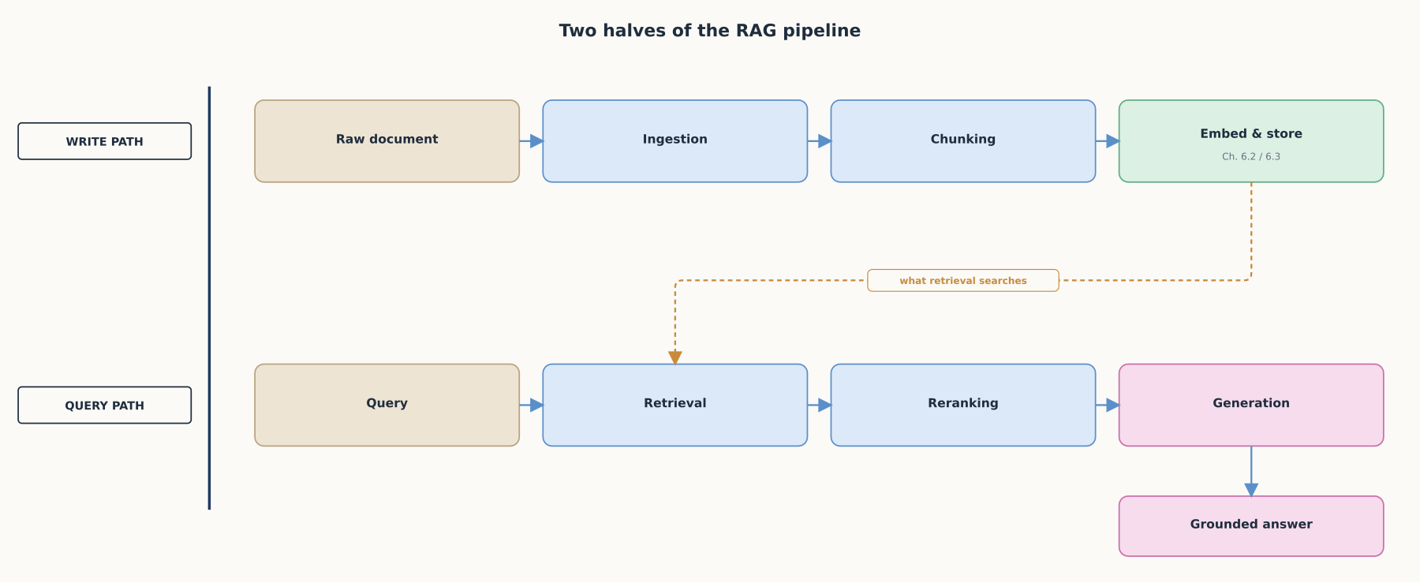
HIGH-LEVEL
Two halves of the same pipeline
One half indexes documents, the other half answers questions against what got indexed.

Slide 4
DEEP-DIVE
Ingestion turns a raw file into something a chunker can work with
A PDF, a scanned form, an HTML export, and a Word doc share no common format
"Extraction of structured content from raw, unstructured documents"
Includes OCR for pages with no text layer at all
Pulls tables out as tables, not scrambled text
Output is broken into document elements using "deep understanding of document formats"
A table flattened or a page skipped here is damage every later stage inherits

Slide 5
DEEP-DIVE
Chunking: fixed-size and recursive splitting
Tries a list of separators in order, falling back only when needed
Default separator list: "\n\n", "\n", " ", ""
Paragraph breaks first, then lines, then words, mid-word only as a last resort
Fast, cheap, and produces predictable, bounded chunk sizes
Knows nothing about meaning: a paragraph boundary is not always a topic boundary

Slide 6
DEEP-DIVE
Chunking: semantic chunking
Compares embedding similarity between consecutive sentences
Places a boundary where that similarity drops past a breakpoint percentile threshold
Chunk boundaries track an actual shift in subject, not a fixed character count
Costs an embedding call per sentence during ingestion
Output size is no longer predictable ahead of time

Slide 7
DEEP-DIVE
Chunking: parent-document (small-to-big) retrieval
"Small documents, so their embeddings can most accurately reflect their meaning"
"If too long, then the embeddings can lose meaning"
But also want "long enough documents that the context of each chunk is retained"
Fix: index small chunks, store a pointer back to a larger parent
Retrieval "fetches the small chunks but then looks up the parent IDs" and returns the larger document
A precise, focused match at search time; full surrounding context at generation time

Slide 8
DEEP-DIVE
Chunking: structure-aware chunking
Builds directly on the document elements ingestion already identified
Never splits a table row, a code block, or a list item across two chunks
A length-based splitter would cut exactly where structure carries meaning
Needs the richer, element-aware ingestion pass to work at all

Slide 9
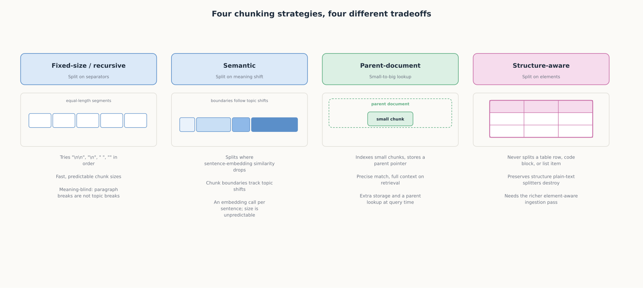
DEEP-DIVE
Four chunking strategies, four different tradeoffs
Predictability, cost, and context are traded off differently by each strategy, not solved by any single one of them.

Slide 10
DEEP-DIVE
Retrieval narrows millions of chunks to a shortlist
An ANN index (Chapters 6.2 and 6.3) turns a query embedding into a fast approximate search
Typically returns the top few dozen or few hundred candidates, ranked by similarity alone
Pure similarity ranking has a blind spot: near-duplicate results all say the same thing
Ten relevant results that repeat one point is not the same as ten results covering the space

Slide 11
DEEP-DIVE
Maximal Marginal Relevance: diversity in the shortlist
"A document has high marginal relevance if it is both relevant to the query and contains minimal similarity to previously selected documents"
Scores each candidate against the query and against what has already been selected
Original paper: a search for airline-disaster coverage returning dozens of near-identical articles
"Perfect precision, therefore, may prove insufficient in meeting user needs"
A tunable parameter weights relevance against redundancy avoidance directly

Slide 12
DEEP-DIVE
Reranking: bi-encoder retrieval vs. cross-encoder reranking
Retrieval uses a bi-encoder: query and every document embedded independently, ahead of time
Built for speed against millions of stored vectors
A cross-encoder passes the query and one candidate through the same network together
Outputs "a single score between 0 and 1 indicating how relevant the document is"
Far more accurate, and "scoring thousands or millions of pairs would be rather slow"
Only ever runs against the shortlist retrieval already produced, often around 100 candidates

Slide 13
DEEP-DIVE
Reranking in production: Cohere Rerank
Given a query and a list of documents, it "indexes the documents from most to least semantically relevant"
Returns a relevance_score for each candidate
A top_n parameter caps how many candidates survive into the prompt
Rerank 4.0 uses a single multilingual model covering 100+ languages
Packages the cross-encoder step as a production API rather than a model a team hosts itself

Slide 14
DEEP-DIVE
Lost in the middle: where evidence lands matters
A 2023 study by Stanford, UC Berkeley, and Samaya AI researchers measured a U-shaped performance pattern
"Performance is often highest when relevant information occurs at the beginning or end of the input context"
"Significantly degrades" when relevant information sits in the middle of long contexts
True "even for explicitly long-context models"
A reranker's job is not just picking the best evidence, it is placing it where a model actually uses it

Slide 15
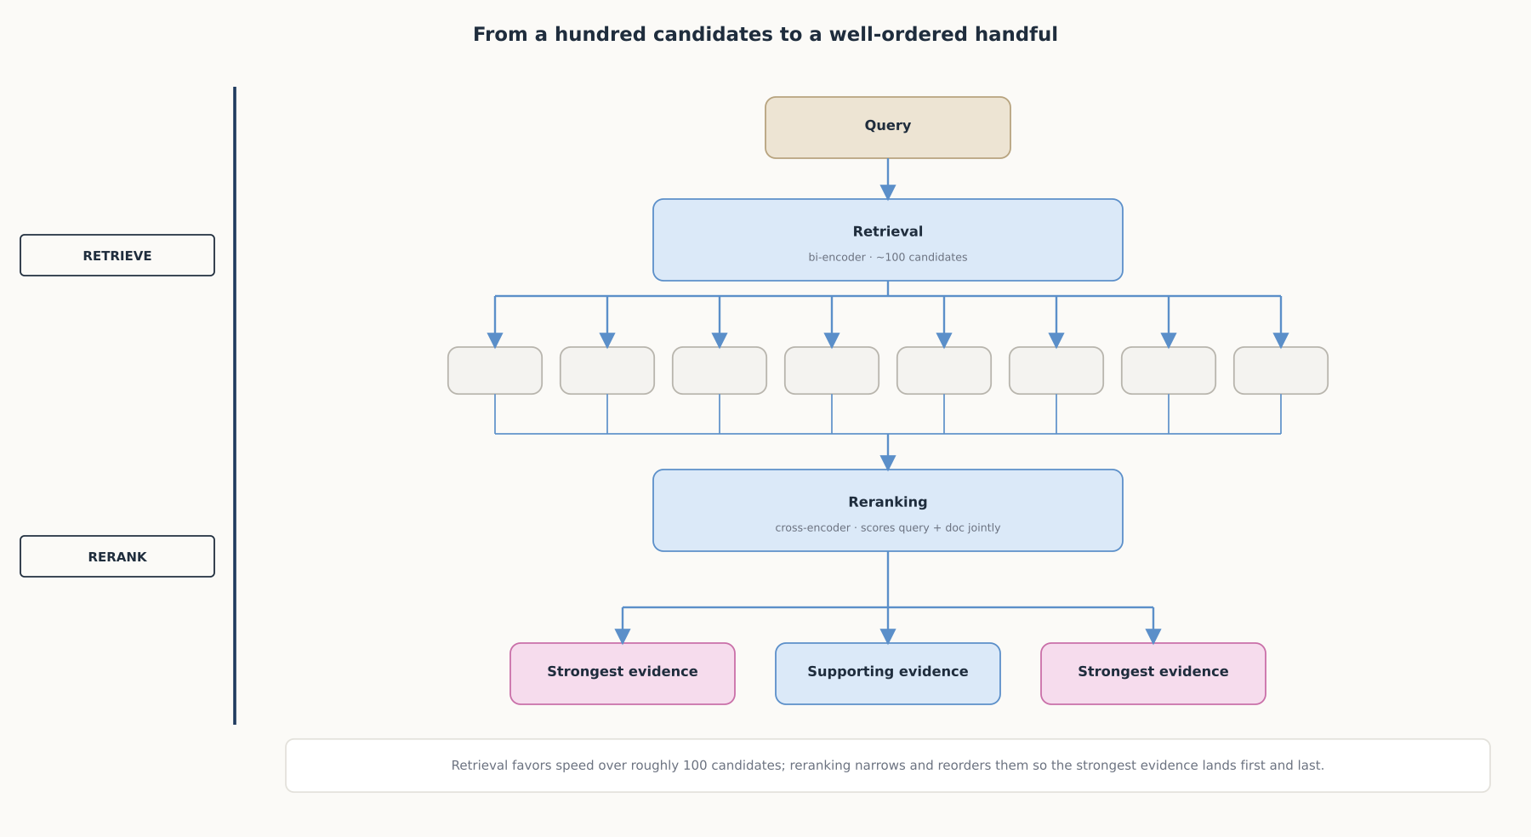
DEEP-DIVE
From a hundred candidates to a well-ordered handful
Retrieval is built for speed over millions of candidates; reranking trades that speed for accuracy over the hundred or so retrieval already found.

Slide 16
DEEP-DIVE
Generation assembles the reordered passages into a prompt
Everything upstream exists to hand the model a small, well-ordered set of passages
Not an entire knowledge base dumped into context
Retrieved passages, the user's question, and instructions to answer only from what was given
A fluent answer is not automatically a correct one
The model can still blend, misattribute, or invent a detail that sounds consistent but isn't supported

Slide 17
DEEP-DIVE
Grounding turns a fluent answer into a verifiable one
Citation features "ground [a model's] responses in your source documents"
Return "the exact passages that support each claim," not just a fluent paragraph
Precise location data: a character range for plain text, a page range for a PDF
A user can check any claim against its source directly
API-level citation parsing is "significantly more likely to cite the most relevant quotes" than prompting alone
Grounding becomes a property of the pipeline, not a hope about instruction-following

Slide 18
COMPARISON & RELATED CONCEPTS
Four chunking strategies
Aspect | Fixed-size / recursive | Semantic | Parent-document | Structure-aware
How it splits | A fixed count, falling back through separators | Where sentence-embedding similarity drops | Small chunks, each linked to a larger parent | Never splits a table row, code block, or list item
Size predictability | High, bounded and consistent | Low, follows topic shifts | Small chunks predictable; parent size varies | Follows the underlying element's natural size
Cost to compute | Very low, no embedding calls to chunk | An embedding call per sentence | Base strategy cost plus a parent lookup | Needs a richer, element-aware ingestion pass
Best suited for | Uniform plain-text where speed matters most | Long documents that shift topic mid-section | Precise matching with full generation context | Documents where structure carries meaning
Four chunking strategies, each trading predictability, cost, and context differently, not four ways of doing the same thing.

Slide 19
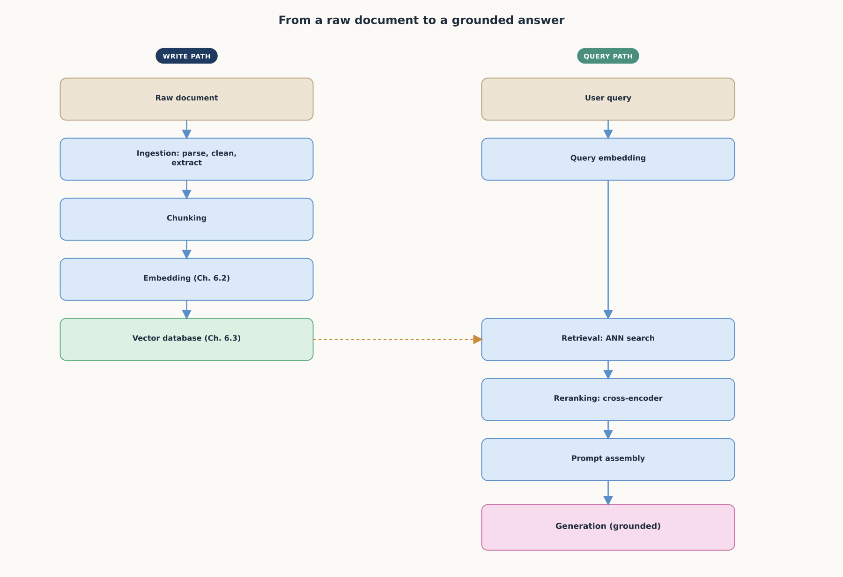
REFERENCE ARCHITECTURE
From a raw document to a grounded answer
This chapter completes the mechanical pipeline. Chapter 6.5 covers advanced patterns built on top of it: hybrid search variations, HyDE, GraphRAG, and agentic RAG.

Slide 20
CHECK YOUR UNDERSTANDING
Discuss before moving on
1. What does ingestion do to a raw document before it can be chunked, and why does the quality of this stage limit everything downstream?
2. Compare fixed-size/recursive chunking with semantic chunking. What does each optimize for, and what does each give up?
3. What problem does parent-document (small-to-big) retrieval solve, and how does it solve it?
4. Why does reranking use a cross-encoder instead of the same bi-encoder used for retrieval, and why isn't a cross-encoder used for the initial retrieval step directly?
5. What does "lost in the middle" mean, and how should it change how reranked results get placed in a generation prompt?

