Slide 1
CHAPTER 8.1 · PHASE 8: AI AGENTS — FOUNDATIONS
What Is an "Agent"?
From Classical AI Agents to LLM Agents

Slide 2
TL;DR
One loop, two different deciders
• An agent perceives, decides, and acts to pursue a goal, whether or not an LLM is involved.
• Classical AI already fully specified this loop: PEAS (Performance measure, Environment, Actuators, Sensors) and Russell & Norvig's rationality standard.
• Wooldridge & Jennings (1995) added a second lens: autonomy, social ability, reactivity, pro-activeness, years before LLM agents existed.
• What an LLM changes is not the loop. It's what sits inside the decide step: natural-language reasoning instead of hand-coded rules or a symbolic planner.

Slide 3
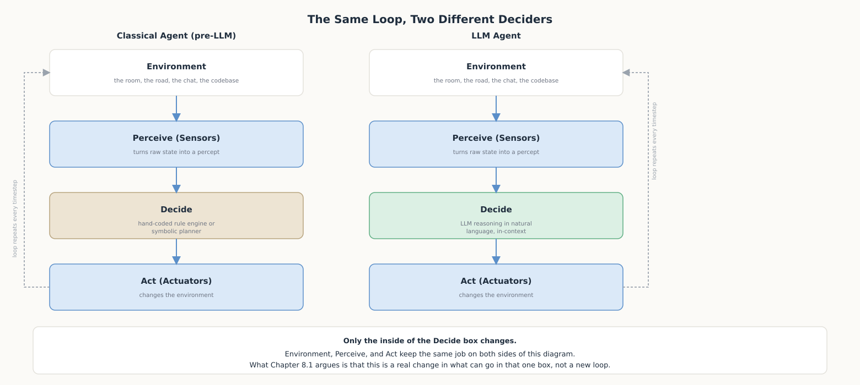
HIGH-LEVEL EXPLANATION
The same loop, two different deciders

Slide 4
DEEP-DIVE · 1 OF 5
The Classical Definition: PEAS and Rationality
• PEAS: Performance measure, Environment, Actuators, Sensors, a four-part spec for any task environment.
• Taxi driver example: perf. = safe/fast/legal/comfortable/profitable; environment = roads & traffic; actuators = wheel/pedals/signal; sensors = cameras/GPS/speedometer.
• Rationality: "an ideal rational agent should do whatever action is expected to maximize its performance measure, on the basis of the evidence provided by the percept sequence and whatever built-in knowledge the agent has."
• Three details that matter: rationality is relative to the chosen performance measure, judged over the whole percept sequence, and only requires the best expected bet, not a guaranteed-correct outcome.

Slide 5
DEEP-DIVE · 2 OF 5
The Classical Agent-Architecture Taxonomy
• Simple reflex: condition-action rules on the current percept only; narrow range of applicability.
• Model-based reflex: adds internal state to track what can't currently be seen.
• Goal-based: plans against explicit goal information describing desirable situations.
• Utility-based: ranks states by a utility function instead of a binary goal, enabling trade-offs.
• Learning: performance element + critic + learning element + problem generator, improving any of the above from experience.

Slide 6
DEEP-DIVE · 3 OF 5
Multi-Agent Systems Before LLMs
• Wooldridge & Jennings (1995), "weak notion of agency": a system defined by four properties.
• Autonomy: operates without direct human intervention; controls its own actions and state.
• Social ability: interacts with other agents via an agent-communication language.
• Reactivity: perceives its environment and responds in a timely fashion.
• Pro-activeness: takes the initiative toward a goal instead of only reacting.
• Why it matters now: today's LLM multi-agent frameworks are these same four properties, applied to language-model-based agents (deep dive in Phase 11).

Slide 7
DEEP-DIVE · 4 OF 5
What an LLM Actually Adds
• The old bottleneck: a classical decide step needed hand-written rules, a symbolic planner, or a hand-tuned utility function.
• Wang et al. (2023): "large language models (LLMs) have shown potential in human-level intelligence, leading to a surge in research on LLM-based autonomous agents."
• The real change: natural language becomes a universal interface for perception, reasoning, and action, replacing hand-coded logic with an in-context reasoning engine.
• Still bounded: by what the model was trained on and by the scaffolding built around it, just a much larger boundary than explicitly-coded logic.

Slide 8
DEEP-DIVE · 5 OF 5
What Doesn't Change
• Still a perceive-decide-act loop. An LLM agent has to answer the same PEAS questions any other agent does.
• Still judged by the same rationality standard: act to maximize the performance measure, given the percept sequence and available knowledge.
• Still needs an explicit environment and action space: which actuators ("tools" from Chapter 8.2 on) an LLM agent may invoke is a real design decision, not automatic.
• What's genuinely new is covered next: perception/reasoning/memory/action/tools (8.2), the decide-act cycle in practice (8.3), and agent vs. workflow vs. assistant vs. chatbot (8.8).

Slide 9
COMPARISON & RELATED CONCEPTS
Classical agent vs. LLM agent vs. a single LLM call
Aspect | Classical agent | LLM agent (with loop) | Single LLM call
Decide step | Hand-coded rules / planner / utility fn | LLM reasoning, across multiple steps | LLM reasoning, exactly once
Percept sequence? | Yes | Yes, loop re-perceives after acting | No, one prompt in, one response out
An agent under PEAS? | Yes | Yes | No: no loop, no actuators acting back
Handles the unanticipated? | Only as well as the rules/utility fn generalize | Often, via language reasoning | Only within that one response

Slide 10
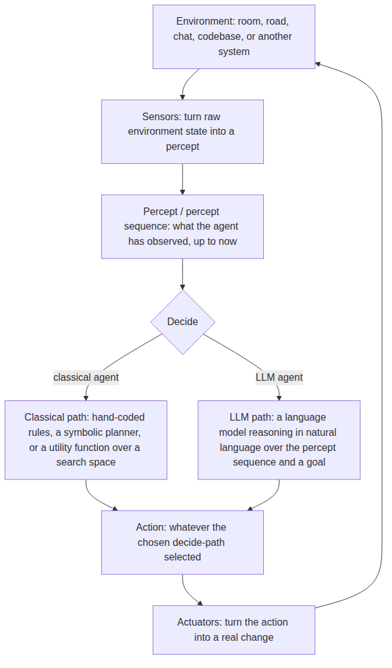
REFERENCE ARCHITECTURE
Where a classical vs. an LLM decide step sits
Sensors: convert raw state into a percept, identically on both paths.
Percept sequence: what rationality is judged against.
Decide, classical path: hand-coded rules, planner, or utility function.
Decide, LLM path: an LLM reasoning over the percept sequence and a goal.
Actuators: turn the chosen action into a real change, identically on both paths.

Slide 11
HANDS-ON
The same reflex agent, two different deciders
• Build one environment + harness: a room with a temperature; perceive / decide / act, exactly the PEAS-shaped contract.
• Classical decide: a two-branch condition-action rule table (heat / cool / idle).
• LLM decide: flan-t5-small reads a one-sentence description of the percept and replies in one word, parsed back onto the same 3-action space.
• Run both through the identical harness: only the decide_fn argument changes between the two runs.
• The takeaway: an LLM decide step trades a rule table's predictability for the ability to reason in language, a real design trade-off, not a strictly free upgrade.

