Slide 1
CHAPTER 8.2 · PHASE 8: AI AGENTS — FOUNDATIONS
Anatomy of an LLM Agent
Perception, Reasoning, Memory, Action, Tools

Slide 2
TL;DR / INTUITION
One decide box, five separable parts
• The 8.1 decide box is not monolithic. It's five parts: perception, reasoning, memory, action, tools.
• Perception and action are not new. They're 8.1's sensors and actuators, wearing new names.
• Reasoning, memory, and tools are where an LLM changes things. This is where an LLM agent's internals stop resembling a classical agent's.
• This chapter maps all five. Depth on each is deferred: memory (8.5), tools (8.4), reasoning strategies (8.7), the loop (8.3).

Slide 3
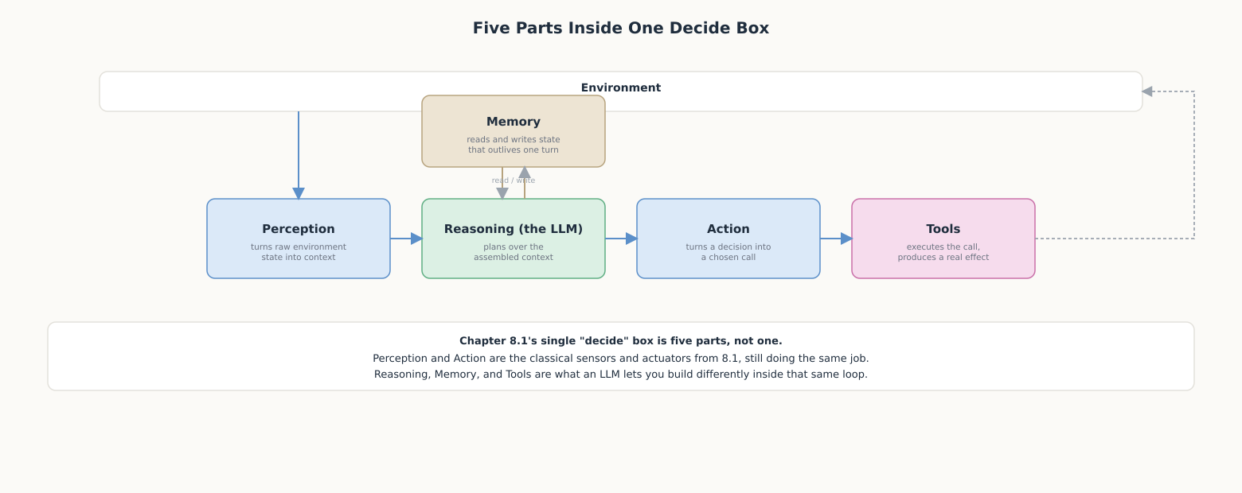
HIGH-LEVEL EXPLANATION
Five parts inside one decide box

Slide 4
DEEP-DIVE · 1 OF 5
Perception: What Goes Into the Context
• The only channel: whatever text (or image, for multimodal models) is in the context window right now.
• A selection problem: the window is finite, so deciding what to leave out matters as much as what to include.
• Usually a pipeline: system prompt + retrieved docs + conversation history + prior tool results, assembled before reasoning ever runs.
• Position matters: where something sits in a long context is not free of consequence for how much weight it gets.

Slide 5
DEEP-DIVE · 2 OF 5
Reasoning: The LLM as Decide's Engine
• Replaces hand-coded logic: the LLM reasons in natural language instead of executing a rule table or planner.
• Wei et al.: "a series of intermediate reasoning steps" can significantly improve complex reasoning, one technique among several.
• Output shape varies: a final answer, or just a stated intent that action still has to translate into something executable.
• Not always one pass: multiple LLM calls chained together, with perception/action/tools interleaved, is Chapter 8.3's agent loop.

Slide 6
DEEP-DIVE · 3 OF 5
Memory: Short-Term vs. Long-Term
• Short-term: the context window itself, fast but bounded in size and lifetime.
• Long-term: external storage, unbounded but needs a retrieval step to reach reasoning at all.
• MemGPT (Packer et al.): borrows OS virtual-memory paging, treating the context window like scarce main memory.
• Generative Agents (Park et al.): "the memory stream maintains a comprehensive record," retrieved and synthesized into reflections.
• Naive full-history memory degrades: it eventually exceeds the window, and buries what matters well before that.

Slide 7
DEEP-DIVE · 4 OF 5
Action: From a Decision to an Effect
• The gap: reasoning's raw output is just more text, not a valid function call or database write.
• Action translates: a stated intent into a specific, structured, executable call.
• Same actuator-scoping risk as 8.1: action is where a designer decides which stated intentions are actually permitted to become real effects.
• A natural checkpoint: validation, confirmation, or a human-in-the-loop gate (Chapter 10.6) belongs here, the last reversible moment.

Slide 8
DEEP-DIVE · 5 OF 5
Tools: Actuators an LLM Doesn't Have By Default
• By itself, an LLM only generates text. Tools are callable functions action can invoke to get a real effect.
• Toolformer (Schick et al.): "decide which APIs to call, when to call them, what arguments to pass," combining reasoning with precision.
• Needs three things: a name, a description reasoning uses to decide when to reach for it, and an argument schema.
• A loop within the loop: a tool's return value usually becomes next turn's perception, not just an effect and nothing else.

Slide 9
COMPARISON & RELATED CONCEPTS
Classical implementation vs. LLM-based implementation
Aspect | Classical (8.1) | LLM-based | What's genuinely different
Perception | Hand-coded sensors, fixed fields | Context assembly: text (+ images) | One unified channel, no new sensor code
Reasoning | Rule engine / planner / utility fn | The LLM, optionally multi-step | Generalizes, but no formal guarantees
Memory | Explicit tracked internal state | Context window + external store | Far larger, but needs retrieval to reach reasoning
Action | Executes the planner's choice directly | Translates natural language into a call | Needs a validation layer reasoning's output lacks
Tools | Actuators wired into fixed code | Callable functions, selected at runtime | Extensible by adding a definition, not rewriting logic

Slide 10
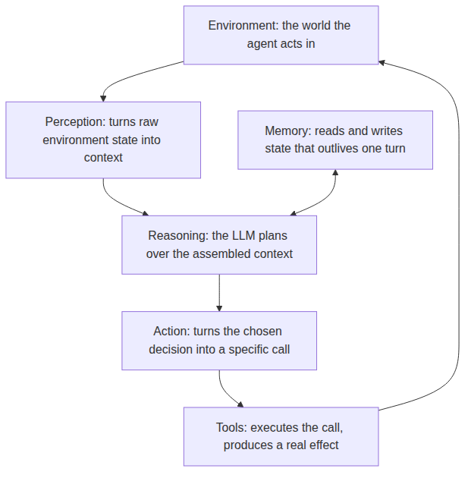
REFERENCE ARCHITECTURE
The five components, wired into one turn
Perception: selects and formats environment state into context.
Memory: read/write side channel to reasoning, not a pass-through stage.
Reasoning: the LLM, working over context plus retrieved memory.
Action: translates reasoning's decision into a validated, executable call.
Tools: what action actually invokes to produce a real effect.

Slide 11
HANDS-ON
A minimal agent with all five parts visible
• Memory + tools: a plain list (notes), plus save_note and recall_notes as the only ways to touch it.
• Perception: wraps the raw user text into a percept dict.
• Reasoning: flan-t5-small classifies the request as SAVE or RECALL, same pattern as 8.1's thermostat.
• Action: turns that one-word decision into the actual save_note/recall_notes call, stripping a leading phrase like "remember that" first.
• Verified: the deterministic parts (memory, tools, perceive, act) were run end-to-end; two saves followed by two recalls return exactly the right notes, and an unmatched query correctly returns nothing rather than dumping everything.

