Slide 1
CHAPTER 8.3 · PHASE 8: AI AGENTS — FOUNDATIONS
The Agent Loop
Plan, Act, Observe, Reflect (ReAct and Beyond)

Slide 2
TL;DR / INTUITION
One task, run through the loop more than once
• A single reasoning pass commits before anything has happened. Step two's right move usually depends on step one's actual result.
• The loop: plan, act, observe, repeat. Reasoning runs again after every observation, not once per task.
• Reflect is a separate, outer layer. It judges a whole finished attempt and only engages after one falls short.
• Two results ground this in evidence. ReAct: interleaving beats separating. Reflexion: revising beats retrying blindly.
• The loop never stops on its own. Termination has to be built in deliberately, or it isn't there at all.

Slide 3
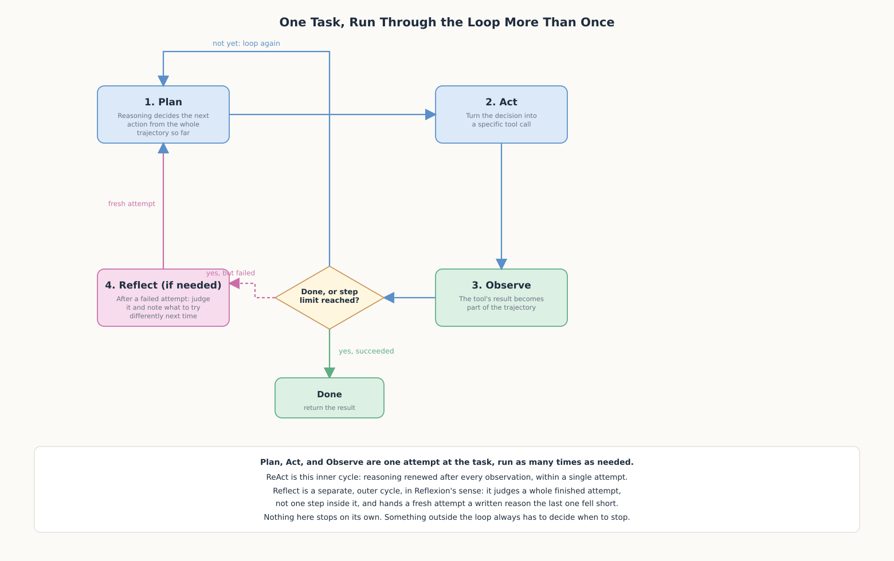
HIGH-LEVEL EXPLANATION
Plan, act, observe, and reflect when it fails

Slide 4
DEEP-DIVE · 1 OF 5
Why a Single Pass Doesn't Scale
• The core limit: a single pass commits to a full course of action before anything it decides has happened.
• Plan-and-Solve (Wang et al.): "devising a plan to divide the entire task into smaller subtasks, and then carrying out the subtasks according to the plan."
• Its inherited limit: the plan is fixed before any subtask runs, so a surprising result can't revise it.
• The loop's answer: commit only to the next action, execute it, then decide what comes after.

Slide 5
DEEP-DIVE · 2 OF 5
ReAct: Interleaving Reasoning and Acting
• Yao et al.: "generate both reasoning traces and task-specific actions in an interleaved manner... greater synergy between the two."
• On HotpotQA/FEVER: overcomes "issues of hallucination and error propagation prevalent in chain-of-thought reasoning."
• On ALFWorld/WebShop: outperforms imitation and RL methods by 34% and 10% absolute success rate, with only 1-2 in-context examples.
• A concrete action space: "finish[answer], which would finish the current task with answer"; termination is just another action.

Slide 6
DEEP-DIVE · 3 OF 5
Observation: How the Environment Talks Back
• The mechanism, made formal: a tool's return value becomes the next Plan step's context (Chapter 8.2's own point, now central).
• An observation isn't guaranteed to confirm the plan. A failed search is exactly as much an observation as a successful one.
• What accumulates is the whole trajectory. Every thought/action/observation triple so far, not just the latest one.
• The cost: an unbounded trajectory eventually exceeds the context window, and buries what matters well before that.

Slide 7
DEEP-DIVE · 4 OF 5
Reflection: Learning From a Failed Attempt
• Shinn et al. (Reflexion): "verbally reflect on task feedback signals... maintain their own reflective text... to induce better decision-making in subsequent trials."
• Three components: an Actor (the loop itself), an Evaluator that scores attempts, a Self-Reflection model that writes the lesson.
• A different loop, nested outside the first: ReAct revises within one attempt; Reflexion revises across whole attempts.
• The result: 91% pass@1 on HumanEval, surpassing GPT-4's 80% baseline: same model, improved by hindsight, not new weights.

Slide 8
DEEP-DIVE · 5 OF 5
Termination: Knowing When to Stop
• 1. The model's own finish decision: cheapest, but only as reliable as the model's own judgment of "done."
• 2. A hard step limit: ReAct: "We set 7 and 5 steps for HotpotQA and FEVER... more steps will not improve ReAct performance."
• With a defined fallback: "when ReAct fails to return an answer within given steps, back off to CoT-SC"; not just stopping, but stopping usefully.
• 3. An external evaluator: most expensive, but the only one that can catch a confidently wrong finish.
• A real system layers more than one. A step limit as backstop, finish as the common case, an evaluator where being wrong is costly.

Slide 9
COMPARISON & RELATED CONCEPTS
How much is decided upfront vs. revised as you go
Aspect | Plan-and-Solve | ReAct-style loop | Reflexion
When the next action is decided | All subtasks planned once, upfront | Freshly, after every observation | Only between whole attempts
Uses a mid-task result? | No: the plan is fixed | Yes: that's the entire mechanism | Only at the start of the next attempt
What stops it | Finishing the last planned subtask | Model's finish decision, a step limit, or both | An evaluator's pass, or a trial limit
Right amount of machinery for | Tasks decomposable from the question alone | Tasks needing a real result before deciding | Tasks worth retrying with hindsight

Slide 10
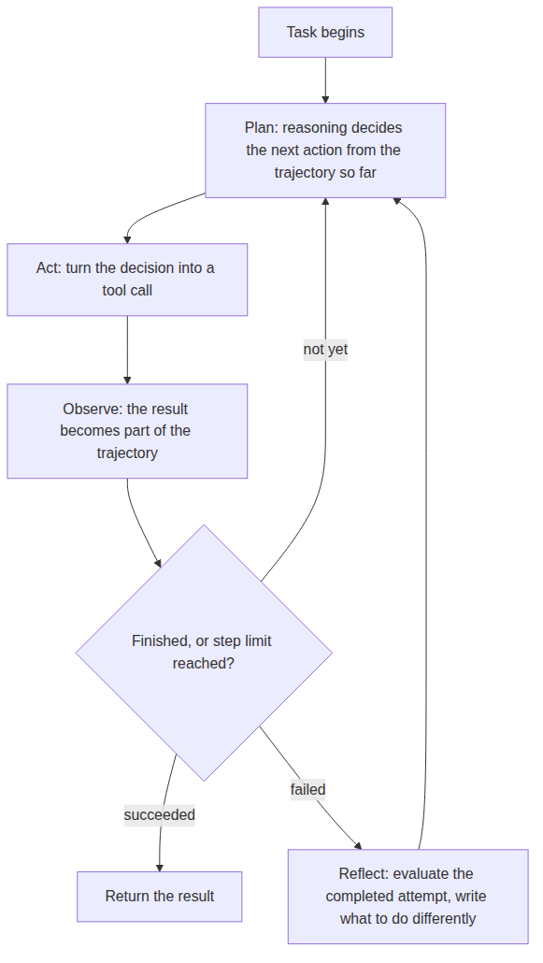
REFERENCE ARCHITECTURE
The inner loop (ReAct) and the outer loop (Reflexion)
Plan: reasoning over the full trajectory, deciding one next action.
Act: translates the decision into a specific, executable tool call.
Observe: folds the actual result back into the trajectory.
Check: the termination logic: done, failed, or keep going.
Reflect: outer-loop only: engages after a whole attempt is judged to have failed.

Slide 11
HANDS-ON
A small loop that plans, acts, observes, reflects, stops
• Task: a two-hop question: find the country a landmark is in, then that country's capital.
• Deterministic Plan step: rule-based, not an LLM, so every decision in the trace can be verified by hand.
• Run 1 (3 steps): clean two-hop success: search landmark, search country, finish.
• Run 2 (4 steps): first search misses, Reflect simplifies the query, then succeeds, right at the step budget's edge.
• Run 3 (4 steps, fallback): genuinely unanswerable question exhausts the step limit and returns an honest "not found", never a fabricated answer.
• All three traces were executed and checked line by line against the code.

