Slide 1
CHAPTER 8.4 · PHASE 8: AI AGENTS — FOUNDATIONS
Tool Use & Function Calling
A Deep Dive

Slide 2
TL;DR / INTUITION
From a decision to a checked, executed call
• A schema is not documentation. It's what a validation step checks a proposed call against before anything executes.
• Native function calling replaces parsed prose. A model emits a structured, typed call directly instead of text a parser has to guess at.
• A rejected call and a failed call are different. One never touched the real function; the other might have a partial, real effect.
• Calling multiple tools in one turn is a new problem. Not a bigger version of calling one tool right: it raises an independence question.
• Every mechanism here fails in its own distinct way. Bad descriptions, overlapping tools, and calls that reach execution unvalidated.

Slide 3
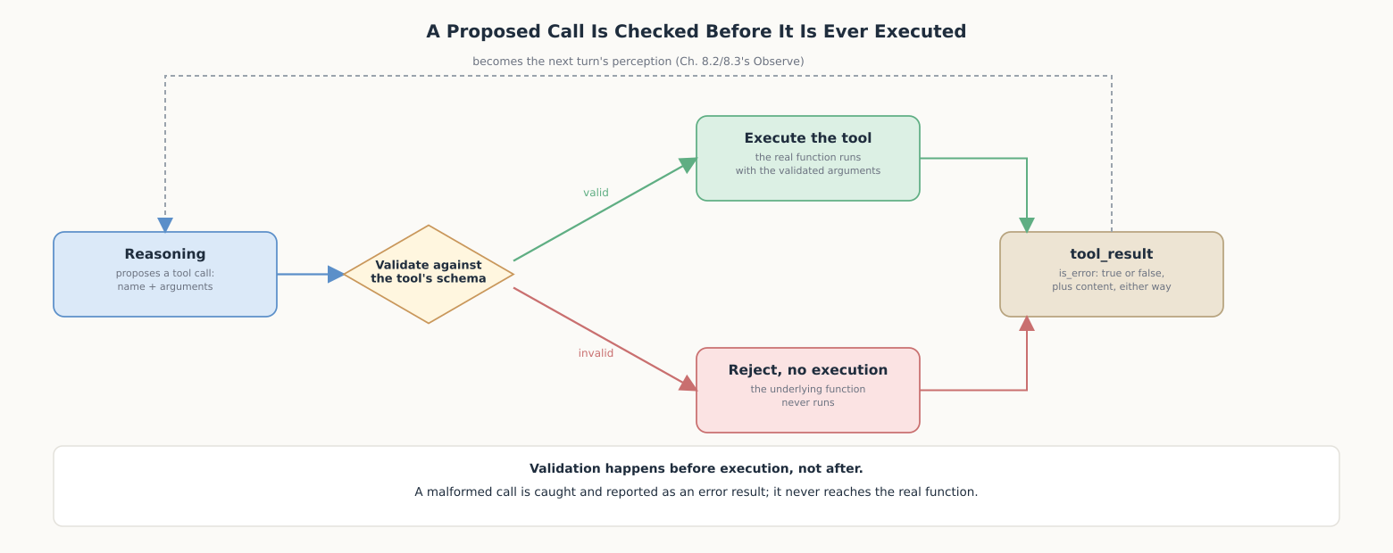
HIGH-LEVEL EXPLANATION
Validated before executed, either way a result comes back

Slide 4
DEEP-DIVE · 1 OF 5
What a Tool Definition Actually Requires
• Anthropic's three fields: name, description ("what it does, when it should be used, and how it behaves"), and input_schema.
• input_schema is a JSON Schema object: a machine-checkable contract, not decoration: type, required fields, allowed values.
• OpenAI: "the model intelligently choose[s] to output a JSON object containing arguments"; models fine-tuned to match the schema.
• Two separate decisions: whether to call a tool (the description's job) vs. how to fill it in (the schema's job).

Slide 5
DEEP-DIVE · 2 OF 5
Structured Output Instead of Parsed Prose
• Before native function calling: ReAct's search[query] convention: a hand-written parser has to recover the call from text.
• A nested bracket breaks a naive parser silently. search[find x[1] in the array] truncates at the wrong ] with no error raised.
• Anthropic: "Claude responds with stop_reason: \"tool_use\" and one or more tool_use blocks."
• The difference isn't cosmetic: a caller reads a field directly instead of inferring intent from matched text.

Slide 6
DEEP-DIVE · 3 OF 5
Execution and the Result Round-Trip
• is_error, per Anthropic's docs: "Set to true if the tool execution resulted in an error."
• Rejected vs. failed are not the same risk. A rejected call never touched the function; retrying it is always safe.
• A failed-after-executing call may have a partial effect. A payment or a write might have partly happened; blind retry can duplicate it.
• The message has to say which happened. is_error alone can't distinguish validation failure from partial execution failure.

Slide 7
DEEP-DIVE · 4 OF 5
Parallel Tool Calls
• Anthropic: "By default, Claude may call multiple tools in a single response."
• Independent calls: weather in Paris and Tokyo: nothing depends on the other's result, safe to run together.
• Dependent calls: look up an account, then check its orders: the second call needs the first call's result first.
• The quiet failure mode: a guessed argument can still pass schema validation while pointing at the wrong thing entirely.

Slide 8
DEEP-DIVE · 5 OF 5
Designing Tools Well
• Failure mode 1: an ambiguous description: reasoning guesses silently rather than raising an error.
• Failure mode 2: too many overlapping tools: the fix is design discipline, not a smarter model.
• Failure mode 3: a malformed call reaches execution unvalidated and produces a wrong answer that looks right.
• Compounding effects: a wrong tool choice costs loop steps; an irreversible tool is a candidate to exclude from parallel calls.

Slide 9
COMPARISON & RELATED CONCEPTS
A text convention vs. a native function-calling API
Aspect | ReAct-style text (8.3) | Native function calling | What's genuinely different
How a call is produced | Free text matching a prompted format | A structured tool_use block, output directly | Reading a field replaces parsing a string
Catching a malformed call | Whatever the hand-written parser checks for | Schema validation, checked before execution | A precise contract replaces ad hoc parser logic
Knowing generation stopped for a call | Inferred from matching the expected pattern | A dedicated stop_reason: "tool_use" field | Intent is read off a field, not inferred
Reporting failure | Whatever shape the calling code chooses | A tool_result with an explicit is_error flag | Failure is legible without inferring tone or shape

Slide 10
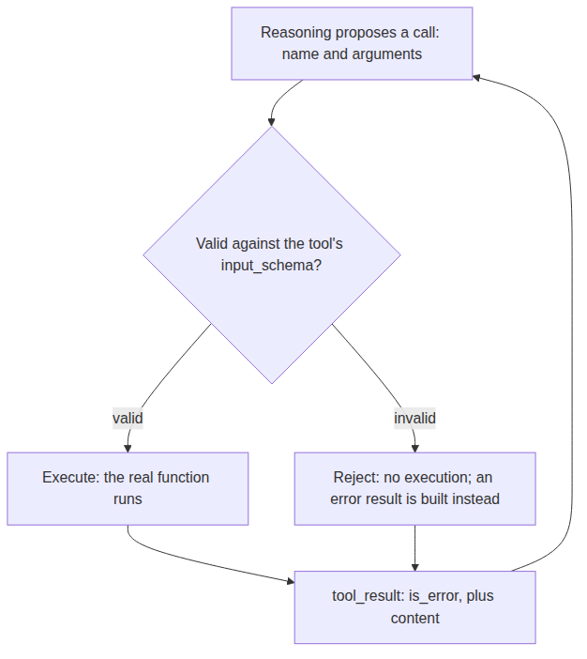
REFERENCE ARCHITECTURE
A proposed call, validated, then executed or rejected
Reasoning: proposes a call: a name and its arguments.
Validate: checks the call against input_schema before anything runs.
Execute: the real function, only ever reached after validation passes.
Reject: builds an error result directly; the function never runs.
tool_result: carries is_error plus content back to Reasoning either way.

Slide 11
HANDS-ON
A call that's rejected, corrected, and then succeeds
• Tool: convert_temperature, with a real input_schema (value, from_unit, to_unit, all required).
• validate_call: checks required fields, types, and enum values before the real function is ever touched.
• Run 1 (1 step): a well-formed call passes validation immediately and executes: 212.0.
• Run 2 (2 steps): a call missing to_unit is rejected pre-execution; Plan reads the error, corrects exactly that field, and the retry succeeds: 0.0.
• The detail that matters: convert_temperature is never called with incomplete arguments; the failure is caught, reported, and fixed before execution, not after.

