Slide 1
CHAPTER 8.5 · PHASE 8: AI AGENTS — FOUNDATIONS
Memory Systems for Agents
A Comparative Deep Dive

Slide 2
TL;DR / INTUITION
Two policies: what gets written out, what gets pulled back in
• Every memory system answers two questions. What's worth writing outside the context window, and what's worth retrieving right now.
• MemGPT: the model decides, via function calls. Virtual context management, borrowed directly from OS-style paging.
• Generative Agents: a fixed pipeline decides. Every event is logged; a scored retrieval function does all the real work.
• Neither is memory in a deeper sense. Both are concrete, inspectable write/retrieve policies with their own failure modes.
• The differences are exactly where memory succeeds or fails. In practice, not in theory.

Slide 3
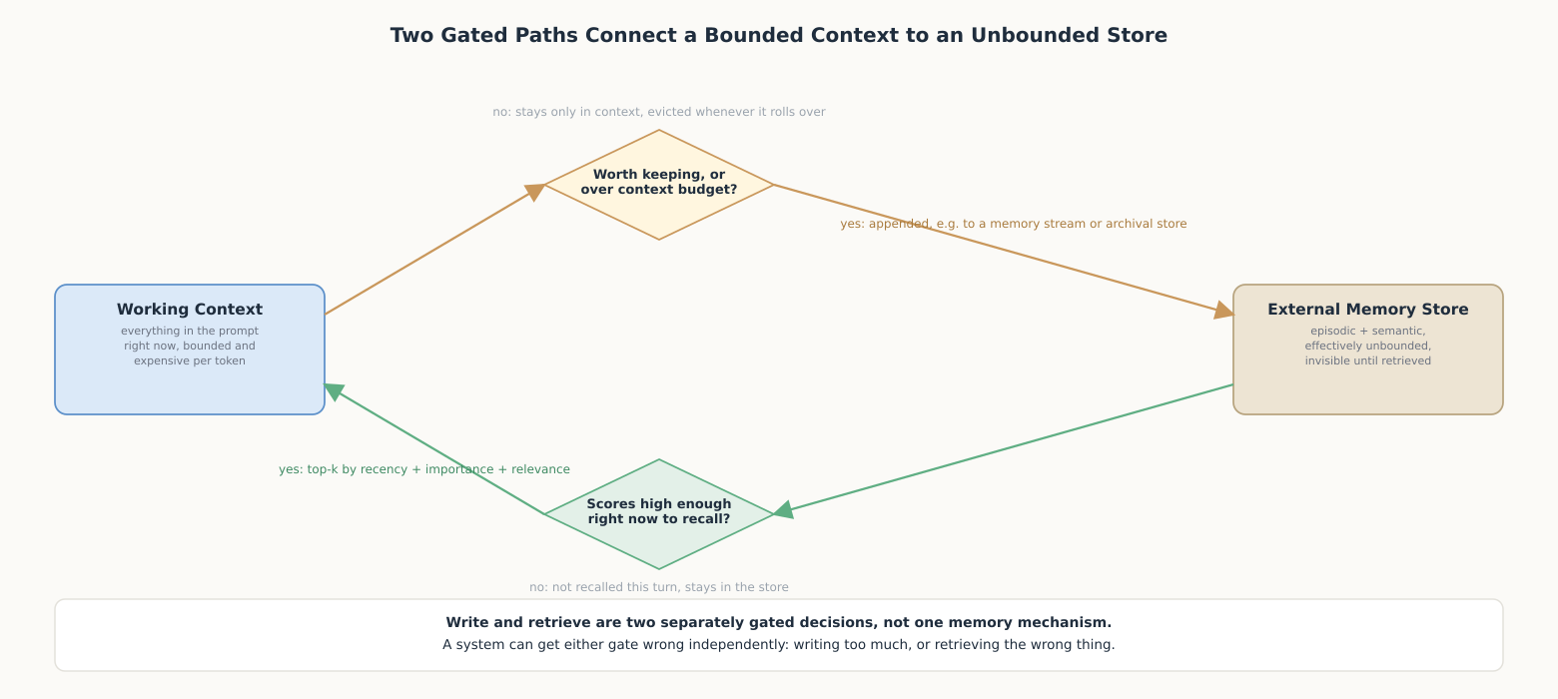
HIGH-LEVEL EXPLANATION
Two gated paths, not one memory mechanism

Slide 4
DEEP-DIVE · 1 OF 5
Why the Context Window Forces a Memory Problem
• MemGPT's framing: "limited context windows, hindering their utility in tasks like extended conversations and document analysis."
• Attention cost is quadratic. Widening the window makes every turn more expensive, not just the turns that need more history.
• Resending full history compounds. A 50-turn conversation resent in full each turn processes roughly 50x its own token count in aggregate.
• Prompt caching helps cost, not the ceiling. A cached prefix is still counted against the hard context limit.
• This is why Ch. 8.3's termination limits exist. A loop needs either a stopping reason or a memory system deciding what to stop carrying.

Slide 5
DEEP-DIVE · 2 OF 5
MemGPT: Virtual Context Management
• The OS analogy, in the paper's words: "hierarchical memory systems in traditional operating systems... data movement between fast and slow memory."
• Main context vs. external context: working context (editable, in-prompt) vs. recall storage and archival storage (outside it).
• The model moves its own memory: "MemGPT orchestrates data movement... via function calls that are generated by the LLM processor."
• Eviction is a capacity trigger, not judgment: at 100% of the flush token count, the queue manager evicts roughly half the context.
• Interrupts decouple paging from the user's wait. Evaluated on document analysis and multi-session chat, the two failure modes it targets.

Slide 6
DEEP-DIVE · 3 OF 5
Generative Agents: Stream, Retrieval, Reflection
• The memory stream: a list of memory objects, each with a description and access timestamps; nothing filtered at write time.
• Retrieval score, weighted sum: recency (0.995 decay per hour) + importance (LLM-rated 1-10 poignancy) + relevance (similarity).
• Reflection triggers on cumulative importance: threshold of 150; prompts for "3 most salient high-level questions" over the last 100 records.
• The ablation's own finding: observation, planning, and reflection each contribute critically to believability.
• Reflection is the only synthesis step. Storage and retrieval only ever surface what already existed verbatim.

Slide 7
DEEP-DIVE · 4 OF 5
A Taxonomy: Working, Episodic, Semantic, Procedural
• Working memory: the context window itself; Ch. 8.2's short-term memory under a formal name.
• Semantic memory: durable facts about the world; a RAG vector store is a semantic memory in this sense.
• Episodic memory: specific past events at specific times; a Generative Agents-style memory stream is episodic by construction.
• Procedural memory: the rules that determine behavior; the model's weights, system prompt, and code, not either store discussed here.
• Placement has a cost: a durable preference stored as an episodic event loses priority to recency it doesn't deserve.

Slide 8
DEEP-DIVE · 5 OF 5
What Goes Wrong
• Staleness: nothing forces a stored fact to expire or self-correct when it stops being true.
• Interference: a weighted-sum score can rank a recent, unimportant memory above an old, highly relevant one.
• Unbounded growth: every retrieval over an ever-growing store costs more compute and storage over time.
• Partial mitigations exist: timestamping, widening the retrieval query, and mandatory (not optional) maintenance.
• None of these are solved, only managed. Choosing a memory system means choosing which failure mode you can tolerate.

Slide 9
COMPARISON & RELATED CONCEPTS
Model-issued judgment vs. a fixed, always-on pipeline
Aspect | MemGPT | Generative Agents
What triggers a write | A function call the model itself decides to issue | Every perceived event, unconditionally, at write time
What triggers a retrieval | A function call the model itself decides to issue | Every turn, scored automatically
Eviction from short-term memory | A fixed capacity trigger, no relevance judgment | Not applicable the same way; the stream is the long-term store
Compressing repetition | Not a first-class mechanism | A dedicated reflection step, triggered on cumulative importance

Slide 10
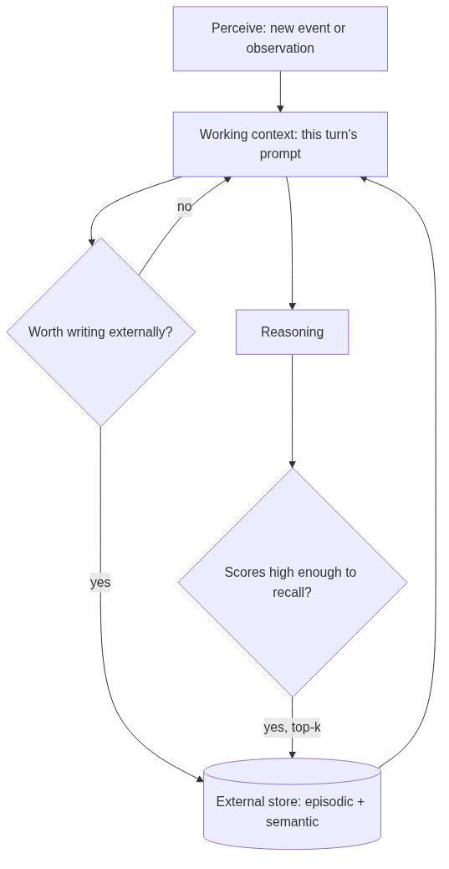
REFERENCE ARCHITECTURE
A write path and a retrieve path sharing one external store
Perceive: a new event enters working context before anything is decided about it.
Write gate: decides whether an item is worth appending to the external store.
External store: holds episodic and semantic content, invisible until retrieved.
Retrieve gate: scores stored items against the current situation, admits the top-k.
Working context: the only thing reasoning ever directly sees.

Slide 11
HANDS-ON
A small, testable memory stream
• MemoryStream: recency (exponential decay) + importance + keyword-overlap relevance, normalized and weighted.
• Reflection trigger: cumulative importance crossing a threshold generates a deterministic theme summary.
• Simulated day: 7 events across 6 hours, mixing routine (teeth, bed) with a promotion/party thread.
• Result: exactly 2 reflections fire; a query for "promotion party" retrieves the 3 on-topic memories, none of the routine ones.
• The point of reflection: not remembering more, but remembering the same amount in a form that's cheaper to use later.

