Slide 1
CHAPTER 8.6 · PHASE 8: AI AGENTS — FOUNDATIONS
Context Engineering
for Agents

Slide 2
TL;DR / INTUITION
Curating a finite budget, not filling a free list
• Prompt engineering vs. context engineering: "the set of strategies for curating and maintaining the optimal set of tokens... during LLM inference."
• A window that could hold everything isn't one that should. Every token in it competes for the same fixed, finite budget.
• Four places the curation decision gets made: system prompt altitude, tool set size, retrieval timing, and history management.
• This chapter is the synthesis chapter. It reframes Ch. 8.2's window, 8.4's tools, and 8.5's memory gates as one budget problem.

Slide 3
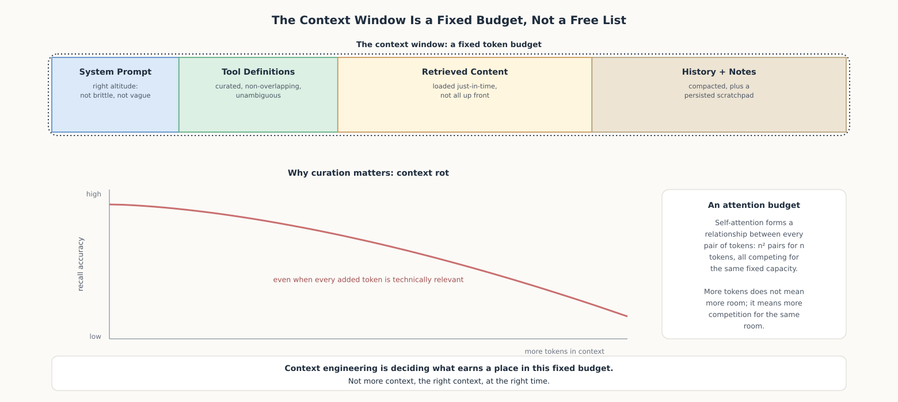
HIGH-LEVEL EXPLANATION
A fixed budget, and why filling it carelessly has a cost

Slide 4
DEEP-DIVE · 1 OF 5
Context as a Finite, Attention-Limited Resource
• Self-attention: "n² pairwise relationships for n tokens" - longer context means more competition, not just more cost.
• Context rot: "as the number of tokens... increases, the model's ability to accurately recall information... decreases."
• Needle-in-a-haystack benchmarks: isolate this cleanly - inert filler still degrades recall of an unrelated target fact.
• The counter-intuitive implication: Ch. 8.5's retrieval gate returning a generous top-k isn't a free hedge; extra memories are extra competition.

Slide 5
DEEP-DIVE · 2 OF 5
System Prompts at the Right Altitude
• Failure mode 1, too brittle: "hardcoding complex, brittle logic... creates fragility and increases maintenance complexity."
• Failure mode 2, too vague: "vague, high-level guidance that fails to give... concrete signals... or falsely assumes shared context."
• The Goldilocks zone: "specific enough to guide behavior effectively, yet flexible enough" to generalize.
• The tell: a brittle prompt reads as an ever-growing patch list; a vague one leaves basics like tone or approval limits unstated.

Slide 6
DEEP-DIVE · 3 OF 5
Tool Design as Context Engineering
• Same Ch. 8.4 failure modes, new angle: every tool definition sits in context on every turn, whether or not it's called.
• Anthropic's diagnostic: "if a human engineer can't definitively say which tool should be used... an AI agent can't be expected to do better."
• Of the 3 tool failure modes, this hits one hardest: overlapping tool sets - specifically a volume problem, not a quality problem.
• Mitigation: load only a task-relevant subset of tools dynamically, rather than all of them in every context window.

Slide 7
DEEP-DIVE · 4 OF 5
Just-in-Time Retrieval vs. Upfront Loading
• The default: "maintain lightweight identifiers (file paths, stored queries, web links...) and... dynamically load data... at runtime."
• Worked contrast: load the whole codebase upfront vs. load one file and follow references only if reasoning actually needs them.
• Neither wins unconditionally: "a hybrid strategy, retrieving some data up front for speed, and pursuing further... exploration at its discretion."
• Generalizes Ch. 8.5: MemGPT's model-issued memory calls were already this same just-in-time decision, applied to any resource.

Slide 8
DEEP-DIVE · 5 OF 5
Managing Long-Horizon Tasks
• Compaction: "summarizing... and reinitiating a new context window with the summary." Risk: loss compounds across repeated passes.
• Structured note-taking: "the agent regularly writes notes persisted to memory outside of the context window," pulled back later.
• Sub-agent isolation: "specialized sub-agents... handle focused tasks with clean context windows"; only a summary crosses back.
• Not competing solutions: three different places to spend the same cost - lost detail, agent judgment, or coordination overhead.

Slide 9
COMPARISON & RELATED CONCEPTS
Three long-horizon techniques, three different costs
Aspect | Compaction | Structured notes | Sub-agent isolation
Where detail ends up | Summarized, kept in a reinitialized window | Written outside context, pulled back when needed | Never enters main context; only a summary does
What's at risk of being lost | Whatever summarization judges unimportant | Whatever the agent fails to write down in time | A sub-agent's detail its own summary omits
What it composes with | Whatever's still in context right now | Survives compaction untouched | Can use compaction or notes internally

Slide 10
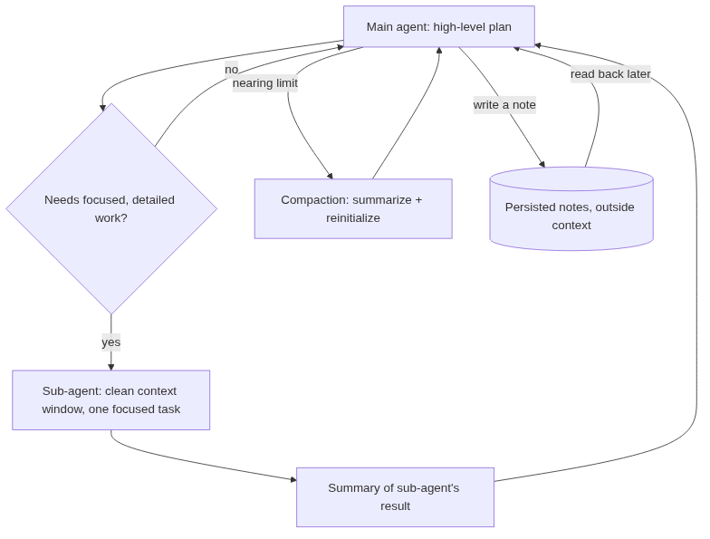
REFERENCE ARCHITECTURE
A main agent's context stays small; sub-agents absorb detail
Main agent: holds the high-level plan; never accumulates a sub-agent's full history.
Sub-agent: gets a clean context window scoped to one focused task.
Summary: the only thing crossing back, deliberately smaller than the sub-agent's own context.
Compaction: fires when the main agent's own context nears its limit.
Persisted notes: Ch. 8.5's write gate for notes; survives compaction untouched.

Slide 11
HANDS-ON
Compaction and structured notes, side by side
• ContextManager: tracks turns + a token budget; compacts (summarizes oldest turns) once the budget is exceeded.
• A separate scratchpad: write_note() persists a fact outside the turns list entirely; _compact() never touches it.
• 6-turn debugging task: one compaction fires, collapsing 4 turns into 1 summary; 2 recent turns kept verbatim.
• Result: the ticket number survives in the summary (a judgment call) AND in the scratchpad (a structural guarantee).
• The point: a note survives because it was never inside what got compressed, not because a summarizer chose well.

