Slide 1
CHAPTER 8.7 · PHASE 8: AI AGENTS — FOUNDATIONS
Planning and Reasoning
Strategies for Agents: A Comparative Map

Slide 2
TL;DR / INTUITION
Two axes, not a list of unrelated names
• Axis 1, commitment: one step at a time (reactive) vs. a full plan upfront (deliberative).
• Axis 2, shape: a single chain (linear) vs. branching, vs. branches that can merge (graph).
• Nothing here is re-derived. CoT, ToT (Phase 5) and ReAct, Reflexion, Plan-and-Solve (Ch. 8.3) just get placed on the map.
• Two new names fill it in: plan-and-execute (separates planning from execution) and graph-of-thought (branches merge).

Slide 3
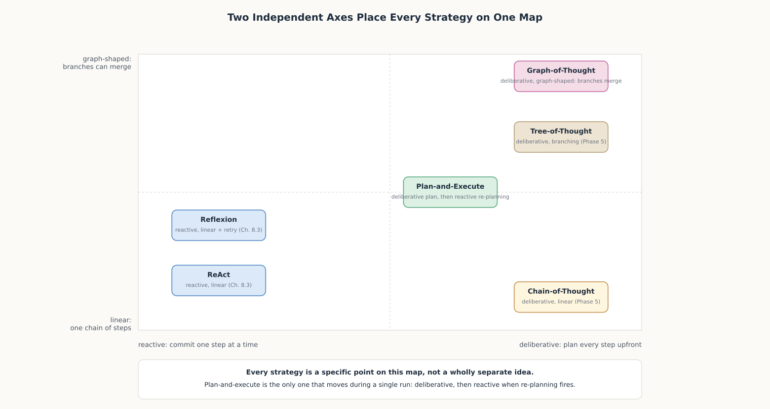
HIGH-LEVEL EXPLANATION
Every strategy is a point on this map

Slide 4
DEEP-DIVE · 1 OF 5
Two Independent Axes
• Commitment axis: reactive pays per-step environment cost; deliberative pays nothing per step but can't notice a bad early assumption.
• Shape axis: linear holds one line of reasoning; branching holds several, at a per-candidate cost.
• The four quadrants: reactive+linear (ReAct), deliberative+linear (CoT), deliberative+branching (ToT/GoT), and the empty one: reactive+branching.
• Why reactive+branching is rare: every extra candidate needs its own real tool calls, not just its own model call.

Slide 5
DEEP-DIVE · 2 OF 5
Plan-and-Execute: Separating Planning From Execution
• Not the same as Plan-and-Solve (Ch. 8.3): a multi-call architecture, not a single prompting technique.
• Two components: "a planner... generate[s] a multi-step plan" and "executor(s)... invoke... tools to complete that task."
• Re-planning: "the agent is called again with a re-planning prompt... to finish... or... generate a follow-up plan."
• Trade-off: "cost savings over ReAct agents" and faster execution, vs. "restricted by serial tool calling."

Slide 6
DEEP-DIVE · 3 OF 5
Graph-of-Thought: When Branches Need to Merge
• The structural change: "model the information generated by an LLM as an arbitrary graph" - not a tree.
• What a tree can't do: recombine two branches; a graph vertex can have more than one incoming edge.
• Result on sorting: "increasing the quality of sorting by 62% over ToT, while... reducing costs by >31%."
• When it's worth it: tasks that decompose into independent sub-results needing later combination, not pure either/or decisions.

Slide 7
DEEP-DIVE · 4 OF 5
Reactive vs. Deliberative: What Each Assumes
• ReAct, Reflexion, plan-and-execute: assume a real environment; their reactive half has nothing to react to without one.
• CoT, ToT, GoT: need zero tool calls; they can run entirely inside one model response.
• Not a hierarchy: a deliberative strategy can run inside a single Plan step, then hand off to ReAct-style execution.
• Ch. 8.6 connection: only the reactive strategies accumulate context long enough to need compaction or notes.

Slide 8
DEEP-DIVE · 5 OF 5
Choosing a Strategy: Cost, Latency, Failure Recovery
• Cost (calls for n steps): CoT = 1; ReAct/Reflexion ≈ n; branching ≈ n × candidates; plan-and-execute ≈ n + replans.
• Latency: branching can parallelize candidates; reactive strategies are inherently sequential.
• Failure recovery, the sharpest divide: CoT has none; Reflexion recovers per whole attempt; plan-and-execute recovers per step.
• No universal default: the right strategy depends on what a wrong answer actually costs in the task at hand.

Slide 9
COMPARISON & RELATED CONCEPTS
Three genuinely different positions, not a ranking
Aspect | ReAct / Reflexion (8.3) | Plan-and-execute | Graph-of-thought
How far ahead it commits | One action at a time | A full plan upfront, revised via re-planning | N/A: no real environment at all
On a contradicted assumption | The next step just sees the new observation | A re-planning call revises the remaining plan | A weak thought is pruned or merged, not "corrected"
Needs a real environment | Yes, by definition | Yes, for executor and re-planner | No - runs entirely on generated text

Slide 10
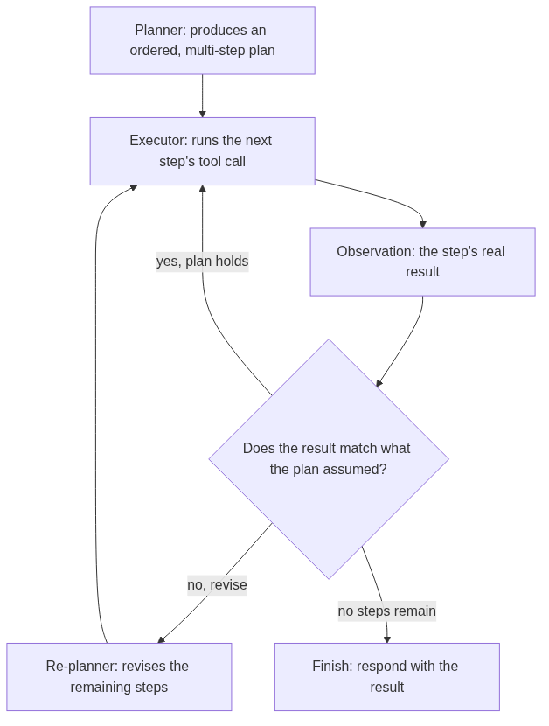
REFERENCE ARCHITECTURE
A plan is produced once, then executed and revised
Planner: produces the full ordered plan upfront, before any tool is called.
Executor: runs one step's tool call at a time (Ch. 8.4's mechanism).
Observation: the step's real result (Ch. 8.3's Observe, for one step).
Check: the hinge: does the plan still hold, need revision, or finish?
Re-planner: revises only the remaining steps, never the ones already run.
Finish: returns the result once no steps remain and the plan holds.

Slide 11
HANDS-ON
A plan that gets revised, not just followed
• The plan: find_flight, find_hotel, check_budget - a standard hotel plus flight comes in over budget.
• The re-planner: fires only when the observation actually violates the plan's assumption, not on a fixed schedule.
• Result: 5 steps run, not 3; 1 re-plan fires; hotel switches to budget; final total lands at $950, under the $1200 limit.
• What Plan-and-Solve couldn't have done: no real tool call, no real observation - the overage is only caught after the whole plan is reasoned through.
• The precise advantage: revises exactly the part of the plan a real result invalidated, and nothing else.

