Slide 1
CHAPTER 8.8 · PHASE 8: AI AGENTS — FOUNDATIONS
Terminology Untangled
Agent vs. Workflow vs. Assistant vs. Copilot vs. Chatbot

Slide 2
TL;DR / INTUITION
Two checkable questions, not one vague axis
• Question 1, architectural: does fixed code decide the sequence of steps, or does the model decide it at runtime? Splits workflow from agent.
• Question 2, autonomy: how many actions run before a human reviews the result? Orders chatbot, assistant, copilot, and agent.
• Why it matters: a product's name is a marketing decision; these two questions are answerable from its actual behavior.
• The punchline: a 'Copilot agent' can classify as an agent once you check its architecture, whatever its name says.

Slide 3
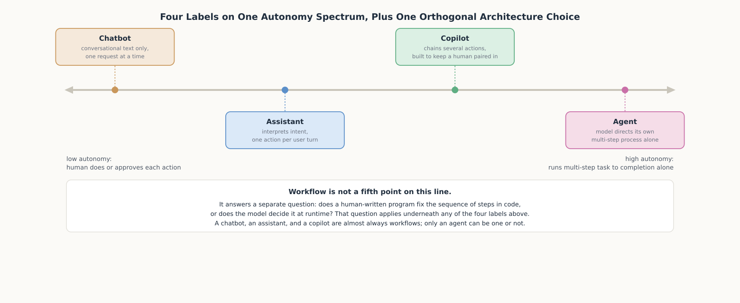
HIGH-LEVEL EXPLANATION
Four labels on a spectrum, one orthogonal choice

Slide 4
DEEP-DIVE · 1 OF 5
Two Questions That Actually Separate These Five Words
• Architectural (Anthropic): "Workflows are systems where LLMs and tools are orchestrated through predefined code paths"; agents "dynamically direct their own processes."
• Autonomy is a separate spectrum: how many actions run, and how much runs before a human reviews it, is a matter of degree, not a binary.
• Why conflating them misclassifies: a code-completion workflow can look agent-like by autonomy alone; a rigid if/elif triage script can look agent-like by action count alone.
• Why the labels drift: "agent" signals sophistication; "copilot" or "assistant" signals restraint - same system, different sales pitch.

Slide 5
DEEP-DIVE · 2 OF 5
Chatbot and Assistant: The Terms That Predate LLM Agents
• IBM's chatbot definition: answers "one step at a time"; an LLM upgrade improves fluency, not autonomy.
• Chatbot vs. agent, IBM's own line: "AI agents can plan, make task-specific decisions and carry out multi-step workflows with limited human involvement."
• Assistant's extra capability: can "integrate with business systems to automate complex workflows" - it actually acts, not just talks.
• Assistant's autonomy label: "Moderate, balances automation with human collaboration" - a human is still present after every action.

Slide 6
DEEP-DIVE · 3 OF 5
Copilot: A Design Philosophy, Not a Capability Tier
• Original coinage: GitHub Copilot, "a new AI pair programmer" - chosen over "autopilot" on purpose.
• Microsoft's own framing: "With your permission, Copilot will ultimately be able to act on your behalf" - permission and partnership, not unsupervised completion.
• The drift: the brand name outlived the design philosophy; "Copilot agents" now run multi-step tasks with no per-step human review.
• The lesson: a product name is a marketing decision made once; it doesn't track the architecture underneath it over time.

Slide 7
DEEP-DIVE · 4 OF 5
Workflow vs. Agent: The One Distinction With a Primary Source
• Two vendors, same line: Anthropic's model-directs-control-flow definition and OpenAI's "systems that independently accomplish tasks" converge independently.
• OpenAI's exclusion: "basic chatbots, single-turn LLMs, or sentiment classifiers" explicitly do not count as agents.
• Why it's the most rigorous: a workflow's branches are enumerable and testable; an agent's path can differ run to run - Ch. 8.7's planning strategies only apply here.
• Evaluation follows the architecture: workflows get branch-by-branch test suites; agents get statistical task-success rates (Ch. 8.1) - mixing them up misapplies both.

Slide 8
DEEP-DIVE · 5 OF 5
Applying Both Questions to a System You're Handed
• Ask the architectural question first: could every path the system takes be drawn as a fixed flowchart before it ever ran?
• Then ask the autonomy checklist: does it act at all? does it chain multiple actions per turn? is human review before finalizing part of the design?
• Worked example: a support system choosing answer/escalate/return at runtime is not a workflow; whether it's a copilot or an agent hinges on whether every action is queued for human confirmation.
• What decides it: the system's checkable behavior - never the name printed on its interface.

Slide 9
COMPARISON & RELATED CONCEPTS
Three points on one spectrum, not three unrelated ideas
Aspect | Chatbot | Assistant | Copilot
Takes action beyond a text reply | No, text only | Yes, one action per user turn | Yes, several actions chained together
Human involvement per interaction | Reviews every reply by reading it | Reviews after each single action | Reviews before a chained result is finalized, by design
What the label promises about supervision | No action to supervise at all | A checkpoint after every action | A checkpoint before anything ships, as a design commitment
Agent and workflow are not extra columns here: agent is the one label that can be built either way architecturally, which is exactly what the reference architecture on the next slide checks first.

Slide 10
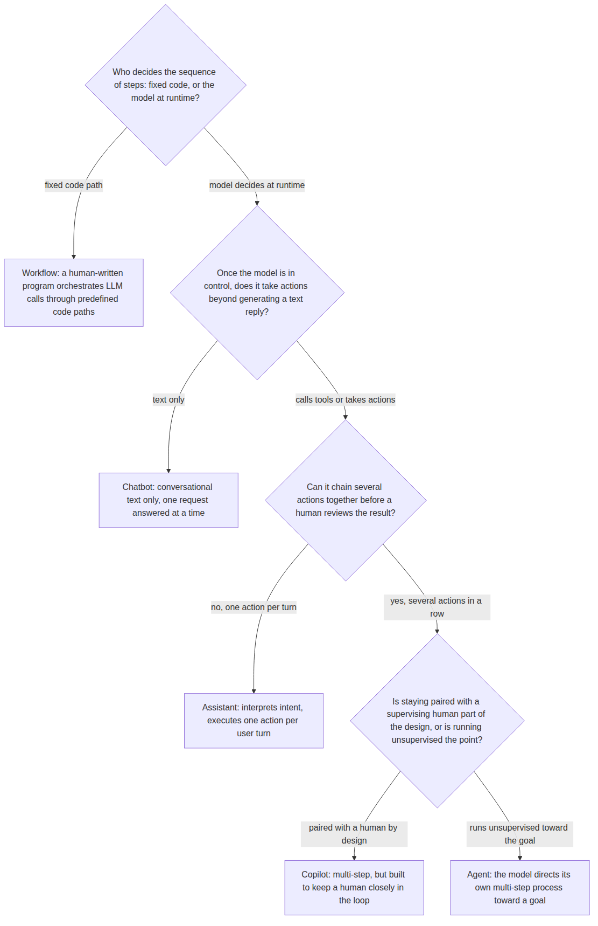
REFERENCE ARCHITECTURE
A decision procedure for classifying any system
Q1, architectural: checked first: fixed code, or the model, decides what happens next.
Workflow: every branch enumerated by a human in code; applies underneath any of the four labels below, not only to non-agents.
Q2: does the model-directed system take any action beyond generating text at all?
Chatbot: conversational text only - there is no action for a human to review.
Q3: do multiple actions chain together in one pass, or does control return after each one?
Assistant: interprets intent and executes one action per user turn.
Q4, design intent: is human review before finalizing part of the design, or is running unsupervised the point?
Copilot / Agent: chains actions but keeps a human paired in, versus runs the full sequence with no review at all.

Slide 11
HANDS-ON
Classifying systems by behavior, not by name
• The function: classify() applies the decision procedure to four boolean fields - never reads a system's name or description.
• Five straightforward cases: an FAQ bot, a scheduler, a code-completion tool, a fixed if/elif triage script, and an open-ended research agent all classify exactly as their behavior implies.
• The sixth case, the point of the exercise: a system named branded_copilot_agent, described as a 'Copilot agent,' still classifies as agent - because it runs unsupervised, whatever its name says.
• What the code can't do: filling in the four behavioral fields for a real system is the actual work; classify() only states precisely which facts that work needs to establish.

